Slide 1

RIGHT PLUS and the Community-Based Research Approach
Valeria Stuardo Á.
School of Publica Health, UChile
Institute of Public Health, UNAB
Community-based research in vulnerable populations in Latin America

Slide 2


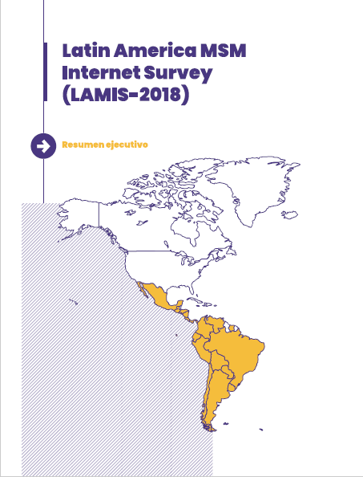



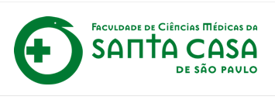
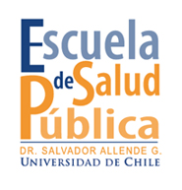

LAMIS-2018 and Right network creation
Purpose: to generate information that will allow the design and implementation of effective responses to HIV/STI and other health problems in gay men, bisexual men, other MSM and transgender women in Ibero-American countries through CBR
https://www.coalitionplus.org/lamis

Slide 3
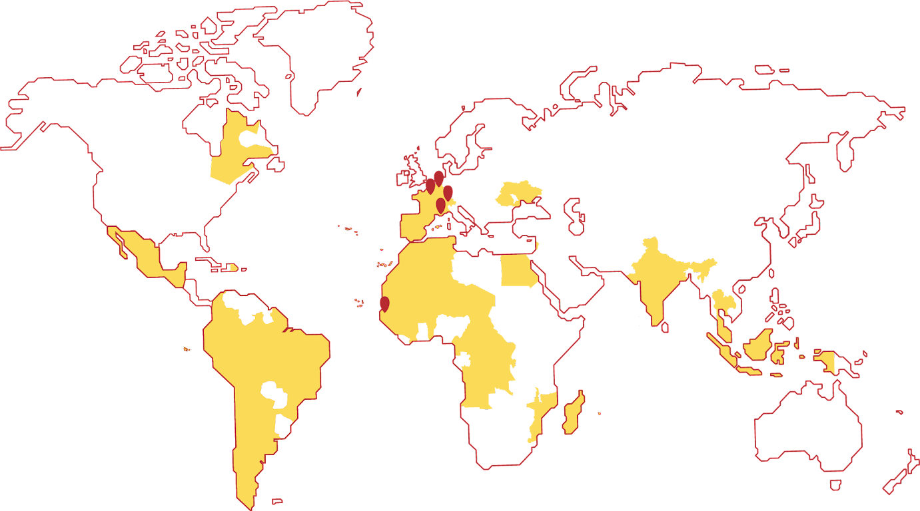

In 2019, Right was integrated into Coalition PLUS and becomes
Coalition PLUS:
International Union of Community-based NGOs for AIDS and viral hepatitis, founded in 2008
15 member organisations
110 partner organizations
Collaboration with 55 countries
Decentralised governance by networks:
7 geographical networks
1 linguistic network
2 thematic networks
Community based approach:
Community based research
Access to community health services
Policy advocacy

Slide 4
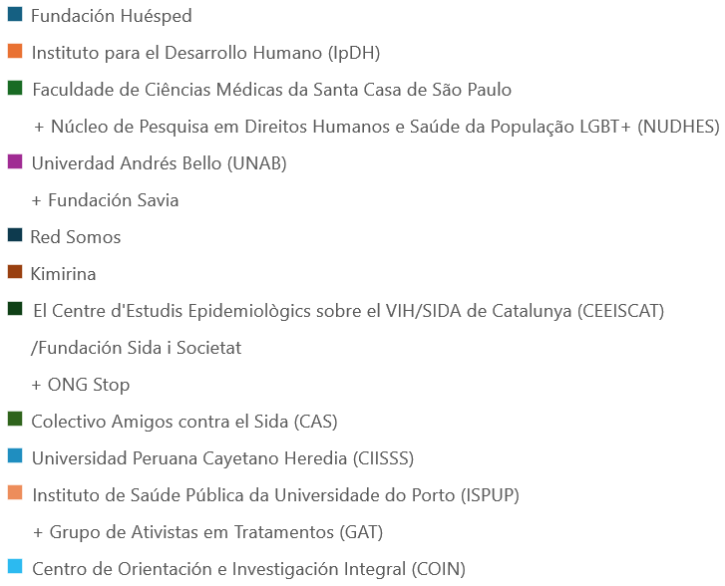
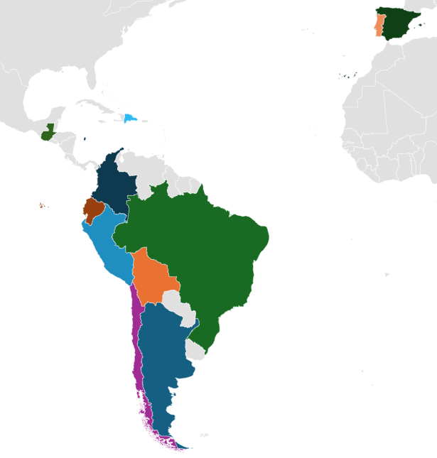

Right PLUS: the research Network of Coalition PLUS
10 CBO
5 Ues

Slide 5
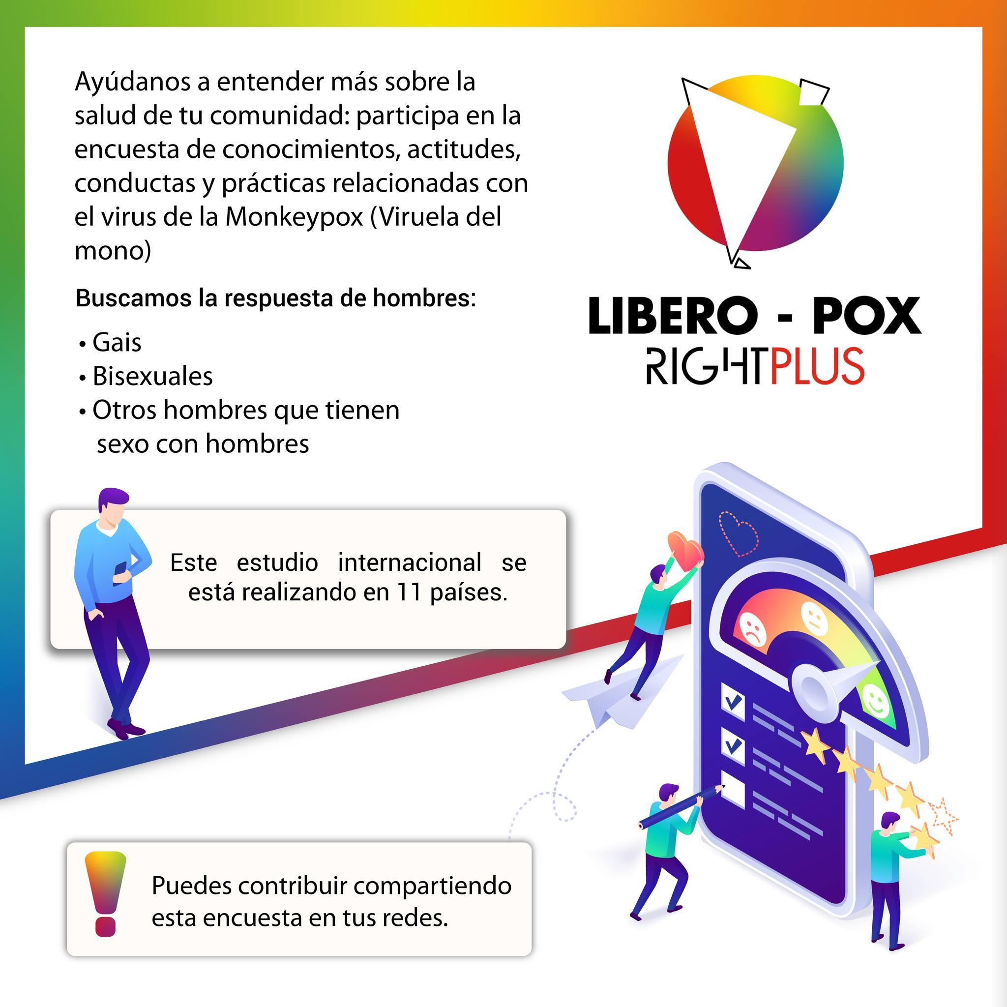
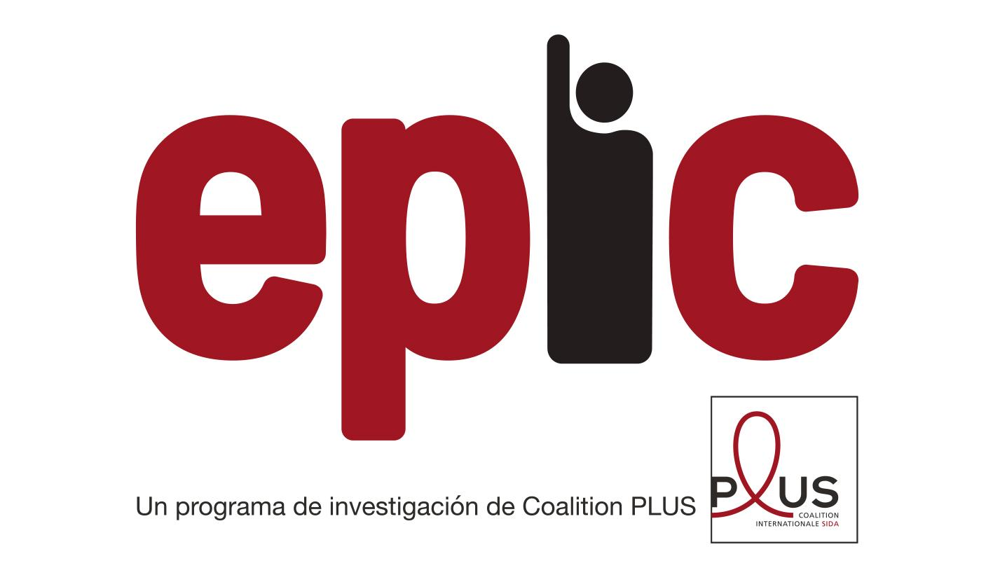
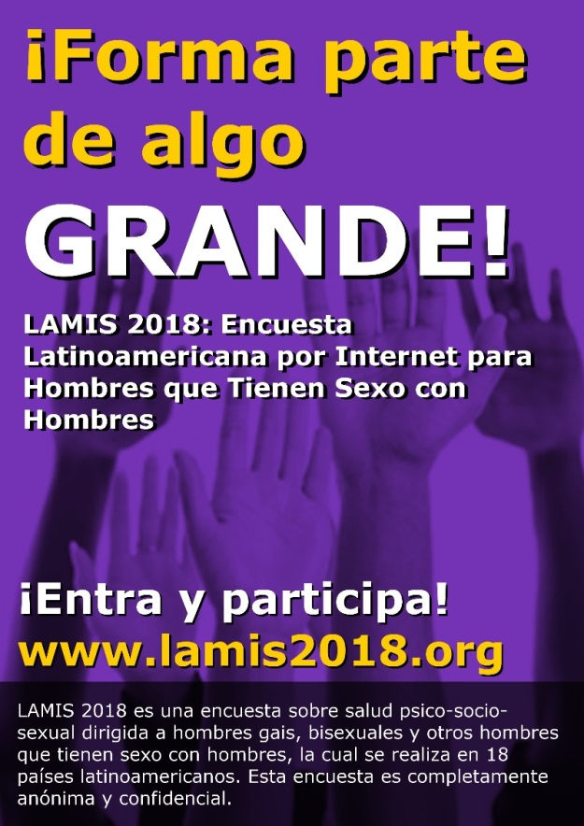
EPIC: global health response crisis from community research
FUTURE
LAMIS 2025
Notes:
(intimate Partner violence, community-based testing, ...)

Slide 6
Conceptual framework
Sexual Justice
Bottom-up approach
Socio-structural factors, intersectionality and SH inequalities
Community-based research (CBR)

Slide 7
Speakers presentation

