Slide 1



MPOX AMONG GBMSM IN PERU: views from the community
Carlos F. Cáceres
Universidad Peruana Cayetano Heredia,
Centro de Investigación Interdisciplinaria en Sexualidad, SIDA y Sociedad, Lima, Perú
Community-based research in vulnerable populations in Latin America

Slide 2
Summary
Main Question
We sought to describe:
the main challenges and needs of GBMSM diagnosed with Mpox, and
community organizations’ views of the official response to Mpox in Peru.
Key Findings
Community organizations identified challenges and needs related to:
Individuals’ finances, mental health and social life
Emergence of MPOX stigma including in health services
The government’s response in prevention, care and communications
Lack of flexibility and adaptation to local needs
Key Messages
As future outbreaks will continue occurring:
learning from needs & challenges faced during the Mpox outbreak will be useful to correct and reinforce the Peruvian health system response
especially when vulnerable populations such as GBMSM are most affected.

Slide 3
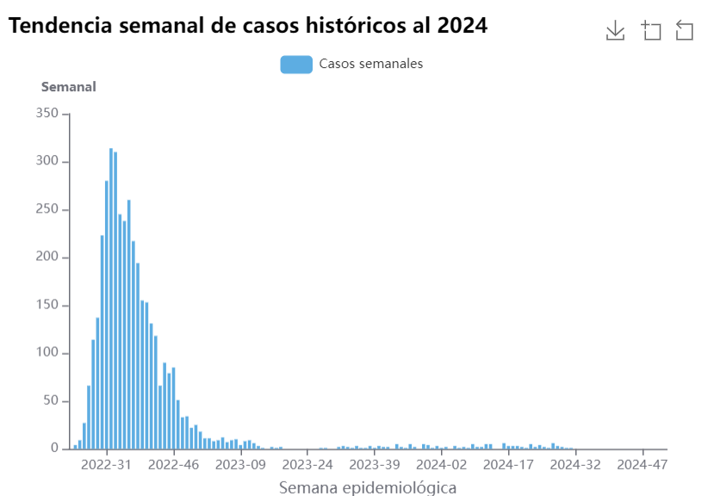
Introduction
Mpox is a zoonotic disease characterized by a rash
Caused by a virus of the genus Orthopoxvirus
Endemic in some countries of central and western Africa.
In July 2022 Mpox was declared a public health emergency of international concern (PHEIC) by WHO.
As of July 2024, globally:
  99,176 confirmed cases
  208 deaths.
Peru:
  5th in the Americas
  3,939 cases detected
  20 deaths.
Fuente: https://app7.dge.gob.pe/maps/sala_mpox/

Slide 4
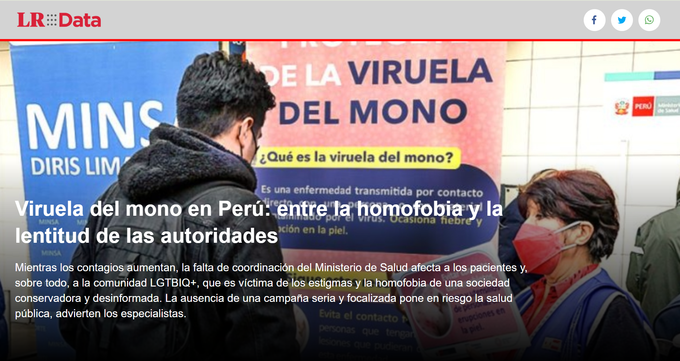
GBMSM were the most affected.
Government took measures to control the outbreak
This triggered reactions from media, civil society and LGBT community
Quality of life of GBMSM was affected.
Community-based, mixed-methods study conducted in Peru
Qualitative data on quality of care received by MSM diagnosed with monkeypox.
Fuente: Diario La República

Slide 5
Methods: Study components
Online survey (Right +)
In-depth Interviews (Peru)
Analysis of Official Documents (Peru)
The Libero-Pox survey was a product of RIGTH-PLUS.
Adults GBHSH who were diagnosed with mpox
Stakeholders:
                Health Authorities
                Health personnel
                Representatives of Community Organizations
Search for documents and communications related to the Mppox outbreak, issued by the Peruvian Ministry of Health on its official portals
Adults GBHSH living in participating countries
Argentina, Bolivia, Brazil, Chile, Colombia, Ecuador, Spain, Guatemala, Peru & Portugal
Available in Peru between December 2023 and March 2024.
Advertising on Grindr, Meta, X (Twitter) and by direct messaging (key collaborators)
Recruitment through Libero-Pox survey and key collaborators
Notes:
La idea es explicar los 3 components pero resaltar que solo se presentarán los datos de entrevistas.
%Dx Mpox: 8% (82/987).
%Dx Mpox among people with/without HIV: 14% (14/147) among people with HIV diagnosis vs 6% (29/497) among people without HIV diagnosis.
% Hospitalized: 10% (8/82)

Slide 6
We analyzed interviews among:
  GBMSM diagnosed with Mpox
  Representatives of Community Organizations
We performed content analysis of text codified as:
  Impact of Mpox diagnosis
  Care
  Lessons learned
We will describe the challenges and needs encountered during the Mpox outbreak.
In-depth Interviews
Adults GBHSH who were diagnosed with mpox
Stakeholders:
                Health Authorities
                Health personnel
                Representatives of Community Organizations
Recruitment through Libero-Pox survey and key collaborators

Slide 7
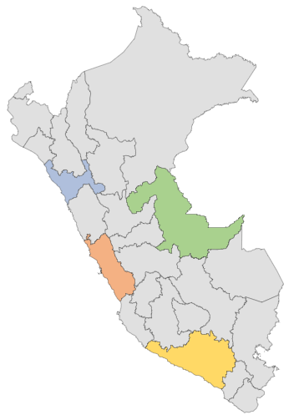
IN-DEPTH INTERVIEWS
Findings
With GBMSM diagnosed with Mpox
17 interviews analyzed
15 Peruvian, 2 Venezuelan
13 were living with HIV
Besides the lesions, all but 1 had symptoms.
With Representatives of Community Organizations (RCO)
2 from Lima and 1 from Trujillo
Trujillo
(La Libertad): 4
Pucallpa
(Ucayali): 1
Lima-Capital (Lima): 10
Arequipa
(Arequipa): 2

Slide 8
Challenges and needs faced by GBMSM with Mpox in different aspects of their everyday life
Labor/
finances
(3 GBMSM)
“And that was my stress, wasn't it?, if they would pay me or not: When I arrived, they told me they would not, because I had not worked... I said that I had my medical test, that it was a medical problem, like Covid. And they told me it would not proceed.” 46 years old, Peruvian, Lima.
“Because they could fire me or something like that, I tried to hide it (mpox lesions) for a few days because mine were not very noticeable, it was like an acne pimple - it was not visible from afar.” 27 years old, Peruvian, Lima
“… but they (close friends) did tell me: ‘for sure you got it because you are gay, the news says that it is affecting the gay population’... So and practically, that happened because the news from the WHO was that, so the Ministry of Health made it its own.” 27 years old, Peruvian, Lima.
Stigma related to Mpox and sexuality
(2 GBMSM, 1 RCO)
Notes:
Labor/Economic: 3 participants reported being worried about losing their job if they notify their infection to their job, or worried about not getting paid for the days of medical leave. However, there has also been MORE people who didn’t have any problem with their jobs.
Stigma related to Mpox infection and sexuality: 2 participants reported that their Friends made comments about assuming they got Mpox infection because they were gay. 1 representative of a community organization (RCO1 Lima) mentioned there or stigma even within the community).

Slide 9
Challenges and needs faced by GBMSM with Mpox in different aspects of their everyday life
Concerns about infecting others
(2 participants)
"I was afraid of spreading it (Mpox); that my mother would get infected; or that something would happen...“. 46 years old, Peruvian, Lima.
“… I became aware that I shouldn't infect more people, right?, starting with my family... obviously in my work too, right? I reported, I was no longer going to work in the middle of the outbreak...“. 33 years old, Peruvian, Trujillo.
Preventive measures
(2 participants)
“I didn't leave my bedroom, as I mentioned… I was the last to bathe… To bathe I was obviously very careful so that the blisters did not burst with something, ok? and it was disinfected after my shower, my mom disinfected normally, for that she used her mask, used the gloves and then returned, for my clothes it was the same.”. 33 years old, Peruvian, Trujillo.
“… since this happened to me in February, I have not set a foot in a sauna again, and I usually go to saunas to relax for my work.”. 34 years old, Peruvian, Arequipa
Notes:
Concern about Mpox transmission to others: 2 participants reported that they were worried about remission to their families or colleagues at work, and took actions to prevent it.
About preventive measurements: 1 participant report that their family stablish a disinfection routine to prevent transmission. Another participant reported avoiding places were infections may occur such as saunas.

Slide 10
Challenges and needs faced by GBMSM with Mpox in different aspects of their everyday life
Psychological stress and need for emotional support
(2 RCO)
“…also, emotional support for people who came out with smallpox, we called them on the phone and saw how they were doing, how they were emotionally, because they were sad, right? Then we also had a kind of live session about emotional management, if you have already had or have monkeypox at that time...“. RCO3, Lima.
“In their physical appearance, it affected their self-esteem a lot that they saw themselves with those things and that other people moved away from them, like this...”. RCO2, Trujillo.
“… and some friends were already beginning to see me, with the pimples in my hand and they began to gossip,... 'Hey, you have monkeypox. Sure, all gays have that.’ ” 35 years old, Peruvian, Lima
Notes:
Psychological stress and need for emotional support: 2 RCO from lima and Trujillo reported that they were contact by people who was extremely worried, stress and sad about the infection and one of them provided emotional support by phone.

Slide 11
Challenges and needs faced by GBMSM seeking care:
Lack of Respect for Privacy
(4 GBMSM and 2 RCO)
“… I didn't feel very comfortable because they made me undress and get into position, so, on all fours as it's called, in front of several students... there were about four or five students looking at my private parts." 24 years old, Peruvian, Trujillo.
“… there were people who had to take off their polo shirts in front of everyone there in the middle of the parking lot... I had to show the area of my penis injury there in that place to the nurse." 28 years old, Peruvian, Lima.
“I feel that there is an underreporting because many people did not say that they had monkeypox. I have even talked to several who told me, "I have found out that they do this (strip patients in public) in health centers, I am not going to say anything". RCO3, Lima.
Notes:
Mistreatment, no respect of privacy and underreporting of cases: When seeking care 2 GBMSM reported cold and distant treatment from HP. 3 GBMSM reported experimenting lack of privacy during clinical examination, having to expose their bodies in front of strangers, both during screening and hospitalization. 1 Representative of Community Organization (RCO) from Lima reported they knew three cases being stripped out in public and that that prevent people from going to public health center seeking care. Another RCO from Trujillo said people were mistreated by HP who either didn’t wanted to treat them (they saw 40 cases according to RCO) or scolded them because of getting infected.
3 participants reported having problems accessing care because they had to find the site “they belong”.
2 participants reported that health personal didn’t know the protocols, where they should go to receive care and get tested.
However, a lot of people have a positive experience with medical care (8/15 interviews)

Slide 12
Challenges and needs faced by GBMSM seeking care:
Patients not being received when seeking care
(3 GBMSM)
“… but it is not because they did not want to treat me, but that... they did not know what the protocol was like because it was just new, so they did not know anything.“ 23 years old, Venezuelan, Lima.
“Because that's what they told me "no, you don't belong here", of course, but I'm already here, I'm possibly a case of monkeypox, how are you going to send me to another establishment, the idea is not to spread it.“ 23 years old, Venezuelan, Lima.
“… we have had about forty to fifty MSM who have come here with a lot of pain. Why?, because they were sent to the Emergency Hospitals and rejected because the staff is afraid of catching smallpox, because of the ignorance that existed on the subject. RCO2, Trujillo.
Other challenges and needs encounter by GBMSM seeking care were:
Finding health centers without diagnostic tests (1 GBMSM)
Very late telephone follow-up (1 GBMSM)
Notes:
Non-integrated health care networks: Some GBMSM reported that they were told they don’t belong to the facility network, and they should go where they belong, causing delays to access care.
Lack of knowledge of care protocols: Some GBMSM reported that health personnel, specially at the beginning of the outbreak, didn’t know what to do or what information to provide in order for patients to receive timely care.

Slide 13
Challenges and needs related to the Peruvian Ministry of Health response and other CBOs:
Lack of collaboration across institutions
(3 RCO)
"Yes; for example, we have ties with other organizations, and we can get together and organize studies more than anything; but at the level of investigations, not at the level of ‘we are going to do things for the community’… So, I do feel like there's that little gap…“ RCO3, Lima.
"Yes, I was telling you that we were never invited (by government to consult about communications)...“ RCO1, Lima.
Other challenges and needs encounter by COL seeking care were:
Government take to long to provide information and prepare communication materials. (1 RCO)
Bureaucracy makes too much time for taking actions (1 RCO)
Too much dependency on international guidelines make it harder to adjust them to local needs (1 RCO)
Notes:
Lack of joint work across institutions: 1 RCO from lima reported that ONG don’t really work together as each one usually fight for their own goals, objectives and interests, and that the interaction between some Communitive representative and activist, with the government can most of the time be confrontational and unproductive. All RCO mentioned that they were not invited by the government to participate in either the design of protocol or communications, and that their participation mostly rely on reaching target community to provide information, linkage to care and vaccination.

Slide 14
Conclusions
During the Mpox outbreak, some GBMSM diagnosed with Mpox in Peru faced challenges and needs that affected their lives:
  Finances: Lack of understanding at work
  Mental health: Lack of social support
  Social life: Stigma
Experiences at health facilities of some GBMSM who had Mpox (i.e. lack of respect for privacy, not being received, fear among HCW) → Operation of Stigma
Government response showed many limitations (i.e. control and educational strategies, protocol design, communication with the community)
Government efforts were perceived as unnecessarily slow and rigid by some community representatives.

Slide 15
Recommendations
3
1
2
4
Improve regulations to protect the right to medical leave without consequences that affect people’s economic stability and well-being.
Educate the community: Fight social stigma and avoid linking Mpox infection with vulnerable communities.
Reinforce care and follow-up activities providing information and linkage to emotional support strategies, such as mental health services and hotlines.
Closely monitor the quality of care at health centers and strengthen mechanisms for the protection of the rights of the patient.
Notes:
First recommendations is based on cases where people was afraid of losing their job is their infection was disclosed, or not getting paid during medical leave.
Second recommendation was taking from one RCO comment, that emphasize that any risk-related information about Mpox should be based on behavior and not sexual orientation or specific population, to prevent stigma.
Third recommendation is based on the need for emotional support for people who may need it.
Fourth recommendation is based on the mistreatment problems. This would also help to prevent underreporting as if more people feel safe to attend public health facilities, more cases would be detected.
Fifth recommendation is based on GBMSM experience with HP not knowing were they should seek for care and test.
Sixth recommendation is based on lack of joint work between community
Seventh recommendation is based on RCO comments about delay to provide preventive strategies and information and problems because health authorities follow international guidelines in a rigid way.
We haven’t learned from the COVID 19 pandemy and HIV.
Ministry of Health should have being prepared for the outbreak that was comming.

Slide 16
5
6
Ensure timely and regular training of health personnel (especially at frontline, primary care and emergency) about guidelines and protocols.
Establish a platform to facilitate collaboration between empowered community organizations and public health institutions: decision-making, communications, patient referral and care
Ensure flexibility in the outbreak response: information, preventive strategies, and control measures, informed by international guidelines but adapted to local needs.
7
Recommendations
Notes:
First recommendations is based on cases where people was afraid of losing their job is their infection was disclosed, or not getting paid during medical leave.
Second recommendation was taking from one RCO comment, that emphasize that any risk-related information about Mpox should be based on behavior and not sexual orientation or specific population, to prevent stigma.
Third recommendation is based on the need for emotional support for people who may need it.
Fourth recommendation is based on the mistreatment problems. This would also help to prevent underreporting as if more people feel safe to attend public health facilities, more cases would be detected.
Fifth recommendation is based on GBMSM experience with HP not knowing were they should seek for care and test.
Sixth recommendation is based on lack of joint work between community
Seventh recommendation is based on RCO comments about delay to provide preventive strategies and information and problems because health authorities follow international guidelines in a rigid way.
We haven’t learned from the COVID 19 pandemy and HIV.
Ministry of Health should have being prepared for the outbreak that was comming.

Slide 17
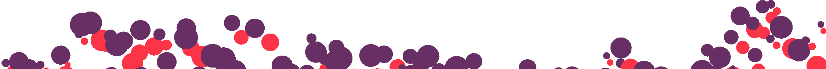
Acknowledgements
To the key community collaborators who helped with the recruitment of people for the interviews.
To the Facebook group administrators of:
  Gay Unidos-Peru&Venezuela
  Gay Peru
  Somos Gay Peru
To the study team: Michael Reyes-Díaz, Percy Fernández-Dávila, Clara Sandoval, Walter Navarro, Hugo Sánchez
Finally, to the study participants for sharing their information, time and believing gin our work.
Notes:
Los grupos de Facebook ayudaron en la encuesta, no en las entrevistas, pero como parte de los entrevistados vino de la encuesta, los menciono.

