Slide 1




ESTHAR I and II: developing a community-based research line on sexual health of and with transmasculine and nonbinary people in Argentina
Pablo D. Radusky, Ph.D.
Research Department, Fundacion Huesped

Slide 2


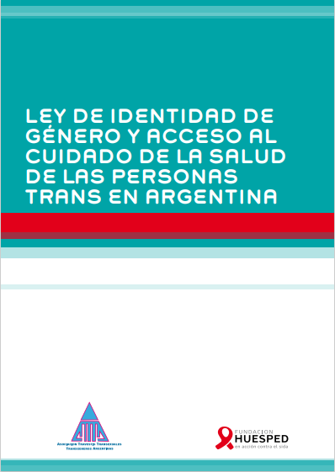


Background
National Survey (2013)
452 transwomen and 46 transmen, from all regions of the country
Collaboration with ATTTA (National Trans Community Organization)
Interviews conducted by 23 trans people

Slide 3

Lessons Learned
Transmasculine population is underrepresented in research.
Need to make visible and include the nonbinary population.
The terms are important: community chooses how to name themselves.
These populations characteristics, needs and interests significantly differ from those of the transfeminine population: specific questions and topics, differentiated questionnaire.
Need to include the community in all stages of the research process, from design to interpretation of results.

Slide 4




ESTHAR (2019)
Encuesta sobre Estado de Salud y Factores Asociados en Hombres Trans de Argentina
To explore sexual practices and access to sexual and reproductive health, mental health problems, and associated psychosocial variables
415 transmasculine and nonbinary (assigned female at birth) people, >16 years old, residents in Argentina (353 transmasculine, 62 nonbinary)
Structured questionnaire online, May-September, 2019
Partnership with ATTTA, and other community organizations, at a national level

Slide 5




ESTHAR (2019)
Encuesta sobre Estado de Salud y Factores Asociados en Hombres Trans de Argentina
Phase I (qualitative): Design of the questionnaire
Identification of relevant topics and how to ask (e.g., terms)
Design of preliminary questions
Revision of pilot version
Adjustment
following comments
2 focus groups and interviews with community members
Review by community representatives and leaders

Slide 6




ESTHAR (2019)
Encuesta sobre Estado de Salud y Factores Asociados en Hombres Trans de Argentina
Phase II (quantitative): Dissemination, analysis and report
Dissemination of questionnaire
Data Analysis
Interpretation of results
Reports and publications
Communication channels, social networks and private groups of trans community organisations and members
Participation of
peer research associates
Review and comments
by community representatives, authorship

Slide 7

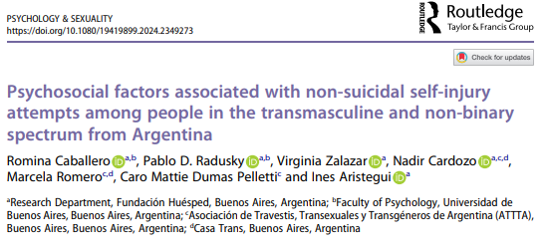

ESTHAR (2019)
Encuesta sobre Estado de Salud y Factores Asociados en Hombres Trans de Argentina

Slide 8

ESTHAR II (2024-ongoing)
Encuesta sobre Estado de Salud y Factores Asociados en Hombres Trans de Argentina II
After 5 years…
Need to update information, especially in those areas that were critical in ESTHAR I (e.g., adverse mental health outcomes; exposure to violence and stigma, reduced access to healthcare).
Asses impact of legal changes, such as the Law of Voluntary Termination of Pregnancy (VTP, 2021).
Need of evidence-based recommendations for decision-making to improve access of this community to sexual and reproductive health, with focus in VTP.

Slide 9



ESTHAR II (2024-ongoing)
Encuesta sobre Estado de Salud y Factores Asociados en Hombres Trans de Argentina II
Explore access to sexual and reproductive health for transmasculine and nonbinary people with the ability to gestate, with a special focus on access to VTP by updating evidence from ESTHAR I.
Qualitative component: 2 focus groups (8-10 participants each)
Quantitative component: online questionnaire based on ESTHAR I (>350 participants)
People identified as transmasculine or nonbinary (assigned female at birth), >18 years old, residents in Argentina, with ability to gestate.
Partnership with community organizations (e.g., ATTTA, AMMAR, Mocha Celis)
Two peer research associates (members of the community) as part of the research team.
Explore most culturally appropriate terms for the community, regarding identities, sexual and reproductive health, pregnancy, etc., to train healthcare staff.

Slide 10

Conclusions and takeaways
Full involvement of the community in all the stages of the research process, from design to report of results.
Inclusion of peer research associates.
Words matter: explore with the community the most adequate terms.
Adjust dissemination strategies to different audiences (community, policymakers, healthcare providers, general public, etc.)

Slide 11
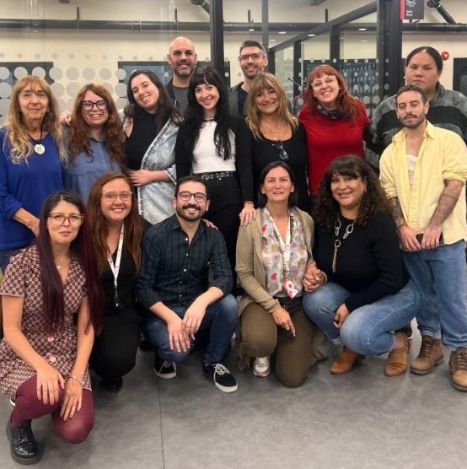
Research team
Implementation Science Division, Research Department
Rodrigo Acuña
Inés Aristegui
Boris Brunori
Romina Caballero
Susana Cahn
Nadir Cardozo
Gastón Devisich
Mariana Duarte
Solange Fabian
Emilia Frontini
Nur Magaquian
Estefanía Panizoni
Pablo D. Radusky
Camila Serrao
María Celia Trejo
Virginia Zalazar
Ana Zeltman

Slide 12






Thank you!
pablo.radusky@huesped.org.ar
@fundhuesped
www.huesped.org.ar

