Slide 1



Session slidedecks
Person-Centred Care Advocacy Academy
25-28 November 2024, Lusaka
In partnership with
The Person-Centred Care programme of IAS – the International AIDS Society – is implemented with financial support from, and in collaboration with, Gilead Sciences. The IAS has full control over all the activities and decisions relating to, and forming part of, the Person-Centred Care programme.

Slide 2
Today’s programme (Tuesday 26 Nov)
Time | Session | Speaker / Moderator
08:00 – 09:30 | Session 1 – Setting your goals for the academy
09:30 – 09:45 | Break
09:45 – 12:00 | Session 2 – Foundations needed for Person-Centred Care
 | Definitions and key terminology | Sharon Kruger
 | The foundations for “good” communications | Njekwa Mukamba
12:00 – 13:00 | Lunch
13:00 – 14:30 | Session 3 – The core elements of Person-Centred Care
14:30 – 15:00 | Break
15:00 – 17:00 | Session 4 – Person-centred design discovery phase
 | Introduction to person-centred design | Chanda Mwamba
 | Client journey mapping presentations | All
Notes:
Kombatende
Summarize the day
Highlight that there will be group work after lunch

Slide 3

Session 1 – Setting your goals for the academy
Time | Activity | Who
08:00 – 08:30 | Faculty statements What does PCC mean to me? Why am I passionate about PCC? Why I want you to be passionate about PCC! | All faculty
08:30 – 09:15 | Network café 3 x 10-minute conversations with a partner Discuss your objectives and priorities for the academy | All participants
09:15 – 09:30 | Personal reflection time to set your SMART objective for the academy. | All participants
Refer to pages 8 – 9 of your workbook

Slide 4

Session 2 – Foundations needed for Person-Centred Care
Time | Activity | Who
09:45 – 10:15 | Definitions and key terminology | Sharon Kruger
10:15 – 12:00 | The foundations for “good” communications | Njekwa Mukamba
Refer to pages 10 – 12 of your workbook

Slide 5
Definitions and key terminology of person-centred care
Sharon Kruger

Slide 6
Question:
What does person-centred care mean to you?
Notes:
Word game – respect, individuality, empathy, involvement, support, empowerment, flexibility, holistically

Slide 7
Respect, Dignity, Choice, Engagement, Mobilisation, Community-led, Rights, Integrated Services, Youth-friendly, Uniqueness, Partnership, Involved, Empowerment, Support, Values, Care, Communication, Mutuality, Empathy, Positive-regard, Individualised, Joint-Decision Making, Valued, Holistic,
Supportive, Consideration, Acceptance
Shared Responsibility, Togetherness

Slide 8

Universal definition
A person-centred approach places the individual at the centre of all interactions with them and decentres the condition.
It means treating each person with respect, recognizing their unique qualities, and involving them in decisions about their life.

Slide 9
This approach considers the person holistically including their life experiences, age, culture, beliefs, identity, language and more.
It involves offering flexible support in accordance to their preferences and priorities.
It emphasizes strengths and abilities, rather than focusing on what the person can’t do when identifying the help they need.
This approach values the role of the person’s support network, like family and friends, as partners in their care.

Slide 10
Person-centred care within the HIV response means:
  Being respectful of, and responsive to, the needs, experiences, values and preferences of the individual as a unique and whole person
  Considering the complex health needs of a person (beyond only HIV treatment or prevention), their identity and the contexts in which they live, rather than focusing on the disease alone
  Personalized, coordinated and enabling – person-centred care empowers people on HIV treatment or people seeking HIV prevention services
  Focused on the person receiving care, the person providing the care, and the relationship between them
  Treating people living with HIV or vulnerable to HIV acquisition as equal partners in planning, developing and monitoring care

Slide 11

The Power of Language
Language is powerful and influences our thoughts, perceptions and behaviour.
Language can embody stigma and discrimination which impacts access to testing, acquisition of HIV, and engagement with treatment.
Language plays a role in supporting and empowering individuals, as language shapes how communities refer to and label individuals living with HIV.

Slide 12
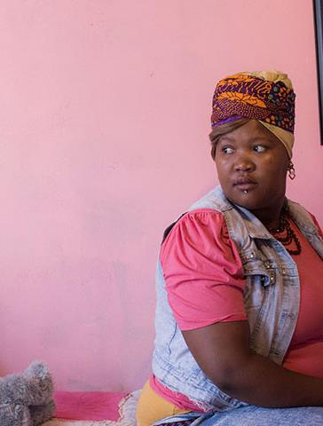
Why language matters?
Appropriate language can strengthen the global response to the HIV pandemic by diminishing stigma and discrimination, increasing support and understanding for individuals and communities living with HIV.

Slide 13

Language Checklist
Is the language you use focused on reducing stigma?
Is the language you use person-centred?
Is the language you use reflective of the values and preferences of the relevant community?

Slide 14

Person-first language
Person-first language is important because many communities impacted by HIV feel that identifying a person by their physical health, mental health or social condition alone indicates a lack of respect and diminishes the multifaceted nature of the human condition.
While some communities prefer person-first language, it is also important to connect with local communities around the language that they feel is most appropriate in their context and how they wish to be referred to.

Slide 15
The words we use matter in the response to HIV
Do… | Don't...
use: people or person living with HIV; person or people with COVID-19; person or people with TB; person or people living with HIV and TB; healthcare seekers or clients. | label people as: HIV-infected; infected; co-infected; cases; carriers; victims; patients; sufferers.
spell out the names of key populations: gay men and other men who have sex with men sex workers and their clients trans people people who inject drugs people in prisons and other closed settings | use acronyms for key and vulnerable populations unless you have genuine space constraints, possibly in a graphic.
talk of the response to HIV or COVID-19 and ending the HIV pandemic as a public health threat. | use war talk and fearmonger.

Slide 16
How can we rewrite these using person-first language?
HIV positive person Person living with HIV
Drug abusing prostitutes Sex workers who use drugs
HIV-infected people People living with HIV
HIV prevention patient Client accessing HIV prevention services
Person at-risk of HIV infection Person vulnerable to HIV acquisition

Slide 17
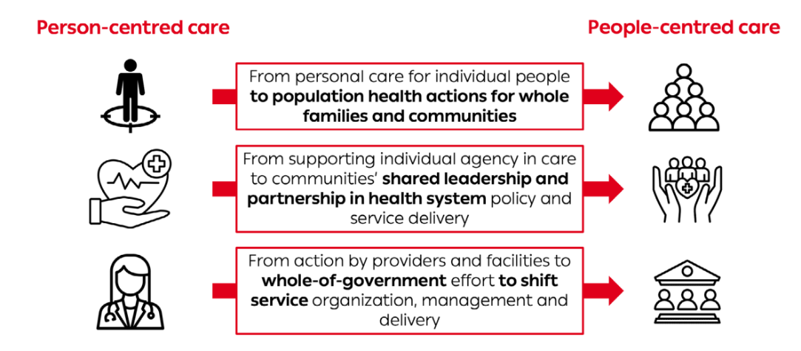
Is it person-centred care or people-centred care? Both are correct!

Slide 18
Some more PCC terms
Reflection
Which terms are new to you?
Read definitions on page 37-39 of workbook.
Any volunteers to share a story that illustrates one of these definitions?
Any questions on these definitions?
Cultural humility
Differentiated service delivery (DSD)
Gender-affirming care
Harm reduction
Integrated healthcare services
Social participation
Universal health coverage (UHC)

Slide 19
The foundations for “good” communications
Njekwa Mukamba

Slide 20

Outline of Presentation
Definition of Communication
2) Objectives of Good Communication
3) Principles of Good Communication
4) Good Communication in Action
The foundations for “good” communications

Slide 21
Definition of Communication
Communication is the process of transmitting information and common understanding from one person to another. (Keyton, J (2011)
Communication is the exchange of information between individuals through a common system of symbols, signs, or behavior.(Webster Dictionary, 2023)
Communication is the process by which people use messages to generate meanings within and across various contexts, cultures, channels, and media. (West, R & Turner, L.H, 2018)

Slide 22
Objectives of Communication
Making your client feel:
  Comfortable > Authentic engagement
  Valued > Listening to what is important from their perspective & Sharing information that matters to them
  In control > Agreed plan of action
Notes:
Authentic Engagement – To engage with a client we need to build rapport, ask open ended question/ seek information with each patient, give them the information that they are seeking, confirm that you have heard right. (Ask-tell-ask!)
Sharing Information: Once you have understood one another, you can now explain the diagnosis, treatment and next steps
Mutually Agreed Plan of action: Engage the client in final decisions of treatment and next steps

Slide 23

Types of Communication
Verbal:
    Spoken words – use of technical terms
    Tone of voice
    Language used – native
Nonverbal:
  The way we stand and sit
  Facial expressions
  Silence
  Eye contact
  Gestures (smiling, leaning forward, nodding)
Notes:
Authentic Engagement – To engage with a client we need to build rapport, ask open ended question/ seek information with each client, give them the information that they are seeking, confirm that you have heard right. (Ask-tell-ask!)
Sharing Information: Once you have understood one another, you can now explain the diagnosis, treatment and next steps
Mutually Agreed Plan of action: Engage the client in final decisions of treatment and next steps

Slide 24

Principles of Good Communication
1) Building rapport
2) Active listening
3) Asking good questions
4) Giving good information
Notes:
Authentic Engagement – To engage with a client we need to build rapport, ask open ended question/ seek information with each client, give them the information that they are seeking, confirm that you have heard right. (Ask-tell-ask!)
Sharing Information: Once you have understood one another, you can now explain the diagnosis, treatment and next steps
Mutually Agreed Plan of action: Engage the client in final decisions of treatment and next steps

Slide 25
Rapport Building
Building a comfortable connection so that people can share information
Creating a relationship based on trust and respect
Created through both verbal and nonverbal actions
Notes:
Authentic Engagement – To engage with a client we need to build rapport, ask open ended question/ seek information with each client, give them the information that they are seeking, confirm that you have heard right. (Ask-tell-ask!)
Sharing Information: Once you have understood one another, you can now explain the diagnosis, treatment and next steps
Mutually Agreed Plan of action: Engage the client in final decisions of treatment and next steps

Slide 26
Techniques for Building Rapport
Introduce yourself and ask the clients’ name.
Use same language as person you are talking to.
Show patience, do not interrupt
Make eye contact (if appropriate)
Do not attend to other tasks during a consultation
Say “yes”, “um-hum,” or a use a nonverbal gesture so they know you are interested and engaged
Use affirming statements
Notes:
Authentic Engagement – To engage with a client we need to build rapport, ask open ended question/ seek information with each client, give them the information that they are seeking, confirm that you have heard right. (Ask-tell-ask!)
Sharing Information: Once you have understood one another, you can now explain the diagnosis, treatment and next steps
Mutually Agreed Plan of action: Engage the client in final decisions of treatment and next steps

Slide 27
Activity 1: Affirming Each Other
Write down 3-4 positive accomplishments or efforts you have made as a healthcare worker or when caring for someone in your professional or personal life.
Pair up with a new partner.
Take turns reading your accomplishments.
Partner should respond with an affirming statement.
Notes:
The accomplishments do not have to be grand accomplishments, but rather can be small positive gains or even efforts that were not completely successful.
Refer to Worksheet ____ for this activity
Ask participants to follow the instructions on the slide.
Allow participants 5 minutes to write down their accomplishments.
Allow participants 5 minutes to work with a partner responding with affirming statements.
Debrief the activity as a large group (allow 5 minutes) by asking:
What was it like to hear affirming statements about your accomplishments?
What was it like to offer affirming statements?
How would this make a patient feel?
Why is it helpful and important to offer affirming statements?

Slide 28
Active Listening
Is an essential component of good communication.
Listen to hear, not to tell
Notes:
The accomplishments do not have to be grand accomplishments, but rather can be small positive gains or even efforts that were not completely successful.
Refer to Worksheet ____ for this activity
Ask participants to follow the instructions on the slide.
Allow participants 5 minutes to write down their accomplishments.
Allow participants 5 minutes to work with a partner responding with affirming statements.
Debrief the activity as a large group (allow 5 minutes) by asking:
What was it like to hear affirming statements about your accomplishments?
What was it like to offer affirming statements?
How would this make a patient feel?
Why is it helpful and important to offer affirming statements?

Slide 29
Key Elements of an Active Listener
Pay attention
“Listen” to the speaker’s body language
Show that you are listening (nod, smile, maintain an open body posture)
Put aside distracting thoughts and avoid being distracted by environmental factors
Clarify, reflect and summarize
Provide feedback
Defer judgment
Respond appropriately
Notes:
The accomplishments do not have to be grand accomplishments, but rather can be small positive gains or even efforts that were not completely successful.
Refer to Worksheet ____ for this activity
Ask participants to follow the instructions on the slide.
Allow participants 5 minutes to write down their accomplishments.
Allow participants 5 minutes to work with a partner responding with affirming statements.
Debrief the activity as a large group (allow 5 minutes) by asking:
What was it like to hear affirming statements about your accomplishments?
What was it like to offer affirming statements?
How would this make a patient feel?
Why is it helpful and important to offer affirming statements?

Slide 30

Activity 2: Active Listening
The Broken Telephone Game
Notes:
the Broken Telephone Game, is a classic party game that has entertained people of all ages for generations.
The game’s premise is simple: a message is whispered from one person to another, passing through a sequence of repetitions until it reaches the final person.
What makes this game so intriguing is the transformation the message undergoes along the way, often resulting in hilarious and unexpected outcomes.

Slide 31
Asking Good Questions
To ask good questions, we must be aware and conscious of how we are communicating
Open questions usually start with:
  What…How…In what way…
  Where…From where…Who…From whom…
  Please give an example…Please say something more about this…
Notes:
Chinese Whispers, also known as the Broken Telephone Game, is a classic party game that has entertained people of all ages for generations.
The game’s premise is simple: a message is whispered from one person to another, passing through a sequence of repetitions until it reaches the final person.
What makes this game so intriguing is the transformation the message undergoes along the way, often resulting in hilarious and unexpected outcomes.

Slide 33
Giving Good Information
Person-centred care requires the healthcare worker to provide good information to their clients.
Good information enables the client to understand his/her illness and treat it well includes:
What the treatment for the illness involves
How to prevent the illness in the future
What the diagnosis of the illness is
How to take the medicine prescribed
When to return to the health centre
What to expect with the illness (recovery period)

Slide 34
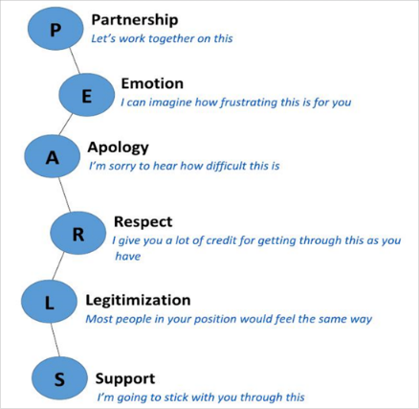
Good Communication In Action
Which aspects of PEARL did you notice in the video?
Notes:
This video shows how PCC might work when we apply principles of good communication and PEARL. Do you recall what PEARL stands for?

Slide 35

Reflections on session 2 – page 12
What are some examples of “good” communication approaches?
Do you have an example of a situation or experience where communication styles and approaches made the outcome less effective than it could have been? Why?
What approaches to “good” communications are most relevant in my context?
How can “good” communications be supported and encouraged in your context?
Key takeaways from Session 2 for me

Slide 36
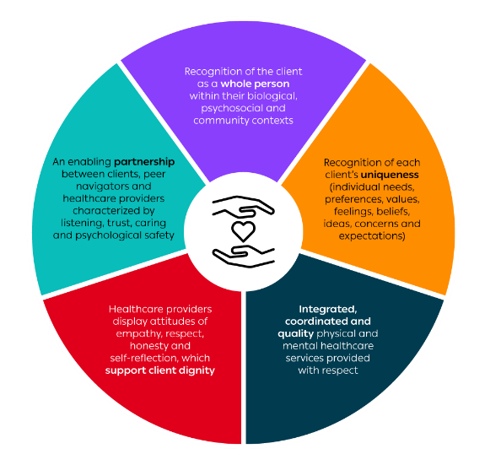
Session 3 – The core elements of PCC
Time | Activity
13:00 – 14:15 | Five breakout groups will rotate with each group spending 15-minutes with each of the faculty members 1. Empathy and Respect – Sharon Kruger 2. Engagement and Relationship – Chanda Mwamba 3. Communication, shared decision-making and discretionary power – Njekwa Mukamba 4. Integrated care with holistic focus – Sandra Simbeza 5. Coordinated care with individualized focus, continuity of care and relationships (e.g. POC systems in facilities) – Juddy Wachira
14:15 – 14:30 | Reflections and Q & A on the core elements – discussion led by Kombatende Sikombe
Refer to pages 13 – 14 of your workbook

Slide 37
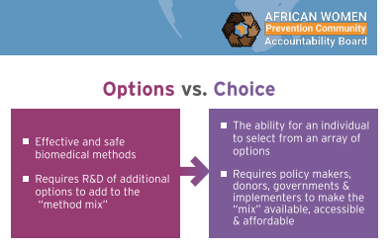
The HIV Prevention Choice
Manifesto For Women and
Girls In Africa
Availability and access is necessary but insufficient
Women and girls need control over their health and their bodies
Interventions must prioritize key and marginalized women and address stigma, discrimination and criminalization
Facilitate participation in research
Prioritize integrated services
Assumed ability to adhere should not influence which products are offered
Source:
The HIV Prevention Choice Manifesto for Women and Girls in Africa

Slide 38
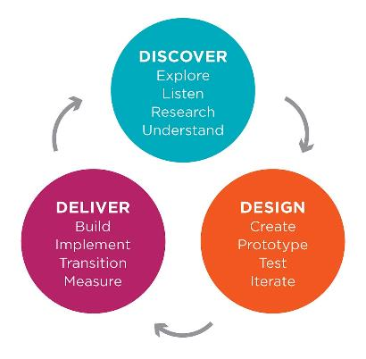
Session 4 – Person-centred design discovery phase
Time | Activity | Who
15:00 – 16:00 | Introduction to person-centred design | Chanda Mwamba
16:00 – 16:45 | Client journey mapping presentations | All
Refer to pages 15 – 19 of your workbook

Slide 39
Introduction to person-centred design
Conducting The Human-Centred Design (HCD) Process: Client Journey Mapping
Chanda Mwamba

Slide 40


What does it mean to be a human-centred designer?
Mindset
Empathy development
Creativity
Co-designing
Identification of actionable insights
Rapid ideation and iteration
Various exercises and activities
Methods
1.Ideo.org. The Field Guide to Human-Centered Design. Available at: heps://www.designkit.org/resources/1.
2.Beres LK, et al.Human-centered design lessons for implementation science: improving the implementation of a patient-centered care intervention. JAIDS Journal of Acquired Immune Deficiency Syndromes. 2019 Dec

Slide 41
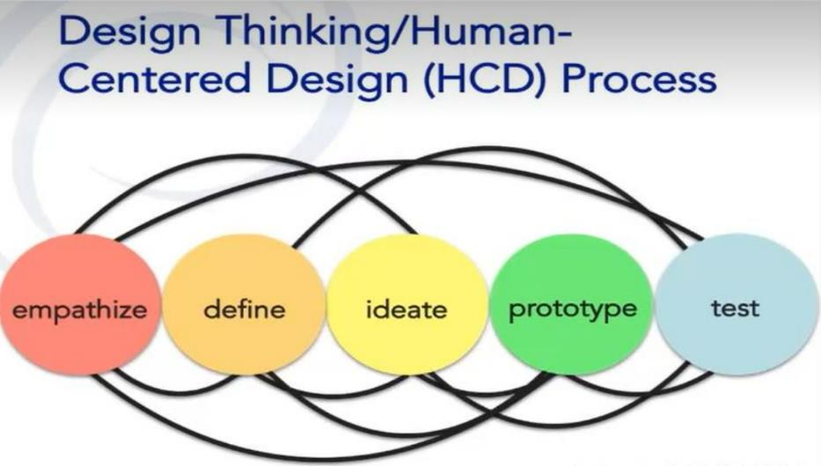
HCD processes overview

Slide 42
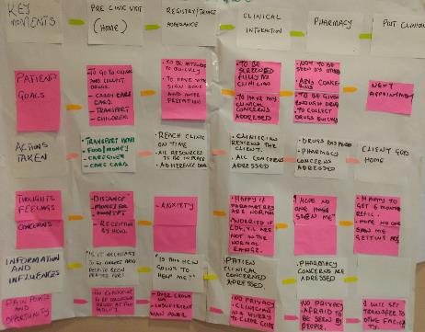
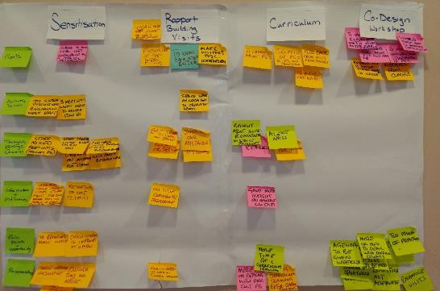
Empathize: journey mapping
Example visualized HCD activity outputs
Beres LK, et al.Human-centered design lessons for implementation science: improving the implementation of a patient-centered care intervention. JAIDS Journal of Acquired Immune Deficiency Syndromes. 2019 Dec 1;82:S230-43.

Slide 43
Group activity
In a group, develop a client journey map for a specific context and client segment
Highlight PCC opportunities in the client journey
    PCC activities to improve the client’s experience with the services.
    Scenario where a healthcare provider does something ‘they did not have to do’ to be helpful
Nominate a group member to summarize the journey in a short verbal presentation

Slide 44
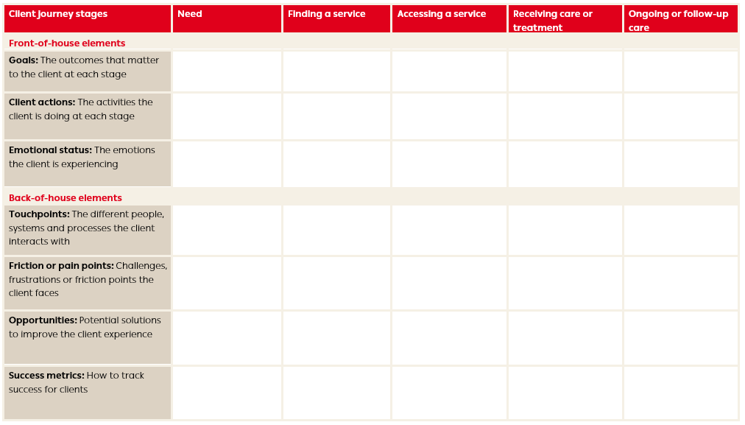

Slide 45

Timing
Group work until 16:00, followed by client journey map presentations
Report back from each of the five groups to share the group’s client journey, pain points and how this can be used to communicate why a change is need to improve quality of care. Tell us a compelling story!
Photo at 16:45
Free time until dinner at 18:30

Slide 46

Group check-in
Time | Session | Speaker / Moderator
08:00 – 08:15 | Reflections on yesterday’s sessions | Kombatende Sikombe
08:15 – 08:30 | Overview of CIDRZ-led PCC initiatives and site visit preparations | Njekwa Mukamba

Slide 47
Let’s RECAP together
R | Reflect on what you learnt yesterday
E | Explain something you learnt yesterday
C | Compare what you learnt with what other’s learnt
A | Apply your learning today – e.g. be an active listener
P | Plan - what do you hope to learn today?
Notes:
Ask participants to look through their reflections from yesterday
Ask for1-3 volunteers of something that they learnt to share
Turn to person next to them and compare what they learnt
Take a few moments to reflect on what they hope to learn today – look at pages 20 – 25 of workbook

Slide 48
Today’s programme (Wed 27 Nov)
Time | Session | Speaker / Moderator
08:00 – 08:30 | Group check-in
 | Reflections on yesterday’s sessions | Kombatende Sikombe
 | Overview of CIDRZ-led PCC initiatives and site visit preparations | Njekwa Mukamba
08:30 – 10:00 | Session 5 – PCC implementation in real-world contexts
 | Community-led initiatives with National Network of Zambian Living with HIV (NZP+) and Treatment Action and Literacy Campaign (TALC), Zambia | Fred Chungu (NZP+) and Owen Mulenga (TALC)
 | Academic Model Providing Access to Healthcare (AMPATH) program, Western Kenya | Juddy Wachira
 | CIDRZ Key Population Hub, Zambia | Maurice Musheke
 | Pediatric Adolescent Virus Elimination (PAVE), South Africa | Sharon Kruger
 | JSI PCC-Assessment Tool Implementation, Zambia | Lackeby Kawanga
 | Q and A | Kombatende Sikombe
10:00 – 10:30 | Break
10:30 – 12:00 | Session 6 – There is no health without mental health
 | Healthcare provider stress management | Sandra Simbeza
 | Reflections and lessons learnt so far | All
12:00 – 13:00 | Lunch
13:00 – 17:00 | Site visits
Notes:
Kombatende
Summarize the day
Case studies in the morning, a focus on mental health and then site visits in the afternoon

Slide 49
Overview of CIDRZ-led PCC initiatives and site visit locations
Njekwa Mukamba

Slide 50

Retention in care: a global challenge for HIV programs
Data suggest that client-provider interactions is an important driver of retention, but few strategies have been tested that empirically evaluate the effects of provider behaviour and client experience on retention in HIV care.
Mwamba et al., BMJ GH 2018, Sikazwe et al., CID 2021
Notes:
Because of improvements to testing and linkage over the last 10 years, retention in HIV care has now become the prominent challenge for securing benefits of success to date
Diverse barriers to sustained HIV care include obligations that keep clients away from getting medication at the clinic as well as spending too much time at the clinic
Differentiated service delivery as well as system integration has eased these barriers.
Recipient of care encounter challenges to accessing care. However, client-provider interactions are important, but few strategies have been tested that empirically evaluate the effects on provider behavior and the client experience on retention in HIV care.

Slide 51
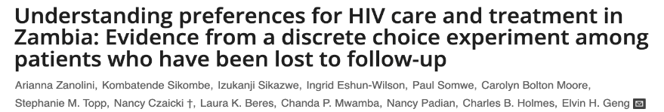
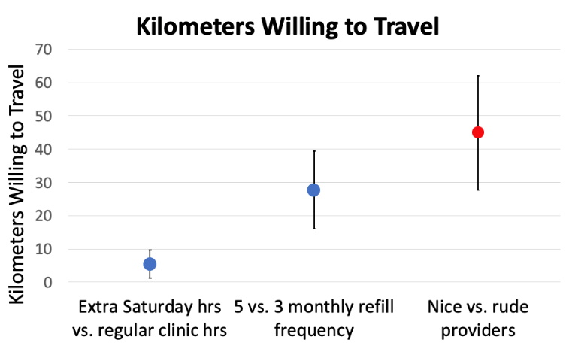
Clients willing to travel up to 45 km for “kind” health care workers
Zanolini et al., PLoS Med 2018
Notes:
In 2015 – 2016, CIDRZ in collaboration with Ministry of Health (MoH) implemented the Better Information for Health in Zambia (BetterInfo) Study aimed at establishing the true outcomes of clients who were lost to follow-up.
Our own formative work for this BetterInfo trial emphasized existing literature about the importance of inter-personal interactions with health care workers
In clients lost to HIV care and traced in the field, we conducted a discrete choice experiment - a method taken from marketing to quantify what people want or their preferences.
In this formative study, we found that Clients were willing to travel up to 45 km for “Nice/ kind” health care workers, compared to 30 km for longer refills, and only 5 kilometres for a clinic that was open on a Saturday

Slide 52
What would it take to return to clinic? (N=603)
Public health: priority setting is necessary
Focus facility efforts on prevailing barriers
Prioritize addressing
psychosocial problems
Prioritize addressing
clinic based problems
Izukanji Sikazwe et al Patient-reported Reasons for Stopping Care or Switching Clinics in Zambia: A Multisite, Regionally Representative Estimate Using a Multistage Sampling-based Approach in Zambia Clinical Infectious Diseases, 2021.
Notes:
Under the BetteInfo study, we also asked patients what would have to change to bring them back to care – As you look at this figure, it is apparent that most of the reasons were clinic based, shown by the green bars.
Psychosocial and structural reasons were also prevalent, but perhaps clients see facility characteristics as the most easily changed and therefore the “rate limiting factor” for return.
Further, we see facility-level variations - each bar (clinic-based changes needed to return to clinic ranged from 15 to 82%).
THESE EARLY FINDINGS on the inter-personal encounter between clients and health care workers LED TO THE PCC STUDY

Slide 53
Definition of Person-Centered Care (PCC)
Treating people who use health and social services as equal partners in planning, developing and monitoring care to make sure care services meet
their needs.
Notes:
To use patient centred care is to treat patients as equal partners in planning, developing and monitoring care.
"Put simply, being person-centred is about focusing care on the needs of the person rather than the needs of the service. It doesn’t mean that ‘what the person says, goes’, but it does mean that we have to take into consideration and act on what people want when we plan and deliver their care."- https://rcni.com/hosted-content/rcn/first-steps/what-person-centred-care-means

Slide 54

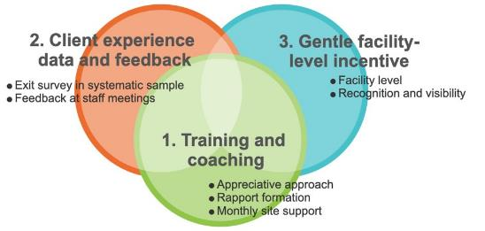
Person-Centred Care Trial
Outcomes
Service delivery
Client experience
Client retention
Client clinical outcomes
Provider experience
Formative Phase
Trialed Intervention
Theory of change
Qualitative work
Human-centred design
Summary Trial Results:
70% reduction in HIV care visits with a bad experience and 56,000 visits with bad experience averted during the intervention period
Qualitatively improved inter-personal dynamics between clients and providers
Notes:
From 2019-2021 we conducted a stepped wedge, cluster randomized trial of an intervention intended to improve person-centredness of HIV care across 24 government-run health facilities in Lusaka, Zambia. *Click*We began with a formative phase to design our approach. *click* The resulting trialed intervention included three main components: 1. provider training and coaching, 2. collecting client experience data and sharing it with facility staff members, and 3. supporting facilities to create improvement plans and providing gentle incentives for improved performance. We measured multiple outcome types. *click* . This intervention had measurable positive effects on client experience and retention, but not viral suppression (As presented in detail at CROI 2023 and in a forthcoming publication).
From 2022 to date, CIDRZ continues to lead PCC agenda in Zambia in collaboration with the Performance Improvement (PI) and Quality Assurance Quality Improvement (QAQI) Departments under the Zambian Ministry of Health. I will talk more in terms of what we are doing to advance PCC in Zambia.

Slide 55
Beyond PCC Trial: Strengthening
Quality Improvement through
Person- Centred Care Approaches.
(SQI-PCC)
Notes:
Having found out that PCC works, we were now concerned with how PCC can be taken up by the health system. At the same time, we received overwhelming support for further scale up of PCC beyond the study sites. In 2022 to about August 2024, CIDRZ worked with MoH QAQI Unit so as to strengthen quality improvement through Person Centred Care Approaches Project with the Ministry of Health.

Slide 56
SQI-PCC Project Goals
1) Assess the current landscape of the national PI/QM agenda
2) Engage diverse stakeholders to develop a roadmap for strengthening PI/QM programs and integrating promising activities from the recently completed person-centered care (PCC) study
3) Provide a combination of technical assistance, policy development/advocacy, and engagements to facility, national, regional, and global quality improvement efforts.
Notes:
Having found out that PCC works, we were now concerned with how PCC can be taken up by the health system. Therefore, we needed to do three (3) things; 1) understand what was happening in terms of Performance Improvement and Quality Management; 2) Engage stakeholders to develop a road map for strengthening PI/QM program and 3) Provide technical assistance for Quality Improvement at different levels.

Slide 57
Study Methods
We conducted six(6) consultative stakeholder workshops.
  Code book was developed, and minutes coded with common themes.
Conducted six(6) focus group discussion.
  The FGDs were audio recorded and transcribed verbatim.
Semi- structured interviews to understand the perceived barriers.
Thematic analysis was employed to analyse the data.
Notes:
In order to understand the perceived facilitators and barriers and what opportunities exist to integrate PCC, we :
We conducted six (6) stakeholders workshops aimed at understanding the facilitators and barriers to PCC integration within the health system in Zambia.
We further conducted six (6) Focus Group Discussions (FGDs) with HCWs. The FGDs were audio recorded and transcribed verbatim.
We used a semi- structured guide to understand perceived barriers of integrating PCC at facility level, and
We analysed the data using rapid thematic analysis based on consultative meetings minutes and transcribed verbatim.

Slide 58
Study Results
Notes:
I will now share the results

Slide 59
Facilitators for PCC Integration
Leadership buy in at all levels.
Peer to peer mentorship among HCWs.
Positive attitude towards work.
Management support
Positive client feedback.
Love for clients and one’s career.
Notes:
In terms of what would facilitate integration of PCC results, most providers interviewed cited the following:
Leadership buy in- When leaders at all levels of the health system buy in into the PCC approaches, they align their vision and goals with it. This fosters a cohesive environment where everyone is working towards the same objectives. This alignment ensures that frontline healthcare workers understand and embrace the importance of PCC in delivering high-quality care.
Management support - By providing resources, guidance, and leadership, management plays a critical role in fostering a culture of person-centeredness and ensuring that PCC becomes embedded within the Ministry of Health practices and values.
Client positive feedback: Positive feedback from clients motivates and empowers HCWs to actively engage with clients and tailor care plans to meet their unique needs.
Others cited love for their clients and ones career and having a positive altitude towards work. -

Slide 60
Barriers for PCC Integration
Lack of clear deliberate policies and guidelines supporting PCC.
Lack of funding mechanism supporting PCC.
Delivery of health services focusing on biomedical rather than psychological
Limited availability of PCC resources and training.
Notes:
We sought to understand the potential barriers to integrating PCC into the health system in Zambia.

Slide 61
Opportunities for PCC integration
Leverage on existing Contionous Professional Development (CPD) portal platform with HPCZ to include a module on PCC for health professionals.
Inclusion in strategic documents:
  National QA/QI strategy
  SOPs
  Client Satisfaction Tool
Collaboration among implementing partners to incorporate PCC concepts into various health programs
Notes:
Opportunities exist where PCC can be integrated, these include :
Inclusion of a PCC module in the existing CPD portal platform with HPCZ, that health care provider can take as a pre –requiste to license renewal.
Inclusion of PCC in strategic documents such as QA/QI strategy. We recently worked with LPHO on HIV/TB SOPs to include PCC approaches
Integration also requires collaboration among stakeholders and IPs to include PCC approaches into various health programs

Slide 62







Acknowledgement of contributors
Notes:
I wish to especially thank the recipients of care, Zambian Ministry of Health and the following partners for their continued support.

Slide 63
Site Visit Plan – PCC Advocacy Academy
Place | Objectives
1) University Teaching Hospital (UTH) – UTH HIV/AIDS Program | To understand the implementation of CAB-LA and visit a Youth Friendly Corner which has some interventions led by the Treatment Advocacy and Literacy Campaign (TALC).
2) Kabwata Clinic (Intervention site for PCC Intervention) | To understand how the health care providers integrated PCC principles in their workflows.
3) Kamwala/Chawama Wellness Centre | To understand how PCC is applied in service delivery for key populations.

Slide 64
Proposed Agenda - Site Visit
Brief Presentation about Health Facility (10 min)
Question & Answer Session
Guided Tour of Health Facility
Discussion during Guided Tour

Slide 65

Session 5 – PCC implementation in real-world contexts
Time | Session | Speaker / Moderator
08:30 – 08:50 | Community-led initiatives with National Network of Zambian Living with HIV (NZP+) and Treatment Action and Literacy Campaign (TALC), Zambia | Fred Chungu (NZP+) and Owen Mulenga (TALC)
08:50 – 09:00 | Academic Model Providing Access to Healthcare (AMPATH) program, Western Kenya | Juddy Wachira
09:00 – 09:10 | CIDRZ Key Population Hub, Zambia | Maurice Musheke
09:10 – 09:20 | Pediatric Adolescent Virus Elimination (PAVE), South Africa | Sharon Kruger
09:20 – 09:30 | JSI PCC-Assessment Tool Implementation, Zambia | Lackeby Kawanga
09:30 – 10:00 | Q and A | Kombatende Sikombe

Slide 66
Person-Centred Care Community Perspective
TALC
and NZP+

Slide 67
Person-Centred Care : RoC
Person-Centred Care is entails the provision of Individualized care that is Holistic, Engaging, Responsive, and Respectful, with the Recipient of Care Actively Participating in Defining their care in Consultation with Policy Makers & Service Providers.

Slide 68
What do Recipients of Care expect
To be involved in treatment planning
To be recognized not only as Recipients of Care but as people with the right to own their decisions
Respectful services which are responsive to their wishes
Timely access to ART services (Shortening waiting time)
Ease access to HIV and health information.
Good communication from the provider
To be treated with dignity, compassion and respect.

Slide 69
Community ART Access Points as a Person-Centred Care model
Differentiated service delivery (DSD) models are person-centred approaches to hiv care that tailor services to the needs of people living with HIV.
The Network of Zambian People living with HIV and AIDS (NZP+) and Treatment and Advocacy Literacy Campaign has been implementing a DSD model called Community ART Access Points which are community-based support Structures that are supported and supervised by Adherence Support Workers (ASW) who are living with HIV.

Slide 70
Community ART Access Point as a Person-Centred Care model
The model is open and sustained engagement with Recipients of care (Roc)
Allow the ROC to choose the ASW to manage their CAAP
Allows the ROC to decide when and where to meet
ROC have full information about appointments for clinical and labs
The ASW explain to Recipients of Care the meaning of their lab results In the language they understand.
CAAP model ensures ART services are brought closer to patients
Supports RoC to develop the knowledge, skills and confidence they need to more effectively manage and make informed decisions about their own health and health care

Slide 71
CAAPs as PCC
CAAP model reduces attrition and improves retention on treatment
It reduces on HIV related stigma and discrimination
It reduces on the long distance to the health facilities
Reduces congestions in the Health Facilities
Reduces on Health care Providers Burnout (By attending to a reasonable number of patients in day)

Slide 72
Value of Community Engagement in Improving Person Centred Services
a structured, supported, meaningful and accountable process that ensures that people living with HIV have a SEAT and a VOICE in decision-making, planning, implementation, monitoring and evaluation, in order to achieve access to quality HIV care for all

Slide 73
Person Centred Services
By With For RoCs
entails the provision of Individualized care that is Holistic, Engaging, Responsive, and Respectful, with the Recipient of Care Actively Participating in Defining their care in Consultation with Policy Makers & Service Providers

Slide 74
As countries strive to enhance differentiated service delivery (DSD) for efficient and high-quality HIV services, there is a strong emphasis on community engagement (CE). By actively involving communities in programme design, implementation, monitoring, evaluation, and policymaking.
CE aims to improve the relevance, acceptability, and effectiveness of these programmes

Slide 75
The Network of Zambian People with Support from ITPC, has been assessing community engagement at various levels from Programme design, implementation, Monitoring, evaluation and policy making
The findings of the assessment inform the GOVERNMENT (Ministry of health) and stakeholders on the involvement of roc at all levels of DSD Planning and implementation.

Slide 76
Nothing about us! Without us!
Thank you!

Slide 77

Client-Provider Communication
A Case Study of Western Kenya
Juddy Wanjiru Wachira, Ph.D
Senior Lecturer,
Department of Mental Health & Behavioral Sciences, Moi University,
Eldoret, Kenya,

Slide 78
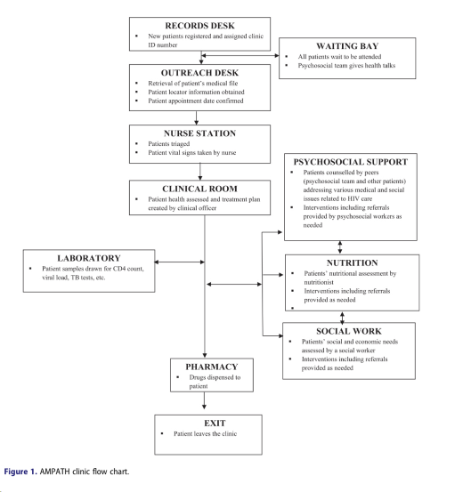
Introduction-The Context
Person Centered Care: a broad set of processes including: (1) empathy, (2) respect, (3) engagement, (4) relationship, (5) communication, (6) shared decision-making, (7) holistic focus, (8) individualized focus, and (9) coordinated care
Academic Model Providing Access to Healthcare (AMPATH) program- Western Kenya
  Supports Ministry of Health facilities in 8 counties with > 180,000 patients.
  Services are free of charge, offered every weekday (8 am and 5 pm).
  Stable patients visit the clinic after every 6 months.
  New and non-adherent patients are seen every 1–6 weeks.
  Providers include clinicians, nurses, support staff (phlebotomist, nutritionist, social workers, peers/outreach workers)
  Average clinician-patient ratio stands at 1:482.
  Care is supported and data are managed via AMPATH’s open-source electronic medical record system (AMRS).
  Clinicians use real-time point of care (AMRS-POC) information for clinical decision-making.

Slide 79
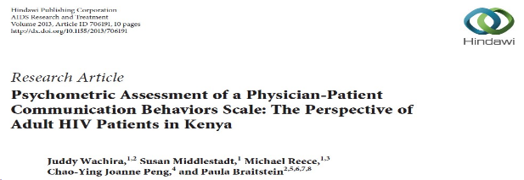
How do we assess communication behaviors?
Matched Pair Instrument (MPI) developed and validated in Canada included 19 items:
  A combination of verbal and action-related behaviors performed by physicians assessing the process and content of communication.
  Items did not account for patient’s role in communication.
Sample: 400 people living with HIV (PLWH)-Adults
Construct and content validity supported a one-dimensional measure of 13 PPCB items.
Biases associated with encoding and comprehension of specific terms, such as “discussion, involvement or concerns,” were noted.
Internal consistency (Cronbach’s alpha = .81) and one-week retest reliability scores (.82) supported the reliability of the 13-item scale.

Slide 80
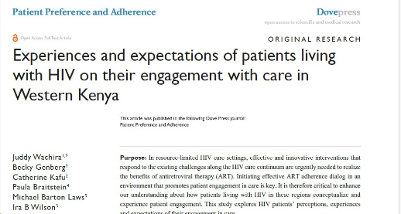
How do PLWH conceptualize PCC?
Qualitative study with 86 PLWH.
PLWH desire active participation in their HIV care.
  However they may not always know how to take up this role.
PLWH engagement was inconsistent and varied depending on the provider.
  Had a sense of how provider’s interpersonal behaviors (communication and relationship dynamics) influenced them.
  Relational boundaries influenced the level and kind of information they shared with their providers.
Factors influencing engagement including those related to patients themselves, providers, and the healthcare system.

Slide 81
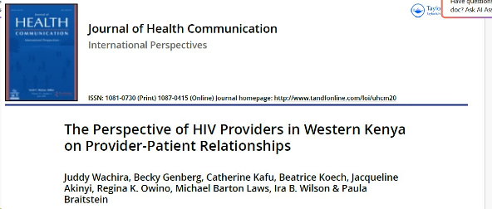
What do providers expect in PCC ?
Qualitative study with 60 providers.
Providers perceived that they had good relationships with most patients.
They had their own expectations of how PLWH should interact with the healthcare system.
Providers may not be accustomed to patients who desire an active role in their care.
  Identified negative patient attributes as the source of poor provider-patient relationships
  Preferred patients who adhered to treatment guidelines
  Did not like patients who challenged their authority
  Did not see it as their responsibility to find more effective ways of interacting with ‘difficult’ patients.
Structural barriers to collaborative physician-patient relationships included
  Non-continuity of relationships
  Lack of specific appointment times
  High provider-patient ratio
  Unable to manage provider fatigue
  Job dissatisfaction.

Slide 82
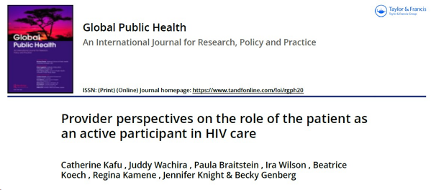
How do providers view the role of PLWH?
Qualitative study with 60 providers.
Two main themes that emerged :
1) General expectations
  Communicate openly
2) Expectation influenced by provider’s professional role
  Clinicians
    Wait for provider to initiate conversations
    Be familiar with clinical procedure
    Have limited knowledge on HIV management
  Nurses
    Introduce themselves
    Have understood their HIV results and clinical procedure
    Engage with the provider
  Social service providers
    Be patient and understanding
    Follow the provider’s instruction
Providers lacked adequate training on key PCC components: patient-provider communication & shared decision making.

Slide 83

Higher provider-patient communication= greater satisfaction
Cross-sectional study with 360 PLWH:
  First line antiretroviral regimen.
  Viral load ≥400 copies HIV RNA/ml.
  Mean age of participants was 48.2 years[standard deviation (SD): 12.05].
Overall, the mean score on clinician PPC skills was 33.3 (SD: 9.0) [lowest score =16, highest score =48].
A high proportion (85%) of participants reported satisfaction with the HIV care services.
Participants who were satisfied with care reported higher clinician PPC skills (mean score =35.02 [SD =8.22]), compared to those who were not satisfied with care (mean =23.44; SD =7.04)
After adjusting age, marital status, education level, years in care, correct knowledge of the most recent VL count, and medication self-efficacy,
  the odds of being satisfied with care increased by 19% (adjusted odds ratio: 1.19, 95% CI: 1.11-1.30) for every one unit increase in the clinician PPC skills score.

Slide 84
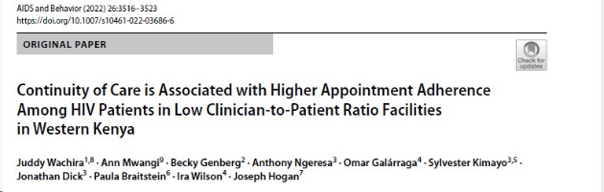
Continuity of care is essential
Retrospective analysis with 12,751 PLWH
  Relationship between continuity of care and adherence to clinic appointments among patients receiving HIV care in high (> 1:133) vs. low (≤ 1:133) clinician-to-patient (C:P) ratios facilities.
We used logistic regression analysis with generalized estimating equations to estimate the relationship between continuity of care (two consecutive visits with the same provider) and adherence to clinic appointments (within 7 days of a scheduled appointment) over time.
Adjusting for age, sex, period in HIV care, years on antiretroviral therapy (ART) and ART regimen:
  Patients in low C:P ratio facilities who had continuity of care, were more likely to be adherent to their appointments compared to those without continuity (adjusted odds ratio = 1.50; 95% confidence interval, 1.33–1.69).
  No strong evidence of a relationship between continuity of care and adherence to clinic appointments (AOR = 1.50; 95% CI 1.33–1.69), in high C:P ratio facilities.

Slide 85
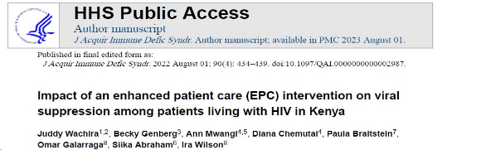
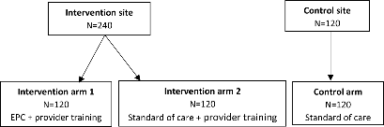
Addressing a combination of PPC barriers
The Enhance Patient Care (EPC) intervention (6 months pilot randomized control trial) incorporated:
  continuity of clinician-patient relationships
  enhanced treatment dialogue
  improved patients’ clinic appointment scheduling
  provider-patient communication training (motivational interviewing-MI).
Viral suppression post-intervention (p=<0.001) (328 participants)was:
  84.4% among those in PPC training + EPC
  83.7% in PPC training + SOC
  64.4% in SOC
Compared to participants in PPC training + EPC, those in SOC had lower odds of being virally suppressed (OR=0.36, 95% CI: 0.18–0.72).
  Clinician training had a significant impact on patient viral suppression.
Compared to SOC, both the EPC intervention and PPC training alone were more cost-effective and cost saving.
  Providing PPC training alone was the dominant strategy (more effective and less costly) compared to the EPC intervention, at $97.72 per HIV infection averted and $4.44 per DALY averted.

Slide 86
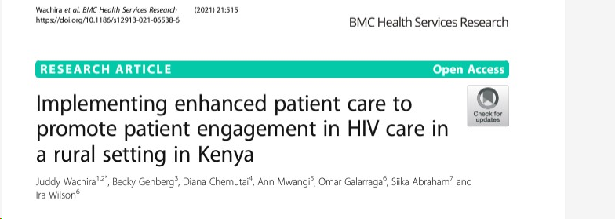
PCC implementations considerations
Smooth integration of the intervention as part of care.
Commitment of stakeholders to the intervention including providers and PLWH.
Adaptability of the intervention to the existing context while still maintaining fidelity.
Embedding the intervention in a facility with adequate infrastructure.

Slide 87
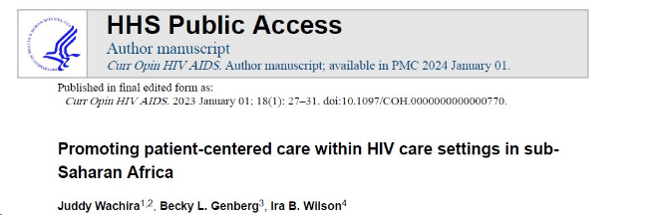
Conclusion
There have been significant steps to promote PCC .
More research on definitions, measures, frameworks, and implementation strategies for PCC is needed to ensure that health systems have the tools for successful implementation.
Additional effort is required to make both PLWH and providers understand their role in PCC.
Addressing structural challenges including limited capital and human resources, high provider turnover and lack of continuity in care is fundamental.

Slide 88
Asante Sana

Slide 89
References
Wachira J, Middlestadt S, Reece M, Peng CY, Braitstein P. Psychometric Assessment of a Physician-Patient Communication Behaviors Scale: The Perspective of Adult HIV Patients in Kenya. AIDS Res Treat. 2013;2013:706191. doi: 10.1155/2013/706191. Epub 2013 Feb 11. PubMed PMID: 23476754; PubMed Central PMCID: PMC3582093.
Wachira J, Middlestadt S, Reece M, Peng CY, Braitstein P. Physician communication behaviors from the perspective of adult HIV patients in Kenya. Int J Qual Health Care. 2014 Apr;26(2):190-7. doi: 10.1093/intqhc/mzu004. Epub 2014 Feb 10. PubMed PMID: 24519123.
Wachira J, Genberg B, Kafu C, Koech B, Akinyi J, Owino RK, Laws MB, Wilson IB, Braitstein P. The Perspective of HIV Providers in Western Kenya on Provider-Patient Relationships. J Health Commun. 2018;23(6):591-596. doi: 10.1080/10810730.2018.1493061. Epub 2018 Jul 6. PubMed PMID: 29979930; PubMed Central PMCID: PMC6094379.
Wachira J, Genberg B, Kafu C, Braitstein P, Laws MB, Wilson IB. Experiences and expectations of patients living with HIV on their engagement with care in Western Kenya. Patient Prefer Adherence. 2018;12:1393-1400. doi: 10.2147/PPA.S168664. eCollection 2018. PubMed PMID: 30122904; PubMed Central PMCID: PMC6078080.
Kafu C, Wachira J, Braitstein P, Wilson I, Koech B, Kamene R, Knight J, Genberg B. Provider perspectives on the role of the patient as an active participant in HIV care. Glob Public Health. 2020 Oct 6:1-11. doi: 10.1080/17441692.2020.1830296. Epub ahead of print. PMID: 33019854; PMCID: PMC8021617.
Wachira J, Genberg B, Chemutai D, Mwangi A, Galarraga O, Abraham S, Wilson I. Implementing enhanced patient care to promote patient engagement in HIV care in a rural setting in Kenya. BMC Health Serv Res. 2021 May 27;21(1):515. doi: 10.1186/s12913-021-06538-6. PMID: 34044818; PMCID: PMC8161597.
Wachira J, Genberg BL, Wilson IB. Promoting patient-centered care within HIV care settings in sub-Saharan Africa. Curr Opin HIV AIDS. 2023 Jan 1;18(1):27-31. doi: 10.1097/COH.0000000000000770. Epub 2022 Nov 14. PMID: 36503878; PMCID: PMC9757848.
Wachira J, Genberg B, Mwangi A, Chemutai D, Braitstein P, Galarraga O, Siika A, Wilson I. Impact of an Enhanced Patient Care Intervention on Viral Suppression Among Patients Living With HIV in Kenya. J Acquir Immune Defic Syndr. 2022 Aug 1;90(4):434-439. doi: 10.1097/QAI.0000000000002987. PMID: 35320121; PMCID: PMC9246844.
Wachira J, Mwangi A, Genberg B, Ngeresa A, Galárraga O, Kimayo S, Dick J, Braitstein P, Wilson I, Hogan J. Continuity of Care is Associated with Higher Appointment Adherence Among HIV Patients in Low Clinician-to-Patient Ratio Facilities in Western Kenya. AIDS Behav. 2022 Nov;26(11):3516-3523. doi: 10.1007/s10461-022-03686-6. Epub 2022 Apr 25. PMID: 35467227.

Slide 90
Programme Science in Action: Lessons from HIV Prevention Programming in Lusaka, Zambia
Maurice Musheke, MPH, PhD
Centre for Infectious Disease Research in Zambia (CIDRZ), Lusaka, Zambia
Notes:
Thank you for the invitation to share CIDRZ’s experience of placing Program Science into Action to advance HIV prevention for Key Populations in Zambia.
My name is Maurice Musheke, and I’m the Deputy Director of Implementation Science at CIDRZ and previously served as the Project Lead of the Key Population Invest Fund Project, whose lessons and experiences I am sharing with you today.

Slide 91
Presentation Outline
CIDRZ KPIF Zambia Programme Overview
The Programme Science Question
CIDRZ Programme Science Cycle in Action:
PrEP Innovations in KPIF Zambia
Conclusion

Slide 92
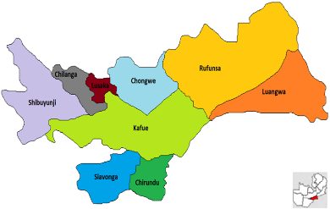
The Zambia KPIF Program
KP Group | National Pop. Size Estimate | HIV Prevalence (%)
FSW | 142,725 | 40%
MSM | 128,053 | 21%
PWID | 26,840 | 15%
TG | 11,435 | 22%
Compared to the general population (10.8%) the burden of HIV among key populations in Zambia is high.
Since September 2019, KPIF has been implemented in Zambia in 4 districts in Lusaka province.
Goal of KPIF is to build capacity of Key Populations Civil Society Organizations (KP CSOs) to lead the delivery of HIV prevention, treatment, and care services
Focus populations:
  Gay men and other men who have sex with men (MSM); Female sex workers (FSW); Trans people (TG); People who inject drugs (PWID)
KPIF implemented in partnership with Zambian MoH
Source: https://www.state.gov/wp-content/uploads/2022/09/COP22-Zambia-SDS.pdf
Notes:
In Zambia, the program is a partnership led by 9 remarkable key population civil society organizations funded through the KPIF program, with overall technical oversight and coordination provided by CIDRZ and clinical service delivery support provided by the Zambia Ministry of Health.
The focus geographically has been on the four largest districts of Lusaka province, which as a Province has the highest estimated numbers of KP in Zambia based on recent national size estimates from PEPFAR..
For program implementation, KP CSOs manage venue-based mapping and outreach, the Safe Spaces, and peer navigation and education. MOH provides delivery of comprehensive clinical services for HIV prevention, treatment, and care. And CIDRZ has overall responsibility for program implementation and oversight, including for direct funding of KP CSOs and building their technical and organizational capacity.

Slide 93
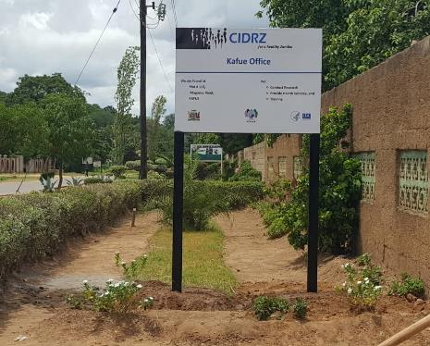
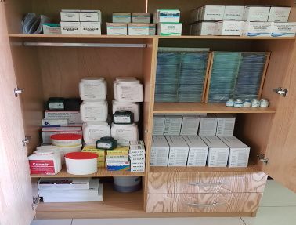
Community-based KP Safe Spaces as Differentiated Service Delivery Access Points
HIV services provided in KP CSO-led “Safe Spaces” in the community.
Each safe space is linked to a MOH health facility “Hub” and serves as an outpost of the “Hub” facility.
MOH KP-friendly teams from the district provide services at Safe Spaces and the “Hub” facility.
Data sent to the “Hub” facility for entry into health facility electronic medical record system, SmartCare.
Notes:
Community-based KP safe spaces are the major service delivery platform for the Zambia KPIF program and service as a differentiated service delivery model to reach all KP groups with comprehensive HIV prevention, treatment, and care services. Each Safe Space is managed by a lead KP civil society organization and is linked to a MOH health facility that serves as a “hub” facility that supplies health workers and clinical supplies for service delivery at the Safe Space.
For program implementation, KP CSOs manage venue-based mapping and outreach, the Safe Spaces, and peer navigation and education. MOH provides delivery of comprehensive clinical services for HIV prevention, treatment, and care. And CIDRZ has overall responsibility for program implementation and oversight, including for direct funding of KP CSOs and building their technical and organizational capacity.

Slide 94
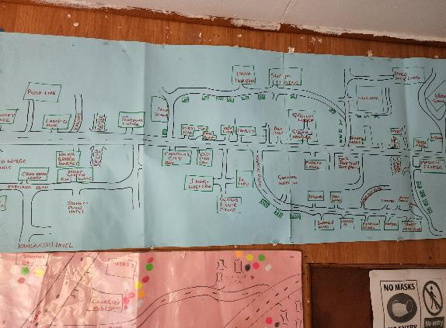
Program Innovation: Venue-based PrEP Delivery
Identification and mapping of community hotspots and safe spaces
Mainstreaming PrEP initiation and refills in all aspects of HIV care.
KP community mobilisation
PrEP initiation
PrEP Refill
Notes:
We also supported KP CSOs to conduct basic programmatic mapping to generate information on the physical locations where KPs congregate and the characteristics of these locations, such as the types and size of KP groups who socialize there to inform procurement of PrEP and other combination and HIV prevention commodities and outreach activity planning.

Slide 95
Programme Science Question
What effect does decentralizing PrEP service delivery to community-based venues and KP CSO-managed “safe spaces” have on PrEP uptake, continuation and equity for KP in Lusaka, Zambia?

Slide 96

CIDRZ Programme Science Cycle in Action
Specify Programmatically Relevant Research Question
Embed Necessary Data Collection Elements/ Tools
Rigorous Monitoring & Evaluation
Knowledge Translation
Leverage Robust Data System
Program Platform & Components
PrEP in Safe Spaces & Venues
Programme Science
Cycle
Introduce Program Innovation/ Evidence-Based Practice
Introduce Program Innovation/ Evidence-Based Practice
Nested Data Collection/ Laboratory Assessment
Notes:
Drawing from our experience implementing public health programs since 2001, CIDRZ Program Science cycles attempts to operationalize thinking around the application of Program Science principles to the Zambian public health setting.
Our cycle starts with a robust program platform that is adequately planned for, resourced, and designed to strengthen public sector health service delivery, is locally led and responsive to local epidemiology, implementation context, and structural barriers to care faced by our intended beneficiaries, usually the communities and patients we serve.
We then attempt to formulate a programmatically meaningful scientific or evaluation question often in the program design stage or at another point early enough to allow course correction of the program.
Typically, this question revolves around introducing a clinical or service delivery model innovation into a new routine practice setting such as a new differentiated service delivery model or diagnostic tool. We then work collaboratively with communities, Ministry of Health, and other stakeholders to plan an implementation strategy for its introduction.
As we prepare to introduce a new practice or innovation, we ready the information management system by developing program specific data collection tools and embedding those into routine data systems or modifying the routine system to either accommodate a new data element or more accurately or reliably report on an existing standard data element. In Zambia, that usually means leveraging the data in the national HIV electronic health record system, SmartCare. If necessary, we may conduct nested data collection or laboratory assessments, such as a brief risk behavior survey or additional viral load measurement.
We then apply proven methodological approaches borrowed from epidemiology, operational research, implementation science, and/or process evaluation to answer our scientific question and test our hypothesis, or at the very least generate meaningful insights for ways to improve the reach and effectiveness of the program or the innovation introduced.
This knowledge is then translated into programmatic action in a participatory process that brings together scientists, communities, government agencies, program implementers, and other diverse stakeholders.
And then the cycle begins again with the next idea for innovation or in response to the next priority or need articulated by the community.

Slide 97
KP Demographic Characteristics, Sept 2019 – March 2023 (N=38,307)
46.5% under 30 yrs
Expansion of Safe Spaces & Introduction of venue-based service delivery
Sikazwe I et al. Journal of the International AIDS Society 2024, 27(S2):e26237 https://doi.org/10.1002/jia2.26237
Notes:
Over the life of KPIF, we have reached over 38,000 KP with HIV prevention interventions, including HIV testing, HIV prevention information and counseling and condoms and condom compatible lubricant.
Over half of all beneficiaries were reached after scale up of HIV prevention services in new safe spaces and through venue-based service delivery.
And over three-quarters of beneficiaries are from urban Lusaka, as expected, where the highest numbers of KP venues and community members are found.
Notable, nearly half of all KP clients were under the age of 30, suggesting a potential need for further differentiation of services to better engage with young KP.
**Total beneficiaries
**More females but likely underestimates biological sex of males/ conflates gender and sex
**Surge in 2022 with venue-based outreach

Slide 98
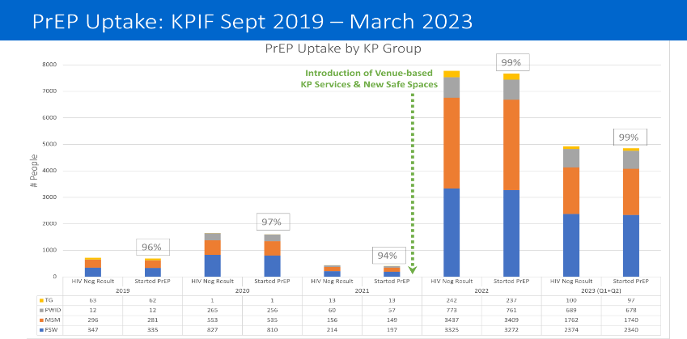
Sikazwe I et al. Journal of the International AIDS Society 2024, 27(S2):e26237 https://doi.org/10.1002/jia2.26237
p=0.014
Interrupted time series model: Solid lines reflects the predicted trend and the dashed vertical line reflects the time of intervention introduction on 1 December, 2021.
Notes:
Following introduction of our program innovation, we observed a significant increase in the absolute number and percentage of FSW, MSM, TG, and PWID who started PrEP following a HIV-negative test result.

Slide 99
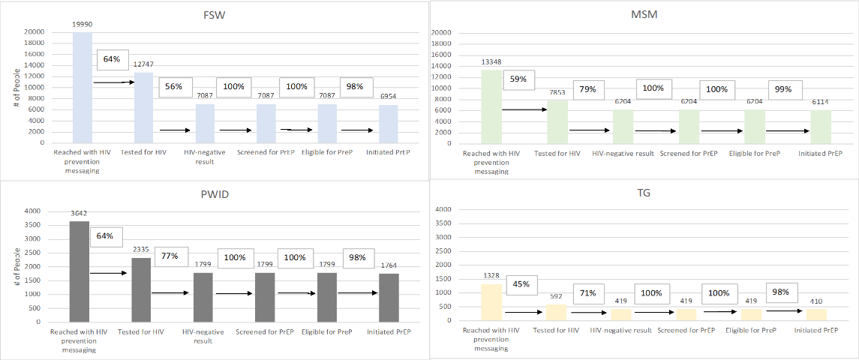
PrEP Cascades by KP Group: KPIF Sept 2019 – March 2023
Notes:
A high proportion of KP clients initiated PrEP after being offered it in scaled up safe spaces and during venue-based outreach. The greatest drop off in the PrEP cascade shown here is in the offering of HIV testing after being reached with HIV prevention services and messaging. This is due to those who are known HIV-positive or having been tested in the last 3 months being screened out for HIV testing services.

Slide 100
PrEP equity—PrEP initiations among KP vs General Population
Sikazwe I et al. Journal of the International AIDS Society 2024, 27(S2):e26237 https://doi.org/10.1002/jia2.26237
Notes:
At programme inception, most PrEP initiations occurred in the general population. The share of PrEP initiations among KP increased significantly after (60.0%; 95% CI: 59.3%, 60.6%) versus before (24.8%; 95% CI: 24.0%, 25.6%) introduction of venue-based PrEP provision (p < 0.001), with KP accounting for most PrEP initiations by the end of the evaluation period.

Slide 101
Conclusion
We show how a Programme Science cycle can produce advancements in service delivery for populations who have been historically underserved in the HIV response in Zambia.
We applied Programme Science principles to demonstrate that decentralizing HIV prevention services to KP venues expanded the reach of public-sector, community-based PrEP delivery beyond that offered by traditional facility-based approaches and improved the share of all PrEP initiations among KP.
For Programme Science to be impactful, it is important to:
  Nurture equitable partnerships with effected communities to define the program science question a priori and identify opportunities for innovation.
  Select outcomes aligned with data available from routine data systems.
  Move toward analysis of individual-level, longitudinal data.

Slide 102
Acknowledgements
The national KP Consortium, Zambian KP civil society organizations, and the KP community for leading KPIF priority setting and implementation, and for advocating for the rights of KP nationally.
The Zambian Ministry of Health and the National AIDS Council for their leadership in the national HIV response.
The Bill & Melinda Gates Foundation and PEPFAR for supporting this program science initiative.
PEPFAR/CDC for funding the KPIF program.
This work was supported by PEPFAR through the U.S. Centre for Disease Control and Prevention, Cooperative Agreement NU2GGH001920.

Slide 103






Using a participant-centred approach during invasive research procedures in adolescents living with HIV
Sharon Kruger, Stellenbosch University, South Africa

Slide 104
Study Overview
To gain insights into the role of the Central Nervous System as a reservoir in children with perinatal HIV
  Enhance and sustain active community/participant engagement for paediatric HIV remission research
Measure and describe participants’ experiences on the PAVE study
Objectives
Neurocognitive
N=80
Neuroimaging
N=80
Biomarker and HIV assessments, including cerebrospinal fluid (CSF)
N=80
Pain Rating scale
Pulse rate
Semi-Structured interview
N=40
Methodology
Family Centre for Research with UBUNTU (FAMCRU) – Cape Town,
Perinatal HIV Research Unit (PHRU) - Soweto
Research sites

Slide 105
Participant Centred Approach
Structure
Process
Outcome
Health Care- Organisational
level
Creating a participant-centred culture (PCC)
Engagement of design & implementation
Create supportive environment environment
Create measures to monitor PCC
Participant-Research level
Cultivate communication
Respect and compassionate care
Engaging participants in care
Research-Participant-Organisational level
Access to care
Participant reported outcomes
Science
Co-learning
Action

Slide 106
Community Engagement
Community
Participant and Family
Peers
Community Advisory Board
Adolescent Community Advisory Board
Study Staff
Global Stakeholders
Global Stakeholders
Study Sponsors
and Networks
Broader Stakeholders
Community
Participant
Programme
Level
Engagement
Community Engagement
Participant
Information Session
Video at Assent
Mock Scanner & MRI Video
Management & Care
Broader Stakeholders
Ethical Review
Medical Professionals
Study level – engagement at different levels and in communities occur at different stages throughout the research process
Programme level engagement - external communication to inform sponsors and networks, advocate for and raise funds
Exchange of information

Slide 107


Planned Visits for HIV Assessments
Visit 1
Visit 4
Verification process
Consent / Assent
Questionnaires
  AUDIT (Alcohol use identification test)
  DUDIT (substance use identification test)
  Caregiver (socio economic questionnaire)
Mock Scan and Video
Neurocognitive assessment
Neuro Imaging screening
Biomarker and HIV Virus
Assessment
CSF and Blood sample collection
Visit 2 and 3

Slide 108
PARTICIPANT–CENTRED RESEARCH PROCESS
STAGE 1
Study Planning
Community
Engagement
STAGE 2
Study Implementation
Participant Centred
Planning
Protocol Development
Stakeholder Engagement
Stakeholder Education
Site meetings and research meetings
Formative research activities
Information workshops with parents, participants, staff members and community advisory boards,
Training of research staff
Feedback to community advisory boards, staff
Implementation
Informed consent process
HIV Assessments
Participant management and support
Follow up and study exit
Analysis and Dissemination and
Preparation
Informed Consent Video
Mock scanner for MRI preparation
Phone and Checklist
Bring a Buddy
After CSF & Blood Collection
2 hour rest and monitoring
Comfort box
Virtual reality meditation experience for pain reduction
Videos, music or Wi-Fi
Pain Questionnaire
Pulse Rate
Qualitative questions to record experience
Telephonic follow-up with symptoms
Visual tools and simulated experiences before procedures, taking a participant-centered approach during procedures, using innovative strategies to reduce pain perception and qualitative assessment of the research experience.

Slide 109
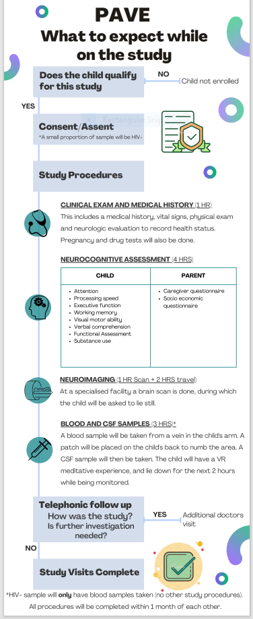
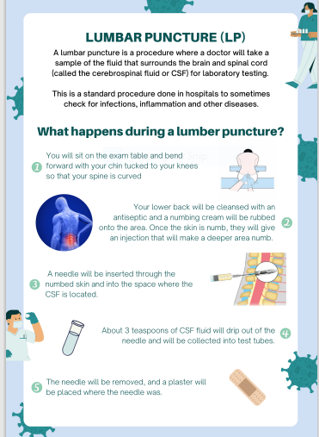
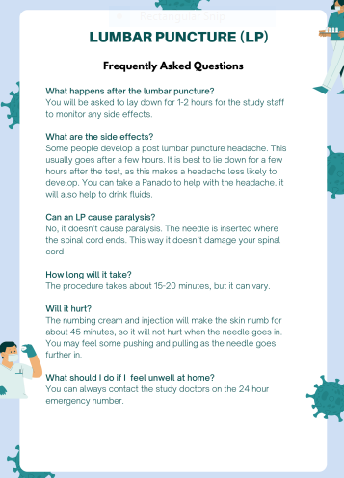
Information leaflet

Slide 110
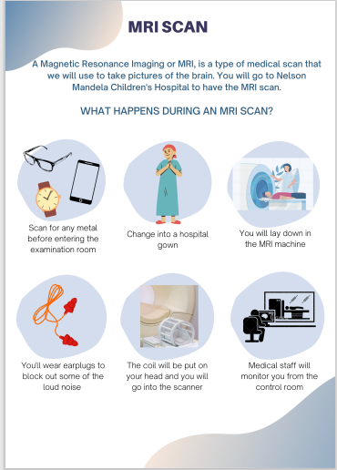
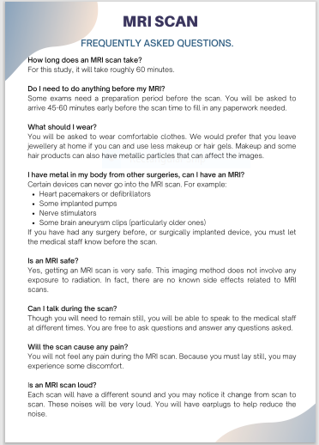
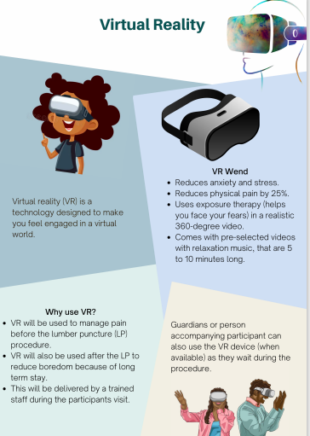

Slide 111
RESULTS
Across both sites, 9 information workshops with potential participants, their caregivers and
staff were conducted,
We enrolled 68% of those approached in Soweto and 98% of those invited in Cape Town.
55 participants completed the pain rating scale immediately after the CSF and blood sample collection visit
25 Interviews analysed (conducted after procedures) were categorised according to
Participants recall the study
The procedure that stood out
Concerns about the study or procedures
What they would tell others about the study
Pain Rating Scale | No Pain | Mild Pain | Moderate Pain | Severe Pain
 | 7 (13%) | 22 (40%) | 25 (45%) | 1 (2%)

Slide 112
RESULTS
Recall of the study and what stood out
Learning about HIV
The MRI and learning about their brains
The LP was associated with discomfort
Meeting with peers was reassuring
They were treated with care
Concerns
Wanting information on results
Apprehension of findings
Apprehension before procedures
Procedures caused discomfort
What they would tell others
Encourage others to participate
Learning experience
Contribution to science – help others
It was not as bad as they had anticipated

Slide 113

Key Findings
Using a participant-centred approach enhanced our study
  Enrolment
  Retention
  Co-learning
  Advocacy
Repetitive sharing of information reduced apprehension
Treating participants with care made a difference
Researchers need to be flexible and adapt protocols and procedures to make research more relevant and credible

Slide 114
JSI Person-Centered Care Assessment Tool:
Zambia Experience
Lackeby Kawanga, JSI, USAID DISCOVER Health

Slide 115
PCC-AT for HIV and Integrated HIV Settings
What is PCC-AT?
A publicly available Excel tool from JSI.com for service providers and stakeholders for assessing and improving person-centered HIV service delivery in HIV specific and integrated settings.
Why use PCC-AT
🔍 Identifies opportunities for structural, capacity, and resource improvements.
🔍 Drives collaboration and streamlines actions to enhance services.
Key Features:
✅ Providers self-assess against clear standards.
✅ Less subjectivity in evaluations.
✅ Minimal time required (~90 minutes).
✅ Offers clear direction for action.
✅ Tracks performance over time.
Notes:
3+ years in the making
Framing: this tool speaks to to USAID's INTEGRATE request under obj 1, for tools to support transition to integration of HIV to PHC (complemented by tools for integration readiness); and also request for ops and formative research to inform and assess effectiveness of integrated service delivery

Slide 116
Tool Development Journey
SYSTEMATIC REVIEW
Registered protocol Review Lit. search Abstract Full review 31 studies from 12 countries
DEVELOPMENT
Framework 3 domains 12 subdomains Tool Based on JSI benchmarking, performance expectation, and action plan approaches
VALIDATION
CONSULTATION Feedback from PEPFAR implementation teams AIDS 2022 FGD with 25 experts Google Survey filled out by 100 people | USE Ghana pilot 5 facilities FGD with staff KII with clients Zambia pilot 30 facilities Compared score to clinical outcomes
ITERATIVE IMPROVEMENT
Repeat measures over time Link with clinical outcomes Importance of disagg. by KP/PP Comm engagement, feedback triangulation Application in integrated PHC settings
Figure 4. Person-centered care assessment tool development process
Notes:
Use case evolution
Tool for HIV settings
Feasibility as QI tool (sample sample [n=5] then larger sample [n=30])
Analysis of scores against key HIV outcomes (CIT, VLC, VLS)
Monitoring of performance over time (actions completed, change in scores)
Involvement of community representatives/groups/advocates in results review
Tool for settings working toward integration of HIV into PHC

Slide 117
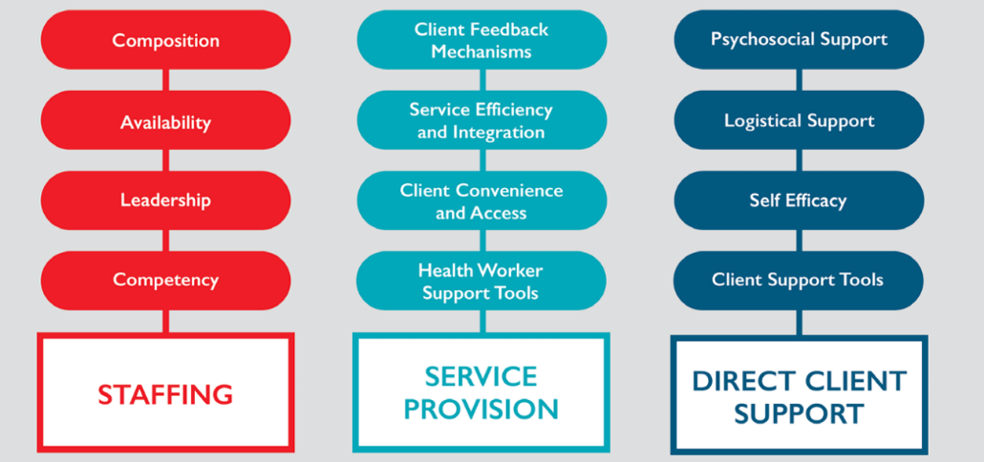
Framework for PCC in HIV and Integrated HIV Settings
Figure 1: Domains and subdomains resulting from systematic review
Notes:
These domains and sub-domains are designed to assess facility resources and systems in place to provide pcc.
The PCC-AT is informed by the PCC framework established via the systematic literature review.
The PCC-AT is an Excel-based tool that measures health facility staff perspectives on PCC service delivery within HIV treatment settings. PCC-AT implementation, led by a trained facilitator, requires in-depth discussions amongst health facility staff to assign a score using a benchmarking approach for each of the 56 performance expectations linked to the three domains and twelve subdomains of PCC. Once scoring is complete, the PCC-AT process concludes with action planning which guides health facility staff to identify areas of weakness and their causes, and to develop strengthening activities to address gaps.

Slide 118
Example PCC-AT Standard, PE, and Responses
Domain: Service Provision | Subdomain: Service efficiency and integration
Performance Standard | Performance Expectation | Response Options
The facility arranges and sequences services for optimal client flow in terms of speed, efficiency, service integration, and confidentiality. | Facility offers a full package of integrated HIV and associated (TB, STI, FP, MNCH, NCD) clinical, diagnostic and pharmacy services. | The facility offers few integrated services
 |  | The facility offers clinical, diagnostic and pharmacy services for HIV-related conditions or non-HIV health issues, but not both.
 |  | The facility offers clinical, diagnostic and pharmacy services for HIV-related conditions and some non-HIV health issues, or for non-HIV health issues and some HIV-related conditions.
 |  | The facility offers full package of clinical, diagnostic and pharmacy services for HIV-related conditions and most major health issues.
 | Facility offers integrated mental, emotional, and social services (mental health, substance use, nutrition, housing, GBV, etc.) onsite or at a nearby location. | No referral or on-site services offered
 |  | Travel time > or = 1 hour
 |  | Travel time < 1 hour
 |  | Services available on site
 | Facility operates bi-directional referral system including two-way coordination and information sharing (e.g., client records, progress) to ensure continuity of care across health system levels and community programs. | No documented referral system in place
 |  | Uni-directional referral system operational using paper records
 |  | Bi-directional referral system operational using paper records
 |  | Bi-directional referral system operational using digital medical record sharing

Slide 119
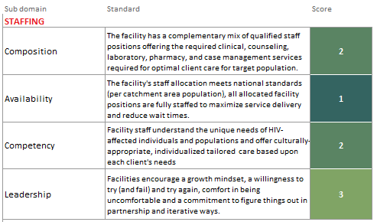
PCC-AT Scoring
Once all performance expectations are answered, Excel automatically generates a set of scores.
Results are depicted visually on a graph.
Discrete scores reduce ambiguity, simplify assessment, and prioritize action.
Figure 2: Summary of scores by standard
Notes:
Note that tool very intentionally calculates scores in the background so you don’t see them during actual response selection; Goal is not for teams to get caught up in whether they’re a 1 or 2 in certain areas; above all, the goal is to spur discussion

Slide 120
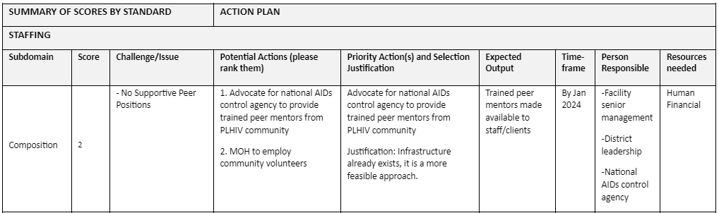
Translation to Action
Scores provide a roadmap for action, enabling continuous improvement by prioritizing needs, monitoring progress, and identifying new areas for strengthening person-centered care.
Figure 3: Excerpt from PCC-AT action plan

Slide 121



PCC-AT Implementation in Zambia
Methodology
Design: Mixed-method, cross-sectional study.
Site Selection:
  66 eligible facilities in Copperbelt and Central provinces.
  30 randomly selected; 29 in final analysis.
Participants:
  Health facility staff with ≥1 year of experience.
  Varied roles, including HIV nurse practitioner, Clinical Officers, registered nurses, counselors, and community health workers.
Data Collection:
  PCC-AT implemented through guided discussions and action planning September 2023
Objectives of implementation
Identify PCC strengthening activities prioritized by facility staff.
Explore common challenges and themes in PCC-AT action plans.
Analyze differences in actions by facility size (ART clinic volume) and geographic location.
Compare PCC-AT scores to clinical outcomes
PCC-AT Implementation Process
Preparation: Staff training on PCC-AT use and facilitation.
Scoring: Teams assessed performance expectations across 12 subdomains.
Action Planning:
Identify low-scoring areas.
Conduct root cause analysis.
Develop priority actions and timelines.

Slide 122
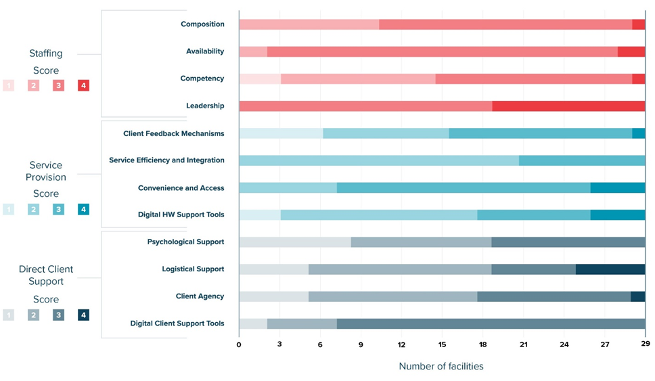
Results
PCC Scores
Figure 7: Distribution of PCC-AT scores by subdomain
Notes:
Takeaway: facilities tend to score in the 2-3 range; on average, score highest in staffing domain, followed by SP, and lowest in DCS; these trends are consistent with Ghana findings
The median score for staffing was 3 with staff competency having the largest range (1 to 4) and staff leadership having the smallest range (3 to 4). The median score for service provision was 2 with client feedback mechanism and digital health worker support tools having the largest ranges (1 to 4) and service efficiency and integration having the smallest range (2 to 3). The median score for direct client support was also 2 with logistical support and client agency having the largest range (1 to 4) and digital client support tools and psychosocial support having the smallest range (1 to 3).

Slide 123
Results
Narratives
Gaps Identified
Key Findings:
Gaps were most common in service provision (25 facilities), direct client support (22), and staffing (15).
Subdomain-specific issues:
  Service Provision: Digital health tools, client feedback mechanisms.
  Direct Client Support: Psychosocial support, client agency.
  Staffing: Competency around and composition.
Differences by Setting and Clinic Volume
Geographic Differences:
Urban/Peri-urban: CLM and documentation of client feedback.
Rural: Accessibility and GBV training.
Clinic Volume Differences:
Low/Medium: IEC materials, lab staff needs.
High: Peer counselor assignments.
Common Themes in Action Plans
Themes Across Facilities:
Stigma reduction and client rights training (higher in rural areas).
Culturally appropriate materials (IEC) (common in low-volume and rural facilities).
Peer counselor assignments (common in high-volume facilities).
Lab infrastructure needs (rural and low-volume facilities).

Slide 124
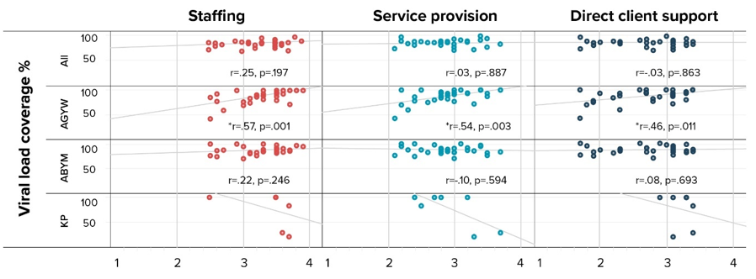
Results
Correlation analysis: PCC-AT scores vs. HIV outcome indicators
Figure 8: Correlation between PCC-AT domain scores and viral load coverage by client population group

Slide 125
Conclusions
PCC-AT is feasible and effective for identifying strengths, weaknesses, and priorities in person-centered HIV service provision.
Common challenges and themes point to opportunities for targeted interventions.
Differences in priorities by facility type highlight the need for context-specific strategies
PCC-AT facilitated a structured approach to assessing and improving PCC in HIV treatment.

Slide 126
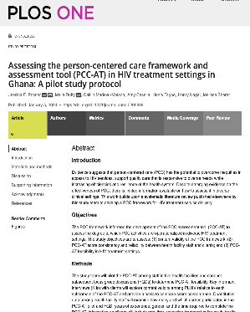
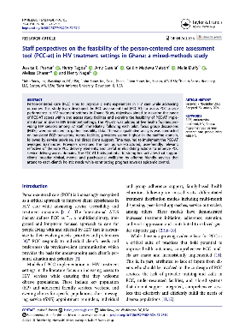
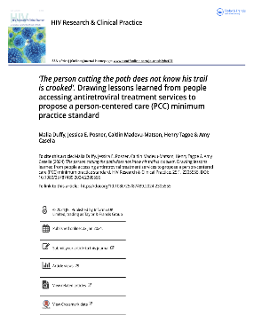
Publications
Systematic review
Ops research in Ghana
  Protocol
  Feasibility results
  Consistency and validity results
  Commentary
Ops research in Zambia
  Protocol
  Qualitative results–action plans
  Quantitative results–scores vs. HIV outcomes (under development)

Slide 127

Thank You
Contact:
Lackeby Kawanga
lackeby_kawanga@zm.jsi.com

Slide 128

Session 6 – There is no health without mental health
Time | Session | Speaker / Moderator
10:30 – 11:15 | Healthcare provider stress management | Sandra Simbeza
11:15 – 12:00 | Reflections and lessons learnt so far | All

Slide 129

Person-Centred Care Advocacy Academy 2024
Healthcare Providers Stress Management Training Module.
Presenter: Sandra Simbeza

Slide 130
Being a healthcare worker
Why did you become a healthcare worker?
What are the 1 – 2 best things about being a healthcare worker?
Notes:
To ground the group in something positive, we want to open by having people share their stories. This should take no longer than 10 minutes. Ask the group, ‘why did you become a health care worker?’. Depending on how long someone talks, allow for 2 – 8 people to respond. Do not allow the responses to take more than 5 minutes.
Then ask the group ‘what are the 1-2 best things about being a health care worker?’. Again, allow several people to share, but not for it to take more than 4 minutes.
Summarise by saying ‘There are many reasons we are in this profession and many good things about the work that we do.’ We are going to talk a bit more now about what we want to achieve as health care workers, and some of the challenges that may be there.

Slide 131
What are the goals of HIV care in Zambia?
Provide services for all people living with HIV
Continue to keep those who access services in HIV care
Achieve good health for all patients who are in HIV care
These goals are shared by both
health care workers and clients
Notes:
Almost every country has been affected by HIV, and have specific goals
Can you tell us what are the goals of HIV care in Zamiba? [allow free discussion]
The fundamental goal for HIV patients set by the MOH, Zambia is to [hit down arrow]:
Provide services for all HIV infected people as per 95-95-95, which is 95% of those infected know their HIV status, 95% of those infected are linked to ART, 95% of those on ART are virally suppressed.
[Hit down arrow again] Certainly both patients and HCWs want viral load suppression and to avoid treatment failure, viral resistance, and opportunistic infections and mortality.
Yet, though more people are accessing universal test and treat, engagement in care remains a problem
The global response to HIV and especially that from Zambia, has been great! Yet, many studies show that viral load suppression is alarmingly low because most people don’t even know their status. So in our case if 100 people are infected, only 70 know their status, of whom about 60 link to care and about 50 are virally suppressed – That is, only half of all people living with HIV are virally suppressed.
Even after ART initiation, perhaps only 70% of people are still on ART after 3 years.

Slide 132
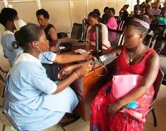
Challenges faced by healthcare workers
What are some of the challenges you face in working towards achieving these goals?
Notes:
We want to dive in some of the challenges faced when providing healthcare to HIV patients? (or any patients, if primarily an audience of providers that work with different illnesses’)
[List opinions on a flip chart ]
Do not go into too much detail about these barriers as you will discuss this in the next set of slides
You are right that things such as
Work overload
Poor working conditions
Delayed lab results
Poor pay
Lack of appreciation from patients
Challenges with co-workers
Addressing the different needs of patients
Patients not doing what they are supposed to
And others…
Pose a great challenge,.
As one of your colleagues once told us [READ NEXT SLIDE]

Slide 133
“Being a HCW is … an extremely difficult thing. You have to be strong, you need to have … a neutral heart.” – Healthcare worker
Notes:
The conditions that you just described create mental tension or emotional strain.
Mental tension or emotional strain create stress and when stressed, we often have reactions – where we just act without thinking
For example, We become angry and irritated with others. This same person who was talking about needing a strong and neutral heart, went on to say
[READ Next SLIDE]

Slide 134
Reactions under stress, in the words of a colleague:
“But sometimes when some patients go far, your temper may rise and you respond –
‘You, madam! You should have manners!
Go and sit down, you came late!’
And you even go outside and sit and we won’t talk to each other again.” – Healthcare worker
Notes:
READ SLIDE
These reactions are understandable.

Slide 135
Imiti ipalamine taibula kushenkana
Notes:
Trees that are close together cannot avoid rubbing each other - that is, tensions between HCWs, their collegues and patients are inevitable. This creates stress

Slide 136
Stress: What is stress?
Stress happens a lot to healthcare workers globally
Stress comes from discrepancy between what needs to be done and what we can accomplish
When we are stressed, both clients and healthcare workers often have reactions with undesirable outcomes
Notes:
Ask the question and allow for 1-2 quick answers, then show what is on the slide

Slide 137
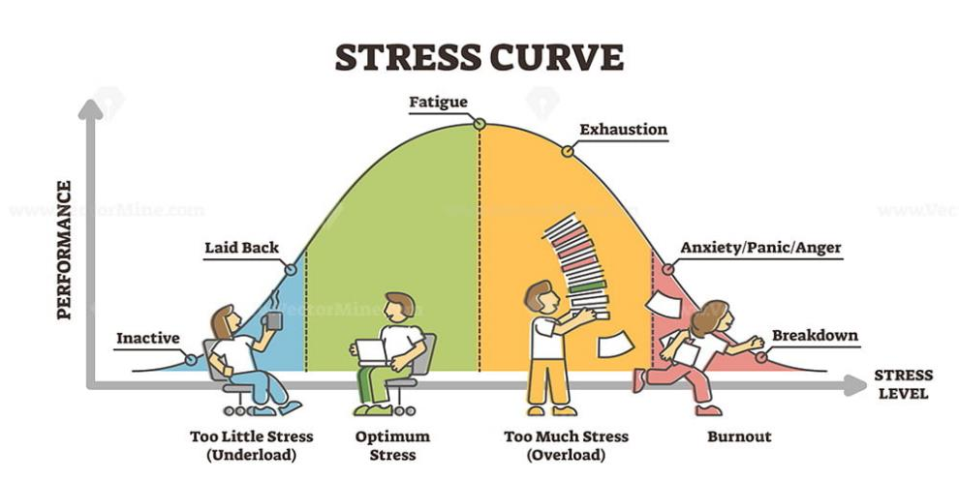
The Stress Curve
Source: Vector Mine
Notes:
Notes to the Facilitator
Everyone has some ideal level of stress which differs from person to person.
As shown in the figure, if there is not stress performance may suffer, due to boredom, but too much of it may lead to burn out.
Each one us must learn how to manage our stress level, too much stress can have negative consequences such as burn out.

Slide 138
Managing Stress: What can we do?
There are things that we can do as individuals, co-workers and in the work environment to help to prevent stress and burn out.
We need to rehearse so that we react to situations that are difficult in a constructive way
We need to do what we can to work together and create a work environment that limits stress.
Notes:
Ask the question and allow for 1-2 quick answers, then show what is on the slide

Slide 139
Exercise 1: Step 1
Write one line per post-it for situations that have stressed you at work
You are allowed to use up to 3 post-its.
Stick the post-its on the left-hand side of the flip charts posted on the wall

Slide 140
Exercise 1: Step 2
Read over the situations and put a blank post-it against each situation that you have experienced

Slide 141
Exercise 1: Step 3
Practical solutions to these stressful situations
At each table, discuss as per the guidance from the facilitators

Slide 142

Learning Point – Stress
Stress can…
  Make us behave in a way we do not like
  Make us feel negative
  Lead to burn out
        Emotional exhaustion: You stop caring about your patients
        Cynicism: You don’t believe anything can change, and
        Inefficacy: You do not get the desired effect of your work
Notes:
As we can see from your own experience, stress affects all of us and it can make us behave in a way we do not like, and can make us feel negative.
Negative effect on HCW ability to deliver standard of care they would like to deliver to their patients
Negatively affects relationships with communities and other aspects of the Health System
We can even start to feel like we are ‘burnt out’. Where you [hit down arrow and read text three times]
Stress and burn out happen a lot to health workers around the world, including here in Zambia. This is probably because of the context of work as a health worker.
You may have experienced burn out yourself but not realized that was what it was.

Slide 143
Somethings we can do to cope as individuals:
Taking care of yourself outside work – good diet, sleep, trust in divine power, exercise, socialize- power of good relationships.
Staying focused
Asking for help
Notes:
Here are some strategies which we came up with. You have named all of them. Essentially, as professionals, we need to regain our calm

Slide 144
Somethings we can do to cope as individuals (Continued):
  Regaining your calm
      Recognize stress by how we feel and behave
      Understand the effect of reactions on ourselves and on others
      Think about how to best manage reactions
      Carry a picture of best practice in dealing with difficult clients and situations
Notes:
To regain our calm, first we have to recognize we are not calm – that we are under stress and are behaving in non-constructive ways – and then stop behaving automatically. To be able to do that, we need to be prepared for difficult situations and have rehearsed how we will deal with it

Slide 145
Somethings we can do to cope on the job:
Deep breathing
Stretching
Walking around
Eating healthy snacks
Organizing your work area

Slide 146
What could colleagues and the workplace do to PREVENT stress or IMPROVE the scenario outcome?
Colleagues can:
Listen
Understand where others are coming from, what is going on in their lives
Team work, cooperation, respect
Mentor
Offer a break
Offer time management or organization tips
Offer help
Be positive
Smile, laugh
Help each other to learn smartcare and practice, practice, practice
Workplace can:
Utilise DSD models
Plan the use of limited space
Be patient
Create compatible work schedules and lunch shifts
Clearly define roles and responsibilities
Workers participate in decisions affecting their jobs
Improved communications
Social interaction among workers
Temperature, light, noise, space
Notes:
Hit down arrows twice and read slide

Slide 147
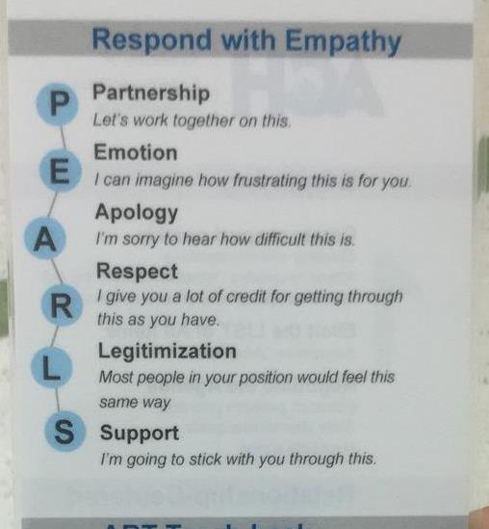
Some things we can do to cope on the job:
Changing the relationship dynamic with the clients
Notes:
Just like we, as health care workers, feel better when someone appreciates the difficulties we face in our jobs, patients often feel better when someone appreciates the challenges they face as a patient – particularly a patient with a chronic illness that requires daily management. It is true that some patients are difficult and will always be difficult. Some patients, however, may be less difficult when we engage with them in a way that recognises their struggles. This can lead to less stress for everyone. You often engage with your patients in this way. But it can be hard, especially when you are stressed and the patient is stressed. This is a tool to help remember an approach that can de-stress a situation. It can apply to any patient, but particularly to those who are difficult or express that they are having some challenges. Research shows us that this makes patients
First, we let them know that we are a team. The health care worker and the patient.
Second, recognize the emotion they are feeling
Third, apologise that they feel this way. It is not your fault, but it is comforting to hear and a kind thing to share
Fourth, offer words of respect
Fifth, help to normalise their experience
Sixth, offer support

Slide 148
Discretionary power
The behaviour of clients can sometimes feel difficult, but healthcare workers hold the power
That power comes with opportunity and responsibility
The choices that you make matter to the client! (sometimes a lot)
If a client struggles to get her medications because she cannot get time off work and you choose to give her two weeks of medications, instead of three months of medications, what might be the consequences?
Notes:
HCW have -– discretionary power: the ability to use judgment when interpreting MoH policy and guidelines in a way that has an impact on patients and colleagues. That is ,HCWs have the power to change things due to the their position using MoH policy & guidelines

Slide 149
Another method to manage stress...
…is the use of Psychological First Aid (PFA).
A tool healthcare workers can use to support each other and manage stress.

Slide 150

Source: Minnesota Department of Health
Notes:
Notes for the facilitator:
We all have been been faced with crisis at on point of our work or personal life.
What kind of crisis have you encountered before ?- Ask a participant to share an experience they have had that they consider was a crisis.
How did they handle it
How did they feel about the situation? Did it stress them
A crisis can lead to stress – which can have undesirable effects, It does have sort of ‘knock on effect’ negatively impacting the quality of care provided to patients.
They are proven approaches we can use to manage stress –
One of them being Psychological first aid – an approach reccommeded by the WHO,

Slide 151
What is Psychological First Aid
It is a humane and supportive response to a fellow human being who is suffering and may need support. It is an acute intervention of choice when responding to the psychological needs of children, adults and families affected by disaster and pandemic.
Source: PFA for all – WHO

Slide 152
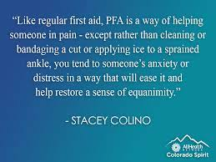
Psychological First Aid
In simple terms it is .....
.
Notes:
Notes :
Others have simplified it as: Read from slide , it
Emphasize that PSA is a tool that HCW can use with each other for stress management.

Slide 153
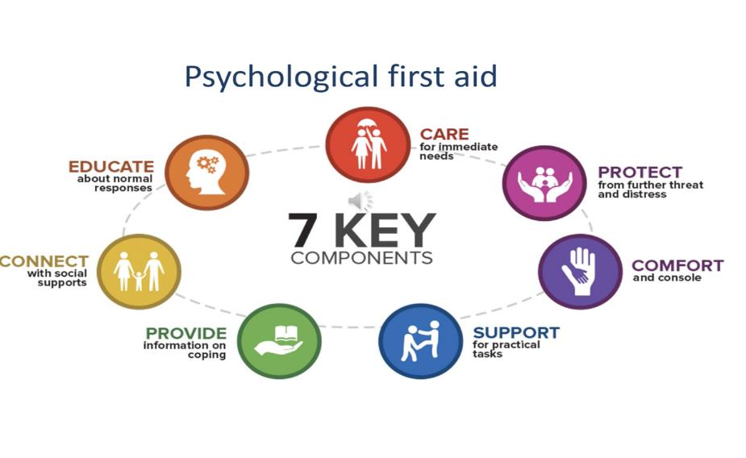
Seven Components of Psychological First Aid
Notes:
Notes for facilitator:
There are 7 components of PFA
Go through each one explaining briefly to participants.

Slide 154
Psychological First Aid is NOT..........
Something only professionals can do.
Psychological debriefing.
Professional counselling or therapy.
Encouraging a detailed discussion of the event that has caused the distress, traumatic experiences and losses.

Slide 155
Psychological First Aid is NOT
Asking someone to analyze what has happened to them.
Pressing someone to talk for details on what happened
Pressuring people to share their feelings and reactions to an event.
Something that everybody who has been affected by an emergency will need

Slide 156
Who may benefit from PFA?
Very distressed people who were recently exposed to a serious stressful event
Can be provided to adults and children, adolescents, parents/caretakers, families who have recently experienced a crisis event and are distressed.
Not everyone who experiences a crisis event will need or want PFA.
Notes:
Notes to facilitator :
Before showing this slide, as participants who do they think can benefit from PFA?

Slide 157
When & where should PFA be provided?
Upon first contact with very distressed people, usually immediately following an event, or sometimes a few days or weeks later depend on situation, resource available.
It can be provided anywhere – but privacy and confidentiality is key.
Notes:
Notes to facilitator :
Before showing this slide, ask participants when and where should PFA be provided?

Slide 158
What things might people who have undergone a crisis need?
Practical things – like a blanket, food, water, shelter
Medical care for injuries or a help with chronic medical conditions
Safety and protection
Information – about the event, loved ones, available services
Someone who is willing to listen
To be able to contact loved ones
Specific support related to their culture or religion
Being consulted and involved in decisions that affect them

Slide 159

How to provide PFA: 3 Main Principles
For Safety and security risk.
Assess dangers
Get information about the event/crisis/situation
1. Look
Notes:
Notes to Facilitator:
Explain to participants that : When providing psychological first aid, you should keep in mind three action principles: look, listen, link
1.Look: It is necessary to first assess dangers, as well as safety and security risks, and then obtain information about the event that is taking/took place and about those in need of assistance, their physical injuries, primary and basic needs, and their emotional responses.
2.

Slide 160

How to provide PFA: 3 Main Principles
Approach the person in need of help and introduce yourself.
Pay attention and listen actively.
Understand the other person's feelings.
Calm the person in crisis/ need
Ask about their needs and concerns.
Help the person in crisis with their immediate needs and try to solve their issue(s).
2. Listen
Notes:
Notes to Facilitator:
To participants : The second principle is to listen. It will require one to:
Approach the person in need of help.
Introduce yourself.
Pay attention and listen actively.
Understand the other person's feelings.
Calm the person in crisis.
Ask about their needs and concerns.
Help the person in crisis with their immediate needs and try to solve their issue(s).

Slide 161

How to provide PFA: 3 Main Principles
3. Link
Make relevant information, services, and other sources of assistance available.
Help them connect or reunite with relatives.
Provide social assistance.
Actively try to help solve the issue(s).
Notes:
Notes to Facilitator:
The third principle is link :

Slide 162
Psychological First AID Examples
Staff Break Room
Available: https://youtu.be/NGr9BnY90WY?si=DTZfxSXC4i6hklb3
2. Vaccination Clinic : Anxious Students in Line
Available: https://www.youtube.com/watch?v=Zu4-mrzgUls
Source: Institute for Disaster Mental Health( IDMH)
Notes:
Notes for facilitator:
We will take some time to watch a videos of when PFA is applied and have a discussion
Discussion point:
What contributes to the stress in these two individuals
Expected answers: the environment, lack of knowledge, misinformation, stress from a work colleague, worry about extended family members
What principles of PFA are used in these two videos- All three of them
What materials were required to provide PFA-
Where was PFA provided ?

Slide 163
When Using PFA, Remember....
Goal is to help people to return to their base line functioning , not to fix all their problems.
People should not be treated identically, individual needs and cultural differences must be respected.
You MUST understand limits of PFA, and know when and how to refer for more intensive mental health care if needed.

Slide 164
PFA, Do’s and Don’ts
DON’T | DO
Over promise or over reassure | Be realistic in your assurance
Minimize a distressed person’s situation or make comparison with others | Validate the survivor’s feelings
Change the subject | Stay with the survivor’s focus
Fill up silence with chatter | Learn to tolerate silence
Take a distressed person anger or frustration personally | Accept that they are venting and it's not really aimed at you

Slide 165

The Serenity Prayer
,
Grant me serenity to accept things I cannot change,
Courage to change the things I can and
wisdom to know the difference.
Notes:
.But sometimes we cannot change the situation by changing how we think, believe or act about that situation … That is when it is useful to remember the serenity prayer [ASK SOMEONE TO READ THE PRAYER

Slide 166
Conclusion
Commitment to 95-95-95 at a global level
HCWs face challenges in achieving this goal
HCWs have the power to apply national guidelines in a manner that works for the patient
Determining what works for the patient requires PCC: Empathy, shared decision-making and coordinated care

Slide 167

Most importantly…
Stress Management =
Happier Healthcare Workers &
Happier Clients

Slide 168
Let’s RECAP together
R | Reflect on what you learnt today
E | Explain something you learnt today
C | Compare what you learnt with what other’s learnt
A | Apply your learning today – e.g. be an active listener
P | Plan - what do you hope to learn at the site visits?

Slide 169
Today’s programme (Thur 28 Nov)
Time | Session | Speaker / Moderator
08:00 – 08:30 | Group check-in
 | Reflections on yesterday’s sessions | Njekwa Mukamba
08:30 – 09:30 | Session 7 – Guidance to support change
 | Global PCC normative guidance Stigma and discrimination reduction PLHIV Stigmas Index 2.0 | Clarice Pinto Erica Spielman Keren Dunaway
09:30 – 10:00 | Break
10:00 – 12:00 | Session 8 – Person-centred design in action
 | How to test your hypotheses and design informed interventions | All faculty
 | Report back – client journey mapping | Chanda Mwamba
12:00 – 13:00 | Lunch
13:00 – 16:30 | Session 9 – Pitching your advocacy plan
 | Optional Q and A session / individual reflection | All
 | Advocating for policy change: the dos and don’ts | Suilanji Sivile
 | Fellow presentations, part 1 | All
15:00 – 15:30 | Break
 | Fellow presentations, part 2 | All
 | Continuing our journey | Emma Williams
18:30 – 20:00 | Dinner
Notes:
Kombatende
Summarize the day
Highlight that they will be presenting individually in the afternoon

Slide 170

Global Person-Centred HIV Care normative guidance
Clarice Pinto
WHO Department of Global HIV, Hepatitis and STI Programmes
November 2024

Slide 171
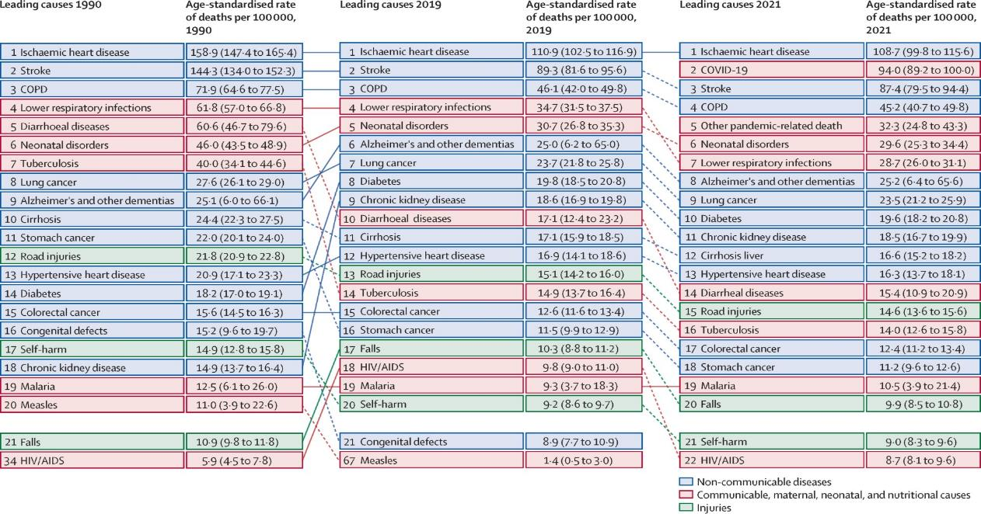
Change in Global Disease Burden (IHME)
Notes:
Big changes in the contribution of HIV to the global disease burden over time as a proportion of leading causes of death. While age standardised death rates per 100,000 have not changes so much between 2019 and 2021, HIV is now seen as the 22nd leading cause of death globally. Murray et al, Published: May 18, 2024DOI:https://doi.org/10.1016/S0140-6736(24)00769-4
Lancet .

Slide 172
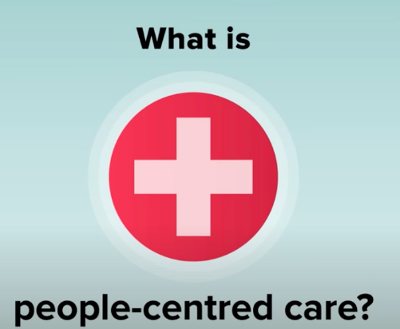
Domains of HIV Person-Centred Care
“People-centred health services are an approach to care that consciously adopts the perspectives of individuals, families and communities and sees them as participants and beneficiaries of trusted health systems that respond to their needs and preferences in humane and holistic ways.”
Domains of person-centred HIV Care
Patient-provider relationship & Client friendly services
Integrated services for one-stop services/ care

Slide 173
Systematic Review -- Person-centered interventions focused on the actions at the service point, found positive outcomes:
Counseling and person-centred communication
Provider sensitization
Friendly services
Client empowerment
HCW feedback

Slide 174


2021 Consolidated Guidelines on HIV Prevention, Testing, Treatment, Service Delivery and Monitoring
See Chapter 7
To access the guidelines, visit: 2021 WHO HIV consolidated guidelines on HIV prevention, testing, treatment, service delivery and monitoring: recommendations for a public health approach, 2021

Slide 175

What WHO says about People-Centred Care for PLHIV?
“HIV programmes should provide people-centred care that is focused and organized around the health needs, preferences and expectations of people and communities, upholding individual dignity and respect, especially for vulnerable populations, and engage and support people and families to play an active role in their own care by informed decision-making”
Source: WHO, 2021, Consolidated guidelines on the use of antiretroviral drugs for treating and preventing HIV infection: recommendations for a public health approach – second edition

Slide 176



What is Person-Centered Care under UHC?
Primary Health Care
Person-Centered Care
Primary health care is care for all at all ages. All people, everywhere, deserve the right care, right in their community.
https://www.who.int/health-topics/primary-health-care#
care approaches and practices that see the person as a whole with many levels of needs and goals, with these needs coming from their own personal social determinants of health
an approach to care that consciously adopts individuals’, carers’, families’ and communities’ perspectives as participants in, and beneficiaries of, trusted health systems that respond to their needs and preferences in humane and holistic ways. It is organized around the health needs and expectations of people rather than diseases.
UHC - all people have access to the health services they need, when and where they need them, without financial hardship; include the full range of essential health services, from health promotion to prevention, treatment, rehabilitation, and palliative care.

Slide 177
WHO Consolidated HIV Guidelines - Good practise statements supporting PCC
Health systems should invest in people-centred practices
Same day ART initiation should include approaches to improve uptake, adherence and retention
Non-judgmental, tailored approaches to assessing adherence
Balanced integration of diagnostic services

Slide 178







WHO Consolidated HIV Guidelines – Service Delivery Recommendations
ART initiation may be offered outside the health facility |  | Conditional
Clinical visits every 3-6 months, preferably 6 months if feasible* |  | Strong
ART dispensing every 3-6 months, preferably 6 months if feasible* |  | Strong
Tracing and support for people who have disengaged |  | Strong
SRH services, including contraception, may be integrated with HIV services |  | Conditional
Diabetes and hypertension care may be integrated with HIV services |  | Conditional
Psychosocial interventions should be provided to all adolescents and young adults living with HIV |  | Strong
Task sharing of specimen collection and point-of care testing with non-lab personnel when professional capacity is limited |  | Strong
Please find the links to:
Consolidated guidelines on HIV prevention, testing, treatment, service delivery and monitoring: recommendations for a public health approach, 2021 update https://apps.who.int/iris/handle/10665/342899?locale-attribute=de&
Service Delivery guidelines, 2021 update
https://apps.who.int/iris/bitstream/handle/10665/341052/9789240023581-eng.pdf
*People who are established on ART: new definition given

Slide 179
A means to person centred care and sustainability
Two key domains - health services and health systems (i.e. governance, financing, supply chain, human resources, laboratory, health information system etc.)
Service integration requires at least a partially functioning integrated system
Role of community and multi-sectoral action fundamental to demand generation for integrated services.
Integration

Slide 180
Integration and shared approaches
Integration entry points | Examples of integration opportunities across HIV, viral hepatitis and STIs
Common modes of transmission, incl. sexual transmission, vertical transmission, injecting drug use | Common approaches to shared prevention interventions such as harm reduction, ”triple elimination”, linkages with sexual and reproductive health, etc.
Comorbidities among HIV, viral hepatitis and STIs | Integrating services such as screening priority populations for HIV and STIs in the same visit
Other disease interactions (TB/HIV, NCDs, mental health, etc) | Promoting linkages with other disease programmes such as with TB, cancer, NCDs, mental health, promoting disability-inclusive programming, etc
Common populations affected by multiple diseases e.g. underserved/poor, young people, key populations | Providing comprehensive services at the same encounter or location such as pregnant women accessing testing for HIV, hepatitis B virus and syphilis at the same antenatal visit
Common service delivery platforms and providers | Strengthening linkages or fully integrated service delivery such as antenatal care for pregnant women, targeted community outreach to sex workers, coordinated delivery of self-tests for HIV and self-sampling for certain STIs, etc.
Common health system resources | joint approaches to strengthen health workforce, coordinated or integrated use of equipment such as multiplex diagnostic tools, shared investments in HMIS, etc
Joint approaches to address social determinants | joint efforts to address stigma and discrimination in the health sector, legal review and reform, etc.

Slide 181



Integration of NCDs into HIV service packages technical brief, 2023 (Global NCD programme, WHO HQ)
Approaches and actions to promote integration of NCD services into HIV services:
  Governance, financing, and community involvement
  Services integration: national levels groups, district and facility levels actions to be considered
  Monitoring, evaluation, and surveillance
Special considerations for cervical cancer
Data sources to estimate # PLHIV with NCDs for costing
WHO guidance on integrating the prevention and control of NCDs in HIV/AIDS, TB, and sexual and reproductive health programmes, 2023
18 strategic actions in 5 areas:
  people and community,
  policy and leadership,
  financing,
  capacity and infrastructure,
  model of care for NCDs.
https://apps.who.int/iris/handle/10665/367861
https://www.who.int/news/item/05-04-2023-world-health-organization-guidance-on-integrating-the-prevention-and-control-of-noncommunicable-diseases-in-hiv-aids-tuberculosis-and-sexual-and-reproductive-health-programmes
Aligned with the WHO Consolidated guidelines on HIV prevention, testing , treatment and services delivery (2021) and the GF guidance note for supporting health and Longevity in PLHIV (2023)
Notes:
Despite very prevalent and availability of simple screening and prevention measures
it has not been adopted by HIV programmes.
PLHIV experienced significant weight gain during COVID-related lockdowns, and can be potentiated by additional factors as use of INSTIs : impact in the body weight and increase the risk for both conditions
Lack of comparative studies with general population

Slide 182


WHO Consolidated HIV Guidelines – HIV – NCD Integration
Examples
South Africa: chronic medication dispensing
>3 million people registered.
Integrated NCD/ART medication pickup at community-based pick-up points
Eswatini: Community distribution
83 facilities and 721 community distribution points implementing community health commodities distribution
USAID, WHO, Ministry of Heath. JIAS 2023
Research gaps
Long term data on health outcomes of people with HIV & NCDs
Cost effectiveness of integration models
Definition of health promotion activities to protect PLHIV against NCDs
Integration into DSD models
Values and preferences of integration
https://www.who.int/publications/i/item/9789240031593

Slide 183



Examples of integration of non-communicable diseases policy adoption
Some countries, such as Zimbabwe, South Africa and Eswatini already share lessons learned from integration of non-communicable diseases.
South Africa and Eswatini have adopted an integrated approach for person-centred services domain
WHO recommends the integration of diabetes and hypertension care with HIV services
Focus on implementation science on operational alignments, lessons and program outcomes
Possible positive benefits for clients could relate to alignment of treatment refills and clinical appointments
Improved case management and holistic approach to disease management into one stop shop approach

Slide 184



WHO Service Delivery Integration of Mental Health
HIV prevention: Integrate PrEP with mental health prevention and promotion
HIV testing services: Post-test counselling that includes mental health screening and referral for relevant services
ART initiation: Routine screening for mental health conditions. Psychological and pharmacological interventions as needed and provision of care.
ART adherence and viral suppression: Regular screening for mental health conditions at all follow up visits. Psychosocial and brief psychological interventions to support adherence and retention in care.
Mental Health and psychosocial needs of those living with or at risk of HIV must be core to any approaches to ending the epidemic.
Psychosocial support addresses the ongoing psychological and social barriers faced by PLHIV, their partners, families and caregivers. It includes:
referral and provision of psychological services for assessment, management and treatment of depression and substance use disorders, regardless of HIV status;
the referral and access to existing socio-economic services;
enrolment on differentiated models of ART delivery, and
community and peer support to motivate PLHIV to better cope with adherence barriers, engage in new social networks and deal more effectively with discrimination.

Slide 185




Mental health is a priority for adolescents living with HIV
New Recommendation
Psychosocial interventions should be provided to all adolescents and young people living with HIV
(Strong recommendation; moderate-certainty evidence)
WHO Technical brief on integrating Psychosocial interventions within HIV services

Slide 186

WHO Technical Brief on Quality of HIV Care (2019)
Consolidates WHO guidance to support the implementation of high-quality HIV services
Suggests policy, strategy and service delivery approaches for quality HIV care
Suggests approaches to selecting quality measures
Aims to support HIV program implementation in low and middle-income settings
Maintaining and improving Quality of care within HIV clinical services technical brief, 2019

Slide 187


WHO: Enablers of Quality HIV Services

Slide 188

CONSOLIDATED GUIDELINES ON HIV PREVENTION, TESTING, TREATMENT, SERVICE DELIVERY AND MONITORING
Chapter 7.12: Improving the quality of HIV care services
COMMUNITY ENGAGEMENT
COMMUNITY-LED MONITORING
2021 WHO HIV consolidated guidelines on HIV prevention, testing, treatment, service delivery and monitoring: recommendations for a public health approach, 2021

Slide 189


Vietnam Country example: Community Monitoring and Advisory Boards for Improved HIV Care
Background: In Vietnam, HIV-related stigma, poor quality of care, and unfriendly services have hindered access to essential HIV services. To address these challenges, a community-driven initiative was launched to promote high-quality, client-centered HIV care through collaborative monitoring and quality improvement efforts.
Community engagement and led monitoring strategies
QoC Improment Interventions and Results
1
Community Advisory Boards (CABs): Established under the Department of Health's authority, CABs serve as a liaison between health providers and clients. They collect real-time feedback and advocate for client-centered changes (Figure 2).
2
Community Scorecards (CSCs): Facilitated by CAB leaders, CSCs allow health providers and clients to jointly assess and improve HIV-related services
Collaborative Approach: The initiative fosters collaboration and joint accountability among clients, community, and health providers, ensuring that client feedback drives service improvements.
3
Lessons Learned
Stigma Assessments
Client Advocacy
Continuous Improvement
Facility-based assessments provided evidence to local health authorities on the need for client feedback in service improvement.
CABs worked to reduce waiting times, improve privacy, and support clients during the COVID-19 pandemic, assisting over 2,000 clients.
Regular CAB meetings and CSC assessments led to actionable improvements based on client feedback, including decreased waiting times, enhanced privacy measures, and increased treatment literacy among clients.
Notes:
Background:
Context: HIV-related stigma, poor quality of care, and unfriendly services hinder access to essential HIV services in Vietnam. Transition to social health insurance and COVID-19 disruptions exacerbated these challenges.
Objective: Promote high-quality, client-centered HIV care through community monitoring and quality improvement, fostering collaboration and joint accountability among clients, community, and health providers.
Intervention:
Community Advisory Boards (CABs): Established under the Department of Health's authority, CABs serve as a liaison between health providers and clients. They collect real-time feedback and advocate for client-centered changes.
Community Scorecards (CSCs): Facilitated by CAB leaders, CSCs allow health providers and clients to jointly assess and improve HIV-related services.
Implementation Period: September 2018 to present.
Key Activities:
Stigma Assessments: Facility-based assessments provided evidence to local health authorities on the need for client feedback in service improvement.
CAB Meetings: Regular meetings to share feedback and develop action plans.
Client Advocacy: CABs worked to reduce waiting times, improve privacy, and support clients during COVID-19.
Impact:
Service Quality Improvements: Decreased waiting times
, enhanced privacy measures, and increased treatment literacy among clients.
Client Feedback Utilization: Regular CAB meetings and CSC assessments led to actionable improvements based on client feedback.
COVID-19 Support: CABs played a crucial role in maintaining access to essential medicines and services during the pandemic, assisting over 2000 clients.
Challenges:
Initial Hesitation: Some provinces were reluctant to establish CABs due to concerns about capacity, privacy, and sustainability.
Voluntary Nature: Recruitment and retention of CAB members were challenging without financial incentives.
Inclusivity: Initial focus on facility-level care needed expansion to include broader community input.
Next Steps:
Expansion and Sustainability: Promote wide-scale adoption of the CAB model through national guidance, best practices sharing, and advocacy for sustainable funding.
Continuous Monitoring: Ongoing monitoring and adaptation to address evolving program needs.
Conclusion:
Scalable Model: The CAB and CSC models are adaptable to other settings and health programs, demonstrating significant potential to improve HIV care quality through community-led initiatives and client-health provider collaboration.

Slide 190


Key HIV treatment service delivery recommendations and guidance promoting continuous engagement and reengagement:
Addressing PLHIV evolving needs across the HIV cascade journey
HIV programmes should implement interventions to trace people who have disengaged from care and provide support for re-engagement
People established on ART should be offered: clinical visits every 3–6 months, preferably every six months if feasible; refills of ART lasting 3–6 months, preferably six months if feasible
Differentiated service Delivery ART Models
Community support should be provided for PLHIV to improve retention in care
Assessment and management of depression should be included in the package of HIV care for all PLHIV
Good practice statement
Psychosocial interventions should be provided to all adolescents and young adults living with HIV
Viral load for treatment monitoring should be complemented with non-judgemental, tailored approaches to assessing adherence.
Task sharing to trained and supervised community health workers and lay providers to support maintenance of ART through dispensing and distribution between regular clinical visits
Adherence support interventions should be provided to people on ART
Good practice statement
ART initiation may be offered outside the health facility
The offer of same-day ART initiation should include approaches to improve uptake, treatment adherence and retention such as tailored patient education, counselling and support
Decentralization of ART care should be considered as a way to increase and improve retention in care.
Diabetes and hypertension care may be integrated with HIV services
SRH services, including contraception, may be integrated with HIV services
Figure Source: The revolving door of HIV care: Revising the service delivery cascade to achieve the UNAIDS 95-95-95 goals Ehrenkranz P, Rosen S, Boulle A, Eaton JW, Ford N, et al. (2021) The revolving door of HIV care: Revising the service delivery cascade to achieve the UNAIDS 95-95-95 goals. PLOS Medicine 18(5): e1003651. https://doi.org/10.1371/journal.pmed.1003651
Notes:
Retention challenges
Significant numbers of patients are lost to follow up after starting ART
Losses to care are increasing over time
Losses to care may be due to a variety of reasons: death, “true” losses, and silent transfer

Slide 191


Research findings on Reasons for Disengagement
Conceptual framework for reasons for disengagement
A recent systematic review identified reasons for disengagement during the "treat all" era.
The review highlighted three main factors:
  Mobility issues
  Lack of perceived benefits of ART (Antiretroviral Therapy)
  Structural/societal factors, such as transport costs or distance
  These factors were commonly reported as reasons for disengaging from care.
https://onlinelibrary.wiley.com/doi/epdf/10.1002/jia2.26230

Slide 192

PEOPLE AT THE CENTER:
The combination of interventions to support adherence, retention, DSD and re-engagement will depend on the context, clinical characteristics, specific needs and preferences of the user.
Images source: ©WHO

Slide 193

People at the center: Combination of adherence, retention, DSD and re-engagement support interventions will depend on context, clinical characteristics, specific client’s needs and preferences
Behavioural
Socio – Economic - Cultural
Emotional / Psychological
Educational
Treatment supporters
(peer supporters and community-based services)
Virtual interventions: Mobile phone text messages (M-heath/ SMS), Reminder devices
Differentiated service delivery ART models, incl. reduced ART refills (3-6 MMD) and 3-6 monthly clinical visits
Tracing and re-engagement: home visits; phone calls/SMS; welcome back services
Easy access to treatment (Community ART services)
Health promotion & IEC materials
Adherence counselling, Behavioural skills training and medication adherence training and Cognitive behavioural therapy
Individual and family/couples Counseling
Home visits & Palliative care
Mental Health assessment and management
Psychosocial support
Adherence Support Groups
Notes:
Once we understand these 4 aspects we can make an adherence support plan according to each client.
This can include several adherence and retention support activities through out the TREATMENT JOURNEY.
Adjustments are necessary and required to be able to integrate long term treatments into one’s daily life.
Efforts to engage the client’s family and community is beneficial for their recovery
Continuous work needs to be done at community level to create better understanding about TB and lessen the impact of discrimination and stigma on client’s adherence to treatment.
Adherence education: Encourages clients to learn about the treatment (Use visual and written educational tools, e.g. pamphlets, flipcharts, posters)
Discuss adherence barriers: Encourages identification of barriers to adherence and consider potential solutions to overcome them
Support group: Provides social support to take medications as prescribed, report treatment-related adverse effects
Peer Supporter (e.g. Treatment buddy): Provides individual support to take medication as prescribed, report treatment-related adverse effects
Community ART Groups: Provides answer to issues related to transport (rotation to pick up medication), missing work/school days
Psychological support: Provides emotional support and follow up of much severe conditions
Individual/ Group follow up: Include one or more individual counselling sessions; or group sessions
Social support: Gives answers to patient needs, improves condition

Slide 194







A WHO led Framework for reaching men with evidence-based approaches and interventions

Slide 195


South Africa Country Example: Coach Mpilo: A Transformative Initiative
Intervention
  Role: Men on ART as peer navigators, case managers, and role models
  Support: Emotional support, practical guidance, and trust-building using lived experiences
Key Activities:
  One-on-one mentorship
  Community engagement
  Continuous, personalized support
  Training: Focus on relationship management, health troubleshooting, stigma reduction, effective communication, and motivational adherence
Outcomes
  Acceptance: 94% of men offered a coach accepted
  Linkage to Treatment: 99% were linked or re-linked to treatment
  Retention: 96% were retained on treatment
Lessons Learned
  Adherence Improvement: Personalized mentorship significantly boosts adherence
  Stigma Reduction: Empathetic, peer-led support combats stigma and isolation
  Sustained Engagement: Comprehensive training enables coaches to address diverse challenges, fostering a supportive environment for sustained treatment and care
https://media.psi.org/wp-content/uploads/2022/07/30232247/Mpilo-Project-Brief.pdf
Notes:
https://media.psi.org/wp-content/uploads/2022/07/30232247/Mpilo-Project-Brief.pdf

Slide 196



Leveraging @ a few best practice examples
My journey to becoming a Coach – a little empathy goes a long way – Sifiso Magagula, Coach Mpilo, South Africa
Changing the narrative around men and HIV in South Africa
  MINA, Coach Mpilo, B-OK bottles – Rodney Knotts, USAID, South Africa
  The Aurum Experience – Keneuwe Dube, Aurum, South Africa
My journey to viral suppression – overcoming siloed care and fear for stigma – Mcdaphton Bellows, Partners in Hope, Malawi
Ensuring men are not missed from health systems: Community- and facility-based HIV programming in Malawi – Kelvin Balakasi, PIH, Malawi
My journey to Yathu Yathu – Nkani ya ma guys – Austine Chanda, Zambart, Zambia
What can we learn from a male-centred tuberculosis response? Results from the Eastern Cape, South Africa – Andrew Medina-Marino, Desmond Tutu Health Foundation, South Africa
Notes:
VMMC, advanced HIV, SD GD, JIAS, Male

Slide 197

Person-centred HIV Care and Integration are key to sustainability
Systems and services to be prioritized for integration
Community Systems and Societal Enablers cannot be left behind

Slide 198
Conclusions
PCC is important for both improved quality of care but for better outcomes
Will be part of the way forward towards the End of AIDS/ Epidemic Control
Promote integrated approaches to addressing HIV alongside other communicable diseases and NCDs
Countries are in the lead and more examples and data will be coming forward as both research and implementation studies come forward
Must be a part of the sustainability roadmap to secure long-term HIV response and success

Slide 199


Thank you
For more information, please contact:
Global HIV, Hepatitis and Sexually Transmitted Infections Programmes
E-mail: hiv-aids@who.int
www.who.int/health-topics/hepatitis

Slide 200
Report back
Client journey mapping

Slide 201


Slide 202

Ensuring quality health care by reducing HIV-related stigma and discrimination
Erica Spielman
HHS/TPP

Slide 203

Stigma and discrimination remain major barriers to uptake of and access to HIV health services
Limits access to services at every step
    Delayed HIV testing
    Poor uptake of HIV prevention services
    Poor linkage to care and retainment in long-term care
Leads to concealment of positive serostatus
Increases the risk of HIV acquisition and progression, violence and marginalization
Reduces the access to education, employment and justice

Slide 204




Global commitment and targets: Where are we ?
The world is off track to ensure less than 10% of the general population reports discriminatory attitudes towards people living with HIV by 2025
Indicator | Latest data available | 2025 target | 2030 target
Percentage of people living with HIV, viral hepatitis and STIs and priority populations who experience stigma and discrimination | 23.6% (*HIV only, experienced S&D in last 12 months) | Less than 10% | Less than 10%
UNAIDS Targets 10-10-10 by 2025
Less than 10% of PLHIV and KPs experience HIV-related Stigma & Discrimination ​
Less than 10% of women and girls, PLHIV and KPs experience gender inequality & violence
Less than 10% of countries have punitive laws & policies​

Slide 205







WHO Guiding Documents (healthcare setting)

Slide 206


Range of interventions that can address different aspect of S&D for key populations

Slide 207




A key initiative to meet the societal enabler targets of the Global AIDS Strategy 2021-2026 and ensure accountability to the 2021 Political Declaration on HIV/AIDS

Slide 208
Ensuring quality health care by reducing HIV-related stigma and discrimination

Slide 209
Primary health care and quality lens
🤓
Shift towards Primary Health Care (PHC)
Advances in HIV prevention and treatment
Reductions in dedicated HIV funding
Benefits of addressing S&D
Strengthens PHC while addressing disease-specific goals through convergence.
Quality lens
High-quality health care ensures that everyone can access essential services, supporting their right to health.
By enhancing outcomes and promoting equity, it also advances UHC and overall community health.
*critical that PHC facilities and workers have the environment and skills to deliver quality, stigma- free services

Slide 210


Health Stigma and Discrimination Framework
There are key actionable drivers of HIV-related stigma:
Lack of awareness
Fear of infection
Attitudes and stereotypes
Institutional environment
Notes:
Highlight various type of stigma (including intersectional) and actionable drivers

Slide 211

Three priority areas for achieving quality, stigma-free health care
Priority 1 | Ensure that people are at the centre of processes and that approaches are framed around enabling a high quality of life
Priority 2 | Build stigma reduction into facility-based quality improvement approaches
​
Priority 3 | Ensure that approaches to reducing stigma engage structures and systems ​
Notes:
Priority 1:
Increase awareness about stigma, person- centred care and different service models that promote quality care
Build trusting relationships and formal engagements with local communities of
people living with HIV and key populations representatives. Build the willingness of health care leaders to collaborate with communities as true partners (29, 30).
Build the capacity of a multi-disciplinary health workforce through ensuring sufficient numbers of workers with good competency levels (23).
Use digital technologies in ways that strengthen privacy and confidentiality, facilitate access
to care and service delivery and improve effectiveness, efficiency and accountability (32).
Priority 2:
Invest and allocate funds at the facility level specifically to reduce stigma through quality improvement.
Create effective structures that make it easier, faster or more efficient for organizations to continuously improve the quality of care (42, 43).
Institutionalize routine learning, reflection and quality improvement (23) by:
Foster inclusive, respectful, safe, friendly and non-discriminatory workplace cultures in health care by
Priority 3:
Strengthen collaborations and sharing of expertise among health care leaders.
Engage and broker partnerships between all stakeholders.
Explore developing and scaling up community- based and community-led service delivery.
Develop and strengthen services networks, including trusted referral pathways to social, legal or other services.
Advocate and campaign for investment in interventions that reduce stigma and unconscious bias, including across social determinants of health.

Slide 212
Priority 1 | Ensure that people are at the centre of processes and that approaches are framed around enabling a high quality of life
Increase awareness about stigma, person- centred care and different service models
  Holistic approaches to cross-cutting health concerns
  HIV and health literacy information
Build trusting relationships and formal engagements with local communities of people living with HIV and key populations representatives.
Build the capacity of a multi-disciplinary primary health care workforce
    • Convene participatory training co-designed and co-facilitated
    • Provide effective supervision and fair compensation to improve retention of health workers.
    • Offer co-counselling for HIV, mental health, substance use conditions
Use digital technologies in ways that strengthen privacy and confidentiality, facilitate access
Person-centred care focuses on individual needs and reduces stigma and discrimination against all clients

Slide 213
Priority 2 | Build stigma reduction into facility-based quality improvement approaches to improve quality of health care services
Invest and allocate funds.
Continuously improve the quality of care
  Use health information systems
  Establish accountability mechanisms
    service user satisfaction survey
    end-user focus group discussions
    Review and response protocols for reported incidents
Ensure safe and responsive feedback mechanisms
    national/facility based confidential hotlines
    suggestion and complaint boxes
    Routine community and peer meetings with health workers
Institutionalize routine learning,
  strengthening research and learning, including through case reviews, sharing of best practices and response to reports of maltreatment,
Foster inclusive, respectful, safe, friendly and non-discriminatory workplace cultures in health care
  modify physical facility and client pathways
  developing and displaying codes of conduct
Quality improvement should be ongoing and its mechanisms, built into service delivery

Slide 214
Priority 3 | Ensure that approaches to reducing stigma engage structures and systems
Strengthen collaborations and sharing of expertise among health care leaders.
Engage and broker partnerships between all stakeholders.
  Offer opportunities to engage actively and meaningfully in planning and quality improvement efforts.
  Develop institutional cultures that promote quality improvement and zero tolerance of stigma.
    mainstreaming standards through cross-sectoral partnerships (e.g. higher education, labour unions, justice and medical professional colleges).
  Strengthen procedures and operational guidelines
    occupational safety standards, standard operating procedures, codes of conduct, anti-discrimination and anti-harassment policies
Explore developing and scaling up community based and community-led service delivery.
Develop and strengthen services networks/ trusted referral pathways to social, legal or other services.
Building the trust of communities is best achieved through collaboration.

Slide 215

Good practice examples in addressing HIV-related stigma and discrimination in health care settings

Slide 216

Integrating opioid agonist maintenance therapy (OAMT) into primary care settings in Ukraine
Large implementation trial (Project ECHO) facilitates knowledge exchange between specialists and primary care providers, OAMT was integrated into
Project ECHO is a support tool developed to treat clients with chronic conditions who do not have direct access to specialists.
It addresses clients’ need for holistic care, including screening and treatment for co-morbid conditions.
24 primary care clinics across 12 regions
Uses implementation science to validate stigma reduction strategies
Results:
Improved clinicians’ attitudes through:
  Ongoing support and training for integrated services.
  Encouraging contact with people who use drugs for better understanding.
Shifting OAMT from specialized centres to primary care improved clinicians' attitudes and significantly reduced stigma towards people who inject drugs.
Reduced stigma led to increased participation in preventive health services and screenings for this group.
This Photo by Unknown Author is licensed under CC BY-ND
Integrated service delivery in primary care that uses differentiated approaches, with strong linkages with specialized and social service, is effective for reducing stigma

Slide 217

The PRISM Ghana-adapted Total Facility Approach for stigma reduction in health facilities
Multi-level intervention that included the Total Facility Approach (MSM)
Champions worked cooperatively with management to design, plan and deliver facility stigma-reduction activities.
Participatory training for ALL staff was conducted.
Contact and partnership with diverse communities was encouraged and part of the training.
Approaches to address intersectional stigma were implemented.
Results: Men who attended intervention facilities were significantly more likely to get tested for HIV than men who attended non- intervention facilities.
"The participatory approaches and on-site delivery of training for all levels of staff were well received and are approaches that will translate well across facility types and country settings.” – Emma A. Baning, Team Leader, Educational Assessment and Research Centre

Slide 218

Enhancing human-rights affirming and non-discriminatory polices between professional medical associations: (Lebanon)
This Photo by Unknown Author is licensed under CC BY-SA
Collaboration:
Society of Inclusion and Development in Communities and care for all , Order of Nurses, Social Workers Syndicate, and others in Lebanon developed a joint position statement addressing stigma faced by key populations and people living with HIV.
Background:
The statement was informed by findings from the REAct tool, emphasizing the right to access healthcare with dignity, free from stigma and discrimination.
Recent Initiatives:
In June 2024, the Social Workers Syndicate and Order of Midwives convened to share experiences on tackling stigma in healthcare.
Impact
Collaboration enhances inclusive and non-discriminatory cultures in healthcare by:
  Establishing clear codes of conduct
  Creating safe feedback mechanisms
  Formalizing partnerships with diverse communities
  Sharing best practices

Slide 219
Scale up national policy to integrate stigma and discrimination reduction in the HIV response.
(Thailand)
“3x4” approach
3 - Working across three levels
individual
system/health facility structure
community
4 - Actionable drivers of stigma
lack of awareness and understanding of stigma
concerns about workplace acquisition of HIV
negative health worker attitudes
facility environment.
Key lessons learned
Collaboration is Key - engaging key partners and stakeholders
Training and Leadership - establishing core teams and providing participatory training enhances facility-specific leadership and ownership of activities.
Community Connection- linking with communities and involving clients in learning sessions helps address stigma more effectively.
Effective Use of E-Learning -E-learning platforms can efficiently reach a wide audience, ensuring that many staff are educated on stigma and discrimination.
Adapting Approaches -Continuous evaluation and modification of programs, such as shortening training and using video testimonials, can improve engagement and effectiveness.

Slide 220

Supporting stigma-free services for health care workers living with HIV (Zambia)
“Even I cannot be open all the time about my status. When I go to collect my ARVs, I put on my Nurses Tutor uniform so that no one knows why I have come. They think I am just there as a tutor. “
Specific strategies used by health care workers living with HIV to protect their confidentiality and privacy
counselling outside of normal clinic hours
collecting ART in plain packages
at-home HIV services such as self-testing or home
delivery of ART integration of services
digitalization of health records.

Slide 221

Health workers helping communities disseminate information about viral suppression and U=U to reduce stigma and discrimination towards people living with HIV
(Cambodia)
December 2023 - U=U information campaigns in Siem Reap and Banteay Meanchey provinces in Cambodia.
Goal: disseminate and facilitate the uptake of guidance and technical documents on U=U
Organized by the Cambodian People Living with HIV Network, the ARV Users Association and the Cambodian Community of Women Living with HIV, in collaboration with partner organizations
engaged with health care workers to produce campaign materials in the local language.
This example highlights how, as leaders respected within their communities, health care workers can be allies supporting community initiatives and advocates and can play a crucial role in leveraging influence beyond the health sector to reduce stigma.

Slide 222

Planning with communities: Designing non-discriminatory, rights-based, youth-friendly PrEP services for adolescents
(Brazil)
A sub-study, nested within the PrEP 1519 study, interviewed adolescents to learn their perspectives on pre-exposure prophylaxis (PrEP) services
Participants valued
inclusion and equal treatment (*including using clients’ chosen pronouns)
protecting privacy and confidentiality
seeing themselves represented in the clinic by health care workers who are also part of their community.
The following actions were significant to a person-centred approach
providing a safe space for adolescents to feel accepted
relaying information in a youth-friendly way
using clear language
supporting young people’s capacity to make autonomous, well-informed decision decisions for their own health.
Involving communities in planning and holding facilities to account is an important quality improvement approach and can bring stigma reduction to HIV prevention services
Notes:
We developed this my learning from stakeholders. We outline the

Slide 223
Interventions to improve quality care and reduce stigma in health care settings
Build trusting relationships and formal engagements with local communities of
adolescent and adolescents living with HIV.
Center counseling messaging positively instead of focusing on risk compensation
-Integrated strengths-based and empowering interventions into counseling
Capacity building of multi-disciplinary health workforce including, encouraging ”upstanders”
( calling out stigma and discrimination)
Facilitate access to services peer navigators, friendly hours, addressing financial barriers, reminder systems
Develop and strengthen services networks, including trusted referral pathways to social, legal or other services.
Addressing intersectional stigma
Invest and allocate funds at the facility level specifically to reduce stigma through quality improvement.
Ensure safe and responsive feedback mechanisms
Foster inclusive, respectful, safe, friendly and non-discriminatory into BOTH workplace cultures and in health care facilities
Explore developing and scaling up community- based and community-led service delivery.

Slide 224


Conclusion: Ensuring quality of care to reduce HIV-stigma
Looking at the WHOLE picture
Approaches that recognize multiple sources of stigma can enhance health and quality of life, particularly for the most vulnerable.
There is still a lot to be done!
Health facilities and communities are central to driving change and there are interventions available to tackle stigma and discrimination.
One Action is not enough - sustained change requires a combination of strategies at different levels not just a single approach.
Scan for technical brief

Slide 225
Acknowledgements
The development of this brief was coordinated by Antons Mozalevskis and Erica Spielman under the guidance of Rachel Baggaley and overall leadership of Meg Doherty (Department of Global HIV, Hepatitis and Sexually Transmitted Infections Programmes, WHO). Lucy Stackpool-Moore (Watipa) provided technical support in drafting the brief and organizing the consultation process.
WHO thanks the following for their expertise, inputs and feedback: Andy Seale and Clarice Pinto (Department of Global HIV, Hepatitis and Sexually Transmitted Infections Programmes, WHO) and external reviewers, including Bruce D Agins (University of California San Francisco), Fletcher Chiu (Global Network of People living with HIV (GNP+)), Laura Ferguson (University of Southern California), Alexandrina Iovita (Global Fund to Fight AIDS, Tuberculosis and Malaria), Laura Nyblade (Research Triangle Institute), Anne Stangl (United States Centers for Disease Control), Omar Syarif (GNP+) and Elena Vaughan (University of Galway).
WHO acknowledges the contributions of external experts who attended online consultations and feedback sessions in April 2024, provided information for the good practice examples and reviewed and gave feedback on the early draft of the document: Edo Agustian (Persaudaraan Korban Napza Indonesia), Christopher Akolo (FHI360), Nadia Badran (The Society of Inclusion and Development in Communities), Emma A Baning (Educational Assessment and Research Centre), Patchara Benjarattanaporn (Joint United Nations Programme on HIV/AIDS (UNAIDS)), Mutale Chonta (Zambart), Nazarius Celsus Dorus (myISEAN), Habib Idriss (Humanitariat), Rose Marcelle Akabe Kalang (International Community of Women Living with HIV in Central Africa), Cheewanan Lertpiriyasuwat (Ministry of Public Health Thailand), Pim Looze (GNP+), Oratile Moseki (Frontline AIDS), Sanny Mulable (University of Zambia), Dang Tra My (Partnership for Health Advancement in Vietnam (HAIVN)), Konstantinos Protopapas (Attikon University Hospital), Simone Salem (UNAIDS), Gary Toh Han Siong (Chi Mei Medical Centre), Taweesap Siraprapasiri (Ministry of Public Health of Thailand), Karoline Soerensen (Watipa), Seum Sophal (Joint Forum of Networks of PLHIV and MARPs or KPs (FoNPAM)), Carla Treloar (University of New South Wales) and Pui Li Wong (Universiti Malaya).
WHO acknowledges colleagues and participants from WHO: Onyema Ajueboro (Headquarters), Lastone Chitembo (WHO Zambia), Serongkea Deng (WHO Cambodia), Monica Alonso Gonzalez (Panamerican Health Organization), Deyer Gopinath (WHO Thailand), Ogtay Gozalov (WHO Ukraine), Aranaí Guarabyra (WHO/PAHO Brazil), Blerta Maliqi (Headquarters), Ioannis Mameletzis (WHO Ukraine), Caitlin Quinn (Headquarters), Igor Semenenko (WHO Ukraine), Kafui Senya (WHO Ghana) and Annette Verster (Headquarters).

Slide 226

Thank You
The community!
Antons Mozalevskis
Bruce Agins

Slide 227
How to test your hypotheses and design informed interventions
Client & HCP experience measures – Juddy Wachira
Empowering and counselling for choice / motivational interviewing – Sandra Simbeza
How can effective communication be measured and supported? e.g. Roter Interaction Analysis System – Njekwa Mukamba
Task-shifting – Chanda Mwamba
Safeguarding of participants - Sharon Kruger
See workbook pages 32-33
Five groups with one faculty member each
Come up with 3 key learnings you want to share with the broader group

Slide 228




The PLHIV Stigma
Index 2.0
People-Centre Care Academy
IAS

Slide 229



What is the
Stigma Index 2.0?
Standardized peer-driven research tool for collecting data on stigma and discrimination
Designed to be used by and for people with HIV to reflect the GIPA principle
Supported by an International Partnership between ICW, GNP+ and UNAIDS, with John Hopkins University since 2008.
More than 100 countries have completed the study and over 150,000 people living with HIV have been interviewed
Xxxxxxxxxxxxxxxxxxxxxxxxx
Xxxxxxxxxxxxxxxxxxxxxxxxx
Xxxxxxxxxxxxxxxxxxxxxxxxx
Xxxxxxxxxxxxxxxxxxxxxxxxx
Xxxxxxxxxxxxxxxxxxxxxxxxx

Slide 230
Why is it called
Stigma Index 2.0?
In 2018, a new version of the tool was launched, that reflect shifts in the HIV epidemic and the global response:
  New questions focusing on KP
  An expanded healthcare section to look at the impact of stigma across the whole continuum of care
Standardized methodology
  The Stigma Index uses a "standardized methodology", with an agreed set of standardized methods and principles to be followed by any country implementing it.
  The use of standardized methodology reinforces the overall quality of the Stigma Index study and allows for comparisons within a single country over time and across settings.
Xxxxxxxxxxxxxxxxxxxxxxxxx
Xxxxxxxxxxxxxxxxxxxxxxxxx
Xxxxxxxxxxxxxxxxxxxxxxxxx
Xxxxxxxxxxxxxxxxxxxxxxxxx
Xxxxxxxxxxxxxxxxxxxxxxxxx
Xxxxxxxxxxxxxxxxxxxxxxxxx
Xxxxxxxxxxxxxxxxxxxxxxxxx
Xxxxxxxxxxxxxxxxxxxxxxxxx
Xxxxxxxxxxxxxxxxxxxxxxxxx
Xxxxxxxxxxxxxxxxxxxxxxxxx

Slide 231








Who does the International Partnership consist of?
The International Partnership of the PLHIV Stigma Index 2.0 consists of the the Global Network of People Living with HIV (GNP+), the International Community of Women Living with HIV (ICW), and the Joint United Nations Programme on HIV/AIDS (UNAIDS), with support of Johns Hopkins University (JHU).

Slide 232



Non-negotiable Principles
Leadership of PLHIV networks
The PLHIV Stigma Index 2.0 implementation must be led by networks of People Living with HIV. This leadership role must include decision-making in all phases of implementation as well as program and financial management.
Standard methodology
The PLHIV Stigma Index 2.0 implementation must follow the 2020 standardized methodology provided by the International Partnership. Contact ICW for information at plhivstigmaindex@gmail.com.

Slide 233


Non-negotiable Principles
Sampling frame
The PLHIV Stigma Index 2.0 requires a sample that is inclusive of all sub-populations (above the national age of consent) of people living with HIV. Specific attention is needed to ensure the inclusion of populations that often encounter barriers to their access to health, including women, young people, people who use drugs, sex workers, gay men and other men who have sex with men, and transgender people.
Quality assurance
For quality assurance and reliability, every country implementing the PLHIV Stigma Index 2.0 must comply with the review process from the International Partnership on its research protocol and can only continue the implementation process upon approval from the International Partnership.

Slide 234

Non-negotiable Principles
Data security and sharing
All data must be securely maintained in accordance with ethical standards throughout the implementation. Post-implementation, the PLHIV Stigma Index data will be securely stored by International Partnership in designated cloud/electronic data storage. Any access to the data can only be done by the express written agreement of the international partnership and implementing national network of PLHIV.
Dissemination
All presentations and reports produced from these analyses will include authors from the implementing national network(s) of PLHIV. For analyses, presentations, and reports developed separately from the initial implementation, authors will be included from the International Partnership in accordance with international standards of authorship. Furthermore, decisions about whether data will be disseminated only in aggregate, after the initial implementation and reporting, will be made by the International Partnership in consultation with the national network.

Slide 235


Implementation Phases
1) Preparation
2) Research protocol development
3) Preparation for data collection
4) Data collection
5) Data analysis and reporting
6) Dissemination and advocacy

Slide 236



IMPLEMENTING STRUCTURE
International Partnership (ICW, GNP+,UNAIDS, JHU)
National PLHIV Network
Steering Committee
Country Coordinator
Data Officer
Research Consultant
(Regional) Team leader
Interviewers

Slide 237

RESULTS: describe what was observed and present your chart, tables and data points.
DISCUSSION: lowering the results to the country context, is it really showing what is happening?
CONCLUSIONS AND RECOMMENDATIONS: should be addressed to a specific audience (KP, women and young ppl) and thinking the what and who for implementing the recommendation.
ADVOCACY: turn your recommendations into action!
The heart of the Stigma Index is advocacy

Slide 238
What and Who approach:
What: Based on the available data, what changes should we implement? What should we prioritize within a specific time frame? What are the opportunities, objectives, and goals?
Who: are our current allies and partners, how can we work with them, and with whom else should we collaborate?
The heart of the Stigma Index is advocacy

Slide 239

1, 3
GAM indicators
The GAM indicators are survey questions that provide information on focus areas:
  HIV/AIDS prevention, transmission, testing, treatment
  Gender equality and empowerment, community leadership, human rights, stigma, discrimination
  Health coverage and integration, investment and resources
The GAM indicators are updated yearly as needed
The information provided by the GAM indicators is enriched by the National Commitments and Policy Instrument, which reports on local laws and policies in countries where the indicators are collected
The PLHIV Stigma Index 2.0 gives data to four GAM indicators.
Notes:
https://www.unaids.org/sites/default/files/media_asset/global-aids-monitoring_en.pdf
https://www.unaids.org/sites/default/files/media_asset/UNAIDS_GAM_Framework_2022_EN.pdf

Slide 240

Who has done the study?
1, 3
Botswana (2022)
Cameroon (2024)
Côte d’Ivoire (2021)
Ghana (2024)
Kenya (2021) (2025)
Malawi (2025)
Nigeria (2021)
South Africa (2025)
Tanzania (2025)
Uganda
Zambia (2023)
Zimbabwe (2022)
Notes:
https://www.unaids.org/sites/default/files/media_asset/global-aids-monitoring_en.pdf
https://www.unaids.org/sites/default/files/media_asset/UNAIDS_GAM_Framework_2022_EN.pdf

Slide 241






Tools and Capacity Building

Slide 242




Thank
You!
k.dunaway@wlhiv.org
hnangombe@gnpplus.net

Slide 243
Session 8 – Person-centred design in action
Time | Session | Speaker / Moderator
10:00 – 10:05 | Introduction to the people living with HIV stigma index 2.0 | Keren Dunaway
10:05 – 11:00 | How to test your hypotheses and design informed interventions | All faculty
11:00 – 12:00 | Building a prototype | Chanda Mwamba

Slide 244
Person-centred design in action
Prototyping activity
Chanda Mwamba

Slide 245

Operationalization of person-centred care principles
Adapted from Scholl et al., 2014.
Source: Kanyike AM, Mwamba C, Keene C, IAS+, Approaches to implementation of person-centred care for people living with HIV in low-resource settings, 13 June 2024
Notes:
Script:
So how do we start to put these principles we learnt over the past few days into practice?
The principles are universal and are important in every context. They are the characteristics of providers and services that are essential to implementing person-centred care. It includes seeing the person as a whole through the biopsychosocial view and prioritizing relationships between clients and providers. These principles form the foundation to design the activities and interventions that bring about change in the health system – they are at the centre of operationalizing person-centred care. They are operationalized through the activities that are put in place to turn these concepts into care that is person-centred in reality. These activities fall under different categories, for example activities that involve changing the structure or organization of the services themselves, or involve supporting healthcare providers to provide care that is person-centred. We will go through these in more detail in the next section of this guidance. But bear in mind that how these activities are implemented has to be adapted for each context.
In an ideal world, implementing these activities would result in converting the principles into person-centred care in practice. However, in reality, there are many obstacles and challenges along the way. These need to be mitigated in order for the activities to be effective. For example, established referral links and clinical processes might challenge the implementation of an activity to reorganise services to be more person-centred, so this challenge needs to be considered otherwise the activity won’t have the intended effect.
There are also certain opportunities that can be leveraged to help facilitate the implementation of these principles. For example, increasing support from funders for integrating care across different diseases may offer support and help the team find funds to reorganise their HIV services to be more person-centred.
The challenges you need to overcome and the opportunities to enable person-centred care also depend on your context.
245

Slide 246
Method in action
How do I make sense of what I’ve learned?
How do I turn my learnings into an opportunity for design?
How do I make a prototype?
  Rapid prototyping and iteration
  Make ideas tangible and solicit feedback

Slide 247
Rapid prototyping
Synthesize ideas
3-5 ideas
Cluster similar ideas
Insight statements
What is your design challenge
Insights
Framing your design challenge
Ideo.org. The Field Guide to Human-Centered Design. Available at: heps://www.designkit.org/resources/1.

Slide 248
How might we questions?
Nature of the intervention
How to make the intervention work in setting
Examples:
Methods: How might we deliver the service in a person centred way?
Intervention exposure: How might we provide consistent support/services
Unique contexts: How might we structure the intervention to ensure barriers are addressed
Partnership: How might we partner with the Ministry of Health/other partners
Ideo.org. The Field Guide to Human-Centered Design. Available at: heps://www.designkit.org/resources/1.

Slide 249


Storyboarding: poster/brochure
Example visualized activity outputs: storyboarding
“Tomorrow’s Headline” for where implementing more person-centred care will get you as a healthcare provider in one year from now
Beres LK, et al.Human-centered design lessons for implementation science: improving the implementation of a patient-centered care intervention. JAIDS Journal of Acquired Immune Deficiency Syndromes. 2019 Dec

Slide 250
Group activity
See pages 34 – 35 of workbook for more ideas
In a group, design a poster/ brochure to promote your PCC intervention prototype
    Synthesize ideas from journey mapping
    Create insight statements
    Translate insight statements into design opportunities with ‘how might we’ questions
    Use key messages for poster/brochure (target participants, why they should engage, expected outcome
    Visuals of key headlines/ call to action to promote the intervention
Nominate a group member to summarize prototyping activities in a verbal presentation

Slide 251



Advocating for Policy Change
Person-Centred Care Advocacy Academy 2024
Lusaka Legacy Resort & Conference Centre, Zambia
Lloyd Mulenga, BSc, MBChB, MSc, MMed, PhD
Director: Infectious Diseases, Ministry of Health, Zambia
Affiliations:
  Ministry of Health, Lusaka, Zambia
  University Teaching Hospital, Lusaka, Zambia
  University of Zambia, Lusaka, Zambia
  Vanderbilt University, Nashville, TN, USA
95
95
95

Slide 252
Policy advocacy
Policy advocacy is the act of taking a position on an issue
Includes sharing that position with someone who wields the power to do something about it
  ultimately results in small-scale reforms, lasting social change
It is the number-one way that advance social change that affects people served
There is a common misconception that non-profit organizations cannot engage in advocacy, but in fact
  promote an informed, healthy and strong society
  Make connections between policymakers and their constituents
  Educate policy makers and the public about policy issues and how public policy affects particular groups of people

Slide 253
Policy makers and decision making
Policy makers are experts in making changes to policy or introduce new policy BUT cannot possibly understand every protocol for making a policy change
  Thus, in order for lawmakers to feel comfortable adopting a policy, they must
    care about the people affected by the policy, and
    be educated on the issue
  That’s where you come in as Advocates!
As practitioners, direct service providers or concerned citizens, you have the best view of how policy issues play out in your community
  you are uniquely positioned to educate lawmakers and inspire them to care about the issues playing out in your community
  you can persuade your lawmakers that your call to action is one worth heeding

Slide 254
How does policy change happen?
Policy change happens in several ways and at all levels of government
Legislative policymaking refers to the process by which elected officials (e.g., members of Congress, state legislators, school board officials, etc.) introduce and pass legislation that becomes law
  In some instances, legislation directly mandates a rule of law, as in the case of a bill that places a cap on what payday lenders can

Slide 255

Policy cycle
Planning advocacy and policy dialogue requires understanding how the policy cycle works
Policy formulation is a highly political process, and knowledge of its formal rules is required in order to participate

Slide 256

How to Plan and Implement Policy Advocacy

Slide 257
How to advance policy change?
Make the pitch for the policy change you want to see
  we’re all advocates for something
Data and research are critical
Effective communications require the right messaging and framing, targeted to the right audiences
Educating and engaging policymakers is important even when you don’t have a specific ask
Building a strong, diverse and engaged partnership base will amplify your impact

Slide 258
Advocacy strategies
Organize and mobilize your stakeholders (e.g., your coalition partners) to speak up, take action and advocate for change
Educate policy makers by providing them with data, research, stories and general information about key issues
Produce data and research that highlights pressing needs in your community
Host educational conferences and trainings to gather, network and share information on policy priorities
Educate the public about the process, and/or introduce communities and constituencies to policy makers
Build public awareness by educating community members on relevant issues that impact them
Organize press conference to build public awareness about an issue and to hold your policymaker accountable

Slide 259
Do
Know exactly what you want – your “ask”
Have your own story
Know your audience
Know your facts and figures
Have a core elevator speech
Be respectful of your audience and their time
Persuade – don’t argue
Be prepared for pushback
Make your ask before you leave!
Leave something behind
Evaluate your efforts
Try, try again
A dozen things you shouldn’t say
It’s easy to get caught up in an emotional argument when you feel so strongly about something. Theatre education is no exception. But your target audience—administrators, legislators, and other decision-makers—are going to respond more positively to a well-organized presentation that is grounded in the kind of information suggested in the Do’s listed above. To wit, here’s a dozen things you shouldn’t say in an advocacy pitch:
Don’t
You can’t cut my program or my job – I belong to the union.
You’re doing this because I didn’t give your daughter the lead in Millie last year.
You had plenty of money last year for new football uniforms.
My kids need me.
We’ve already paid for the rights to shows next year.
Everybody likes our program.
Our program is a lot of fun – it gives students a break from academics.
My kids will drop out if we don’t have a theatre program.
If you came to the shows you would understand what we do.
You’ve been trying to get rid of our program for years.
I know you don’t like some of the shows we produce, but you can’t make everybody happy.
I work fourteen hours a day and I don’t understand why anyone would think our theatre kids aren’t important.

Slide 260
Equity Principles for Comprehensive Policy Advocacy
Supporting evidence-based policymaking and policy advocacy with and for young people
Putting adolescents and youth at the centre as political actors and partners in policy advocacy and decision-making
Ensuring accountability by governments, civil society organizations and other duty bearers
Applying a gender and power lens to policy advocacy
Adopting policy advocacy oriented around the life course, engaging adolescents at early ages in capacity-building and then boosting their political participation as youth activists
Taking affirmative action to leave no one behind
Applying policy advocacy to all settings

Slide 261

Do’s and Don’ts

Slide 262


Slide 263
Continuing our journey together
Emma Williams

Slide 264


Slide 265

Alumni network
IAS Person-Centred Care
Advocacy Academies
Alumni Network (LinkedIn)
Join LinkedIn (free platform for professional networking)
Update your profile, include a photo, be credible!
Join the group and engage
Post questions, share links, comment and reflect on other’s posts
Everyone benefits from engagement

Slide 266

IAS+ courses
Coming soon
Fundraising 101
DSD for HIV testing

Slide 267

IAS 2025
Deadline for submitting abstracts and applying for scholarships is
22 January 2025

Slide 268

What are JIAS Field Notes?
Focused articles providing timely insights regarding contemporary challenges in HIV public health practice.
This includes observations about the mechanisms of change, contextual influences, and findings that emerge from implementation of evidence-based interventions and programmes.
Field Notes can inform others, spread best practices and promote innovative ideas.
1200-word limit
No publication fee!

Slide 269

Membership
Join the largest network of HIV professionals and enjoy benefits such as:
Connecting and networking with thousands of HIV professionals through the IAS Membership Directory
Amplifying the reach and targeting new audiences for your upcoming events through the IAS Members’ Area
Browsing exclusive career opportunities in HIV research, advocacy, implementation and many more benefits

Slide 270
Membership prices
Low- and Middle-income countries | High-income countries | Without our special offer | With our special offer!
USD 35 | USD 70 | 1 year | 1.5 years
USD 65 | USD 130 | 2 years | 3 years
USD 95 | USD 190 | 3 years | 4.5 years

Slide 271

Become an IAS Member!
Join the largest network of HIV professionals and enjoy benefits: iasociety.org/join-us

Slide 272
Seed grant criteria
Deadline for applications: 31 January 2025
Feasible within 6,000 – 8,000 USD budget
Only 3-4 seed grants available
Priority on interventions aimed to change policies or implementation
    Integration of HIV services with other health needs
    Focused on client empowerment for key and vulnerable populations
Notes:
Emma

Slide 273
Application form elements
Title, team, host organization
Introduction: background, rationale
Project description / design / intervention logic:
what you are trying to achieve and how
Participatory elements / research gaps addressed
Impact goals / sustainability
Planning and implementation – milestones and methods, risk assessment, communication, data collection and protection
Financing need

Slide 274
Tips for success
The project addresses an unmet need and adds value
The proposal demonstrates understanding of the context
Arguments are backed by evidence
The intervention logic is clear and SMART: Specific, Measurable, Achievable, Relevant, Time-bound
The proposed work is complementary to other existing initiatives (not duplicative) and creates synergies

Slide 275
Tips for success
All sections of the proposal are consistent, clearly structured, and not repetitive
Transparent budget
The proposal demonstrates value for money
You demonstrate your potential and capacity to deliver: strengths, uniqueness, what you do differently, experience, learning

Slide 276
Follow up virtual learning events and technical support
Complete follow-up survey to let us know your priorities for courses and resources
Quarterly ZOOM meetings
Review of abstracts for IAS 2025!
Review of funding proposals
Review of field notes

Slide 277

Share your feedback on the academy:
How did we do?
How can we improve? What else do you want to learn about PCC or advocacy?

Slide 278

Final reflections and goal setting
See page 36 of workbook

