Slide 1
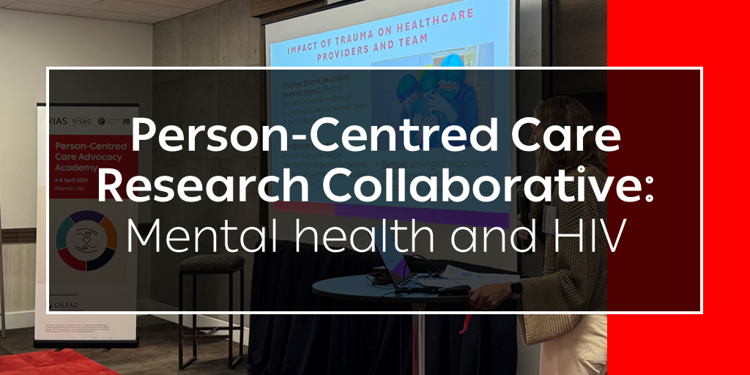
5 June 2025

Slide 2
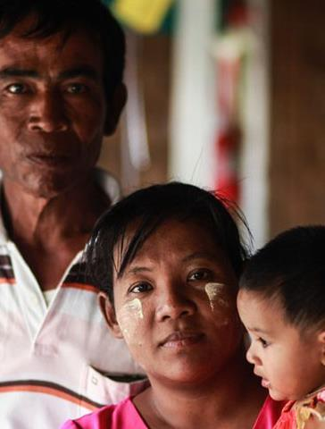
IAS Person-Centred Care programme
Prioritizes integrated, inclusive and responsive healthcare services
Focuses on changing needs, priorities and preferences of each person living with or affected by HIV
Empowers clients and is shaped by the many aspects of people’s intersectional identities
Notes:
This event has been organized by the IAS Person-Centred Care programme which is advocating for integrated, inclusive and responsive healthcare services that focus on the changing needs, priorities and preferences of individuals and empowers them to demand services that respect their identities.

Slide 3
What is the PCC Research Collaborative?
Mission: To work collectively and efficiently to fill evidence gaps around person-centred care for people living with HIV or vulnerable to HIV acquisition
Participants: Researchers, clients and providers who are championing evidence generation related to client-provider relationships, participatory approaches that value experts by experience as well as specific research and policy gaps related to person-centred care within the HIV response
Notes:
The PCC research collaborative has the mission of working collectively and efficiently at a global level to fill evidence gaps around person-centred care for people living with HIV or vulnerable to HIV acquisition. This collaborative will meet around three times a year and will convene researchers, clients and providers who are championing evidence generation related to client-provider relationships, participatory approaches that value experts by experience as well as specific research and policy gaps related to person-centred care within the HIV response

Slide 4
Our path towards strengthening PCC evidence
Launch in Jul 2024 at AIDS 2024 of the PCC Research Collaborative to start “identifying research gaps”
Survey in Nov 2024 to prioritize themes for future meetings
Online meeting in Feb 2025 on “assessing implementation” of PCC approaches
Today’s meeting on “mental health and HIV”
PCC roadmap @IAS 2025 to be published later in Jun 2025
Online meeting in Nov/Dec 2025 on ageing with HIV
Series of online meetings to be scheduled in 2026
PCC research agenda drafted and disseminated for comment
Series of five PCC stakeholder consultations in
2022-23 at AIDS 2022, virtually and at
IAS 2023
Commissioning of systematic literature review on client-provider relationships
in LMICs
Delphi survey of experts to refine global consensus statements and recommendations
Seed grants to document PCC good practice models from Africa and Asia in 2022

Slide 5
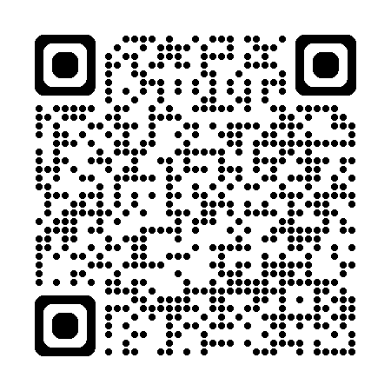
PCC Programme Research Outputs
Access PCC programme resources
Person‐centred interventions to improve patient−provider relationships for HIV services in low‐ and middle‐income countries: a systematic review - Beres - 2024 - Journal of the International AIDS Society
Scaling person‐centred psycho‐socioeconomic support for people living with HIV experiencing homelessness and unemployment in the Philippines: lessons learnt from the Open‐Doors Home programme - Olete - 2024 - Journal of the International AIDS Society
Bridging the access gaps in HIV services for female sex workers who use drugs with person‐centred DSD models in Nairobi, Kenya: lessons learnt - Mwangi - 2024 - Journal of the International AIDS Society
Identifying research gaps – Person-Centred Care Research Collaborative - Meeting July 2024 | IAS Plus
Assessing Implementation – Person-Centred Care Research Collaborative - Meeting February 2025 | IAS Plus
IAS 2025 poster presentation – “A roadmap to scale up person-centred care in the HIV response: Recommendations from a global consensus process”, Kigali, Rwanda – 17 July 2025
Notes:
Poster & Manuscript – PCC Consensus (delphi)
Seed grants – field notes
Ongoing support of alumni
PCC roadmap – IAS 2025 science

Slide 6
Today’s objectives
Understand the evidence base on PCC approaches to mental health and HIV
Discuss research gaps and priorities related to mental health and HIV to inform a research agenda and spark future collaborations

Slide 7
Today’s programme
Topic | Presenter
Overview of recent published research on mental health and HIV, including the exploration of research gaps | Sharon Kruger, Stellenbosch University, South Africa
Evaluating the Effectiveness of the Friendship Bench Intervention and Proposed Implementation Methodology for People Living with HIV in Displaced Rural Communities in Nigeria | Ngwibete Atenchong, University of Global Health Equity, Rwanda
The readiness and capacity for adopting and implementing trauma-informed care in HIV primary care clinics in the Southern United states | Jessica Sales, Emory University, United States
The integration of mental health care for people living with HIV: research from the TREAT Asia network | Jeremy Ross, TREAT Asia/amfAR – The Foundation for AIDS Research, Thailand
Overview of the EPIC community research program and other research programs focused on the mental health support needs of trans people and sex workers in Latin America | Ines Aristegui, Fundación Huésped, Argentina
Discussion Has global research on mental health adequately considered the specific intersectional needs of key populations living with or vulnerable to HIV acquisition? What is the status of current research on person-centred mental health interventions and treatment strategies for people living with HIV and experiencing mental health issues? What opportunities exist for collaboration on this topic among members of the PCC Research Collaborative? | Moderated by: Sharon Kruger, Stellenbosch University, South Africa

Slide 8

Meeting protocols
Stay on mute unless you are presenting, or the moderator calls on you
Use the chat to ask questions and share your thoughts on the points raised by the presenters
If you would like to ask a question or provide a comment during the discussion, raise your hand and wait to be called on

Slide 9

Overview of recent published research on mental health and HIV, including the exploration of research gaps
Sharon Kruger, Stellenbosch University, South Africa

Slide 10
Why mental health and HIV
Studies consistently indicate higher levels of mental health conditions among people living with HIV compared to the general population
Commonly reported mental health conditions include depression, anxiety, suicidal ideation, post-traumatic stress disorder, stigma, and psychological distress
These conditions can lead to increase in alcohol and substance use
Mental health interventions lead to:
    Improved mental health symptoms
    Improved levels of stress and coping
    Improved ART adherence
    Improved retention in care
    Improved health outcomes (reduced viral load)
    Reduced sexual behaviour vulnerabilities
    Reduced HIV transmission
References: 1) Hu, F. H., Liu, P., Jia, Y. J., Ge, M. W., Shen, L. T., Xia, X. P., & Chen, H. L. (2024). Prevalence of mental health problems in people living with HIV: a systematic review and meta-analysis. Psychology, Health & Medicine, 30(3), 397–413. https://doi.org/10.1080/13548506.2024.2424998 2) KJ Sikkema, MH Watt, AS Drabkin, CS Meade, NB Hansen, BW Pence (2010). Mental health treatment to reduce HIV transmission risk behavior: a positive prevention model. AIDS Behav. 2010 April ; 14(2): 252–262. doi:10.1007/s10461-009-9650-y.

Slide 11

Main themes from selected recent research studies
Intersection of social determinants of health, stigma and HIV outcomes
HIV, trauma and vulnerable populations
Mental health interventions for people living with HIV
Healthcare system and other structural service delivery innovations
Based on “mental health and HIV” literature review from past 12 months with goal of sparking reflections
Notes:
Methodology for literature review
150 articles selected from search of “mental health and HIV” in past 9 months related to person-centred care themes
abstracts, discussion and conclusions reviewed for key themes and suggestions of future research priorities
ChatGPT support for an initial analysis of key themes and supportive statements which was human verified
Refining of statements and verification from key citations, especially systematic reviews

Slide 12
1. Intersection of social determinants of health, stigma and HIV outcomes
Selected recent evidence
  Housing insecurity is linked to reduced ART adherence and poorer HIV clinical outcomes (Dombrowski, 2025).
  Polysubstance use correlates with food insecurity and unmet transportation needs (Avery, 2025).
  Pregnant women living with HIV in Africa show a high prevalence of antenatal depression related to intimate partner violence, poor adherence to ART and household food insecurity (Ferede, 2025).
  HIV stigma is strongly associated with depression, reduced quality of life and disengagement from healthcare (Nguyen, 2025).
  Experiences of racial discrimination predict poorer mental health among Black and Latinx people living with HIV in the United States (Lane, 2025) and (Thomas, 2024).
  Spirituality supports well-being but doesn't offset the impact of discrimination experienced by people living with HIV (Lane, 2025).
Notes:
- Factors such as housing, food insecurity, and transportation consistently affect HIV outcomes.
- Substance use intensifies vulnerabilities.
References
Dombrowski JC, Corcorran MA, Carney T, Parczewski M, Gandhi M. The impact of homelessness and housing insecurity on HIV. Lancet HIV. 2025 Jun;12(6):e449-e458. doi: 10.1016/S2352-3018(25)00048-7. Epub 2025 Apr 25. PMID: 40294620.
Avery A, Bitar Y, Hussey D, Hileman CO. Evaluating Connections Between Polysubstance Use, Social Drivers of Health, and Mental Health Symptoms in People With HIV. Open Forum Infect Dis. 2025 Apr 24;12(4):ofaf172. doi: 10.1093/ofid/ofaf172. PMID: 40290561; PMCID: PMC12024707.
Ferede YA, Zeleke AM, Assefa GW, Nigate GK, Tassew WC. Depression and associated factors among human immunodeficiency virus-positive pregnant women in sub-Saharan Africa: systematic review and meta-analysis. AJOG Glob Rep. 2025 Mar 12;5(2):100475. doi: 10.1016/j.xagr.2025.100475. PMID: 40292351; PMCID: PMC12032315.
Nguyen VHA, Tran TNA, Vu TT, Phan YTH, Nguyen TTN, Tran-Thien GP, Tran-Chi VL. The interplay of psychological distress, stigma, and social support in determining quality of life among Vietnamese people living with HIV. Discov Ment Health. 2025 Apr 7;5(1):48. doi: 10.1007/s44192-025-00171-z. PMID: 40192977; PMCID: PMC11977041.
This study supports prior research indicating a strong connection between anxiety, depression, and HIV stigma. PLWH who experience higher levels of anxiety and depressive symptoms tend to perceive greater stigma, often resulting in a negative self-image and increased emotional distress [36, 37]. This interplay between mental health and stigma is evident across diverse socio-demographic groups and is influenced by various contextual factors [36, 38]. Anxiety and depressive symptoms not only amplify the perception of stigma but also create a cyclical relationship, where stigma exacerbates mental health challenges, further increasing depressive and anxiety symptoms [37, 38]. These findings underscore the importance of addressing mental health as a critical component of interventions aimed at reducing HIV stigma.
Thomas JP, Ballew W, Kwong MH. Black Women's Experiences Along the HIV Care Continuum in the United States: A Scoping Review. Health Equity. 2024 Sep 12;8(1):608-617. doi: 10.1089/heq.2024.0020. PMID: 40125386; PMCID: PMC11464859.
This review found that:
Discrimination, stigma, and poverty intersect to create persistent disparities.
Healthcare navigation challenges and provider mistrust reduce engagement.
Villacis-Alvarez E, Haworth-Brockman M, Maier K, Sobie C, Pashe H, Baliddawa J, Daniels N, Murdock R, Russell R, Dan C, Woodhouse F, Cusson S, Patrick L, Schenkels M, Payne M, Kasper K, MacKenzie LJ, Ireland L, Templeton K, Keynan Y, Rueda ZV. "Our needs, our priorities, listen to us!" recommendations for improving HIV prevention and the cascade of care from people living with HIV in Manitoba, Canada: a qualitative study. BMC Health Serv Res. 2025 Apr 23;25(1):587. doi: 10.1186/s12913-025-12645-5. PMID: 40270026; PMCID: PMC12016453.
Lane BL, Sabuncu C, Yang Y, Okantey B, Campbell DN, Bryant TR, Sorkpor S, Millender E, Wong FY, Hall CDX. Discrimination and Mental Health Among Black and Latino People Living with HIV: Understanding the Role of Religion and Spirituality. AIDS Behav. 2025 Apr 17. doi: 10.1007/s10461-025-04720-z. Epub ahead of print. PMID: 40240721.

Slide 13
2. HIV, trauma and vulnerable populations
Selected recent evidence
  Post traumatic stress disorder (PTSD) symptom profiles among gay and other men who have sex with men can relate to increased condomless sex and vulnerability to HIV acquisition (Wiginton, 2025).
  Older people living with HIV face compounded risk of cognitive decline and ART side effects (Prakoeswa, 2025).
  Substance use and trauma histories elevate mental health burden and disengagement from healthcare (Tseng, 2025).
  Populations with mental healthcare needs underuse PrEP despite high interest (Bunting, 2025).
Notes:
- PTSD, adverse childhood experiences, and geriatric vulnerabilities are common among people living with HIV
- High interest in PrEP exists in populations with unmet mental health needs, but uptake is low.
- Trauma-informed and integrated care models are essential future priorities.
References
Wiginton JM, Murray SM, Tobin K, Baral SD, Sanchez TH. Posttraumatic stress disorder symptomology among gay, bisexual, and other sexually minoritized cisgender men in the United States: A latent class analysis. SSM Ment Health. 2025 Jun;7:100390. doi: 10.1016/j.ssmmh.2025.100390. Epub 2025 Jan 4. PMID: 40196235; PMCID: PMC11972599.
Brown C, Ogochukwu E, Nkemjika S, Kambona C, Chiang L, Annor FB. Adverse childhood experiences, positive childhood experiences, suicidal thoughts or behaviors and psychological distress among Kenyan youth-an exploratory analysis of the 2019 Kenya Violence Against Children and Youth Survey (VACS). Child Abuse Negl. 2025 Jun;164:107470. doi: 10.1016/j.chiabu.2025.107470. Epub 2025 Apr 19. PMID: 40253914.
Prakoeswa FRS, Maharani F, Bestari RS, Aisyah R, Ichsan B, Nursanto D, Listiansyah R, Tuanaya MRN. Aging and HIV: Recent Findings in Contributing Factors. AIDS Res Treat. 2025 Apr 11;2025:8814760. doi: 10.1155/arat/8814760. PMID: 40255985; PMCID: PMC12008487.
Bunting SR, Feinstein BA, Wilson A, Rivera J, Ehsan DA, Hazra A. Preferences for PrEP Implementation and Engagement in the HIV Pre-Exposure Prophylaxis (PrEP) Care Continuum among Patients Receiving Psychiatric Care in an Ending the HIV Epidemic Priority County. J Acquir Immune Defic Syndr. 2025 Apr 7. doi: 10.1097/QAI.0000000000003675. Epub ahead of print. PMID: 40192780.
Tseng TY, Mitchell MM, Chander G, Latkin C, Kennedy C, Borison SI, Son C, Knowlton AR. Quality of Life among Predominately African Americans with HIV Who Use Drugs: The Role of Patient-Provider Engagement in Mediating the Impacts of Depression and Healthcare Discrimination. AIDS Behav. 2025 Apr 17. doi: 10.1007/s10461-025-04717-8. Epub ahead of print. PMID: 40240720.

Slide 14
3. Mental health interventions for people living with HIV
Selected recent evidence
  Cognitive Behavioral Therapy (CBT)-based self-help programmes reduce depression and anxiety in people living with HIV in low- and middle-income countries (Vavani, 2025).
  Peer-led interventions (such as Shauriana, "we counsel each other") improve mental and sexual health among gay and other men who have sex with men (Jadwin-Cakmak, 2025).
  Peer navigators can effectively reach street-involved youth in diverse regions (Lee, 2025).
  Engaged client-provider relationships mediate mental health-related quality of life (Tseng, 2025).
  Telemedicine and mHealth platforms facilitate mental healthcare access in Africa (Agbeyangi, 2025).
  Social support mitigates negative effects of stigma and mental health symptoms (Nguyen, 2025).
Notes:
- Evidence supports the use of CBT-based self-help, peer-led models, telemedicine and mHealth to address mental health symptoms.
- Interventions show promise in low-resource settings and marginalized populations.
mHealth, or mobile health, refers to the use of mobile devices and wireless technologies to support health-related services, information, and interventions. It’s a subset of eHealth and includes tools like:
Mobile apps for managing medications, symptoms, or chronic diseases (e.g., HIV, diabetes)
SMS text reminders for appointments or medication adherence
Telehealth via smartphones, including video consultations
Wearable devices that track health metrics (e.g., heart rate, physical activity)
Data collection tools used in remote or underserved areas
In the context of HIV and mental health, mHealth often supports:
Treatment adherence (reminders, education)
Mental health check-ins (mood tracking, self-help tools)
Appointment scheduling
Real-time communication with providers
mHealth is especially valuable in low-resource or remote settings, where traditional healthcare infrastructure is limited but mobile phone access is widespread.
References
Vavani B, Garnefski N, van Luenen S, Dusseldorp E, Amone-P'Olak K, Spinhoven P, Kraaij V. A Booklet Self-Help Intervention for People Living with HIV and Depressive Symptoms in Botswana: A Randomized Controlled Trial. AIDS Behav. 2025 Apr 29. doi: 10.1007/s10461-025-04742-7. Epub ahead of print. PMID: 40299259.
Jadwin-Cakmak L, Harper GW, Ochieng E, Amico KR, Aloo T, Okutah F, Gumbe E, Olango K, Okall DO, Otieno FO, Odero W, Graham SM. Participatory development of the Shauriana program to integrate sexual health and mental health support for young gay and bisexual men and other men who have sex with men in Kenya. Adv Glob Health. 2025;4(1):2442813. doi: 10.1525/agh.2025.2442813. Epub 2025 Mar 6. PMID: 40296878; PMCID: PMC12036828.
Ferede YA, Zeleke AM, Assefa GW, Nigate GK, Tassew WC. Depression and associated factors among human immunodeficiency virus-positive pregnant women in sub-Saharan Africa: systematic review and meta-analysis. AJOG Glob Rep. 2025 Mar 12;5(2):100475. doi: 10.1016/j.xagr.2025.100475. PMID: 40292351; PMCID: PMC12032315.
Tseng TY, Mitchell MM, Chander G, Latkin C, Kennedy C, Borison SI, Son C, Knowlton AR. Quality of Life among Predominately African Americans with HIV Who Use Drugs: The Role of Patient-Provider Engagement in Mediating the Impacts of Depression and Healthcare Discrimination. AIDS Behav. 2025 Apr 17. doi: 10.1007/s10461-025-04717-8. Epub ahead of print. PMID: 40240720.
Agbeyangi AO, Lukose JM. Telemedicine Adoption and Prospects in Sub-Sahara Africa: A Systematic Review with a Focus on South Africa, Kenya, and Nigeria. Healthcare (Basel). 2025 Mar 29;13(7):762. doi: 10.3390/healthcare13070762. PMID: 40218059; PMCID: PMC11989057.
Lee EOJ, Tang TS, Fuentes-Bernal J, MacEntee K, Wachira J, Apondi E, Abramovich A, Oudshoorn A, Ayuku D, Kiptui R, Van Berkum A, MacDonald SA, Saarela O, Braitstein P. Optimal characteristics of peer navigators: adapting peer-based intervention with street-involved youth in Canada and Kenya with the aim of increasing HIV prevention, testing and treatment. Health Res Policy Syst. 2025 Apr 7;23(1):45. doi: 10.1186/s12961-025-01309-9. PMID: 40197481; PMCID: PMC11974212.
Nguyen VHA, Tran TNA, Vu TT, Phan YTH, Nguyen TTN, Tran-Thien GP, Tran-Chi VL. The interplay of psychological distress, stigma, and social support in determining quality of life among Vietnamese people living with HIV. Discov Ment Health. 2025 Apr 7;5(1):48. doi: 10.1007/s44192-025-00171-z. PMID: 40192977; PMCID: PMC11977041.

Slide 15
4. Structural healthcare system and other service delivery innovations
Selected recent evidence
  Person-centred care and support systems within healthcare services can improve mental health and HIV outcomes (Tseng, 2025), (Golub, 2025), (Jadwin-Cakmak, 2025).
  HIV status is often unrecorded in mental health records, impeding coordinated care (Heslin, 2025).
  Person-centred HIV prevention increases uptake of HIV testing and PrEP (Golub, 2025).
  Community-academic partnerships enhance real-world implementation success (Golub, 2025).
  Digital platforms enable HIV and mental healthcare service access despite provider shortages (Agbeyangi, 2025).
Notes:
- Peer navigation, digital health platforms, and community-academic partnerships demonstrate positive impact.
- Innovations often rely on local adaptation.
References
Golub SA, Hubbard S, de Roche AM, Barton SC, Merges A, Klein A. Community-academic implementation science partnership to examine adoption and impact of a patient-centered approach to sexual history. Psychol Serv. 2025 Apr 7. doi: 10.1037/ser0000935. Epub ahead of print. PMID: 40193513.
In 2021, the New York City Health Department initiated a multilevel implementation strategy, focused on promoting the GOALS Approach to Sexual History and Health-an antistigmatizing, client-centered strategy for sexual history taking-as a lever for increasing HIV intervention adoption, reach, and equity. Project Partnership to Increase Access, Client-Centered Care, and Equity in HIV Services is a community-academic implementation science partnership designed to investigate the impact of strategy enactment on implementation outcomes, including changes in intervention utilization (HIV testing, sexually transmitted infection testing, pre-exposure prophylaxis) in practice over time. These data suggest that a multilevel implementation strategy focused on delivery of antistigma, client-centered sexual histories may be a potent implementation strategy for enhancing HIV prevention intervention adoption.
Lee EOJ, Tang TS, Fuentes-Bernal J, MacEntee K, Wachira J, Apondi E, Abramovich A, Oudshoorn A, Ayuku D, Kiptui R, Van Berkum A, MacDonald SA, Saarela O, Braitstein P. Optimal characteristics of peer navigators: adapting peer-based intervention with street-involved youth in Canada and Kenya with the aim of increasing HIV prevention, testing and treatment. Health Res Policy Syst. 2025 Apr 7;23(1):45. doi: 10.1186/s12961-025-01309-9. PMID: 40197481; PMCID: PMC11974212.
Agbeyangi AO, Lukose JM. Telemedicine Adoption and Prospects in Sub-Sahara Africa: A Systematic Review with a Focus on South Africa, Kenya, and Nigeria. Healthcare (Basel). 2025 Mar 29;13(7):762. doi: 10.3390/healthcare13070762. PMID: 40218059; PMCID: PMC11989057.
Tseng TY, Mitchell MM, Chander G, Latkin C, Kennedy C, Borison SI, Son C, Knowlton AR. Quality of Life among Predominately African Americans with HIV Who Use Drugs: The Role of Patient-Provider Engagement in Mediating the Impacts of Depression and Healthcare Discrimination. AIDS Behav. 2025 Apr 17. doi: 10.1007/s10461-025-04717-8. Epub ahead of print. PMID: 40240720.
Jadwin-Cakmak L, Harper GW, Ochieng E, Amico KR, Aloo T, Okutah F, Gumbe E, Olango K, Okall DO, Otieno FO, Odero W, Graham SM. Participatory development of the Shauriana program to integrate sexual health and mental health support for young gay and bisexual men and other men who have sex with men in Kenya. Adv Glob Health. 2025;4(1):2442813. doi: 10.1525/agh.2025.2442813. Epub 2025 Mar 6. PMID: 40296878; PMCID: PMC12036828.
Heslin M, Hunt O, Tassie E, Jewell A, King H, Covshoff E, Campbell L, Croxford S, Pittrof R, Sullivan A, Williams J, Newson M, Trevillion K, Smith S, Hughes E, Stewart R. Recording of HIV diagnosis in mental health records: A data linkage cohort study. PLoS One. 2025 Apr 23;20(4):e0320392. doi: 10.1371/journal.pone.0320392. PMID: 40267086; PMCID: PMC12017511.

Slide 16
Evaluating the Effectiveness of the Friendship Bench Intervention and Proposed Implementation Methodology for People Living with HIV in Displaced Rural Communities in Nigeria
Presenter: Atenchong Ngwibete

Slide 17
Introduction
The Friendship Bench (FB) is an evidence-based psychological intervention developed by Dr Dixon Chibanda in Zimbabwe in 2006.
It addresses unmet mental health needs, with over 13% of Zimbabweans experiencing mental health issues and a suicide rate twice the regional average.
Developed to address common mental heath conditions such as depression and anxiety.
FB uses trained lay health workers (LHWs) to deliver problem-solving therapy.
Objectives:
- Integrate mental healthcare in communities
- Reduce stigma and improve access
- Provide culturally appropriate care

Slide 18
Essential Elements of the Friendship Bench
1. Problem-Solving Therapy (PST):
Individual sessions with LHWs
Focus on solvable problems and SMART goals
Culturally grounded terms: 'Kufungisisa' (thinking too much), 'Mwoyo unorwadza' (heavy heart)
2. Tiered Support Structure: LHWs supervised by mental health professionals
3. Support including weekly text: Weekly encouragement
4. Group Sessions (Circle Kubatana Tose): Peer support and income-generating activities

Slide 19
The Friendship Bench Process
Screening using SSQ¹ and PHQ-9²
Individual counselling sessions
Problem identification and exploration
Action planning and implement-ation
Follow-up and group support
1. SSQ: Shona Symptoms Questionnaire
2. PHQ-9: Patient Health Questionnaire-9 is a tool used to screen for depression and anxiety

Slide 20
Therapeutic and Community Activities
Step 1
Problem Identification (1 hr)
Step 2
Problem Exploration (30–45 mins)
Step 3
Reassurance (30–45 mins)
Step 4
Action Planning (30–45 mins)
Step 5
Implementation and Follow-up
Step 6
Group sessions

Slide 21

Mini review of Evidence on the effectiveness of friendship benches
Photo Credit: The Friendship Bench Zimbabwe
Notes:
Credit: The Friendship Bench Zimbabwe

Slide 22
Title | Country | Population | Methodology | Key Findings
Effect of the Friendship Bench Intervention on ART Outcomes and Mental Health Symptoms in Rural Zimbabwe(Haas et al. 2023) | Zimbabwe | Adults with HIV and CMD (SSQ-14 ≥9) in rural clinics | Cluster-randomized trial across 16 clinics; n=516; SSQ-14 & PHQ-9 used; MEMS used to track ART adherence. | -No significant effect on ART adherence or viral suppression. - Statistically significant reduction in CMD symptoms (SSQ-14) at 3, 6, and 9 months. - No PHQ-9 score difference across timepoints. - No mental health improvements at 12 months
The Friendship Bench to Improve Quality and Access to Counseling in South Africa (Taliep et al. 2023 | South Africa | Community-based counselors and service users (Focused on system/process) | Qualitative evaluation of pilot implementation using focus groups, interviews, and field observation. | Positive perceptions on increased access, trust, and community integration. - Strengthened workforce capacity and collaboration. Promote collaboration between lay health workers and clinical teams
Effect of a Primary Care–Based Psychological Intervention on Symptoms of Common Mental Disorders in Zimbabwe (Chibanda et al., 2016) | Zimbabwe | Adults with CMDs attending primary care | Cluster randomized controlled trial (RCT) | FB significantly reduced symptoms of depression and anxiety compared to standard care (PHQ-9 score difference: −2.86). Sustained effect at 6 months.
Implementing a psychological intervention in a low-resource setting: a qualitative study of youth and counsellor experiences from the Friendship Bench in Zimbabwe (Maunganidze et al., 2023) | Zimbabwe | Adolescents and youth aged 16–24 | Qualitative study (in-depth interviews and FGDs) | Youth found FB safe, acceptable, and beneficial for resolving problems; Lay counsellors noted improved confidence and social connectedness Youth desire more privacy in settings like schools; difficulty accessing sessions

Slide 23
RE-AIMing the Friendship Bench to support mental health in Zimbabwe: a comparative case study (Campbell et al., 2022) | Zimbabwe | Adults with CMDs in primary care clinics | Mixed-methods RE-AIM case study (comparative case analysis across 6 clinics) | FB was effective and feasible; high Reach and Adoption in most clinics; Integration with health systems was crucial Some sites struggled with staff retention and supervision challenges
Feasibility of a peer-delivered psychological intervention for men living with HIV and depression in Malawi (Wroe et al., 2024) | Malawi | Men living with HIV and depression | Feasibility study (pilot implementation with qualitative interviews and surveys) | Adapted FB was feasible, acceptable, and led to improved mental health and ART adherence Some men preferred group sessions over individual counseling; challenges with stigma and masculinity norms
Experiences of Counsellors Offering Problem-Solving Therapy for CMHDs at the Youth Friendship Bench in Zimbabwe (Ndetei et al., 2021) | Zimbabwe | Lay health workers/counsellors working with youth | Qualitative study (interviews with lay counsellors) | Counsellors reported improved problem-solving skills and professional growth; good rapport with clients aided success Frustration with limited referral pathways and systemic support
The Friendship Bench as a brief psychological intervention with peer support in rural Zimbabwean women: a mixed methods pilot evaluation (Fernado etal 2012) | Zimbabwe | Rural women living with HIV (among others) |  | Lay health worker-delivered problem-solving therapy and peer support were acceptable and showed promising results in improving mental health symptoms.

Slide 24
Evidence: Strengths & Gaps
Key Strengths and Proven Impact
Significant Reduction in Common Mental Disorder (CMD) Symptoms
Demonstrated Short-Term Effectiveness
Positive Perception by patients (Trust and community integration)
Effective Task-Shifting & Workforce Development
Empowers Patients with Problem-Solving Skills
Seamless Integration into Primary Healthcare
Very acceptable for certain demographics: women and youths

Slide 25
Evidence: Strengths & Gaps
Areas for Further Study
Further evaluation on the long-term effects of depression and anxiety.
Explore research designs that ensure privacy, especially for youth and men.
How could the FB intervention address the mental health challenges of LGBTQ
Investigate the unexplained decline in maternal-child interaction scores.
Address challenges related to the retention and sustainability of the intervention.
Conduct further research on its effect on ART adherence.
Further research in other countries; West , Central and Northern Africa
Develop designs that create a robust referral pathway.
Perform a comprehensive cost-benefit analysis of the intervention

Slide 26

Status of Person-Centred Mental Health Research for people living with HIV
PCC is gaining traction, but there is still a lack of scalable, community-driven mental health models tailored for people living with HIV.
Most interventions are clinic-based, with limited inclusion of service users in design or implementation.
Friendship Bench presents a scalable, community-embedded PCC model aligned with WHO mental health integration goals.

Slide 27
Proposed Methodology
Study design: Cross-sectional interventional mixed-method study.
Study Setting: FSP Clinic, Daudu, Benue State, located in a displaced settlement.
Target Population: About 522 clients and facility care providers, expert clients as LHAs
Inclusion Criteria: People living with HIV, 18+, being on ART regimen for at least 3 months.
Exclusion Criteria: Severe cognitive impairment or acute health conditions that impede participation. (Severe depression or other mental health issues, Patients with Advanced HIV Disease (AHD))
Intervention
Friendship Bench program (By LHA) approach for 4–6 weeks (Chibanda et al., 2015) +
PCC: PCC training for facility staff and;
Client education aimed at improving health literacy and promoting self-advocacy (assertive communication skills, shared decision-making skills, and navigating the healthcare system)
Notes:
This research ensures a participatory design and inclusivity as the clients, care providers, and other
Stakeholders are involved in the research design, ensuring its co-development.
Implementation allows for the inclusivity of participants through feedback sessions.

Slide 28
Measurements & Tools
A checklist input in KOBO to collect quantitative data from cards and existing tools:
a. Sociodemographic characteristics Source: ART Care cards.
b. Number of people living with HIV diagnosed common mental health conditions and linked to Mental Health Support Tools: PHQ-9 and SSQ
c. Changes in ART Adherence and Opportunistic Infections (OIs) Source: ART Care cards
d. The Care Engagement Tool: Assessing Provider-Client Encounters. We will use a post-encounter feedback assessment tool, which will individually assess providers and clients' communication, involvement in the care process, and satisfaction.
e. We will collect qualitative data using an interview guide with LHAs, care providers, and selected participants to assess the acceptability and impact of the model.

Slide 29
Opportunities for collaboration on the FB among members of the PCC Research Collaborative?
Multi-country evaluations of PCC mental health models like FB for people living with HIV.
Joint development of culturally validated mental health screening tools and PCC tools
Policy advocacy: Collaborate on briefs to promote PCC mental health integration in national HIV strategies.

Slide 30


Slide 31
The readiness and capacity for adopting and implementing trauma-informed care in Hiv primary care clinics in the Southern United states
Jessica M. Sales, PhD
Emory University
June 5, 2025

Slide 32
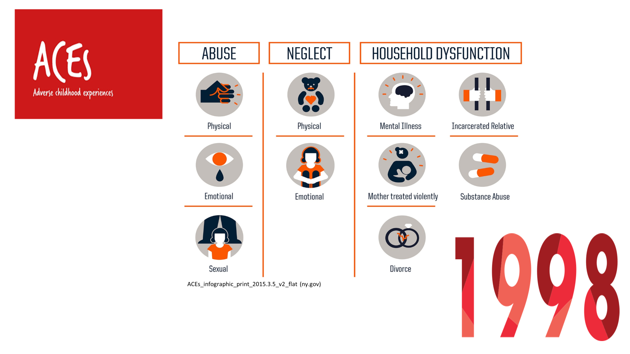
A bit about me…..

Slide 33

Trauma Stock Photo - Download Image Now - Shock, Emergency Room, Mental Health - iStock (istockphoto.com)
Traumatic experience: event(s)/circumstances “experienced by an individual as physically or emotionally harmful or life threatening and that has lasting adverse effects on the individual's functioning and mental, physical, social, emotional, or spiritual well-being.”
- Substance Abuse and Mental Health Services Administration (SAMHSA)
Trauma includes (but is not limited to):
  childhood abuse, sexual assault, intimate partner violence
  school violence, community violence, bullying
  military trauma, natural disasters, forced displacement
  traumatic grief and separation
https://www.samhsa.gov/trauma-violence

Slide 34


Trauma among people with HIV?
Trauma is highly prevalent among people with HIV (PWH)
  Childhood sexual and physical abuse
  Intimate partner/interpersonal violence
  Trauma post-HIV-diagnosis higher than general population
  Community-level trauma …racism, homophobia, transphobia, etc

Slide 35
Why address trauma among people with HIV In HIV CARE SETTIngS?
HIV Health Outcomes
↓ HIV care and ART adherence
↑ HIV viral load, ↑ decline CD4 count
↑ opportunistic infections
↑ AIDS-related mortality
Mental/behavioral Health
↑ PTSD, depression, anxiety, suicidality
↑ Substance misuse
Trauma
Non-HIV health outcomes
↑ Fatigue and impaired daily functioning
↑ Psychosomatic complaints
↓Quality of life
↑ Immune activation
Sexual risk
↓ Condom use
↑ Sexually transmitted infections
↑ Unintended pregnancy
↑ High-risk sex

Slide 36
Why address trauma in HIV primary care clinics?
HIV care visits are often spent dealing with the effects of ongoing trauma
Ryan White-funded HIV care clinics address whole person care
HIV care programs often have existing resources to do so
  Providers and staff have established relationships with patients.
  Providers and staff are trained to ask difficult questions respectfully and sensitively.
  Established networks /collocated services: HIV clinical care, mental health, substance misuse counseling, case management, housing and legal support, peer support.

Slide 37
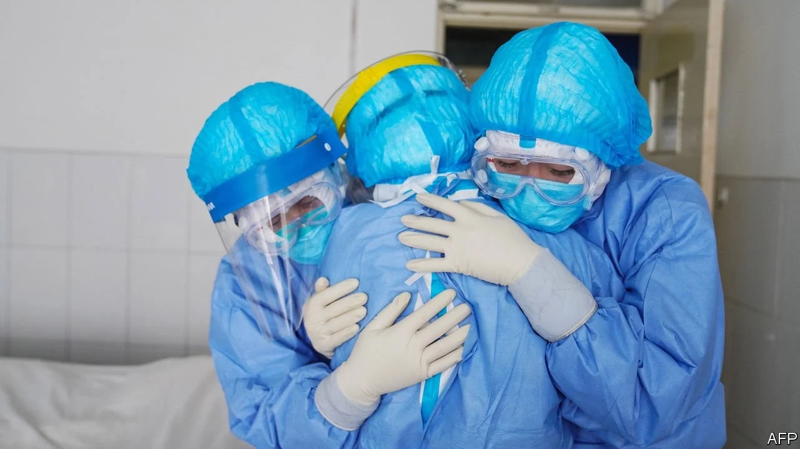
Impact of Trauma on Healthcare Providers and TEam
Vicarious trauma (secondary traumatic stress): Effect on perspective/worldview through indirect exposure to a traumatic event (e.g., narration).
Compassion fatigue: emotional/physical fatigue from feeling compassion for patients without adequate time away to refuel and care for self.
www.economist.com
Burnout: prolonged response to chronic emotional and interpersonal stressors on the job

Slide 38
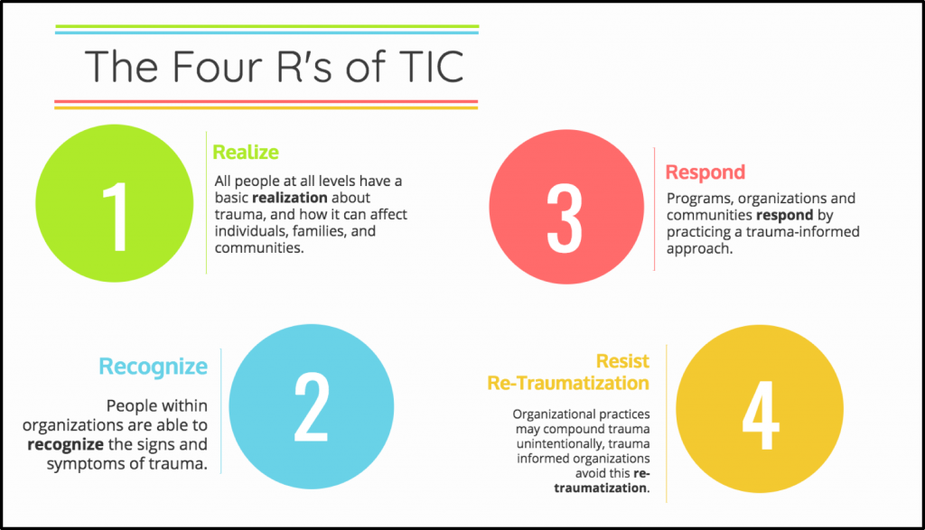
What is Trauma-Informed Care (TIC)?
Image from Trauma Informed Occupational Therapy - The OT Toolbox

Slide 39

Trauma-informed CarE:
Key Domains
https://www.psychologytoday.com/us/basics/teamwork
Substance Abuse and Mental Health Services Administration (SAMHSA)

Slide 40

Methods
Setting: DHHS Region IV Ryan White Clinics
Identification/Recruitment:
  Publicly available data for all Region IV RW-funded grant holders and state-level RW grant holders → emailed directly
  Region IV Southeast AIDS Education and Training Centers newsletter
  RW National Clinical Conference (Dec 2019, New Orleans)
Emailed link to web-based survey: TI-HIV Care Organizational Assessment and Consolidated Framework for Implementation Research (CFIR) constructs
Subset of respondents were purposively sampled for key informant interviews to ensure representation by urbanicity, state, clinic type, and role
  Recorded, conducted by Zoom, transcribed, and dual-coding (underway)
  Explored barriers and facilitators to TIC implementation

Slide 41
TIC Training and Staff Support is a Key Gap for RYAN WHITE CLINICS
  321 admin/staff/providers from 46 Ryan White HIV Clinics in Southeastern US
  Overall, clinics are engaging in TIC practices across all TIC domains
  Training and workforce development / staff support was the area with the biggest gap – especially for providers
µ=4.08; SE =0.07
µ=3.96; SE =0.07
µ=3.92 SE =0.09
µ=3.75; SE =0.08
µ=3.54; SE =0.12
Kalokhe AS et al. AIDS Care. 2022
Kalokhe AS et al. AIDS & Behavior. 2022

Slide 42
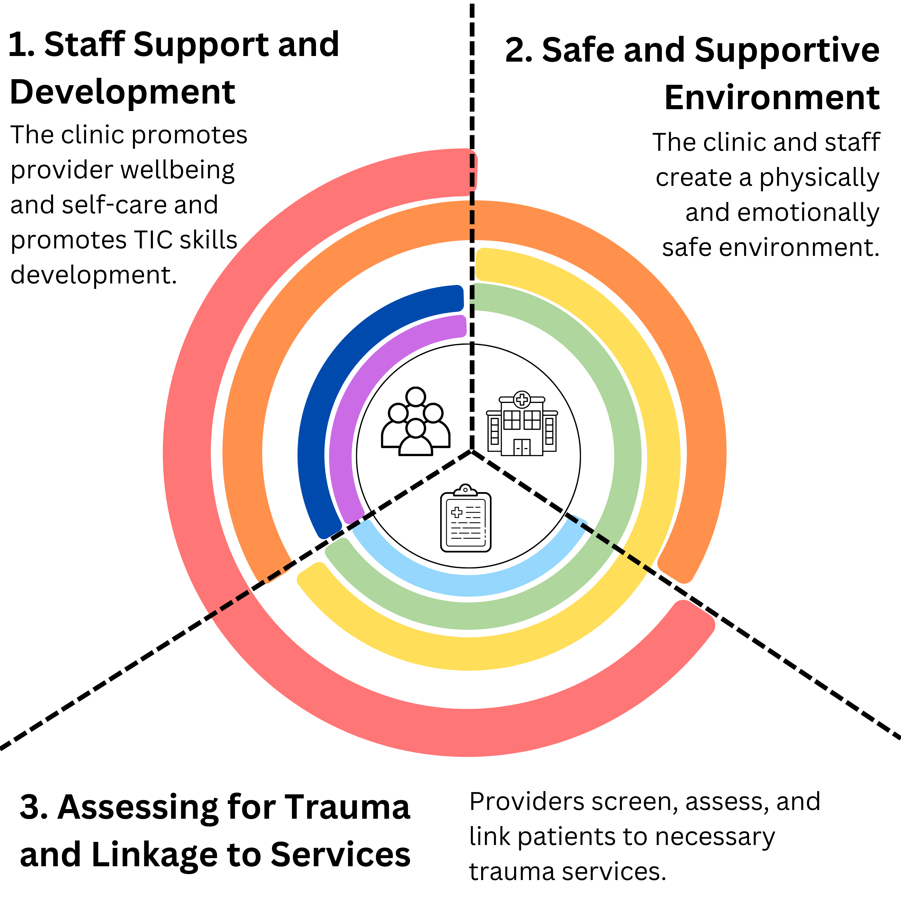
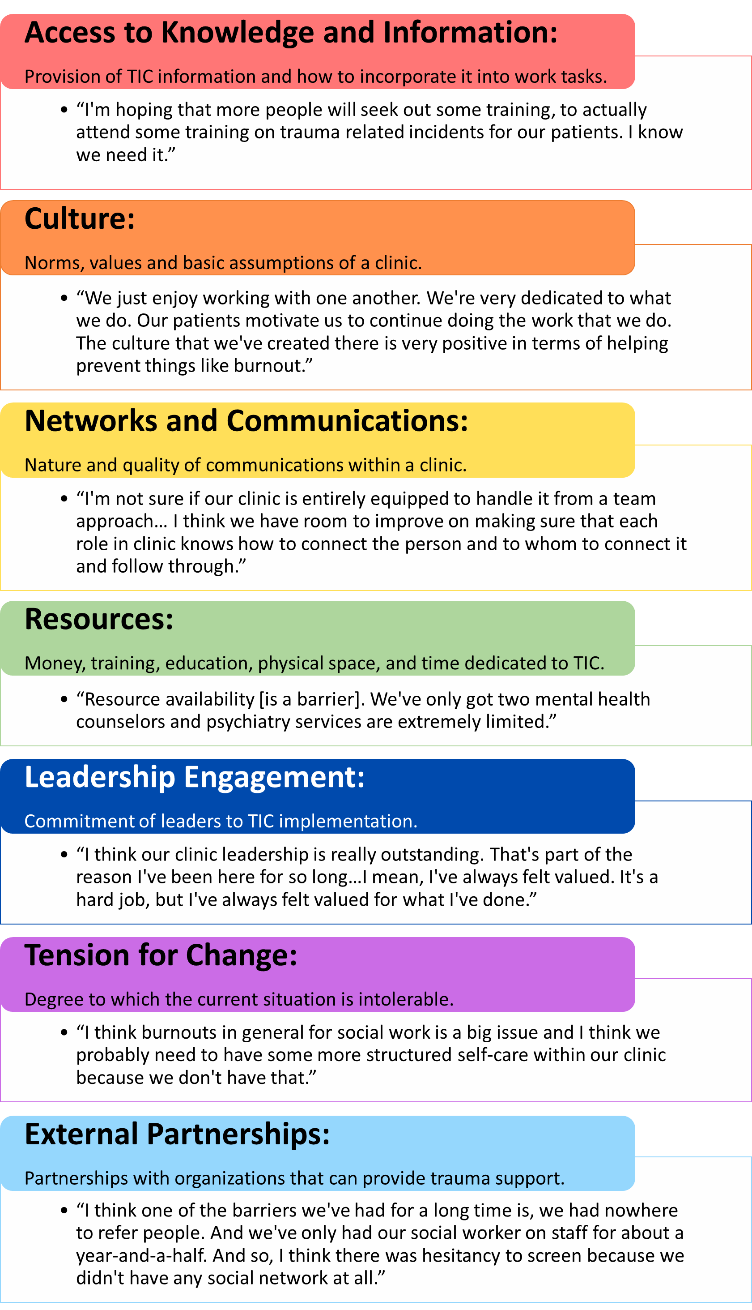
Trauma-Informed Care Components & implementation Determinants
Piper et al, 2024 Global Implementation Research and application

Slide 43
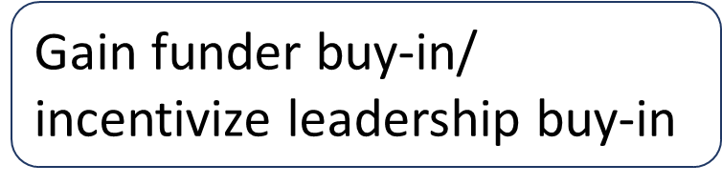
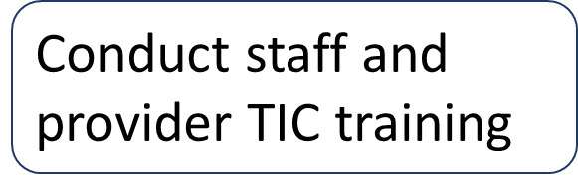
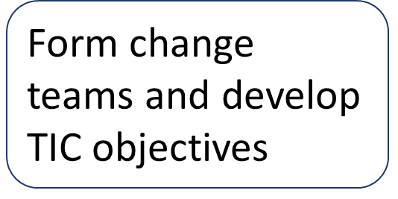


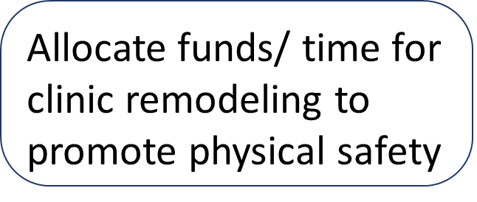
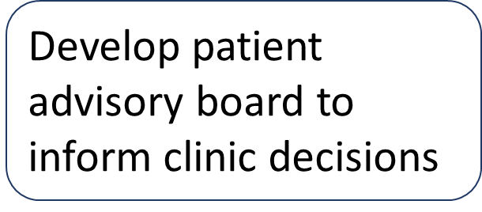

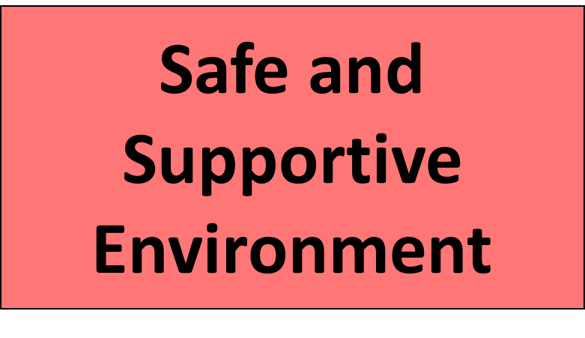
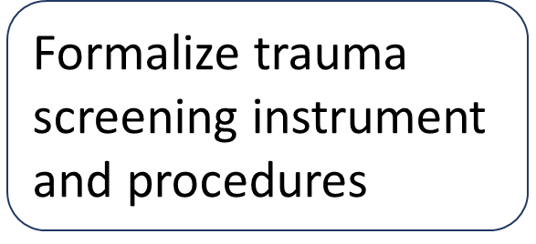
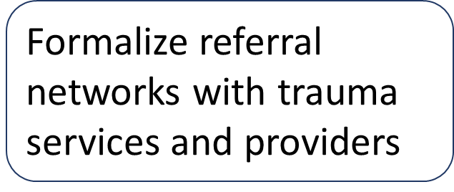

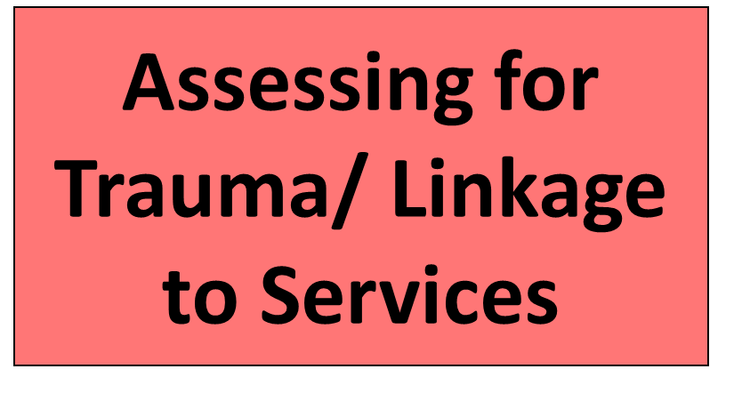
Implications: Roadmap to Trauma-Informed Care

Slide 44
Conclusions
Ryan White Clinics across the Southeastern US are employing trauma-informed care practices
Training and Workforce Development is a key gap in TIC implementation
  Need for TIC training (trauma, screening, triggers, re-traumatization)
  Need to prioritize staff support (team meetings on trauma impact, self-care, debriefs)
Barriers to TIC implementation differed across TIC domains, which indicates different strategies will be necessary to facilitate the adoption/strengthening of different domains of TIC in HIV care settings

Slide 45

Questions?
Thank you!
This research was supported by a grant from the NIMH to Jessica M. Sales and Ameeta Kalokhe (R56MH119903)
Thanks to our study team and to all of the staff, providers and administrators who took part in this study.
Jessica M. Sales
jmcderm@emory.edu

Slide 46
The integration of mental health care for people living with HIV: research from the TREAT Asia network
Dr. Jeremy Ross, Director of Research, TREAT Asia amfAR
Person-Centred Care Research Collaborative – Mental health and HIV
Virtual Meeting, 5 June 2025

Slide 47
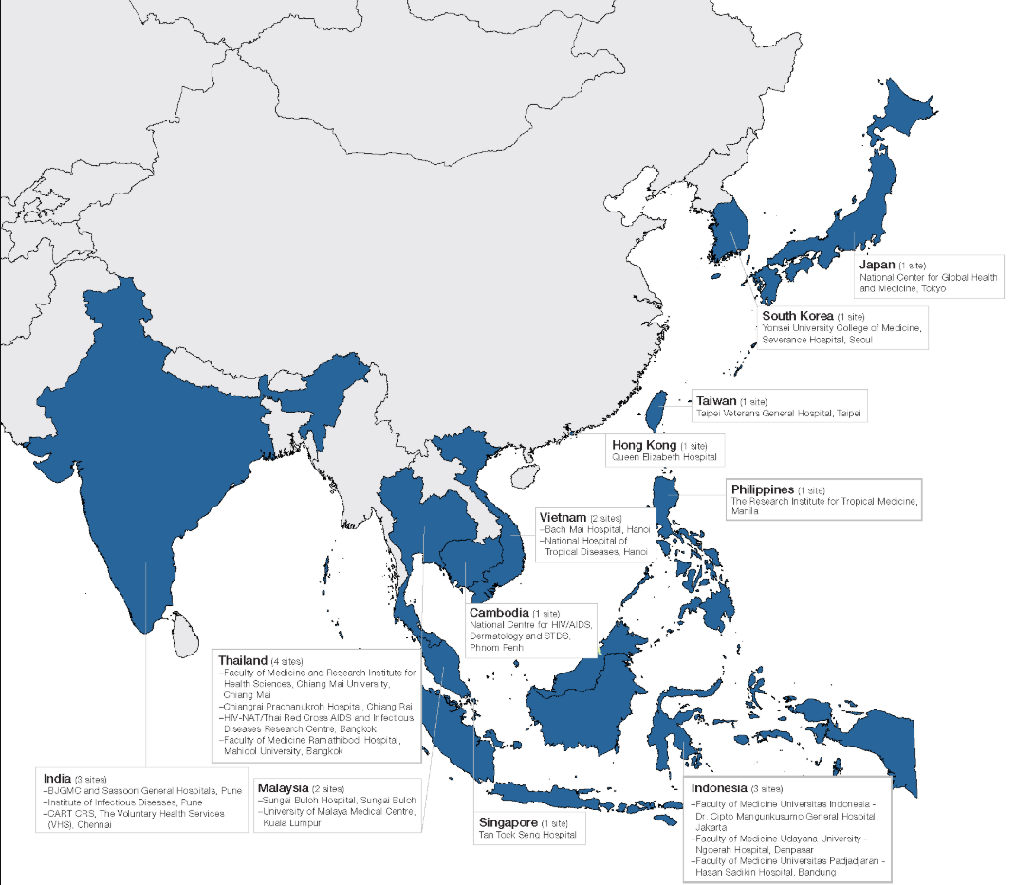
The TREAT Asia network
Collaborative network of clinics, hospitals, research institutions, and civil society
Working to ensure safe and effective delivery of HIV treatments to adults and children across the Asia-Pacific through research, education, community advocacy and policy.
Research: 21 adult and 18 pediatric clinical sites in 12 countries; NIH (and Viiv) funding

Slide 48
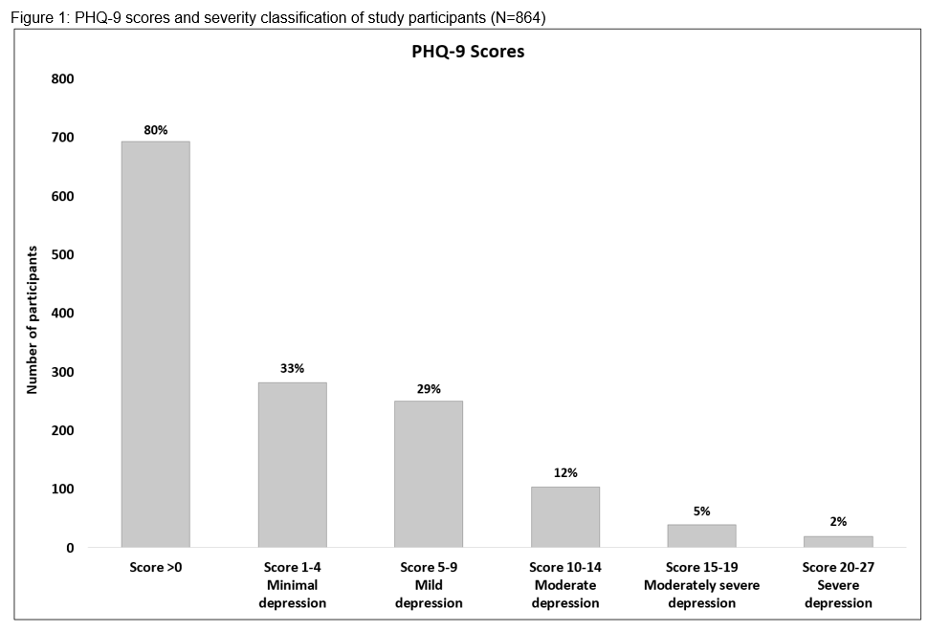
High prevalence of MHDs among PWH
Adult PWH (n=864) @ 5 TREAT Asia clinical sites
  Enrolled Jul 2019 - Jun 2020; median age 39; 88% male; 97% on ART
Moderate-to-severe depressive symptoms in 19% (PHQ-9)
  19% recent suicidal ideation (PHQ-9 Q9 score >1)
Ross JL, et al. Prevalence and Risks of Depression and Substance Use Among Adults Living with HIV in the Asia-Pacific Region. AIDS Behav. 2022 Dec;26(12):3862-3877. doi: 10.1007/s10461-022-03714-5. Epub 2022 Jun 6. PMID: 35668223; PMCID: PMC9170121.

Slide 49
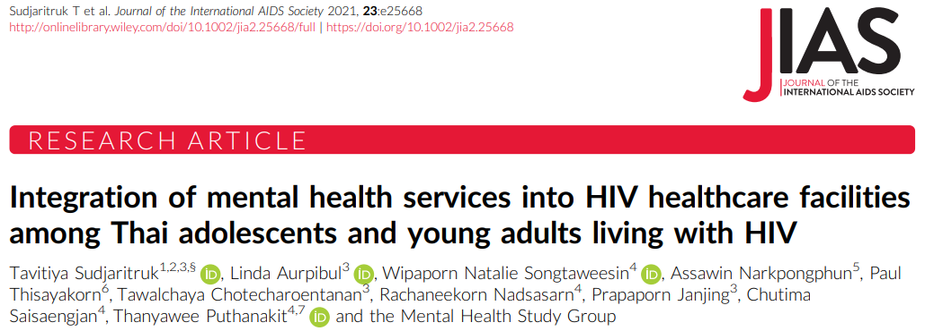
@baseline: 11% significant depressive symptoms; 7% anxiety; and 14% suicidality (recent suicidal thoughts or ever contemplated or attempted suicide)
18.7% hazardous or harmful alcohol use (AUDIT >8)
ALHIV (n=150) @ 2 TREAT Asia pediatric HIV centers in Thailand (Chiang Mai University, Chulalongkorn University)
Median age 19; 73% HIV RNA <50 copies/mL; median CD4 580 cells/mm³

Slide 50
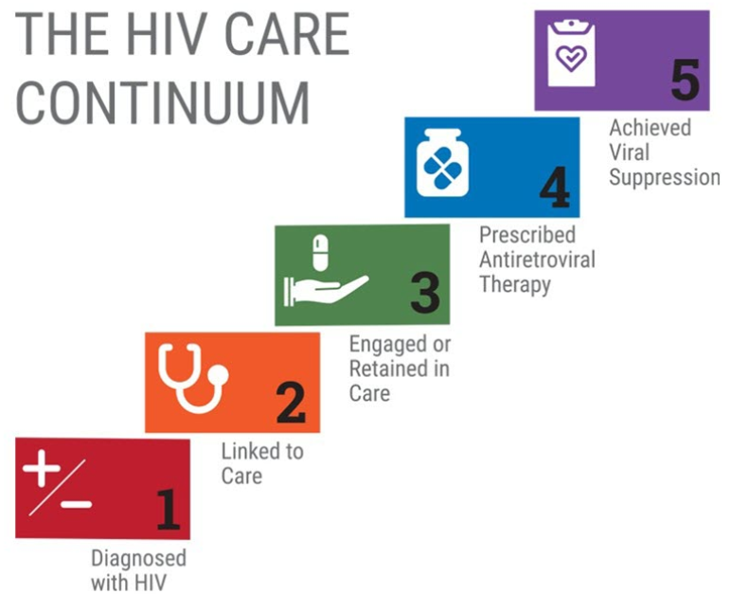
Negative impact of MSDs across HIV care continuum
Lower viral suppression
Poor ART adherence
Delayed ART initiation
Poor HIV care retention
Delayed linkage to HIV care
Delayed HIV testing
Increased risk behaviors and higher risk of HIV acquisition

Slide 51
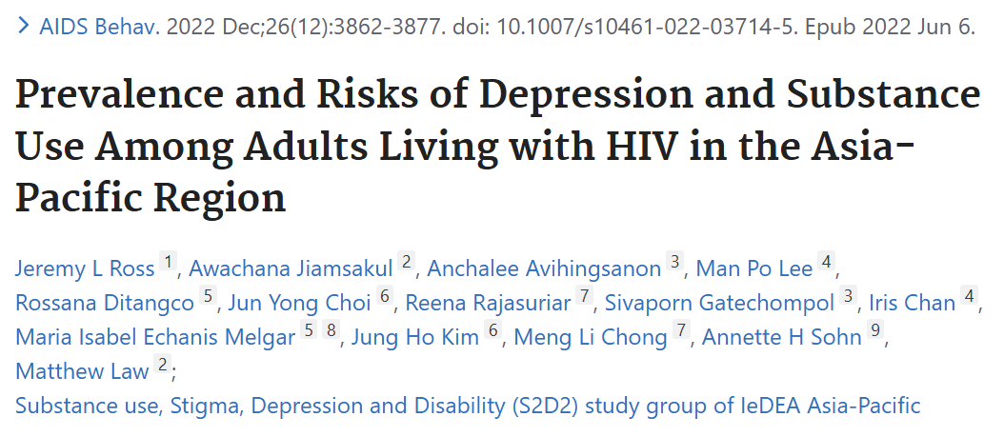
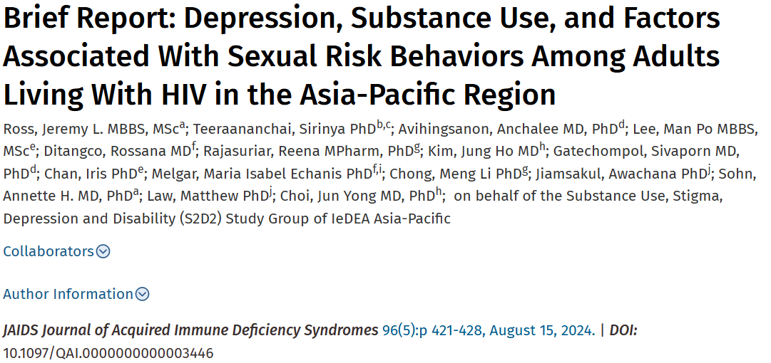
864 adult PWH @ 5 TREAT Asia clinical sites
Median age 39; 88% male
Suboptimal ART adherence associated with moderate-severe depressive symptoms (aOR=2.41, 95% CI 1.23-4.75, p=0.011)
723 adult PWH; median age 38; 89% male
37% had medium- to high-risk sexual practices
More likely in participants with moderate-to-severe depression (aOR 2.09, 95% CI: 1.17 to 3.74)

Slide 52
MHDs associated with other negative outcomes
Mortality: MHD associated with an increased risk of mortality among PWH (Pence 2018, Haas 2020)
Stigma: MHDs associated with higher levels of stigma among adult PLHIV populations in IND, CB, and CH (Charles 2012; Yi 2015; Li 2016)
Quality of life: adult PWH in India with severe depression experienced 2.7 times poorer QoL (Charles 2012)
Frailty: depressive symptoms account for a higher prevalence of frailty among older PWH in China (Ding 2017)

Slide 53
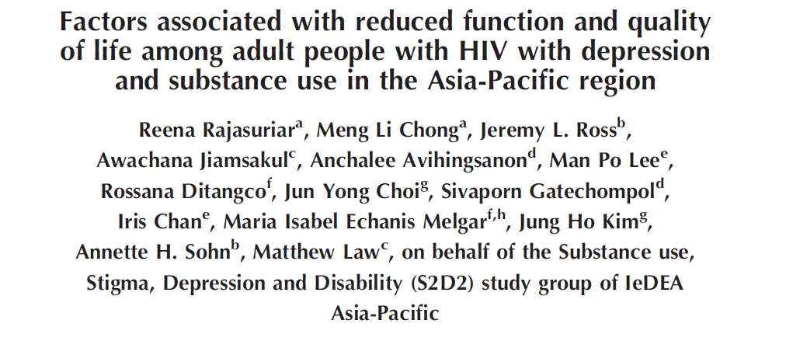
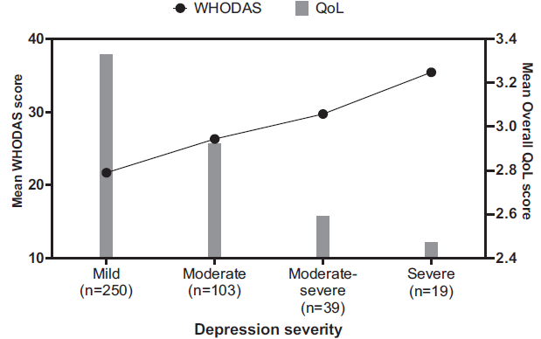
753/864 (87%) participants screened positive for either depression or SU @ 5 TREAT Asia sites
Increase in mean WHODAS 2.0 scores (indicating greater disability) and decline in mean QoL scores found with increasing severity of depressive symptoms
Fig 1b. Trends in mean WHODAS 2.0 and overall QoL scores by depression symptom severity assessed using the PHQ-9 in PWH screened positive for depression in the cohort (n=411)

Slide 54
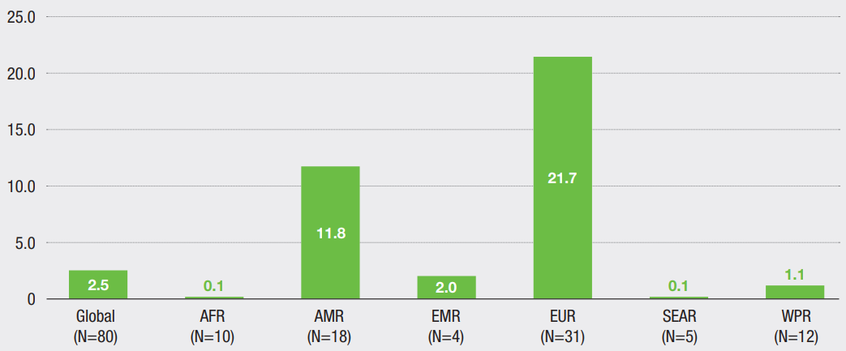
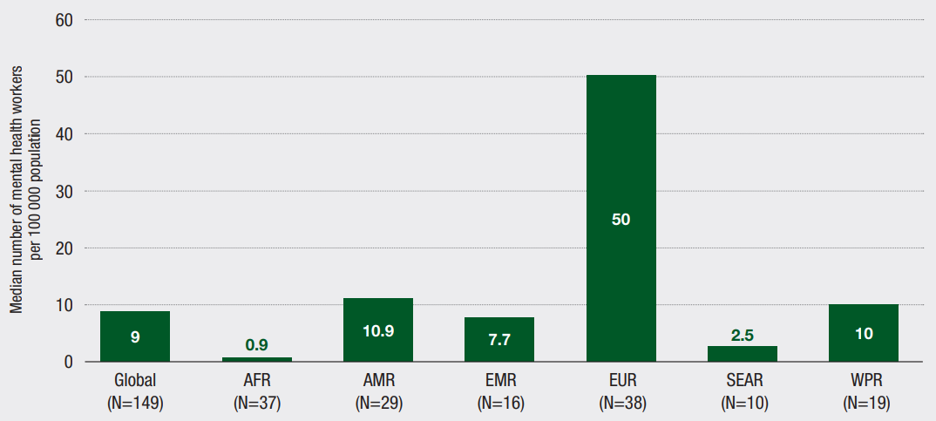
Limited financial and human resources for MH care
World Health Organization. Mental health atlas 2017. Geneva: WHO 2018. License: CC BY-NC-SA 3.0 IGO.
MH care funding in SEA and WPR below global average; MH workforce per 100,000 population well below the global average in SEAR

Slide 55
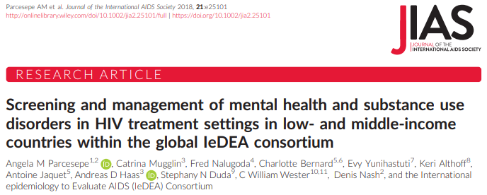
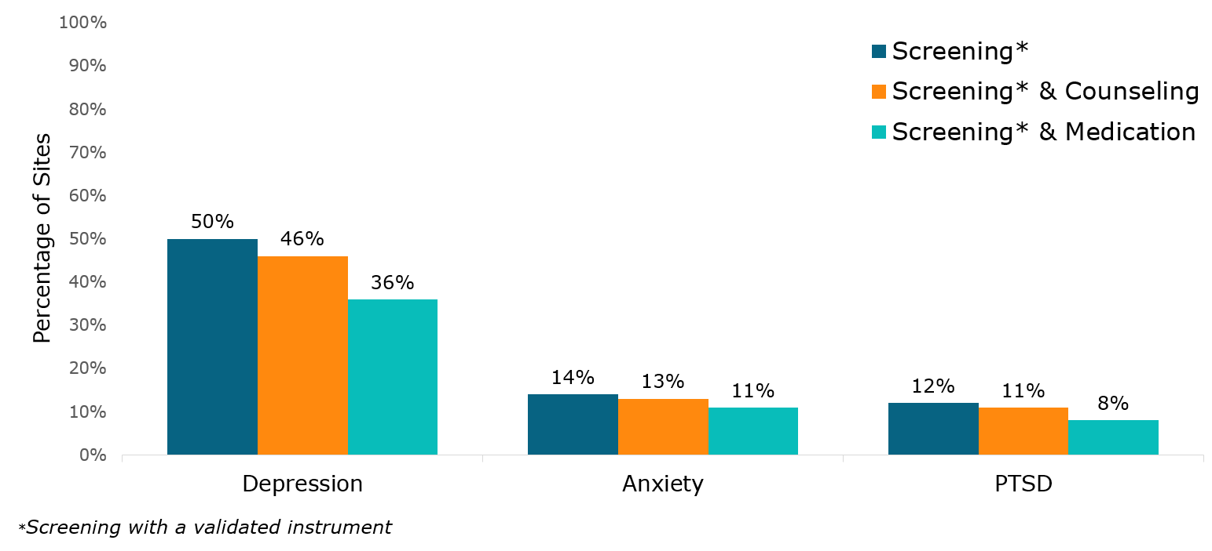
Integration of MH screening and treatment limited
2018 and 2020 assessments of ~90 IeDEA HIV site clinical capacities
Asia-Pacific sites had the lowest rates of screening: 43% for depression; 11% for PTSD
Parcesepe A, et al. Screening and treatment of common mental disorders at HIV clinics participating in the International epidemiology Databases to Evaluate AIDS (IeDEA) consortium. Abstract, AIDS 2022.

Slide 56
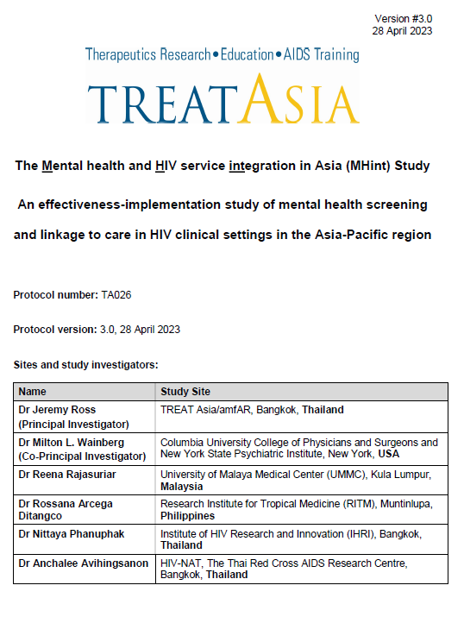
The Mental health and HIV service integration (MHint) study
Mixed-methods implementation-effectiveness hybrid @ 4 sites: UMMC (Malaysia); RITM (Philippines); HIV-NAT and IHRI (Thailand)
  Identify patient and provider-level barriers and facilitators to implementation of MH screening and linkage to care interventions in HIV clinical setting
  Develop and implement ‘optimal’ MH screening and linkage to care interventions/approaches
  Assess the implementation and effectiveness of the MH screening and linkage to care strategies at the study clinics

Slide 57
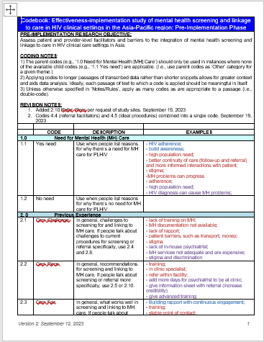
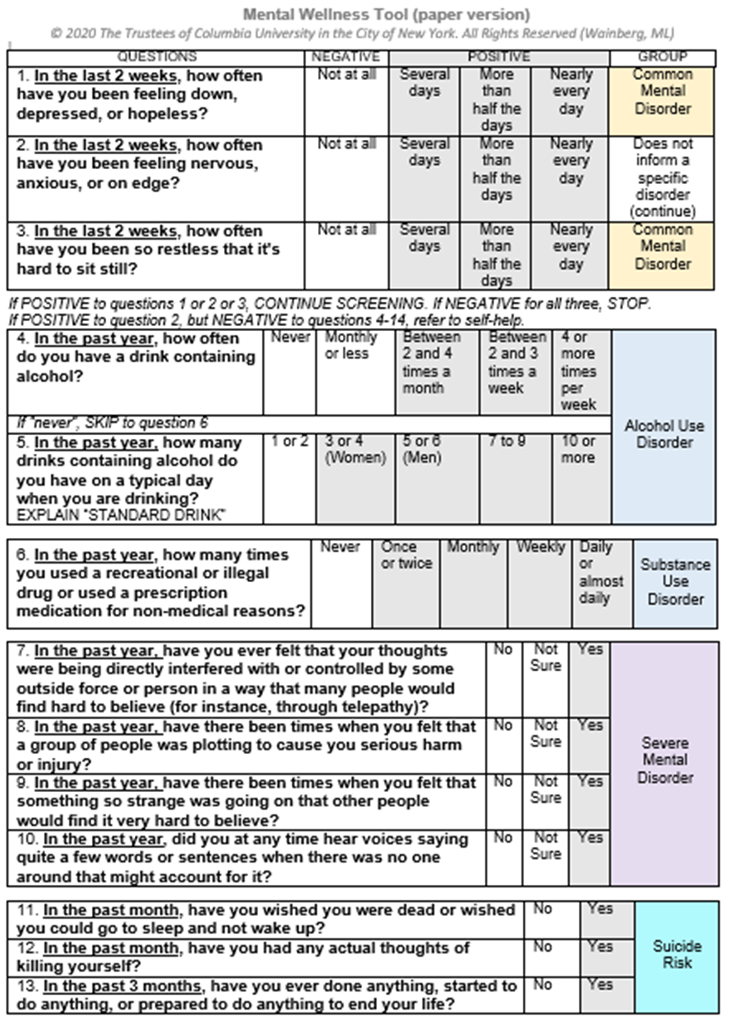
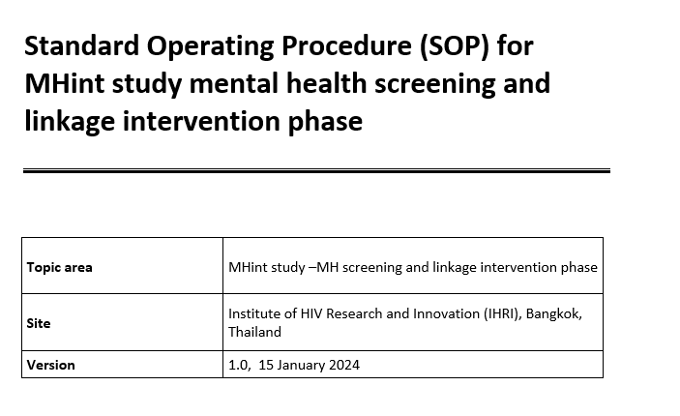
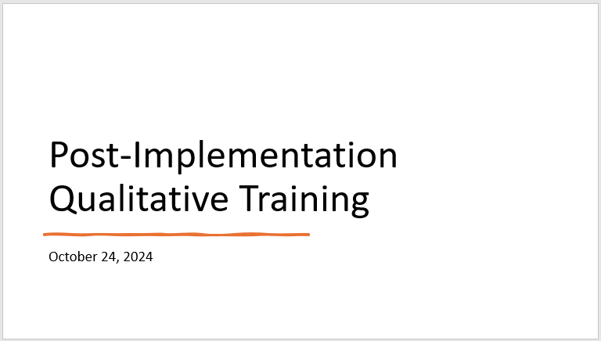
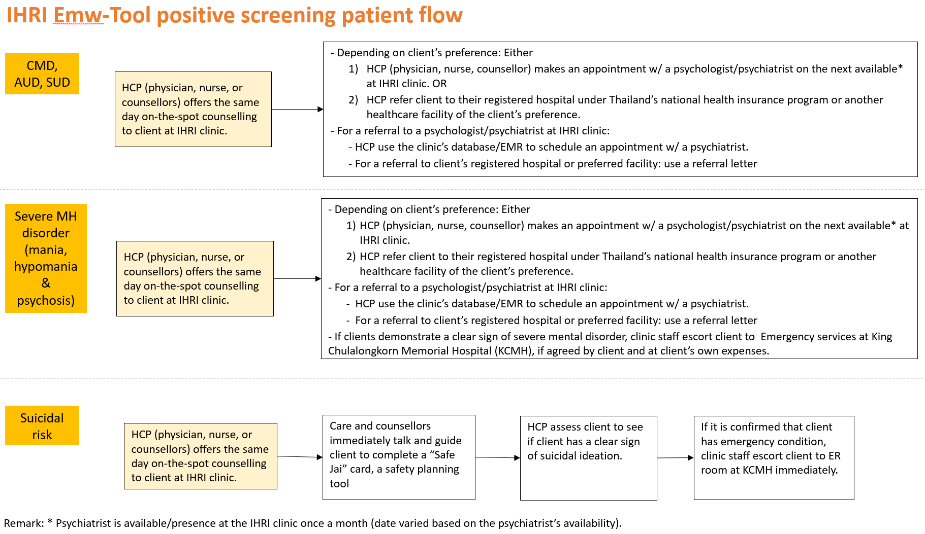
Pre-implementation
PWH and HCP KIIs: barriers & facilitators to MH screening and linkage integration
Validation
Formal validation of E-mwTool (3 sites)
Post-implementation
PWH, HCP, PM and CBO KIIs & FGDs: feasibility, acceptability, implementation, and sustainability
Implementation
Site record review: pre-intervention MH screening & linkage coverage
Medical record review: pre-implementation HIV clinical outcomes (ART adherence, CD4, HIV VL, retention)
Site record review: post-intervention MH screening & linkage coverage
Medical record review: post-implementation HIV clinical outcomes
QoL assessment (HRQOL-4)
PAUSED (partially completed
QoL assessment (HRQOL-4)
Completed.
Screening ~150-600 per site
Comparison vs. diagnostic ‘gold’ standard = The Mini-International Neuropsychiatric Interview (MINI)
Completed.
Analysis and write-up ongoing
12m implementation of MH screening & linkage ‘intervention’
E-mwTool screening (self-administered; different HCPs) and linkage (on- or off-site; psychologist or psychiatrist) SOP
Assess fidelity @~2 months
PAUSED (partially completed

Slide 58
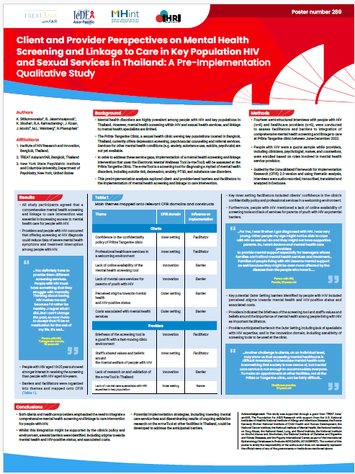
Pre-intervention qualitative analysis of facilitators and barriers to integration of MH screening and linkage to care at IHRI’s clinic
KIIs (n=14) conducted between Jun-Dec 2023
Clients and HCPs emphasized need to integrate comprehensive MH screening and linkage interventions for PWH
Several barriers to integration identified:
  Stigma towards MH and HIV-positive status;
  Lack of MH care specialists with HIV expertise;
  Associated screening/linkage costs
Presented @ APACC 2024

Slide 59
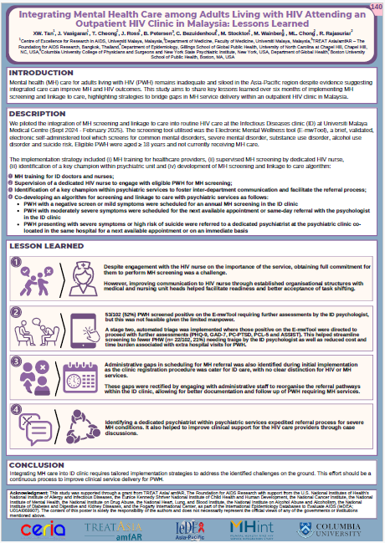
Analysis of implementation of MH screening and linkage to care intervention @ UMMC ID clinic
Importance of engagement with admin staff, HIV nurses and psychiatrist services (champion)
Requires continuous process of tailored implementation strategies that address identified challenges at ‘ground-level’.
Presented @ APACC 2025
Notes:
Other most recent APACC Mhint analyses

Slide 60
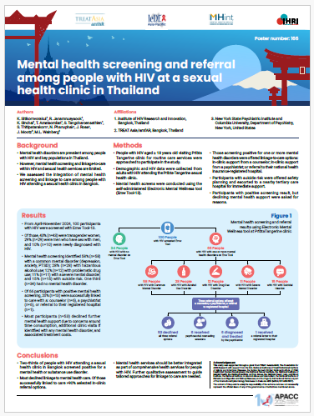
Analysis of implementation of MH screening and linkage to care intervention @ IHRI clinic
66/100 participants screened positive for a MH disorder
53 declined further MH support due to concerns around time consumption, additional clinic visits and associated treatment costs.
Of those successfully linked to care >90% selected in-clinic referral options.
Presented @ APACC 2025
Notes:
Other most recent APACC Mhint analyses

Slide 61

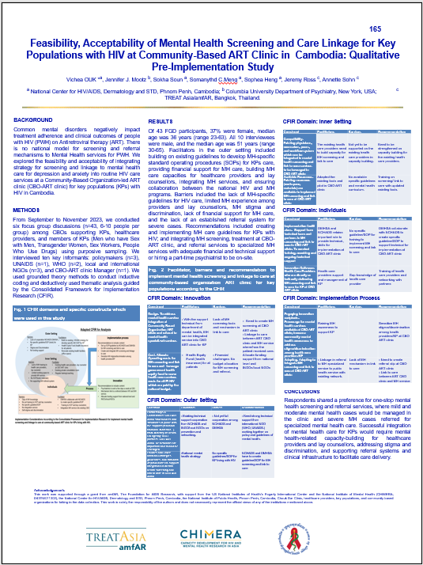
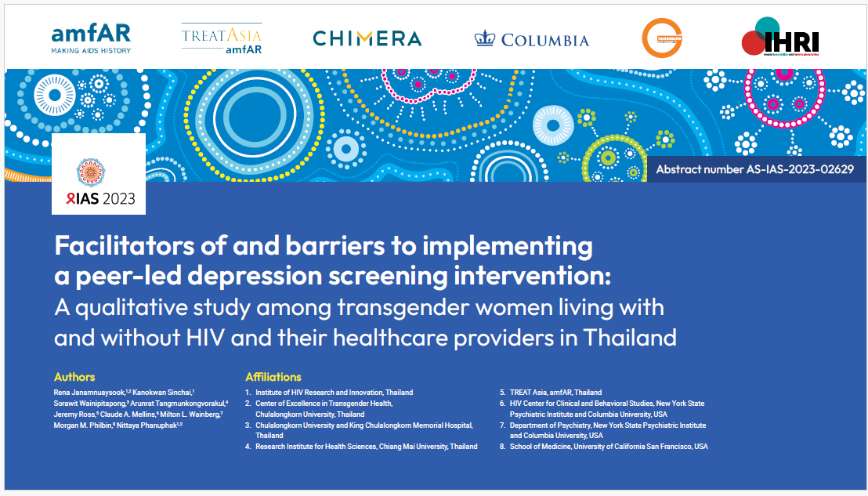
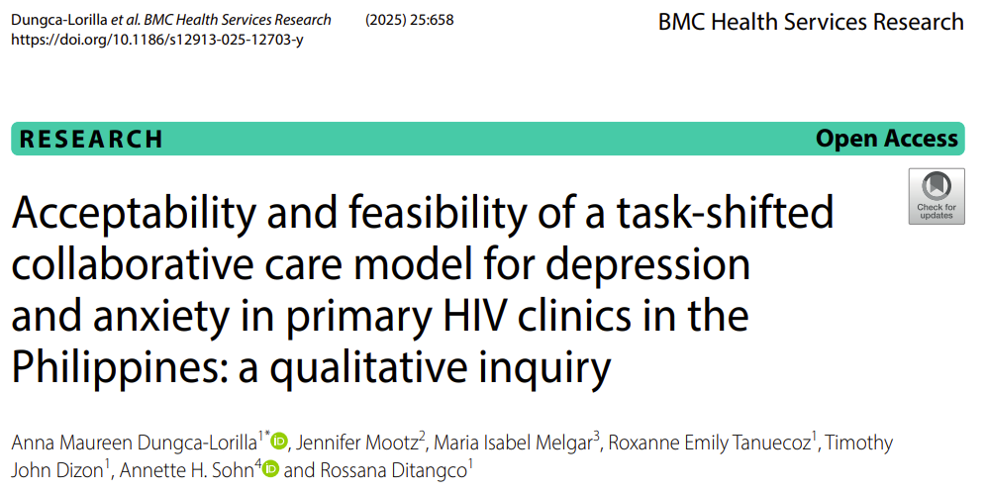
NIH-funded program to develop HIV-MH implementation research capacity in 4 AP countries
‘Fellows’ develop and conduct IR studies assessing various HIV-MH integration approaches e.g., task-shifting to peer HCWs, CoCM,
Indicate feasibility and acceptability of various integration approaches
IAS 2023
APACC 2025

Slide 62
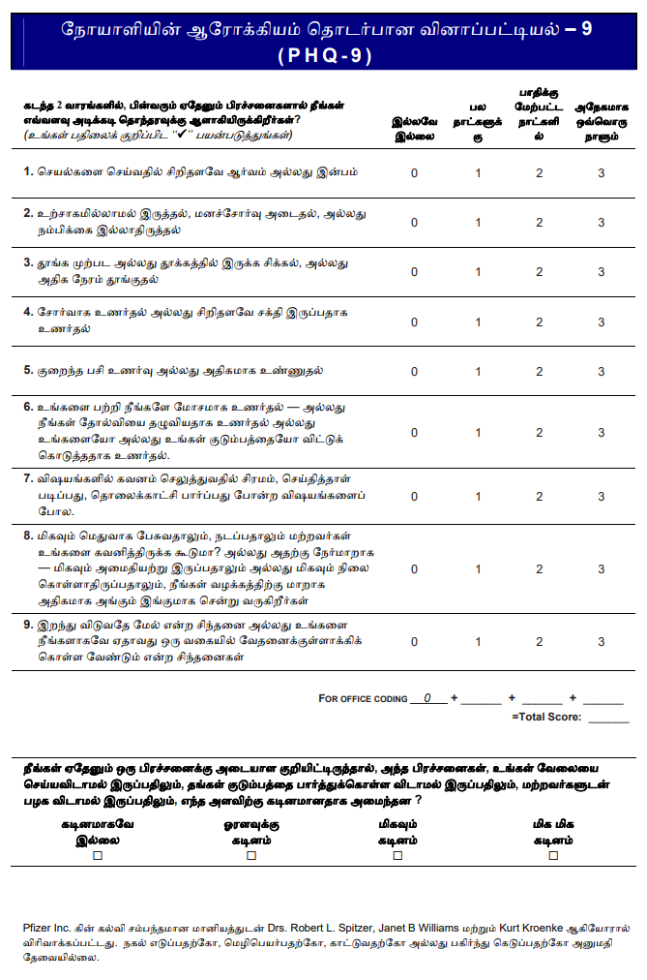
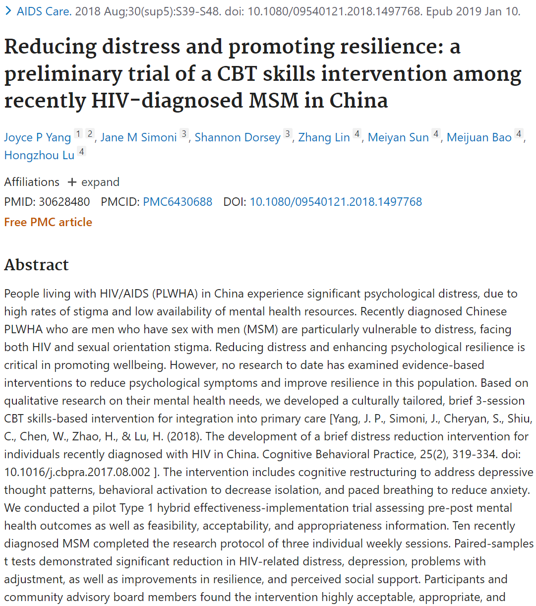
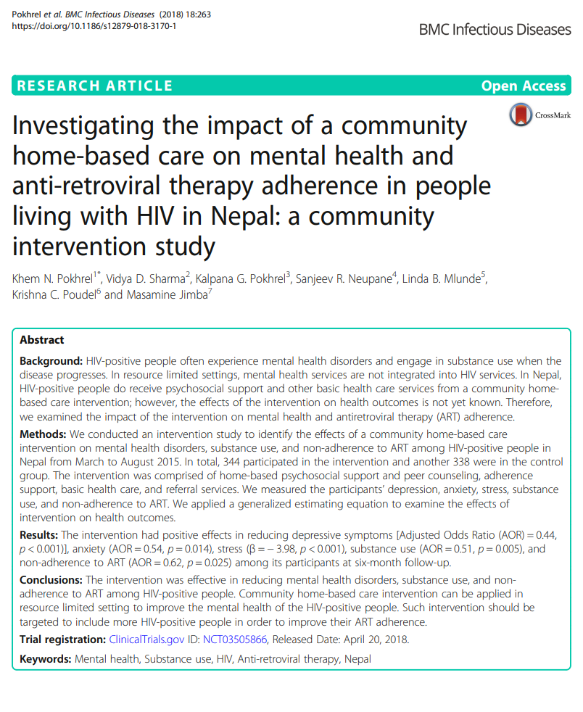
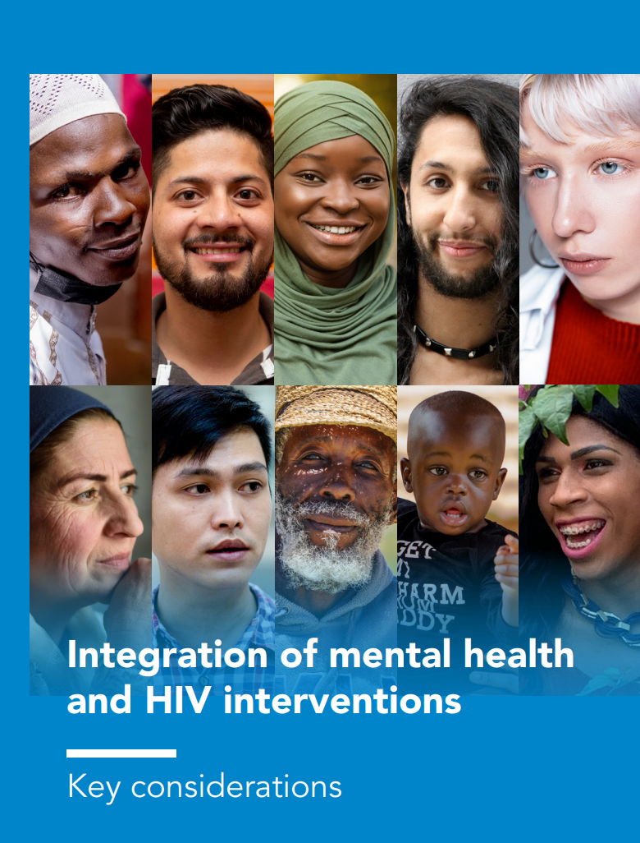
MH-HIV research gaps
Validated MHD screening tools
Effective MHD interventions for PWH
Policy, guidelines and tools
Multi-disorder screening tools
Prevalent MHDs (other than depression)
Examine impact, associations and relationships of MHDs with:
  HIV outcomes (e.g. retention, VS)
  Other health outcomes (e.g. mortality, NCDs)
  Other outcomes (e.g. stigma, frailty)

Slide 63

MH-HIV research gaps (cont.)
Need for implementation research to inform integration, adaptation or scale-up of MH services within HIV care (Chuah 2017; Sohn 2018; Senn 2021)
90% of people living with HIV and people at risk are linked to people-centred and context-specific integrated services for other communicable diseases, noncommunicable diseases, sexual and gender-based violence, mental health and other services they need for their overall health and well-being…by 2026.

Slide 64

Overview of the EPIC community research program and other research programs focused on the mental health support needs of trans people and sex workers in Latin America
Ines Aristegui, Fundación Huésped, Argentina

Slide 65




Mental Health Strategies for Trans People
and Sex Workers:
Insights from Research in Argentina
Dra. Ines Aristegui, Research Department, Fundacion Huesped
Person-Centred Care Research Collaborative – Mental health and HIV
5 June 2025

Slide 66










Studies with Trans People
MSM and TGW
cohort for
anal and oral
Stigma HPV/ KHSV
Index
2010
COPA-T
Adherence to
TARV in
transgender
women
TransITS
Acceptability
and feasibility
of domiciliary
dual test
Impacto
COVID-19
Health and
mental health
access
TRuST II y III
HIV selftest
factibility
2012 ²⁰¹³ ²⁰¹⁴ 2015 2016 2017 2018 ₂₀₁₉ ₂₀₂₀ ₂₀₂₁ ₂₀₂₂ ₂₀₂₃
Acceptability
survey of long-
acting injectables
Sphere
Social
participation
for health
reforms
TransETHICS
Ethical concerns
on TasP
2024
2011
National
Survey on
Trans
People
(OSI)
Survey on PrEP
acceptability
TransHoteles
barriers and
facilitators to
access
healthcare
LGBT Health
in PBA
Offer, demands
and use of
friendly health
services
SONIS
Effect of
hormone
therapy on
quality of
life
ESTHAR
Survey on
health in
trans
masculiniti
es
EPIC
Impact of
COVID in sex
workers
TRANSformá tu salud
Tobacco cessation
HPVac
HPV vaccine
Experiences of
stigma and
discrimination
PreP
preferences
TransViiV
Psychosocial
factors and
retencion in
ARV
HPTN083
Efficacy of
injectable
PrEP
MOSAICO
Efficacy of HIV
vaccine
Penile HPV in
MSM and TGW
Sample
repository
Use of silicone injections
therapeutic approach and
health providers knowledge
TRuST
Acceptability of HIV
self-test
TransTesting
Feasibility of
domiciliary HIV
rapid test
ESTHAR 2
Survey on
SRH and
abortion in
transmen
TransCITAR
Cohort of 500 transgender
and non-binary people
Más por Nosotras
Cohort of sex
workers

Slide 67

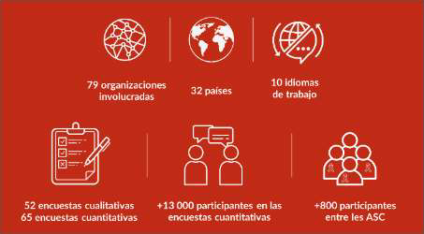

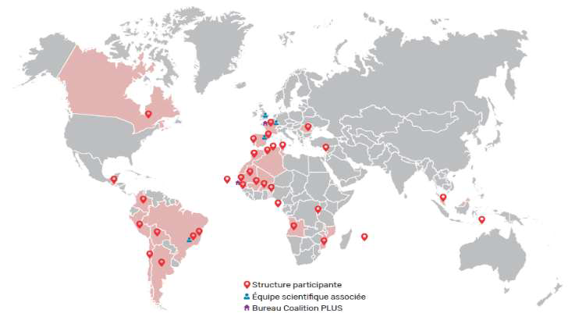




Slide 68






● 500 transgender and gender
diverse individuals living in the
Metropolitan Area of Buenos
Aires
● Sep 2019 - Sept 2022
● 5-year follow-up
● Annual visits
● Medical: physical health, with
focus on HIV
● Psychosocial: social
determinants; mental health
indicators; stigma
● 200 sex workers living in the Metropolitan
Area of Buenos Aires
● Jul 2023 – Feb 2024
● 1-year follow-up
● Biannual visit
● Medical: physical health, focus on SRH
(sexual and reproductive health),
cervical and anal HPV screening,
contraception
● Psychosocial: social determinants;
mental health indicators; stigma; income
protection

Slide 69



Who Could Not Access Care
Needed mental
healthcare but could not
access
Total No Yes
n = 417 ^{n=278}
(66.70%)
n= 139
(33.30%) ^{p-value OR}
Substance use
Substance use (including cannabis), last year 262(62.80%) 156 (56.10%) 106 (76.30%) .001 2.512(1.591-3.967)
Sexualized drug use (excl. Cannabis), last year 144(34.50%) 84 (30.00%) 60 (43%) .009 1.754(1.150-2.675)
Hazardous drinking, yes 134(32.20%) 78 (28.00%) 56 (40.00%) .013 1.721(1.122-2.642)
Discrimination and violence
Discrimination by security forces - last year 30(7.20%) 17(6.10%) 13(9.40%) .288
Discrimination by family - last year 46(11.00%) 26 (9.40%) 20 (14.40%) .122
Discrimination healthcare services - last year 44(10.60%) 21 (7.6%) 23 (17%) .005 2.427(1.291-4.560)
Sexual abuse (lifetime) 309(74.10%) 213 (77%) 95 (68%) .061
Physical violence - last year 46(11.00%) 24 (8.60%) 22 (15.80%) .028 1.990(1.072-3.694)
Transgender Identity Scale
Enacted TIS, Mdn (IQR) 2(0-7) 1(0-6) 4(0-8) .011 NA
Internalized TIS, Mdn (IQR) 0(0-3) 0(0-2) 2(0-4) .000 NA
Score (total) TIS, Mdn (IQR) 4(0-9.75) 2(0-8) 6(1-12) .000 NA
33%
Unmet mental
health needs

Slide 70



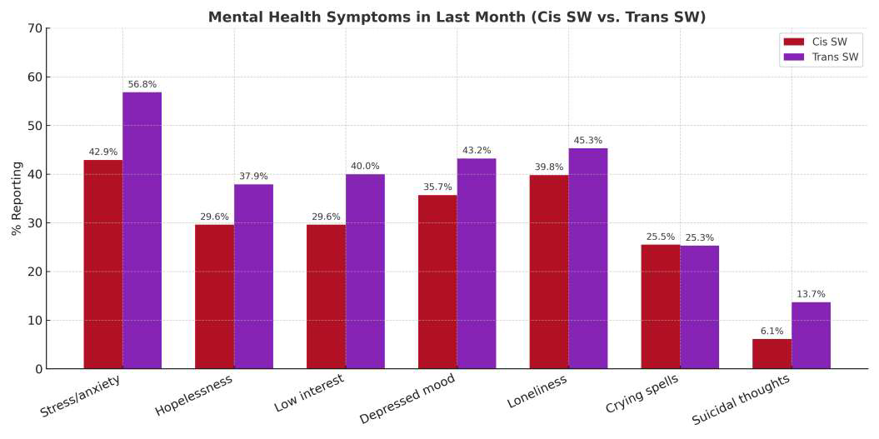
Results
Mental Health Symptoms

Slide 71

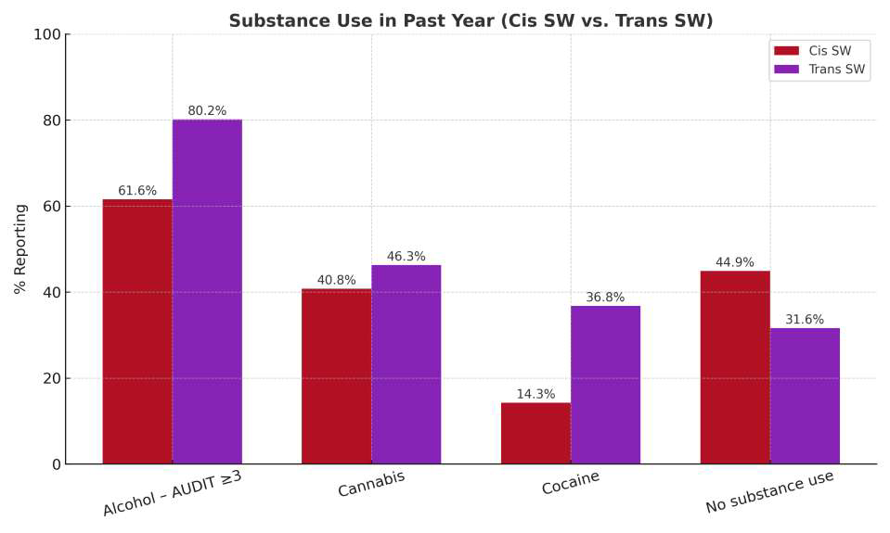
Substance Use

Slide 72

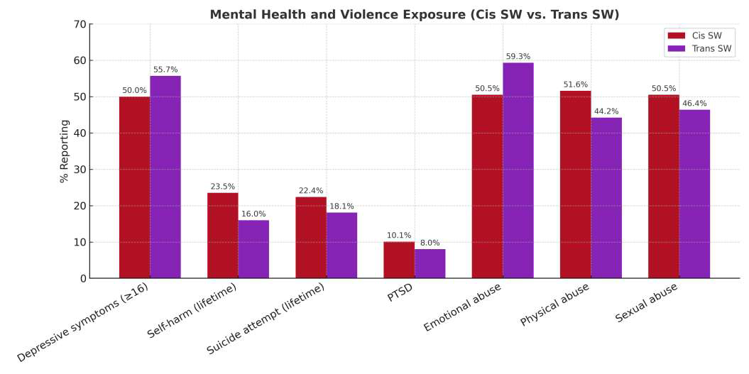
Mental Health Indicators

Slide 73

Resultados
Sociodemográfico
Sociodemographic
Characteristics
Cis (n=98) Trans (n=95) Total (n=193) p-value
Median age (IQR) 36 (29–46) 29 (24–38) 33 (26.5–43)
International migrant (yes) 27 (27.6%) 30 (31.6%) 57 (29.5%) .540
Internal migrant (yes) 14 (21.2%) 40 (83.3%) 54 (47.4%) .000
Unstable housing** 30 (30.6%) 48 (51.6%) 78 (40.8%) .003
Incomplete high school or less 47 (56.6%) 50 (54.3%) 97 (55.4%) .762
Food insecurity 50 (52.6%) 45 (51.7%) 95 (52.2%) .903
Sex work is main income 82 (83.7%) 88 (92.6%) 170 (88.1%) .294
Lives alone 15 (15.3%) 47 (49.5%) 62 (32.1%) .000
Cares for children/adolescents 73 (74.5%) 2 (2.1%) 75 (38.9%) .001
Does street-based sex work 31 (31.6%) 75 (78.9%) 106 (54.9%) .001
Living with HIV 3 (3.2%) 29 (30.5%) 32 (16.9%) .001

Slide 74

Psychosocial factors associated with a
positive VIH diagnosis

Slide 75








Depressive symptoms played a mediating role
.049
Gender identity
stigma
.356***
.057***
Depressive _{CAS}
.161***
symptoms
.854
.138
Gender identity
discrimination
.256
Note. * p < .05, ** p < .01, *** p < .001
Path analysis. Maximum likelihood (ML) estimator.
Excellent goodness of fit: CFI=1.000; TLI=1.000; RMSEA=0.000.

Slide 76



Final Remarks
Mental health care must be accessible, community-
driven, and intersectional.
Structural inequalities — from stigma to unstable housing
— affect both mental health and HIV outcomes.
In a global context of rising anti-rights agendas,
defending rights-based, inclusive approaches is more
urgent than ever.

Slide 77
What We Need Moving Forward
•Peer-led, low-intensity mental health interventions
•Integrated HIV and mental health services
•Mobile outreach for people in unstable living conditions
•Provider training in stigma-free, trans-affirming care
•Protection of rights amid political shifts

Slide 78






Thank you!
ines.aristegui@huesped.org.ar
@fundhuesped
www.huesped.org.ar

Slide 79
Future research priorities articulated by researchers
Intersection of social determinants of health, stigma and HIV outcomes
HIV, trauma and vulnerable populations
Mental health interventions for people living with HIV
Healthcare system and other structural service delivery innovations
Do you agree these are the priorities?
Are you conducting or are aware of studies on these topics?
Notes:
Methodology for literature review
150 articles selected from search of “mental health and HIV” in past 9 months related to person-centred care themes
abstracts, discussion and conclusions reviewed for key themes and suggestions of future research priorities
initial analysis of key themes and supportive statements
Refining of statements and verification from key citations, especially systematic reviews

Slide 80
1. Intersection of social determinants of health, stigma and HIV outcomes
Possible research gaps and future priorities
  Intervention models integrating HIV care within social services (Nguyen, 2025) and (Thomas, 2024).
  Culturally tailored strategies to enhance protective social support (Nguyen, 2025).
  Intersectional stigma reduction programmes addressing racism, HIV stigma and sexual identity (Lane, 2025).
  Evaluation of faith-based interventions for culturally grounded stigma mitigation (Lane, 2025).
Notes:
- Research is needed to evaluate bundled interventions and longitudinal effects of social determinants of health on engagement in care.
References
Dombrowski JC, Corcorran MA, Carney T, Parczewski M, Gandhi M. The impact of homelessness and housing insecurity on HIV. Lancet HIV. 2025 Jun;12(6):e449-e458. doi: 10.1016/S2352-3018(25)00048-7. Epub 2025 Apr 25. PMID: 40294620.
The paper discusses the evolving impacts of housing insecurity, provider mistrust, and systemic fragmentation on care engagement, implying the need for longitudinal tracking.
Avery A, Bitar Y, Hussey D, Hileman CO. Evaluating Connections Between Polysubstance Use, Social Drivers of Health, and Mental Health Symptoms in People With HIV. Open Forum Infect Dis. 2025 Apr 24;12(4):ofaf172. doi: 10.1093/ofid/ofaf172. PMID: 40290561; PMCID: PMC12024707.
Nguyen VHA, Tran TNA, Vu TT, Phan YTH, Nguyen TTN, Tran-Thien GP, Tran-Chi VL. The interplay of psychological distress, stigma, and social support in determining quality of life among Vietnamese people living with HIV. Discov Ment Health. 2025 Apr 7;5(1):48. doi: 10.1007/s44192-025-00171-z. PMID: 40192977; PMCID: PMC11977041.
Support from friends, in particular, has been associated with lower perceived HIV stigma, as it enables individuals to reinterpret stressful situations, such as discrimination, in less harmful ways [35]. Interestingly, however, this study also finds that perceived social support negatively affects the QoL of PLWH in certain circumstances. While social support typically enhances QoL, external factors may distort this relationship. For instance, support from family or community members who harbor negative attitudes toward HIV may inadvertently reinforce stigma through blame or judgment. This can lead to feelings of guilt, shame, or isolation, thereby worsening mental health and reducing QoL. These findings underscore the need for nuanced approaches to social support interventions that ensure the support provided is nonjudgmental and stigma-free. Future research should further explore these dynamics to disentangle the conditions under which perceived social support may either enhance or undermine QoL and stigma reduction among PLWH.
Thomas JP, Ballew W, Kwong MH. Black Women's Experiences Along the HIV Care Continuum in the United States: A Scoping Review. Health Equity. 2024 Sep 12;8(1):608-617. doi: 10.1089/heq.2024.0020. PMID: 40125386; PMCID: PMC11464859.
The authors call for structural and policy-level interventions to address these compounded barriers.
Villacis-Alvarez E, Haworth-Brockman M, Maier K, Sobie C, Pashe H, Baliddawa J, Daniels N, Murdock R, Russell R, Dan C, Woodhouse F, Cusson S, Patrick L, Schenkels M, Payne M, Kasper K, MacKenzie LJ, Ireland L, Templeton K, Keynan Y, Rueda ZV. "Our needs, our priorities, listen to us!" recommendations for improving HIV prevention and the cascade of care from people living with HIV in Manitoba, Canada: a qualitative study. BMC Health Serv Res. 2025 Apr 23;25(1):587. doi: 10.1186/s12913-025-12645-5. PMID: 40270026; PMCID: PMC12016453.
Lane BL, Sabuncu C, Yang Y, Okantey B, Campbell DN, Bryant TR, Sorkpor S, Millender E, Wong FY, Hall CDX. Discrimination and Mental Health Among Black and Latino People Living with HIV: Understanding the Role of Religion and Spirituality. AIDS Behav. 2025 Apr 17. doi: 10.1007/s10461-025-04720-z. Epub ahead of print. PMID: 40240721.

Slide 81
2. HIV, trauma and vulnerable populations
Possible research gaps and future priorities
  Tailored trauma-informed interventions for vulnerable groups (gay men and other men who have sex with men, street involved youth, youth) (Wiginton, 2025), (Lee, 2025).
  Participatory approaches to develop and assess the effectiveness of resilience-focused programmes for youth with adverse childhood experiences in low- and middle-income countries (Brown, 2025).
  Tailored clinical pathways for geriatric HIV and neurocognitive comorbidities (Prakoeswa, 2025).
  Integrated screening for trauma in HIV services (Wiginton, 2025), (Brown, 2025).
Notes:
- PTSD, adverse childhood experiences, and geriatric vulnerabilities are common among people living with HIV
- High interest in PrEP exists in populations with unmet mental health needs, but uptake is low.
- Trauma-informed and integrated care models are essential future priorities.
References
Wiginton JM, Murray SM, Tobin K, Baral SD, Sanchez TH. Posttraumatic stress disorder symptomology among gay, bisexual, and other sexually minoritized cisgender men in the United States: A latent class analysis. SSM Ment Health. 2025 Jun;7:100390. doi: 10.1016/j.ssmmh.2025.100390. Epub 2025 Jan 4. PMID: 40196235; PMCID: PMC11972599.
Brown C, Ogochukwu E, Nkemjika S, Kambona C, Chiang L, Annor FB. Adverse childhood experiences, positive childhood experiences, suicidal thoughts or behaviors and psychological distress among Kenyan youth-an exploratory analysis of the 2019 Kenya Violence Against Children and Youth Survey (VACS). Child Abuse Negl. 2025 Jun;164:107470. doi: 10.1016/j.chiabu.2025.107470. Epub 2025 Apr 19. PMID: 40253914.
Prakoeswa FRS, Maharani F, Bestari RS, Aisyah R, Ichsan B, Nursanto D, Listiansyah R, Tuanaya MRN. Aging and HIV: Recent Findings in Contributing Factors. AIDS Res Treat. 2025 Apr 11;2025:8814760. doi: 10.1155/arat/8814760. PMID: 40255985; PMCID: PMC12008487.
Bunting SR, Feinstein BA, Wilson A, Rivera J, Ehsan DA, Hazra A. Preferences for PrEP Implementation and Engagement in the HIV Pre-Exposure Prophylaxis (PrEP) Care Continuum among Patients Receiving Psychiatric Care in an Ending the HIV Epidemic Priority County. J Acquir Immune Defic Syndr. 2025 Apr 7. doi: 10.1097/QAI.0000000000003675. Epub ahead of print. PMID: 40192780.
Lee EOJ, Tang TS, Fuentes-Bernal J, MacEntee K, Wachira J, Apondi E, Abramovich A, Oudshoorn A, Ayuku D, Kiptui R, Van Berkum A, MacDonald SA, Saarela O, Braitstein P. Optimal characteristics of peer navigators: adapting peer-based intervention with street-involved youth in Canada and Kenya with the aim of increasing HIV prevention, testing and treatment. Health Res Policy Syst. 2025 Apr 7;23(1):45. doi: 10.1186/s12961-025-01309-9. PMID: 40197481; PMCID: PMC11974212.

Slide 82
3. Mental health interventions for people living with HIV
Possible research gaps and future priorities
  Longitudinal studies exploring the sustainability, reach, ability to scale and impact of self-help and peer-led models for mental health supportive interventions (Vavani, 2025), (Jadwin-Cakmak, 2025).
  Effectiveness of the integration of mental healthcare support within antenatal HIV services (Ferede, 2025).
  Evidence-based training protocols for enhancing provider engagement and client-provider relationships (Tseng, 2025).
  Cost-effectiveness studies and strategies for sustaining telemedicine and mHealth interventions in low-resource settings for mental health (Agbeyangi, 2025).
Notes:
- Future research should focus on scaling, integration, and long-term impact assessments.
CONCLUSION: Over one-third of pregnant women with HIV/AIDS experience depression, linked to factors like intimate partner violence, food insecurity, and poor adherence to antiretroviral therapy. Prioritize tailored mental health
services and peer support groups. Increase education on intimate partner violence and implement nutritional support programs. Promote community initiatives and simplify ART regimens for improved health outcomes.
References
Vavani B, Garnefski N, van Luenen S, Dusseldorp E, Amone-P'Olak K, Spinhoven P, Kraaij V. A Booklet Self-Help Intervention for People Living with HIV and Depressive Symptoms in Botswana: A Randomized Controlled Trial. AIDS Behav. 2025 Apr 29. doi: 10.1007/s10461-025-04742-7. Epub ahead of print. PMID: 40299259.
Jadwin-Cakmak L, Harper GW, Ochieng E, Amico KR, Aloo T, Okutah F, Gumbe E, Olango K, Okall DO, Otieno FO, Odero W, Graham SM. Participatory development of the Shauriana program to integrate sexual health and mental health support for young gay and bisexual men and other men who have sex with men in Kenya. Adv Glob Health. 2025;4(1):2442813. doi: 10.1525/agh.2025.2442813. Epub 2025 Mar 6. PMID: 40296878; PMCID: PMC12036828.
Ferede YA, Zeleke AM, Assefa GW, Nigate GK, Tassew WC. Depression and associated factors among human immunodeficiency virus-positive pregnant women in sub-Saharan Africa: systematic review and meta-analysis. AJOG Glob Rep. 2025 Mar 12;5(2):100475. doi: 10.1016/j.xagr.2025.100475. PMID: 40292351; PMCID: PMC12032315.
Tseng TY, Mitchell MM, Chander G, Latkin C, Kennedy C, Borison SI, Son C, Knowlton AR. Quality of Life among Predominately African Americans with HIV Who Use Drugs: The Role of Patient-Provider Engagement in Mediating the Impacts of Depression and Healthcare Discrimination. AIDS Behav. 2025 Apr 17. doi: 10.1007/s10461-025-04717-8. Epub ahead of print. PMID: 40240720.
Agbeyangi AO, Lukose JM. Telemedicine Adoption and Prospects in Sub-Sahara Africa: A Systematic Review with a Focus on South Africa, Kenya, and Nigeria. Healthcare (Basel). 2025 Mar 29;13(7):762. doi: 10.3390/healthcare13070762. PMID: 40218059; PMCID: PMC11989057.

Slide 83
4. Structural healthcare system and other service delivery innovations
Possible research gaps and future priorities
  Implementation science around low-barrier service delivery models for mental health support (Dombrowski, 2025).
  Structural interventions to normalize HIV status dialogue in mental healthcare systems, including ethical strategies to document and share HIV status across providers (Heslin, 2025).
  Evaluation of structural interventions and person-centred policies that can help to better understand, quantify and reduce discrimination within healthcare systems (Thomas, 2024).
  Robust monitoring and evaluation systems for digital mHealth engagement outcomes (Agbeyangi, 2025).
  Appropriately integrated delivery innovations (Thomas, 2024), (Dombrowski, 2025), including PrEP in psychiatric care settings (Bunting, 2025).
Notes:
- Research should evaluate cost-effectiveness, digital tracking, and policy support for these systems.
References
Golub SA, Hubbard S, de Roche AM, Barton SC, Merges A, Klein A. Community-academic implementation science partnership to examine adoption and impact of a patient-centered approach to sexual history. Psychol Serv. 2025 Apr 7. doi: 10.1037/ser0000935. Epub ahead of print. PMID: 40193513.
In 2021, the New York City Health Department initiated a multilevel implementation strategy, focused on promoting the GOALS Approach to Sexual History and Health-an antistigmatizing, client-centered strategy for sexual history taking-as a lever for increasing HIV intervention adoption, reach, and equity. Project Partnership to Increase Access, Client-Centered Care, and Equity in HIV Services is a community-academic implementation science partnership designed to investigate the impact of strategy enactment on implementation outcomes, including changes in intervention utilization (HIV testing, sexually transmitted infection testing, pre-exposure prophylaxis) in practice over time. These data suggest that a multilevel implementation strategy focused on delivery of antistigma, client-centered sexual histories may be a potent implementation strategy for enhancing HIV prevention intervention adoption.
Lee EOJ, Tang TS, Fuentes-Bernal J, MacEntee K, Wachira J, Apondi E, Abramovich A, Oudshoorn A, Ayuku D, Kiptui R, Van Berkum A, MacDonald SA, Saarela O, Braitstein P. Optimal characteristics of peer navigators: adapting peer-based intervention with street-involved youth in Canada and Kenya with the aim of increasing HIV prevention, testing and treatment. Health Res Policy Syst. 2025 Apr 7;23(1):45. doi: 10.1186/s12961-025-01309-9. PMID: 40197481; PMCID: PMC11974212.
Agbeyangi AO, Lukose JM. Telemedicine Adoption and Prospects in Sub-Sahara Africa: A Systematic Review with a Focus on South Africa, Kenya, and Nigeria. Healthcare (Basel). 2025 Mar 29;13(7):762. doi: 10.3390/healthcare13070762. PMID: 40218059; PMCID: PMC11989057.
Thomas JP, Ballew W, Kwong MH. Black Women's Experiences Along the HIV Care Continuum in the United States: A Scoping Review. Health Equity. 2024 Sep 12;8(1):608-617. doi: 10.1089/heq.2024.0020. PMID: 40125386; PMCID: PMC11464859.
Dombrowski JC, Corcorran MA, Carney T, Parczewski M, Gandhi M. The impact of homelessness and housing insecurity on HIV. Lancet HIV. 2025 Jun;12(6):e449-e458. doi: 10.1016/S2352-3018(25)00048-7. Epub 2025 Apr 25. PMID: 40294620.
Heslin M, Hunt O, Tassie E, Jewell A, King H, Covshoff E, Campbell L, Croxford S, Pittrof R, Sullivan A, Williams J, Newson M, Trevillion K, Smith S, Hughes E, Stewart R. Recording of HIV diagnosis in mental health records: A data linkage cohort study. PLoS One. 2025 Apr 23;20(4):e0320392. doi: 10.1371/journal.pone.0320392. PMID: 40267086; PMCID: PMC12017511.
Bunting SR, Feinstein BA, Wilson A, Rivera J, Ehsan DA, Hazra A. Preferences for PrEP Implementation and Engagement in the HIV Pre-Exposure Prophylaxis (PrEP) Care Continuum among Patients Receiving Psychiatric Care in an Ending the HIV Epidemic Priority County. J Acquir Immune Defic Syndr. 2025 Apr 7. doi: 10.1097/QAI.0000000000003675. Epub ahead of print. PMID: 40192780.

Slide 84
Discussion questions
Has global research on mental health adequately considered the specific intersectional needs of key populations living with or vulnerable to HIV acquisition?
What is the status of current research on person-centred mental health interventions and treatment strategies for people living with HIV and experiencing mental health issues?
What opportunities exist for collaboration on this topic among members of the PCC Research Collaborative?
How has the HIV funding crisis affected mental health service delivery for people living with HIV and related research? How can we uphold PCC approaches amidst these shifts and how can planned research be adapted to assess and mitigate these impacts?

Slide 85
PCC activities @ IAS 2025
Satellite session - “The future of person-centred HIV prevention: Latest evidence from the African continent”, Kigali, Rwanda – 14 July, 11:30 – 12:30
Poster presentation - “ A roadmap to scale up person-centred care in the HIV response: Recommendations from a global consensus process”, Kigali, Rwanda – 17 July, 12:15 -13:15
PCC Research Collaborative Networking Dinner, 14 July, 19:00 – 21:00
PCC @ IAS 2025 conference roadmap coming soon!

Slide 86


Acknowledgements
The Person-Centred Care programme of IAS – the International AIDS Society – is implemented with financial support from, and in collaboration with, Gilead Sciences.
Gilead Sciences has nominated Megan Dunbar, Executive Director, Gilead Sciences to participate in the PCC research collaborative.
The IAS has full control over all the activities and decisions relating to, and forming part of, the Person-Centred Care programme.

Slide 87

HIV and mental health
Depression is among the most common mental health conditions in PLHIV (Abas et al., 2014). The prevalence of depression across surveys of PLHIV in sub-Saharan Africa is estimated at 24%, compared with less than 3% for the general population (Patel et al., 2018).
Poor mental health may lead to negative health outcomes at each step in the HIV care continuum (Remien, 2019), from HIV diagnosis all the way to achieving viral suppression. It can interfere with HIV testing and learning one’s HIV status, successfully linking to HIV care, staying in care, initiating ART, and remaining adherent to ART to achieve HIV viral suppression.
A systematic review exploring the relationship between depression and adherence to ART found that the likelihood of achieving good ART adherence was 42% lower among those with depressive symptoms compared to those without depression (Uthman et al., 2014).
Integrating mental health into HIV prevention initiatives could also hasten the decline in new HIV acquisitions by at least 10% and as much as 16.5%. What this means is that by 2030, over 924,000 people around the world could avoid contracting HIV (UGMH, 2021).
References
Abas M, Ali G-C, Nakimuli-Mpungu E, Chibanda D. Depression in people living with HIV in sub-Saharan Africa: time to act. Trop Med Int Health. 2014;19(12):1392–6.
Patel P, Rose CE, Collins PY, et al. Noncommunicable diseases among HIV-infected persons in low-income and middle-income countries: a systematic review and meta-analysis. AIDS. 2018;32(suppl. 1):S5–S20.
Remien, R. H. (2019, January 1). The impact of mental health across the HIV care continuum. Psychology and AIDS Exchange Newsletter. https://www.apa.org/pi/aids/resources/exchange/2019/01/continuum
Uthman, O. A., Magidson, J. F., Safren, S. A., & Nachega, J. B. (2014). Depression and adherence to antiretroviral therapy in low-, middle- and high-income countries: a systematic review and meta-analysis. Current HIV/AIDS reports, 11(3), 291–307.
United for Global Mental Health. (2021). Bending the curve: The impact of integrating mental health services on HIV and TB outcomes
Notes:
Sources:
Remien, R. H. (2019, January 1). The impact of mental health across the HIV care continuum. Psychology and AIDS Exchange Newsletter. https://www.apa.org/pi/aids/resources/exchange/2019/01/continuum
Uthman, O. A., Magidson, J. F., Safren, S. A., & Nachega, J. B. (2014). Depression and adherence to antiretroviral therapy in low-, middle- and high-income countries: a systematic review and meta-analysis. Current HIV/AIDS reports, 11(3), 291–307. https://doi.org/10.1007/s11904-014-0220-1
United for Global Mental Health. (2021). Bending the curve: The impact of integrating mental health services on HIV and TB outcomes
Simoni, J. M., Wiebe, J. S., Sauceda, J. A., Huh, D., Sanchez, G., Longoria, V., Andres Bedoya, C., & Safren, S. A. (2013). A preliminary RCT of CBT-AD for adherence and depression among HIV-positive Latinos on the U.S.-Mexico border: the Nuevo Día study. AIDS and behavior, 17(8), 2816–2829.
Safren, S. A., Bedoya, C. A., O'Cleirigh, C., Biello, K. B., Pinkston, M. M., Stein, M. D., Traeger, L., Kojic, E., Robbins, G. K., Lerner, J. A., Herman, D. S., Mimiaga, M. J., & Mayer, K. H. (2016). Cognitive behavioural therapy for adherence and depression in patients with HIV: a three-arm randomised controlled trial. The Lancet. HIV, 3(11), e529–e538.
Abas, M., Nyamayaro, P., Bere, T., Saruchera, E., Mothobi, N., Simms, V., Mangezi, W., Macpherson, K., Croome, N., Magidson, J., Makadzange, A., Safren, S., Chibanda, D., & O'Cleirigh, C. (2018). Feasibility and Acceptability of a Task-Shifted Intervention to Enhance Adherence to HIV Medication and Improve Depression in People Living with HIV in Zimbabwe, a Low Income Country in Sub-Saharan Africa. AIDS and behavior, 22(1), 86–101.

Slide 88
Behavioural pathway
Mental health conditions contribute to:
  Increased risk behaviors
  Delayed (or lack of) HIV testing and care initiation
  Poor retention in care
  Delayed (or lack of) ART initiation
  Poor ART adherence
All lead to non-optimal HIV treatment and thus, poorer health outcomes (for self and for others)
Whatever the pathway, it is clear that we need to address mental health conditions if we want to improve health outcomes along the HIV care continuum.
References
Bemelmans M et al, J Int AIDS Soc, 2016; Gonzalez JS et al, JAIDS 2011; Uthman et al, Curr HIV/AIDS Rep, 2014; Mayston et al, AIDS, 2012; Krumme et al, J Epidemiol Community Health, 2014; Musisi et al, Int J STD AIDS, 2014; Antelman et al, JAIDS, 2007; Remien et al, AIDS and Behavior, 2007
Notes:
I can say that the Behavioral pathway between mental illness and HIV health outcomes is pretty clear, in that mental health impairment does contribute to:
CLICK THROUGH (7x): increased risk behaviors, delayed HIV testing and care initiation, poor retention in care, delayed ART initiation, and poor adherence
CLICK
All lead to non-optimal HIV treatment and thus, poorer health outcomes
CLICK
Whatever the pathway, it is clear that we need to address mental health problems if we want to improve health outcomes along the HIV prevention and HIV care continua
CLICK

Slide 89
Mental health interventions across the HIV care continuum*
HIV prevention | Integrate PrEP with mental health screening, referral, and substance use services Include interventions for promotion and prevention for mental health with HIV prevention counseling Peer champions, support groups, and mHealth interventions to reduce HIV and mental health stigma Integrated HIV prevention interventions into mental health settings
HIV testing | Post-test counseling that includes assessment of mental health, including risk of suicide, substance use disorders, and depression, and referral for relevant services Interventions for promotion and prevention for mental health Linkage to care (if HIV positive) and HIV prevention (if HIV negative)
ART initiation | Routine screening for mental health conditions (including depression, anxiety, and alcohol use) among people initiating ART, according to national standards and mhGAP guidelines HIV counseling including psychosocial support for promotion and prevention for mental health Peer support groups and family-based interventions, particularly for adolescents ART prescription in accordance with co-occurring mental health conditions and potential side effects
ART adherence, retention in HIV care and viral suppression | Provide psychological support (e.g., cognitive behavioral and behavioral skills therapy) and social support interventions (e.g., phone messages, reminders) to improve adherence, retention in HIV care and viral suppression Regular screening for mental health conditions among individuals who have not achieved viral suppression Suspicion and detection of neurological complications (e.g., HIV-associated neurocognitive disorder or HAND, neuroinfections)
**Some populations may require special attention due to intersecting social and structural determinants that influence physical and mental health outcomes including, but not limited to: pregnant women, adolescents and youth, key populations and aging and older PLHIV.

Slide 90
Focus areas for planning and budgeting
Governance and accountability | Expand partner engagement to include mental health stakeholders including civil society and those with lived experience
Analysis of burden and access to services | Activities for mental health assessment of mapping of existing services for HIV and mental health and assess gaps in service access
Planning and resource mobilisation | Update and harmonise HIV and mental health NSPs and national guidelines
Scale-up of integrated, people-centred services | Strengthen capacity: training and supervision for screening, diagnosis, and treatment (psychotherapy and pharmacotherapy) of mental health conditions, M&E Tools, consumable and equipment: SOPs, algorithms, job-aids (PHQ-9, ASSIST), medicines Patient support: transport costs, patient education materials, community-based support
Strengthen M&E and operational research | Inclusion of indicators and adjustment of data collection tools and procurement supply management tools Operational research to test out models of integration (effectiveness and cost)

Slide 91
Key Resource: Updated Technical Toolbox supporting the integration of mental health services
United for Global Mental Health, in partnership with the Interagency Working Group on Mental Health Integration, has updated its technical toolbox to support national-level stakeholders with their advocacy and programmatic efforts to integrate mental health into HIV and TB programmes. Content: Factsheet on the relationship between mental health, HIV and TB Annotated bibliography summarising the existing normative guidance Guidance notes on planning and budgeting for the integration of MH into HIV programming Compendium of case studies which demonstrate how to integrate mental health within services for HIV programs and its impact on health outcomes List of available technical assistance/support for implementing partners Toolbox available at this link. We will expand this as more resources are developed.

Slide 92


Key Resource: E-learning on Mental Health and HIV/TB
Learn more about the short course on integrating mental health into HIV and TB programmes available at the Global Fund iLearn platform.

