Slide 1
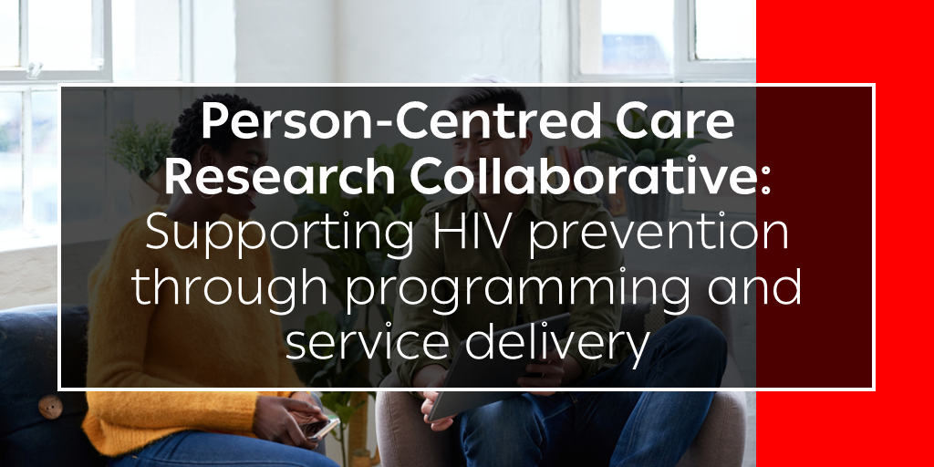

Slide 2

Meeting protocols
Stay on mute unless you are presenting, or a moderator calls on you
Use the chat to ask questions and share your thoughts on the points raised by the presenters
If you would like to ask a question or provide a verbal comment during the discussion, raise your hand and wait to be called on

Slide 3

IAS Person-Centred Care (PCC) programme
Prioritizes integrated, inclusive and responsive healthcare services
Focuses on changing needs, priorities and preferences of each person living with or affected by HIV
Empowers clients and is shaped by the many aspects of people’s intersectional identities
Notes:
This event has been organized by the IAS Person-Centred Care programme which is advocating for integrated, inclusive and responsive healthcare services that focus on the changing needs, priorities and preferences of individuals and empowers them to demand services that respect their identities.

Slide 4

What is the PCC Research Collaborative?
Access PCC programme resources
Mission: To work collectively and efficiently to fill evidence gaps around person-centred care for people living with HIV or vulnerable to HIV acquisition
Participants: Researchers, clients and providers who are championing evidence generation related to client-provider relationships, participatory approaches that value experts by experience as well as specific research and policy gaps related to person-centred care within the HIV response
Objective for 2024-2026: Develop a research agenda for scaling up PCC approaches for people living with HIV or vulnerable to HIV acquisition
Notes:
The PCC research collaborative has the mission of working collectively and efficiently at a global level to fill evidence gaps around person-centred care for people living with HIV or vulnerable to HIV acquisition. This collaborative will meet around three times a year and will convene researchers, clients and providers who are championing evidence generation related to client-provider relationships, participatory approaches that value experts by experience as well as specific research and policy gaps related to person-centred care within the HIV response

Slide 5
Today’s objective
The objectives of this meeting are to identify the evidence-based strategies and future research gaps with regards to person-centred care prevention for people vulnerable to HIV acquisition, with a focus on recent evidence from the JIAS supplement.

Slide 6
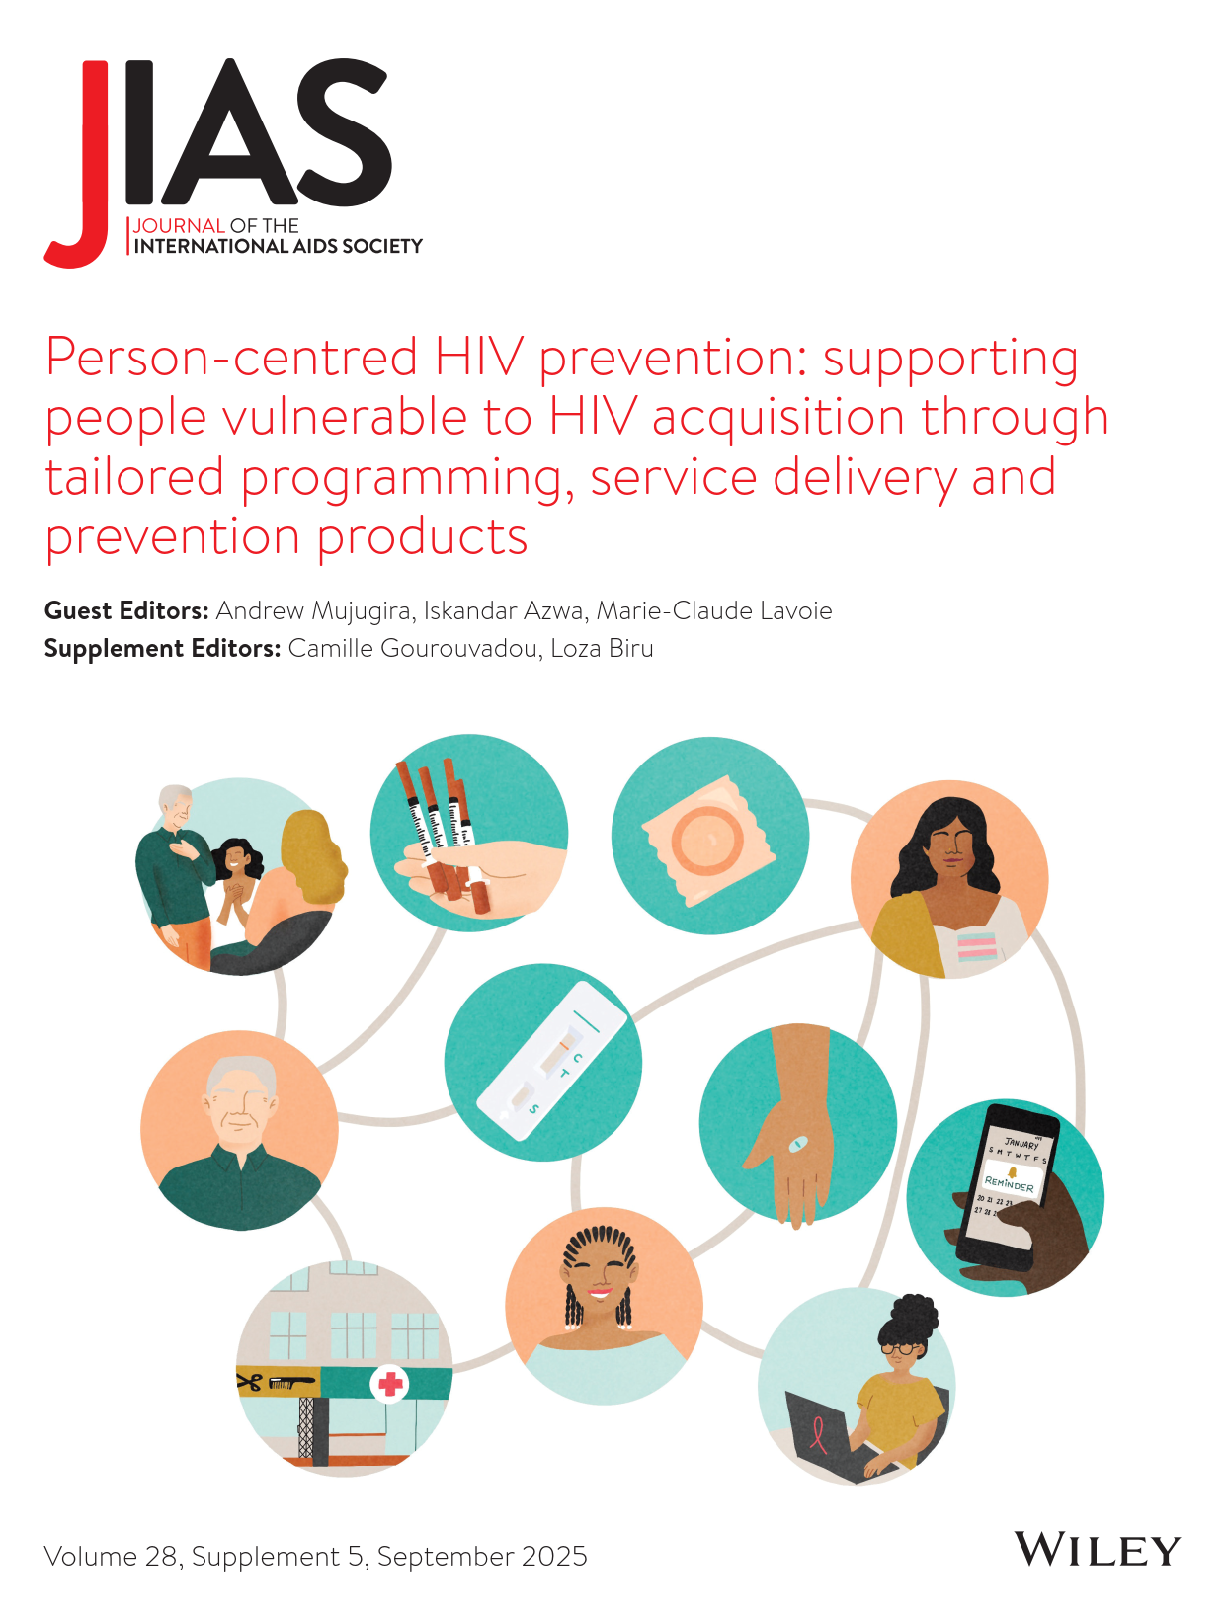
JIAS supplement Sep 2025
Guest editors:
Andrew Mujugira, Makerere University, Uganda
Iskandar Azwa, University of Malaya, Malaysia
Mare-Claude Lavoie, University of Maryland, United States
Notes:
This supplement will feature x research, x viewpoint, x etc
Thank fellow GEs

Slide 7
Supplement objectives
Disseminate new evidence to scale up person-centred HIV prevention interventions, services and products.
Scope included the integration of HIV prevention services with those for hepatitis and tuberculosis, as well as sexual and reproductive health.
Selection prioritized contributions that evaluate novel strategies, including within de-medicalized settings, to overcome or circumvent structural and legal barriers to improve access to prevention services and ensure effective linkage to care among marginalized groups.
Notes:
Document and disseminate evidence on the impact of interventions designed to enhance access to and advance the scale up of effective, person-centred HIV prevention interventions, services and products.
Scope includes the integration of HIV prevention services with those for hepatitis and tuberculosis, as well as sexual and reproductive health.
Selection prioritizes contributions that evaluate novel strategies, including within de-medicalized settings, to overcome or circumvent structural and legal barriers to improve access to prevention services and ensure effective linkage to care among marginalized groups

Slide 8
Key themes of new evidence on person-centred HIV prevention
Acceptability
Accessibility
Choice
Cost-effectiveness
Digital health tools
Self-care
Sustainability
Youth-friendliness
Informed, effective choice is highly valued by clients
Oral PrEP adherence is often sub-optimal but digital tools can support adherence
Diverse demand for long-acting PrEP formulations exists
Safer supply of opioids can reduce HIV and HCV acquisition within broad, trauma-informed care
Status-neutral, appropriately integrated and inclusive primary healthcare and harm reduction services are key
Gender-affirming care can be an effective entry point for HIV prevention services

Slide 9
Programme (part 2) – today
Topic | Speaker
Opening remarks, objectives of session and overview of supplement and editorial themes | Iskandar Azwa, University of Malaya, Malaysia
Sustaining HIV prevention success in Australia through person-centred approaches | Benjamin Bavinton, Kirby Institute, Australia
Enhancing PrEP adherence through person-centred mobile app interventions: a real-world data and machine learning approach using UPrEPU among gay, bisexual and other men who have sex with men in Taiwan | Carol Strong, National Chenk Kung University, Taiwan
Empowering at-risk Thai adolescents and young adults: an observational study of “Stand By You” – a person-centred online service model for HIV self-screening, text-based counselling and linkage to care | Kantarida Sripanidkulchai, Mahidol University, Thailand
Laser hair removal to antiretrovirals: findings from a person-centred care model for transgender people in India | Simran Shaikh, The Johns Hopkins University School of Medicine, New Delhi, India
Rapporteur report back from part 1 meeting focused on evidence from Africa and North America | Andrew Mujugira, The Infectious Diseases Institute Limited, Uganda
Panel discussion to propose and prioritize research gaps on themes | Moderator + speakers
Q&A and open discussion with participants | All participants
Closing remarks | Iskandar Azwa, University of Malaya, Malaysia

Slide 10
Sustaining HIV prevention success through person-centred approaches Insights from the Australian HIV response
Bavinton BR, Gray J, Grulich AE. Sustaining HIV prevention success in Australia through person-centred approaches. JIAS, 28(S5):e70007
A/Prof Benjamin R. Bavinton
Group Leader, Biobehavioural Prevention Research Group
Deputy Head, HIV Epidemiology & Prevention Program
Kirby Institute, UNSW Sydney

Slide 11
Person-centred HIV prevention
Person-centred prevention:
Prioritises autonomy, preferences, lived experience
Focuses on dignity, rights and agency
One size does not fit all – people want and need different prevention approaches at different times in their lives
Choice in prevention is an essential component (not a “nice to have”), including choice in:
Prevention tools and testing options
Service locations
Types of service providers
Timing

Slide 12
HIV prevention in Australia
Successes:
Large declines in HIV diagnoses among Australian-born GBM (>50% decrease in last 15 years) and in inner-city suburbs (~88% decline)
Very high PrEP uptake (~75% of at-risk GBM take PrEP)
High treatment coverage and viral suppression (>98%; >80% on ART within 4 weeks)
But disparities remain:
Increasing diagnoses among migrant GBM (>50% increase in last 15 years)
Geographic inequities outside inner-city areas (minimal change in last 15 years)

Slide 13
Foundations of person-centred prevention in Australia: Approach
“Partnership Approach”
Community leadership
Partnership between community, researchers, clinicians and government
Sustained investment in community organisations
Two-way evidence approach
Implementation of interventions proved by science (e.g. PrEP, TasP)
Community innovations shape prevention strategies (e.g. negotiated safety, strategic positioning)
HIV as an “apolitical” issue, allowing implementation of controversial innovations

Slide 14
Foundations of person-centred prevention in Australia: Service delivery
HIV prevention and testing should be available wherever people seek care
Integrating HIV prevention and testing across the health system, embedded systematically
PrEP prescribed by any doctor
Community-based testing services
Needle-syringe programs across multiple settings
HIV self-testing via pharmacies and online
Allows for two-way holistic care

Slide 15
Research and implementation gaps
Some of our key challenges:
We are not necessarily innovating at the speed we should be (e.g. differentiated PrEP service delivery) – we need better understanding of the barriers and what it will take to convince policymakers to support systemic innovation
No feasible pathway to access to long-acting PrEP products
Limited understanding of what is driving our inequity challenges (e.g. migrant populations, geography) and how to address them pragmatically

Slide 16
Current and future research
Implementing and evaluating new PrEP service delivery models, including:
Nurse-led PrEP delivery in public sexual health centres and community testing services
Pilot programs exploring pharmacy-based PrEP with no doctor’s prescription
Trial of peer-to-peer PrEP delivery
Evaluation of telehealth PrEP models and a new credentialing system for online PrEP providers
Evaluation of national program providing free PrEP to temporary visa holders without access to Medicare
Addressing inequities:
Qualitative research to better understand how to engage GBM in both HIV services and research. This work is informing efforts to increase participation of newly arrived migrants in large national behavioural surveys
Investigating new peer-based testing and PrEP models for outer suburban and regional areas
Currently no clear pathway to access long-acting PrEP products in Australia, but we continue to:
Study community preferences for different PrEP modalities
Conduct mathematical modelling on potential population impact
Ongoing advocacy with government and pharmaceutical manufacturers

Slide 17



Enhancing PrEP adherence through person-centred mobile app interventions: a real-world data and machine learning approach using UPrEPU among gay, bisexual and other men who have sex with men in Taiwan
Jay Chiehen Liao, Huei-Jiuan Wu, Tsan-Tse Chuang, Tsai-Wei Chen, Carol Strong

Slide 18


HIV Prevention with Oral PrEP
Daily
Event-driven
While overall adherence was high, switching from daily to event-driven PrEP regimen was associated with poorer adherence.
24 hour
24 hour
Sex
Wu HJ, Wen-Wei Ku S, Chang HH, Li CW, Ko NY, Strong C. Imperfect adherence in real life: a prevention-effective perspective on adherence to daily and event-driven HIV pre-exposure prophylaxis among men who have sex with men - a prospective cohort study in Taiwan. J Int AIDS Soc. 2021 May;24(5):e25733. doi: 10.1002/jia2.25733. PMID: 34018330; PMCID: PMC8138098.
2 Pills
1 Pill
1 Pill
2-24 hours
before sex
24 hours
after first 2 pills
24 hours
after third pills
Nichols BE, Boucher CAB, van der Valk M, Rijnders BJA, van de Vijver DAMC. Cost-effectiveness analysis of pre-exposure prophylaxis for HIV-1 prevention in the Netherlands: a mathematical modelling study. Lancet Infect Dis. 2016 Dec;16(12):1423-1429. doi: 10.1016/S1473-3099(16)30311-5. Epub 2016 Sep 22. PMID: 27665989.

Slide 19
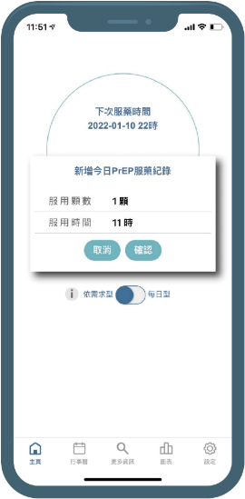
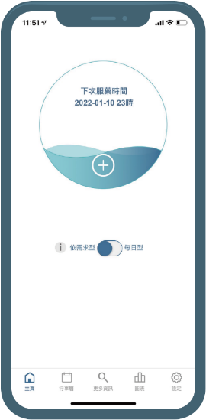
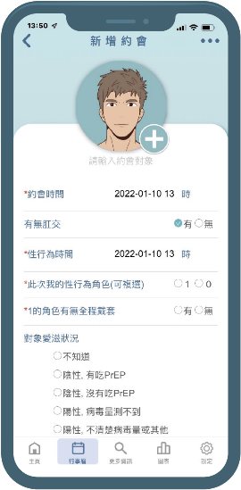

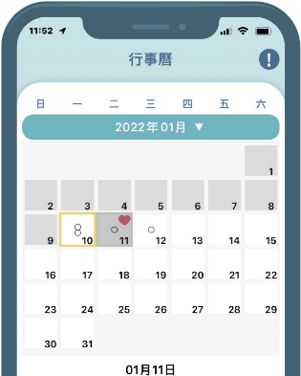

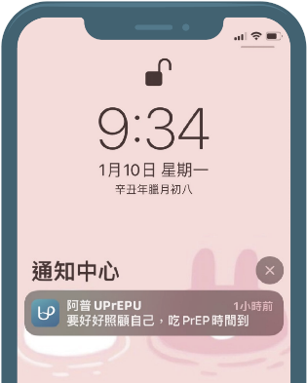
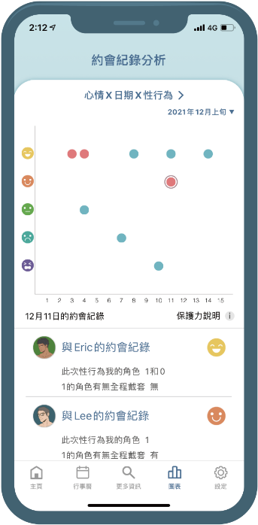


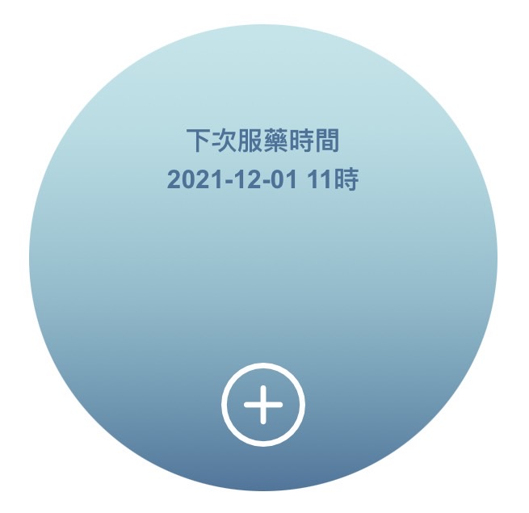
Our mobile app — UPrEPU阿普
1
Record PrEP intake, choice of dosing regimen, and information for each sex event.
Remind the users to take PrEP based on their dosing regimen, potential time, and pre-arranged date for the sex event and monitor their PrEP adherence.
2
3
Track whether users’ sex events were protected by PrEP and log their dynamic PrEP-dosing choices.
Half full
Having PrEP effect but not enough for protection
Full
Having enough for protection

Slide 20




HOLISTIC VIEW
UPrEPU as Person-Centred Care in Action
Captures sexual context & prevention behavior
INDIVIDUALIZED CARE
Individuals have unique values, preferences, and circumstances that should shape their healthcare experiences and outcomes.
Operates at a multidimensional level: Individual, Interpersonal, and Organizational
Predictions based on personal history
COMFORT & SECURITY
Self-monitoring, flexible dosing
Knight JM, Ward MK, Fernandez S, Genberg BL, Beach MC, Ladner RA, Trepka MJ. Perceptions and Current Practices in Patient-Centered Care: A Qualitative Study of Ryan White HIV Providers in South Florida. J Int Assoc Provid AIDS Care. 2024 Jan-Dec;23:23259582241244684. doi: 10.1177/23259582241244684. PMID: 38651291; PMCID: PMC11036924.
PATIENT ENGAGEMENT
Supports decision making, not surveillance

Slide 21
Characteristics of each sexual event e.g., user’s sex role, timing of the event, and condom use | Event-based attributes
User-based attributes | Personal characteristics, derived from cumulative or average data across events (anal sex, number of times PrEP was taken, proportion of condom use)
OBJECTIVE
To determine whether real-world app date can predict if a specific sexual event was protected by correct PrEP use
To evaluate whether incorporating user-level attributes improves prediction compared to using only event-level data

Slide 22
OUTCOME
Primary outcome is a binary variable indicating whether PrEP was taken correctly for an anal sex event. A correct intake was determined if one of the following two criteria was satisfied:
For at least 4 out of 7 days before a sexual event, at least one pill was taken each day.
Two pills of PrEP were taken between 2 and 24 hours before, followed by one pill taken between 24 and 48 hours, respectively, after the first pill intake. However, if at least one pill was taken within 7 days before each sexual event, taking only one pill 2–24 hours before each sexual event was allowed.

Slide 23
TRAINING, EVALUATION AND EXPLANATION OF MACHINE LEARNING MODELS
We used CatBoost to construct our machine learning models
CatBoost was selected for its significantly better performance compared to Random Forest and XGBoost in our empirical evaluation. It is particularly well-suited to our data, as it natively handles categorical features using permutation-based target statistics and accommodates missing values through sentinel imputation, eliminating the need for normalization or scaling.
Two CatBoost classifiers were constructed:
Model 1 (M1):
All 11 event-based attributes
Model 2 (M2):
Besides 11 event-based attributes, 19 dynamic user-based attributes with contextual information were also included, resulting in 30 features. Five nested variants of M2 (M2-a through M2-e), containing successively fewer features (i.e. 25, 20, 15, 10 and 5), were also evaluated.

Slide 24
RESULTS
Cohort characteristics
Participants: 198 users in Taiwan
Study period: January 2022 – May 2023
Total recorded events: 2,356 anal sexual events on UPrEPU
Average app usage: 155 days and 19.5 hours per user
Average number of sexual events per user: 11.9
(SD = 19.8)
Protected events: 1,662 events (70.5%) were protected by correct PrEP use based on study definition
Machine learning models
The Wilcoxon signed-rank test showed that M2 (event and user-based attributes) significantly outperformed M1 (event-based attributes) with a higher F1-score (p < 0.005), under scoring the value of incorporating user-based attributes with contextual information into the prediction model.

Slide 25
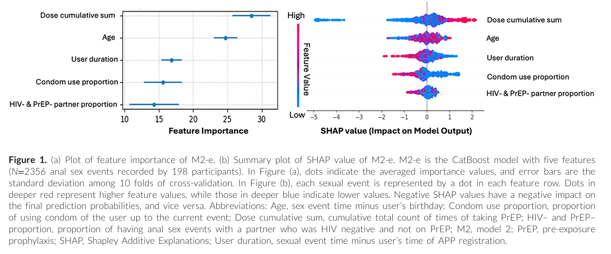
Most influential predictor is cumulative PrEP use
Suggests a learning curve in PrEP adherence
Frequent self-monitoring and visual feedback through mobile apps can reinforce PrEP adherence by enhancing users’ ability to recognize behavioral patterns and implement timely prevention strategies

Slide 26
PERSON-CENTRED IMPLICATION
These patterns reflected habitual tendencies and personal prevention choices within the Taiwanese context, rather than isolated characteristics of individual sexual events.
Understanding these patterns can enhance predictive models and support person-centred interventions. Integrating this insight into clinical care or digital tools may improve consultations and support timely, informed HIV prevention decisions.
FUTURE RESEARCH
Expanding from PrEP adherence to person-centred harm reduction, particularly integrating sexual health and substance-use contexts among chemsex populations.

Slide 27
THANK YOU!
Enhancing PrEP adherence through person-centred mobile app interventions: a real-world data and machine learning approach using UPrEPU among gay, bisexual and other men who have sex with men in Taiwan
Insights from the UPrEPU Mobile App
Carol Strong, MPH, PhD

Slide 28
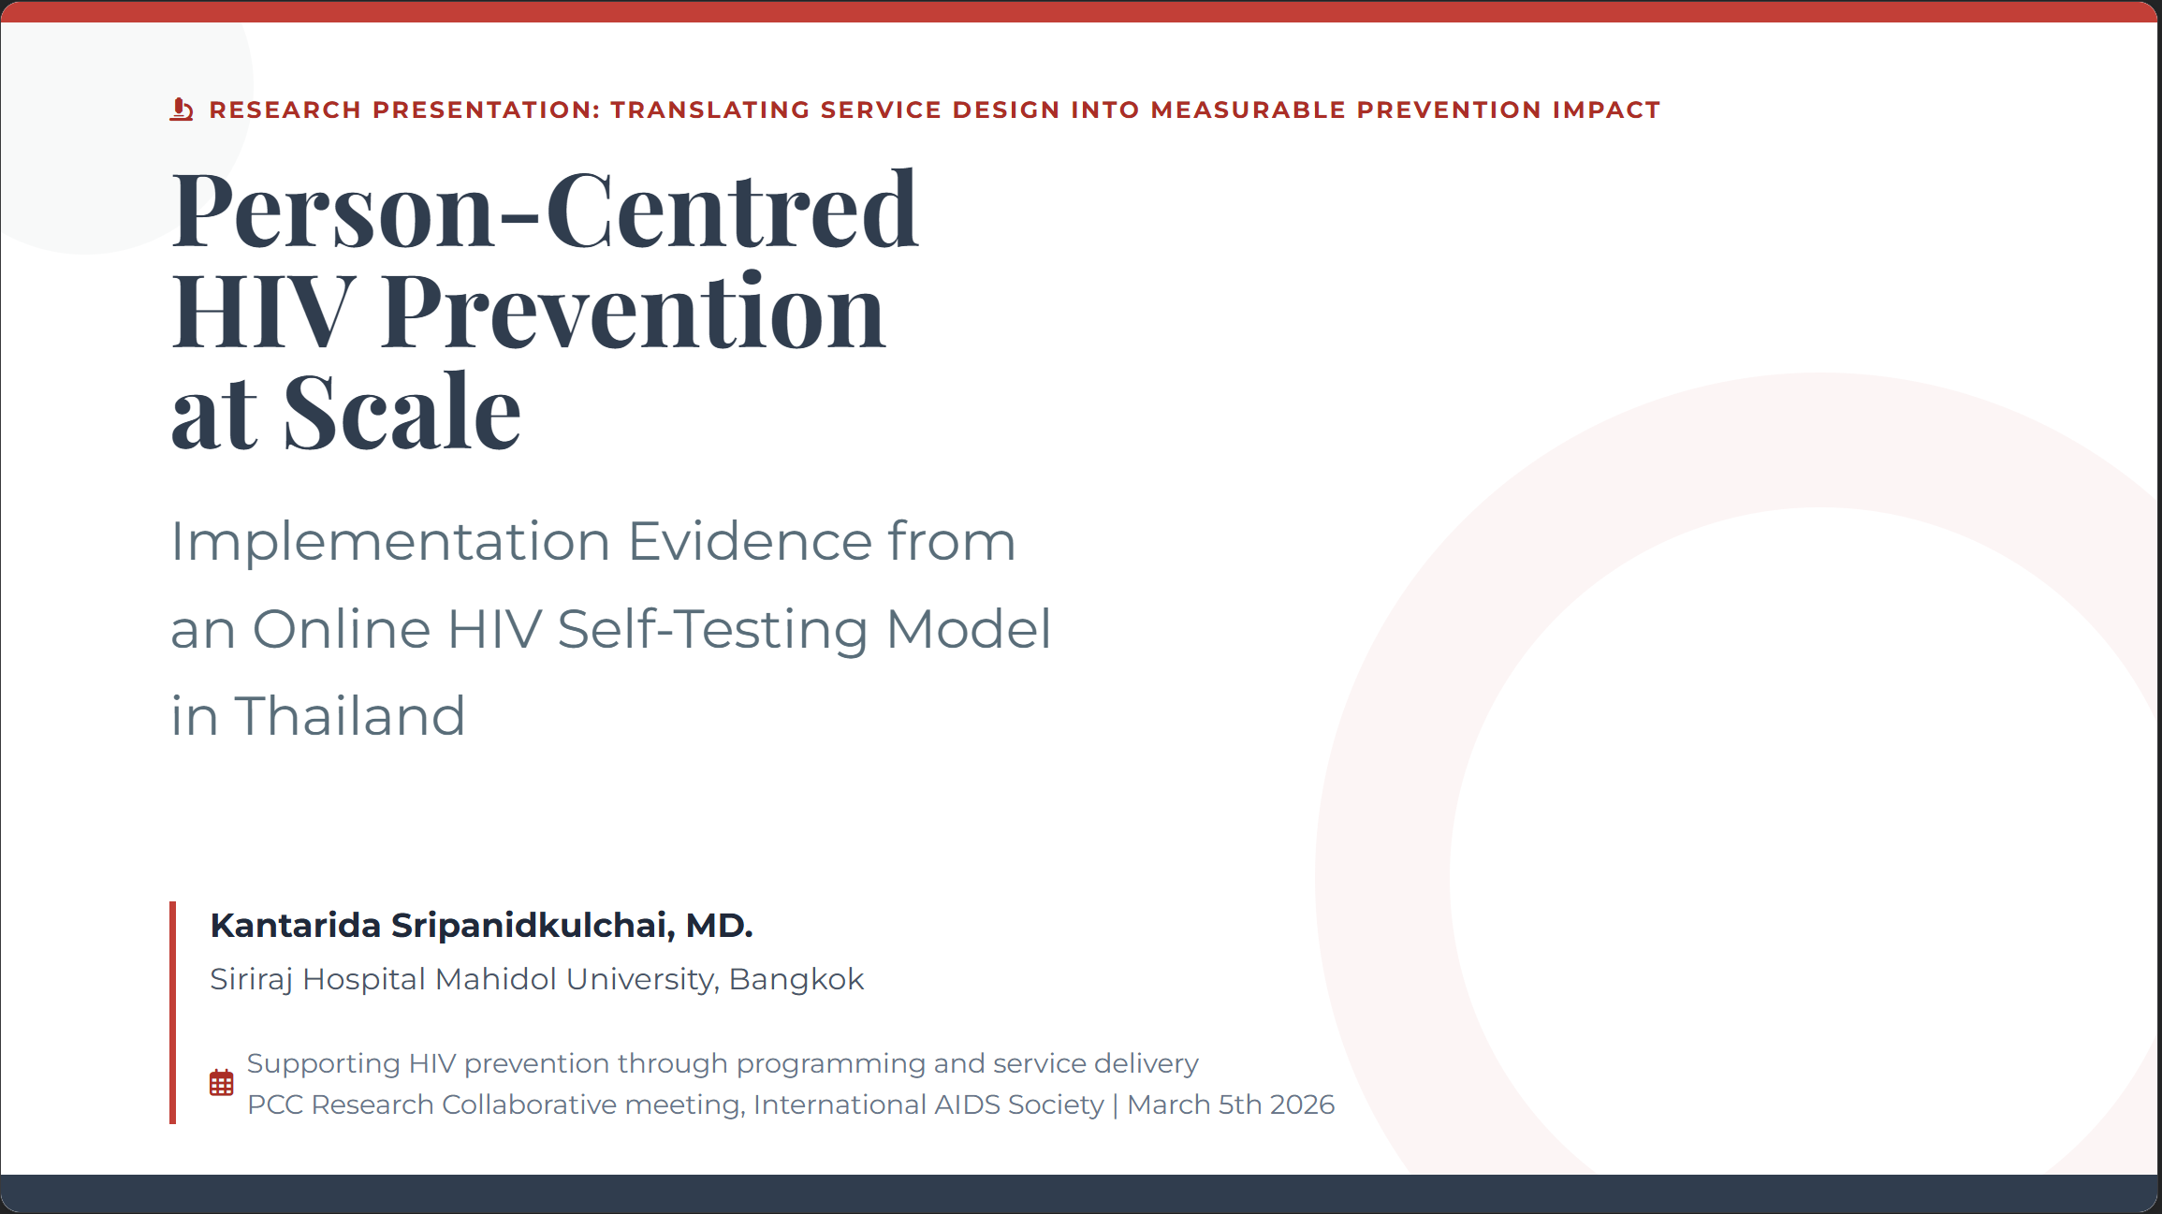
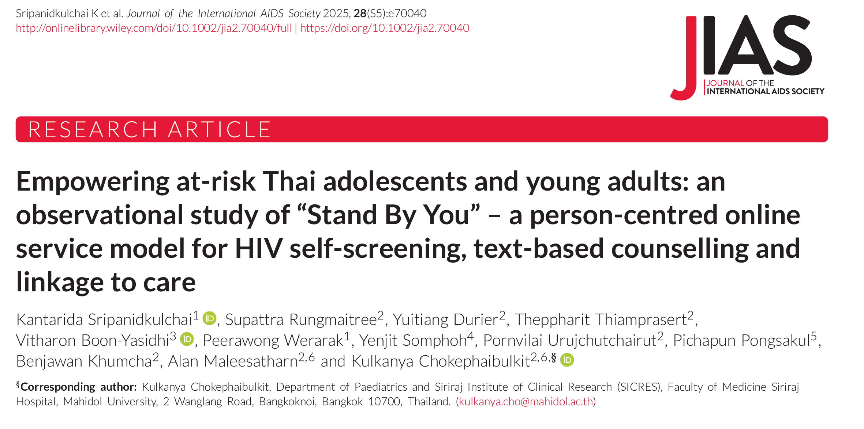




Notes:
Good morning everyone. Thank you for convening this meeting.
Today I will share implementation evidence from Thailand on how a person-centred, online HIV self-testing model can operationalize prevention in real-world service delivery.
This is not a technology story. It is a service design story — about access, autonomy, and measurable prevention impact.

Slide 29
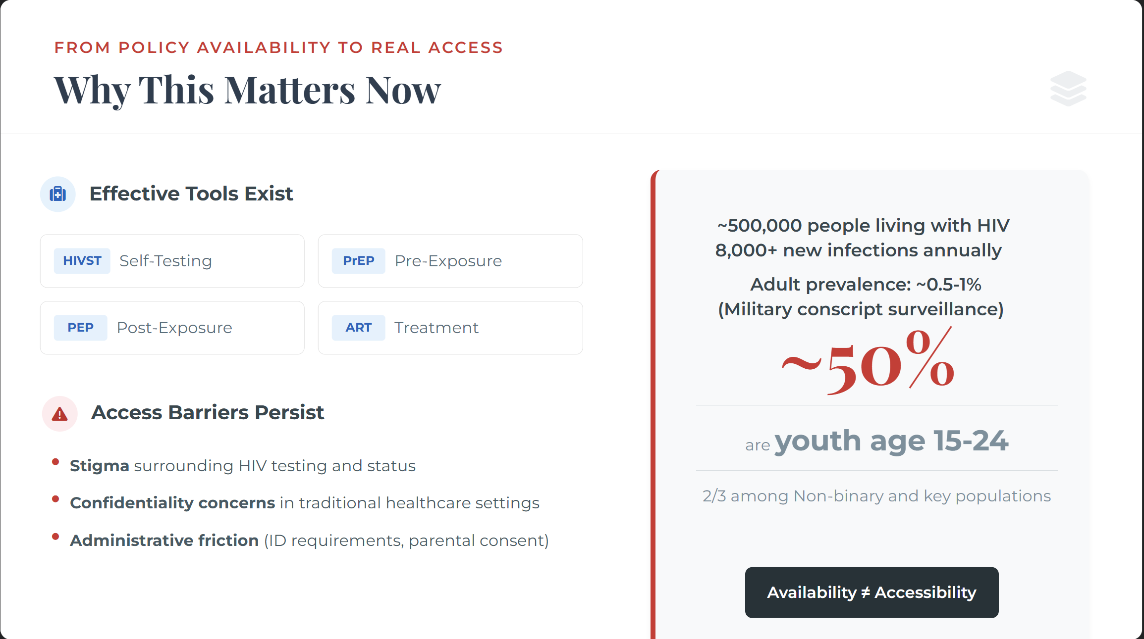


(multiple visits, complex paperwork, or long waiting times)
Notes:
To frame this work, Thailand has approximately 500,000 people living with HIV and more than 8,000 new infections annually. Despite national HIV incidence has declined over the past decade, young people remain disproportionately affected, with nearly half of new HIV acquisitions occurring among those aged 15 to 24, and roughly two-thirds occur among key populations, including men who have sex with men, transgender individuals, and non-binary genders.
So while effective tools exist — HIV self-testing, PrEP, PEP, ART — access barriers persist. Stigma, confidentiality concerns, and administrative friction continue to limit uptake.
HIV self-testing is included in the universal health coverage package, yet access may still require pre-registration with a national ID at designated facilities, which can discourage uptake due to privacy concerns.
Availability does not automatically translate into accessibility.

Slide 30
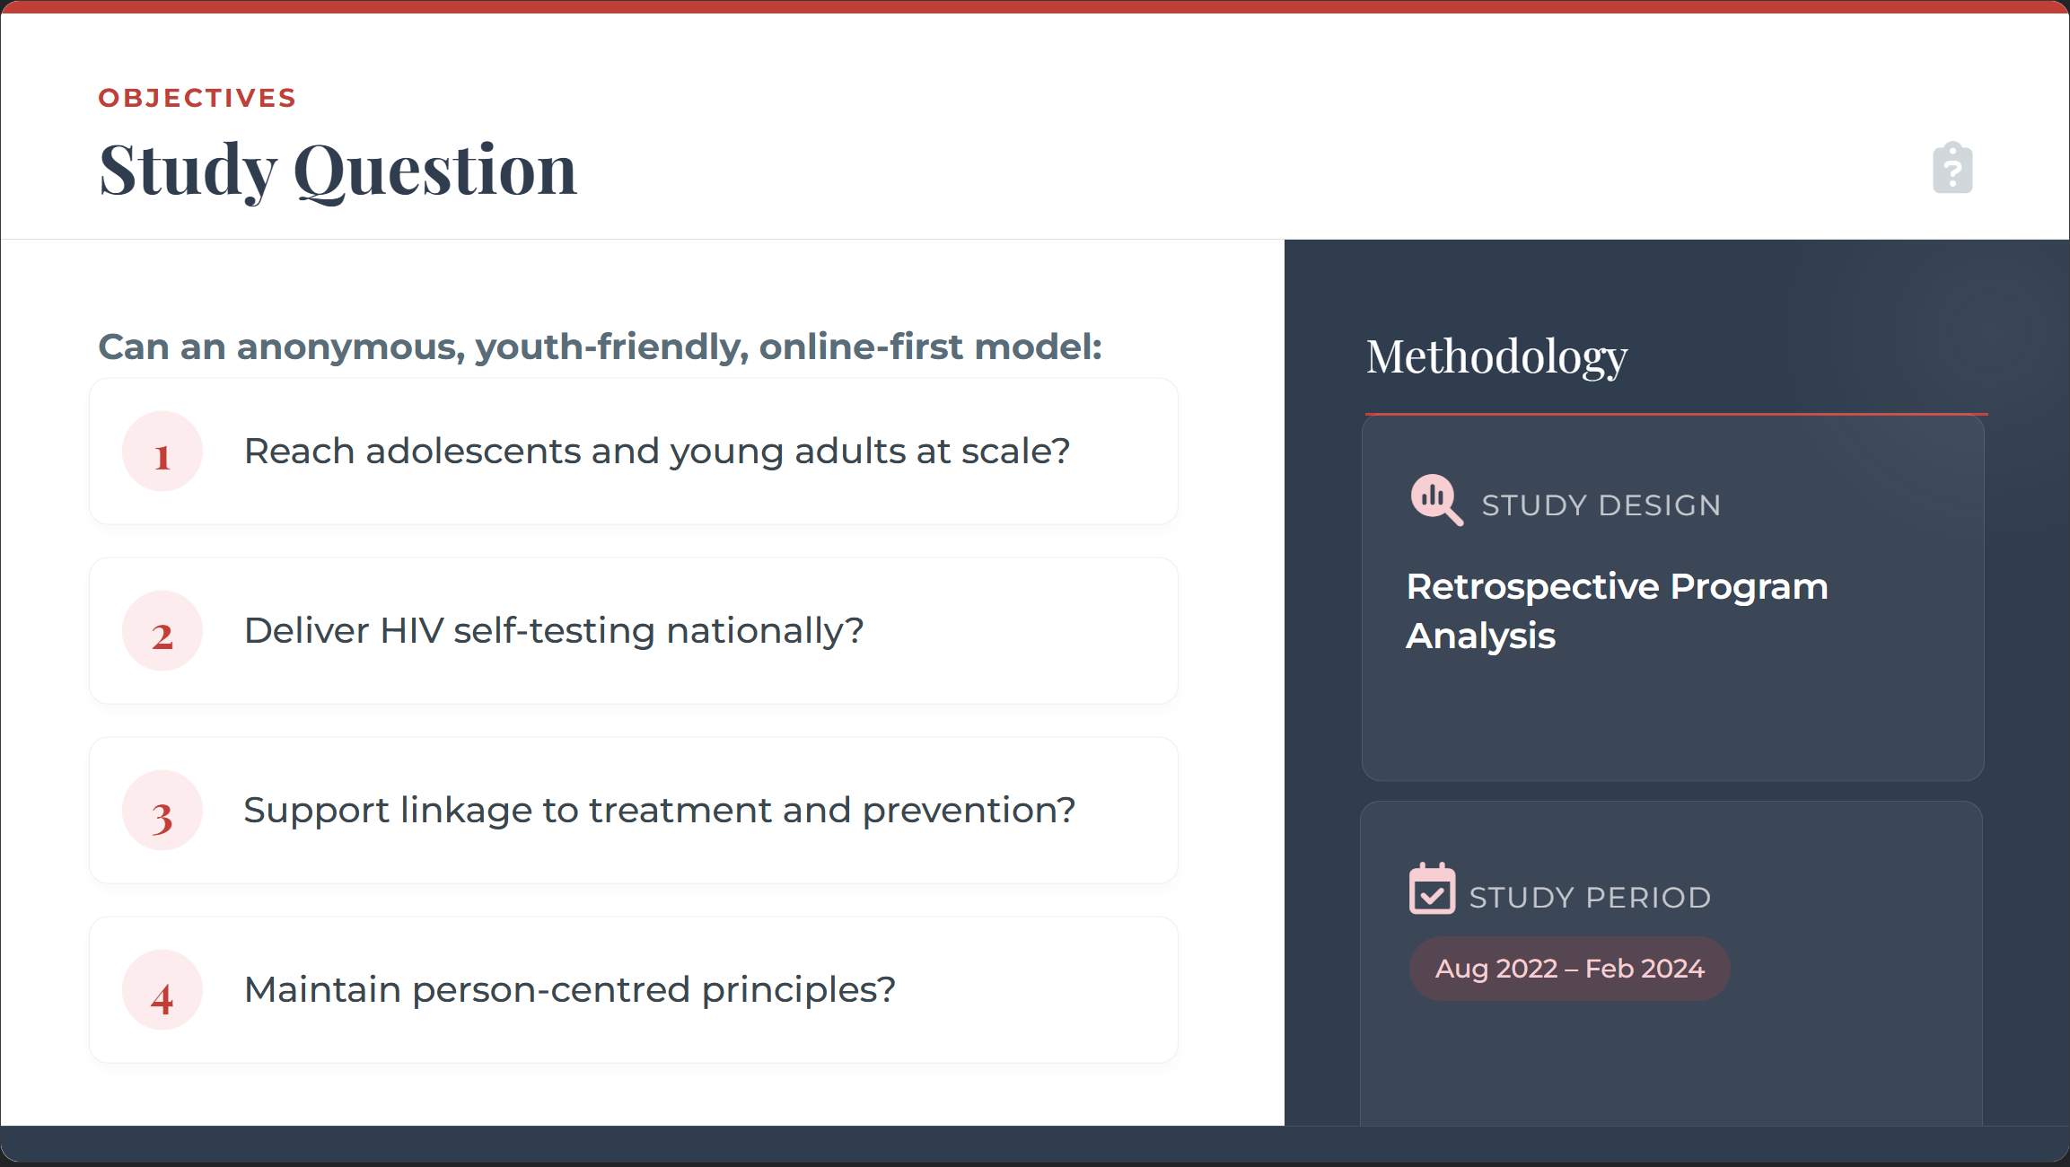
Notes:
We therefore asked:
Can an anonymous, youth-friendly, online-first model:
Reach adolescents and young adults at scale?
Deliver HIV self-testing nationwide?
Support linkage to treatment and prevention?
And maintain person-centred principles?
We conducted a retrospective observational analysis of programme data from August 2022 to February 2024.

Slide 31

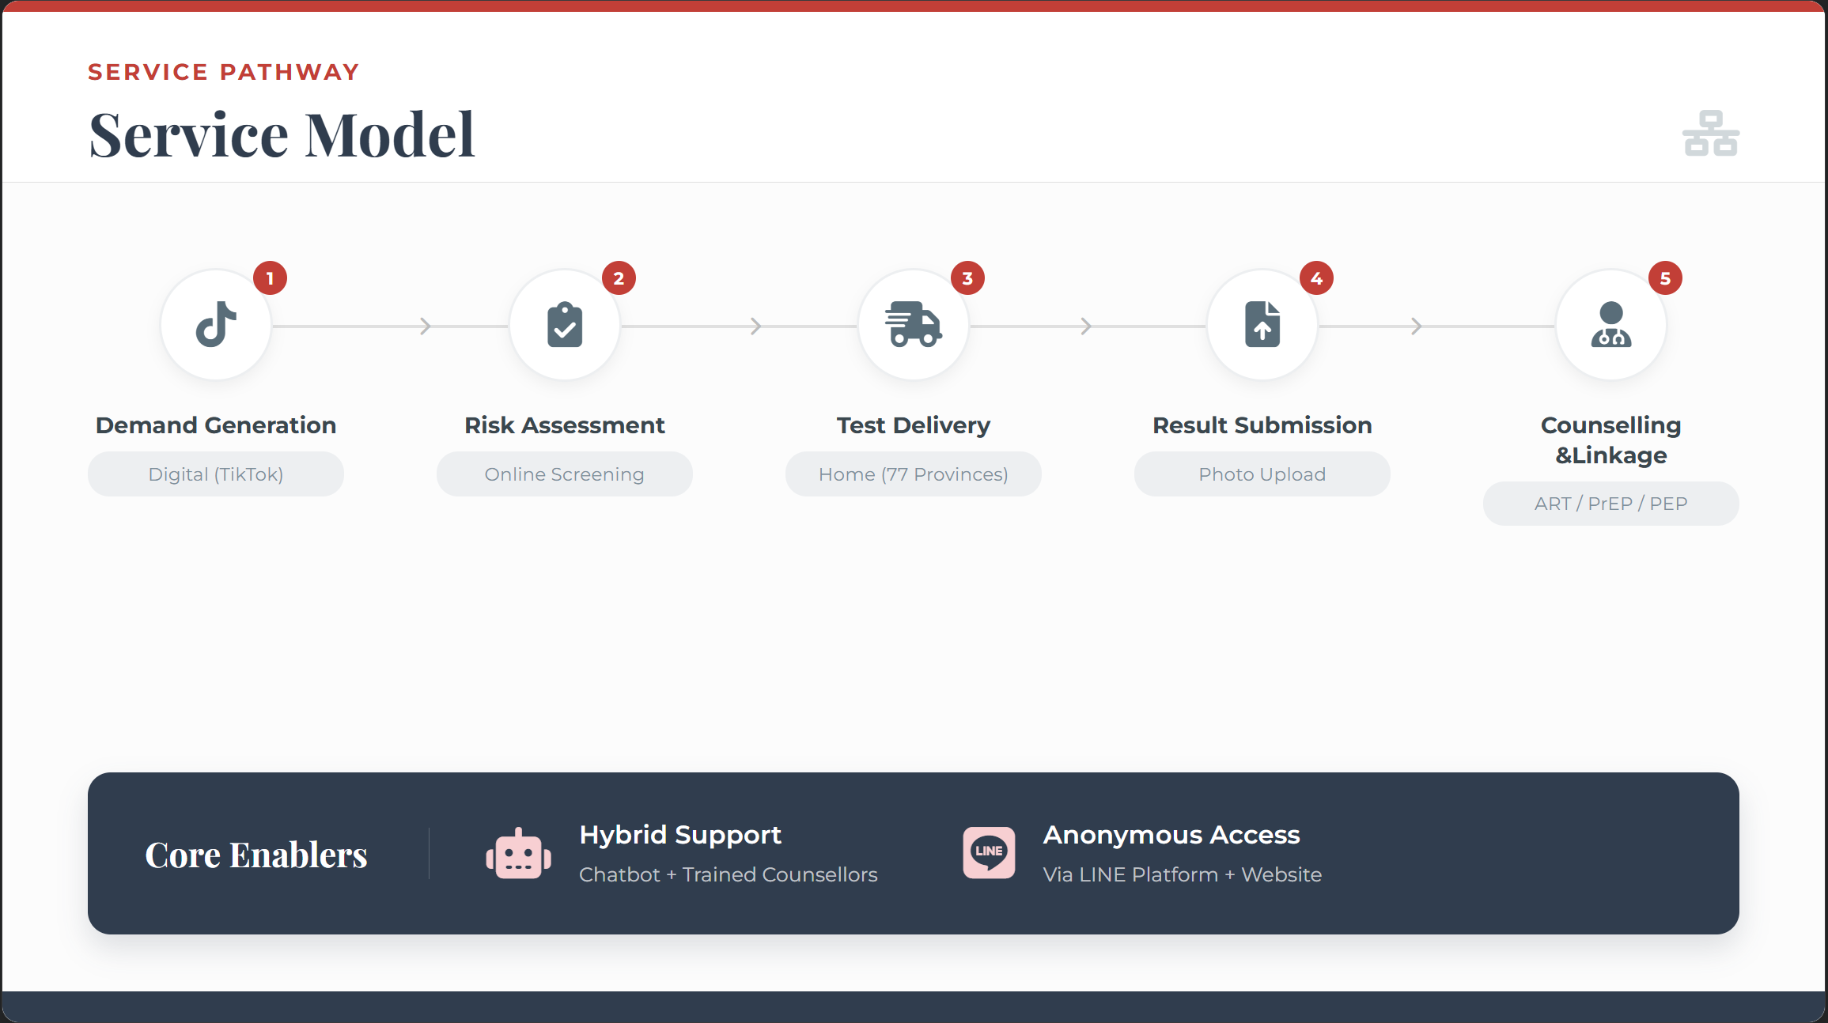
Notes:
The Stand By You program operates through LINE and a website.
Demand is generated through TikTok influencers targeting youth audiences.
Clients complete an online risk assessment, receive tailored recommendations, and can request HIV self-test kits delivered nationwide across all 77 provinces.
The system combines a chatbot with trained human counsellors providing confidential text-based counselling with instant response.
Clients submit results online and receive support for confirmatory testing, ART, PrEP, or PEP linkage as needed.
Access is anonymous. No in-person ID requirement.

Slide 32
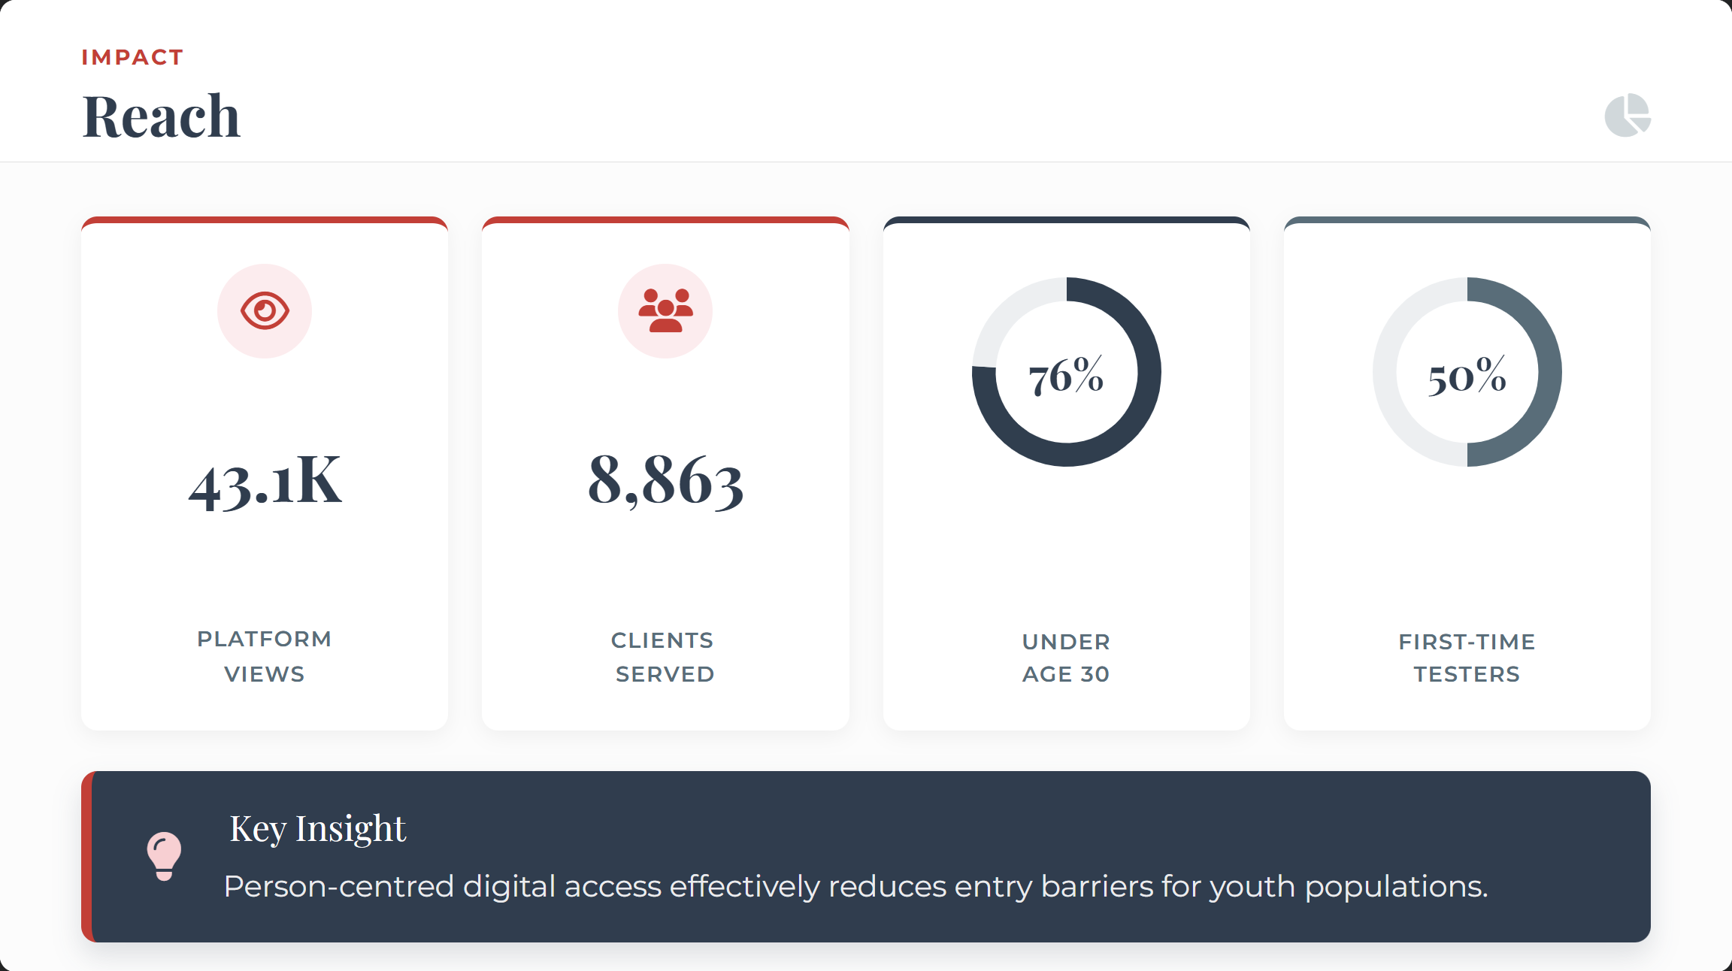

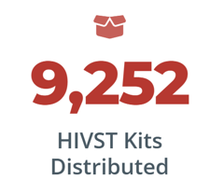

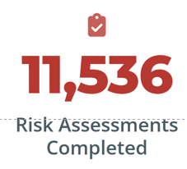

Notes:
During the study period, the platform recorded over 43,000 unique views and served 8,863 clients.
Seventy-six percent were under age 30.
More than half were first-time testers.
That matters because first-time testing is often where stigma, fear, and uncertainty are most intense, and where person-centred design can have the biggest impact.

Slide 33
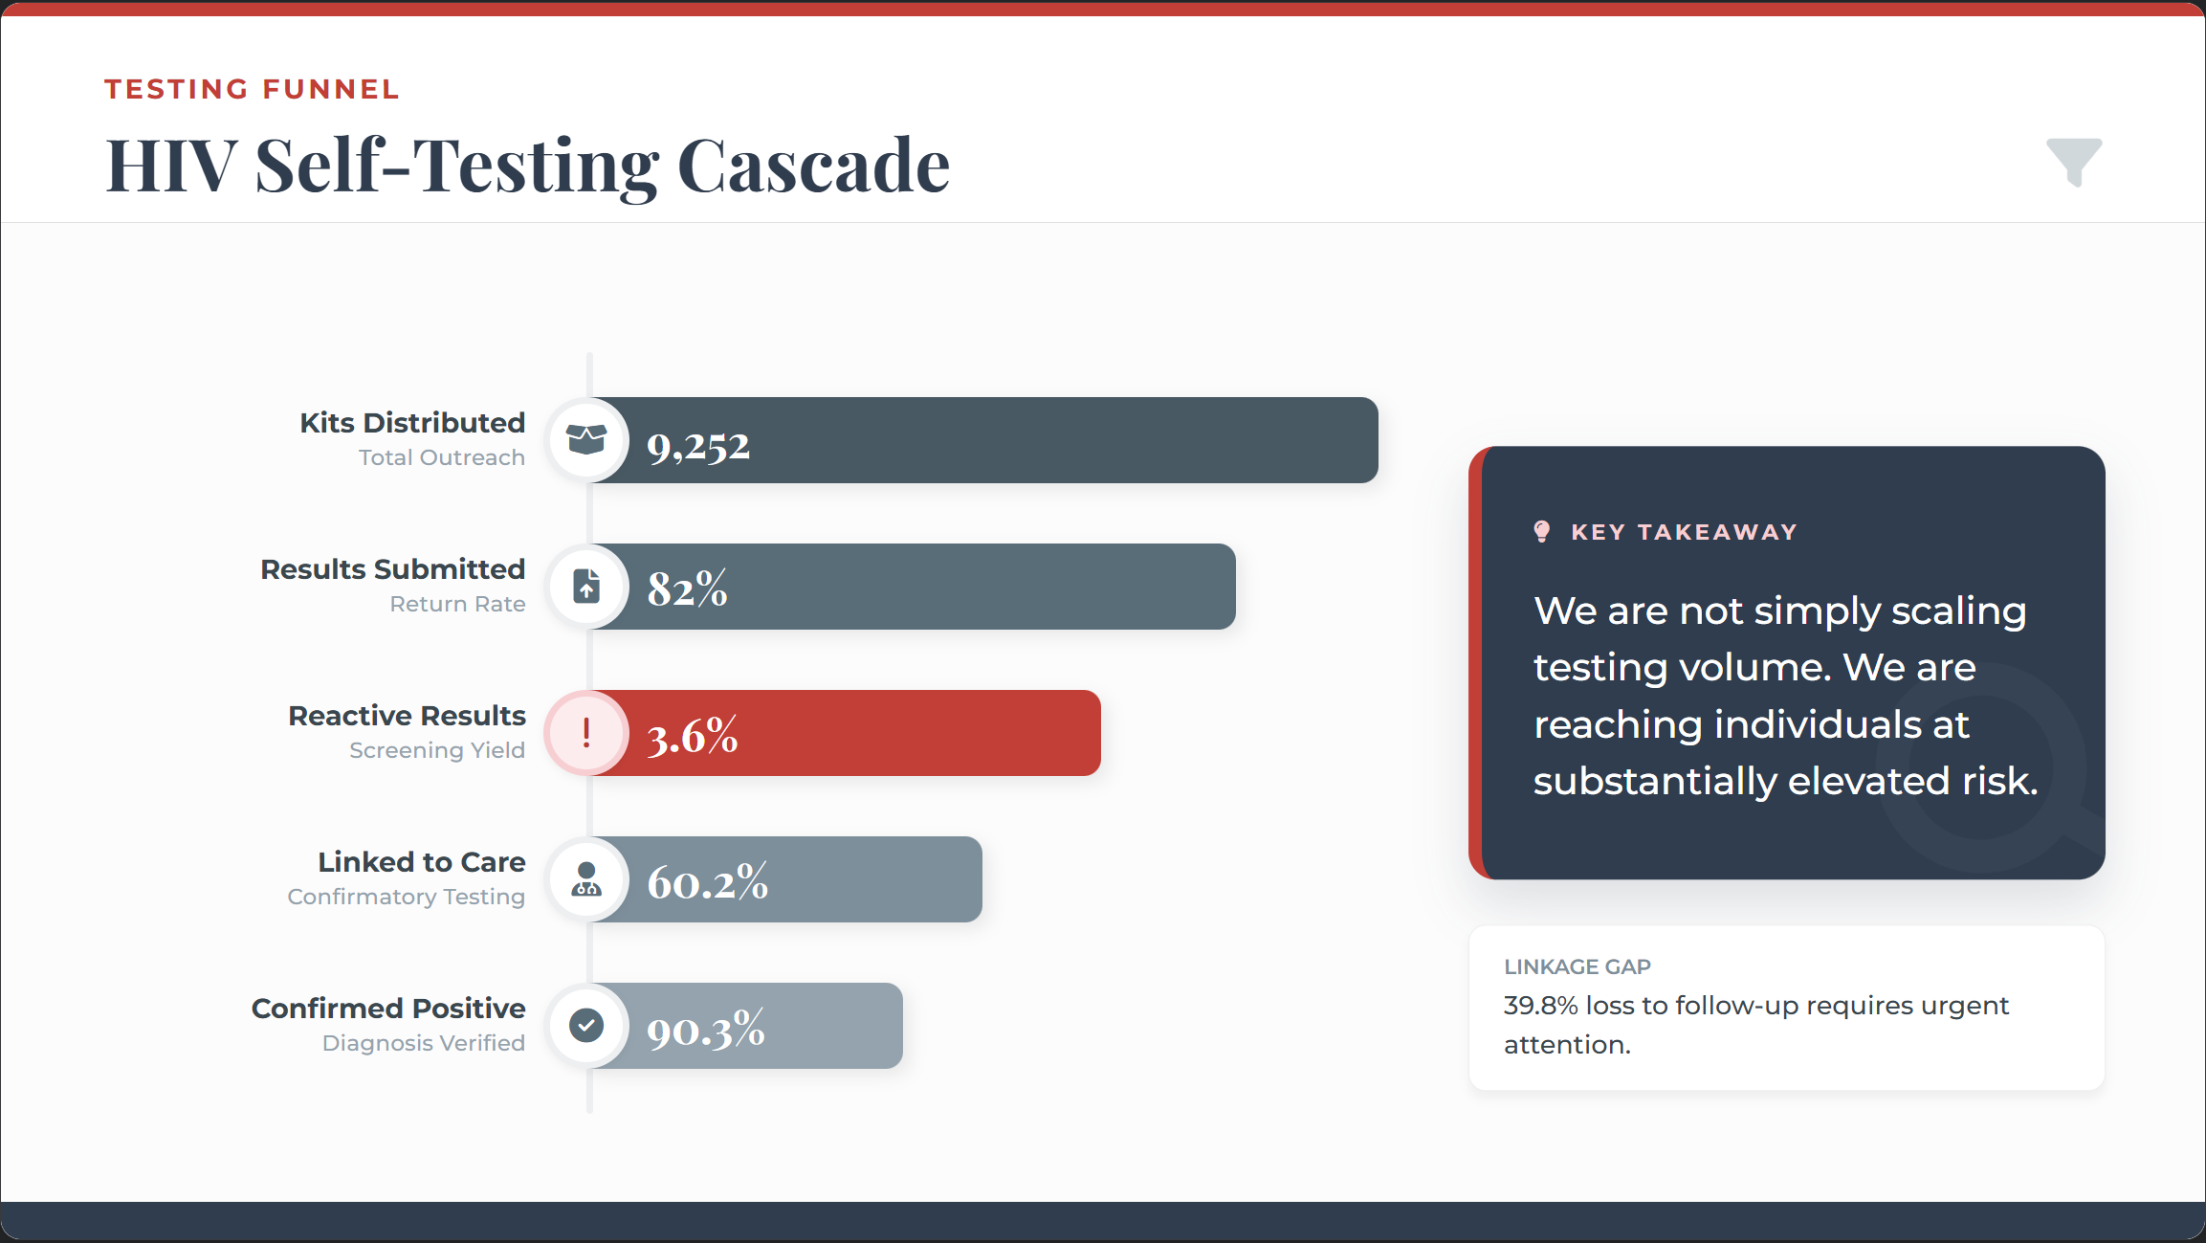

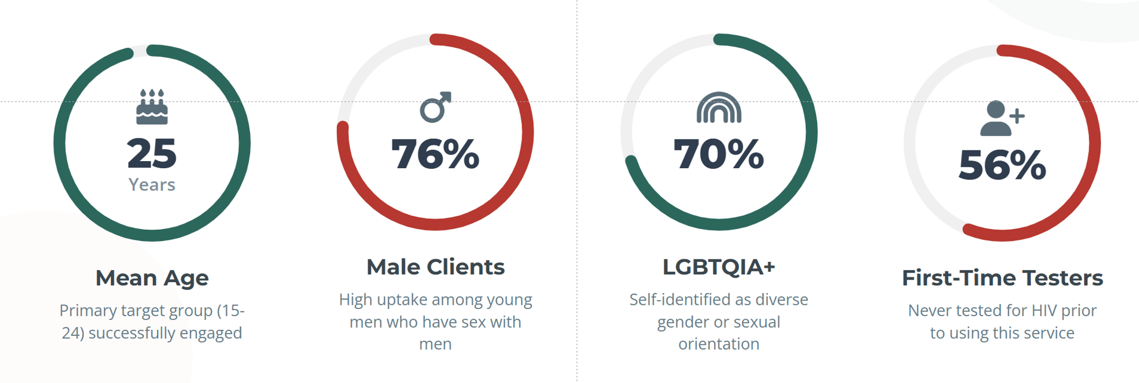
x7
Military conscript surveillance, HIV prevalence 0.5%
⬆
⬇
Notes:
We distributed 9,252 HIV self-test kits nationwide.
Eighty-two percent of clients submitted their results.
In the world of implementation, that 82% is not just a statistic, it’s a signal that the model reduced friction: the pathway was understandable, convenient, and sufficiently supportive to complete.
Among submitted results, 3.6% were reactive.
Sixty percent of those were successfully linked to confirmatory testing and care.
Among those receiving confirmatory testing, 90.3% were confirmed HIV positive.
Now, this 3.6% matters.
Based on military conscript surveillance data, a 3.6% reactive rate is more than seven times higher than background prevalence, which observed more likely among clients identifying as LGBTQIA+, those with a history of STIs, and those reporting receiving money for sex.
Meanwhile, prior HIV testing history and PrEP use were associated with reduced odds of a reactive result.
This suggests we are not simply scaling testing volume.
We are reaching individuals at substantially elevated risk, who might otherwise remain outside facility-based testing, and connect many of them to care.

Slide 34
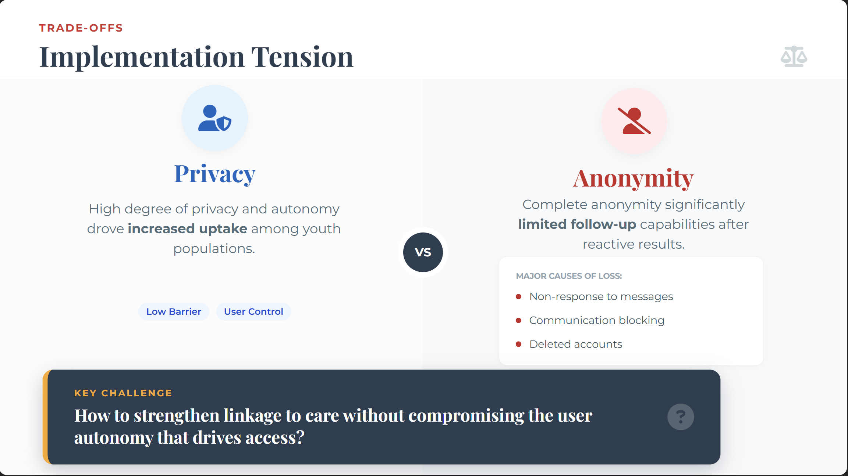
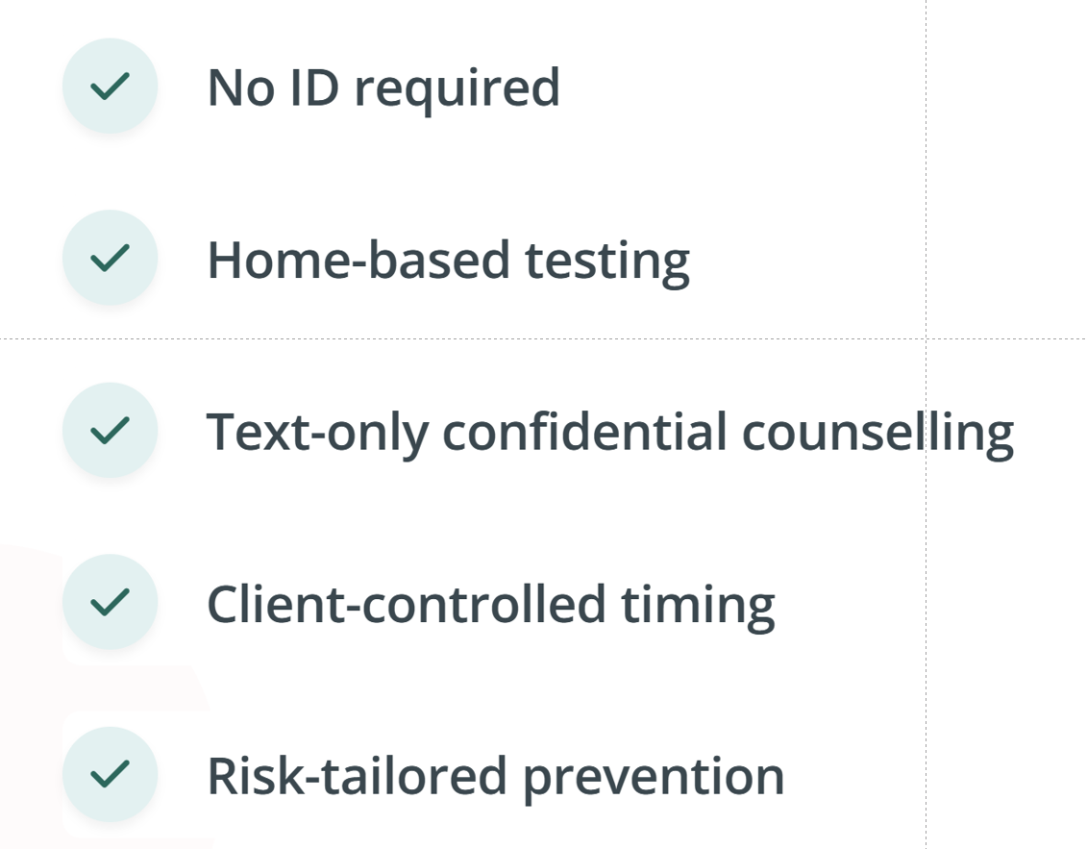
Notes:
However, the cascade also reveals a core challenge.
Anonymity increased uptake — particularly among youth and key populations.
But anonymity limits our ability to actively trace and re-engage individuals after a reactive result.
Some clients were lost to follow-up due to non-response or communication blocking.
This reflects a key tension in person-centred prevention: privacy expands access, but it complicates linkage science.
The question is not whether anonymity works — it clearly does — but how to strengthen follow-up without compromising autonomy.
In our model, counsellors are present, not only to deliver results, but to help people interpret them, manage anxiety, and choose the next step at their own pace.

Slide 35
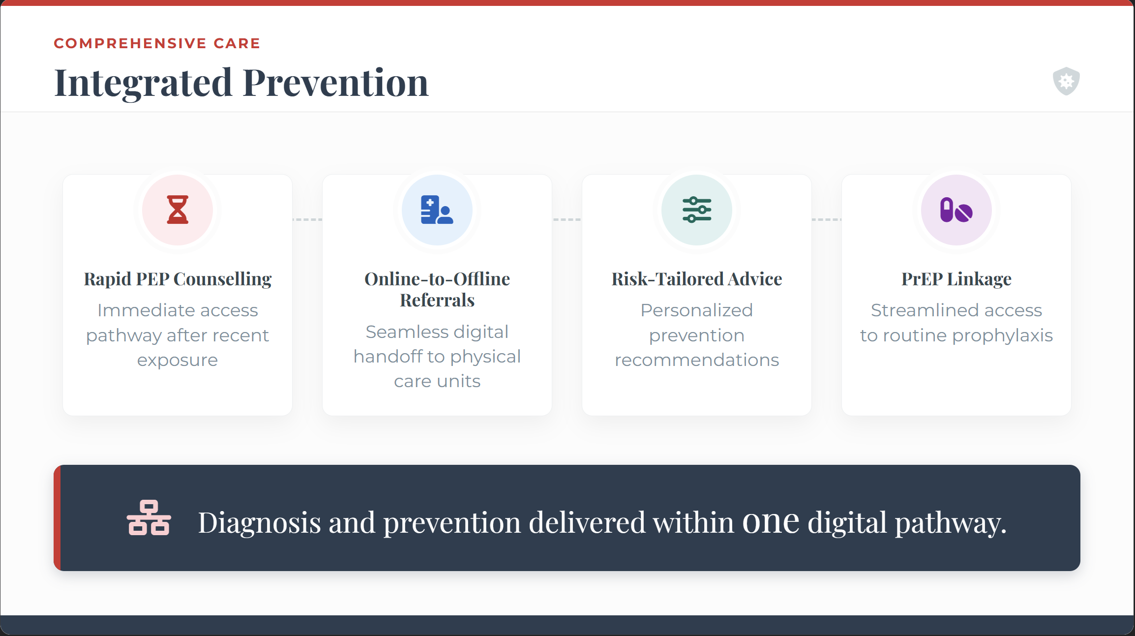
Notes:
The platform also enabled rapid prevention integration.
Clients reporting recent exposure requested PEP counselling and were linked to services.
Risk assessments informed tailored prevention recommendations, including PrEP referral.
This demonstrates that digital platforms can move beyond diagnosis and function as differentiated prevention delivery systems — especially when timing is critical.

Slide 36
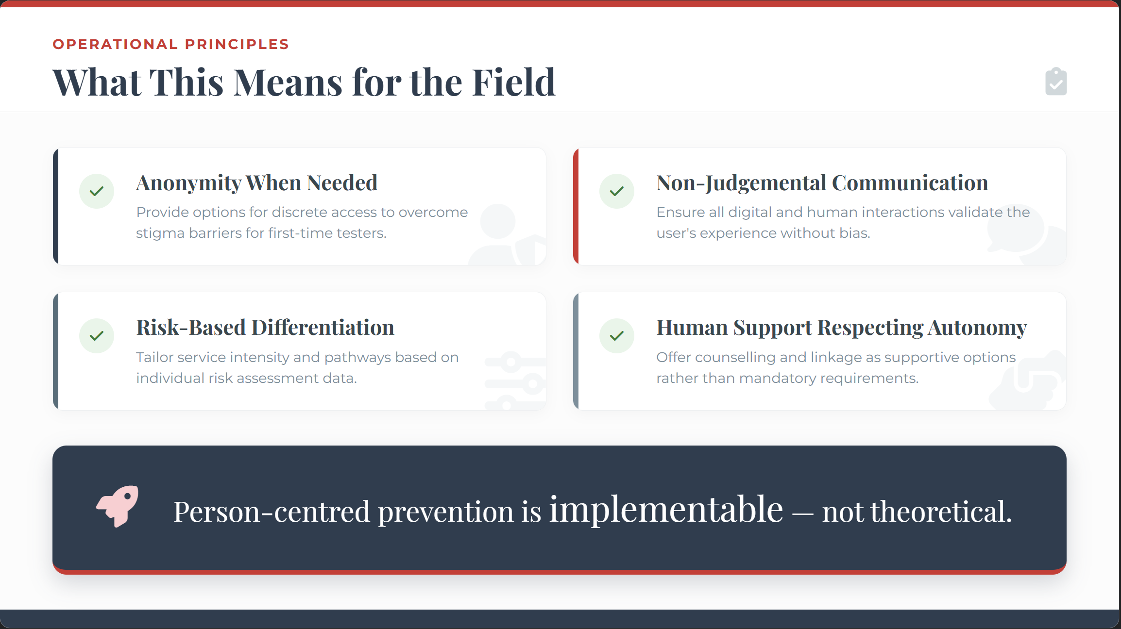
Notes:
From an implementation perspective, this model operationalizes four principles:
Anonymity when needed.
Rapid information without judgement.
Risk-based differentiation.
Human support that respects autonomy.
Stand By You was built to meet young people in the channels they use, offer home delivery without identity requirements, and provide counselling that is private, text-based, and consistent.
These principles are globally relevant, especially in settings where clinic-based stigma and administrative requirements can undermine access, even when policy says services are “available”.
And importantly, this is not only about diagnosing HIV. It is also about supporting people who test negative but remain at risk, and connecting them to PrEP, PEP, and prevention supplies through a service that feels safe and affirming.

Slide 37
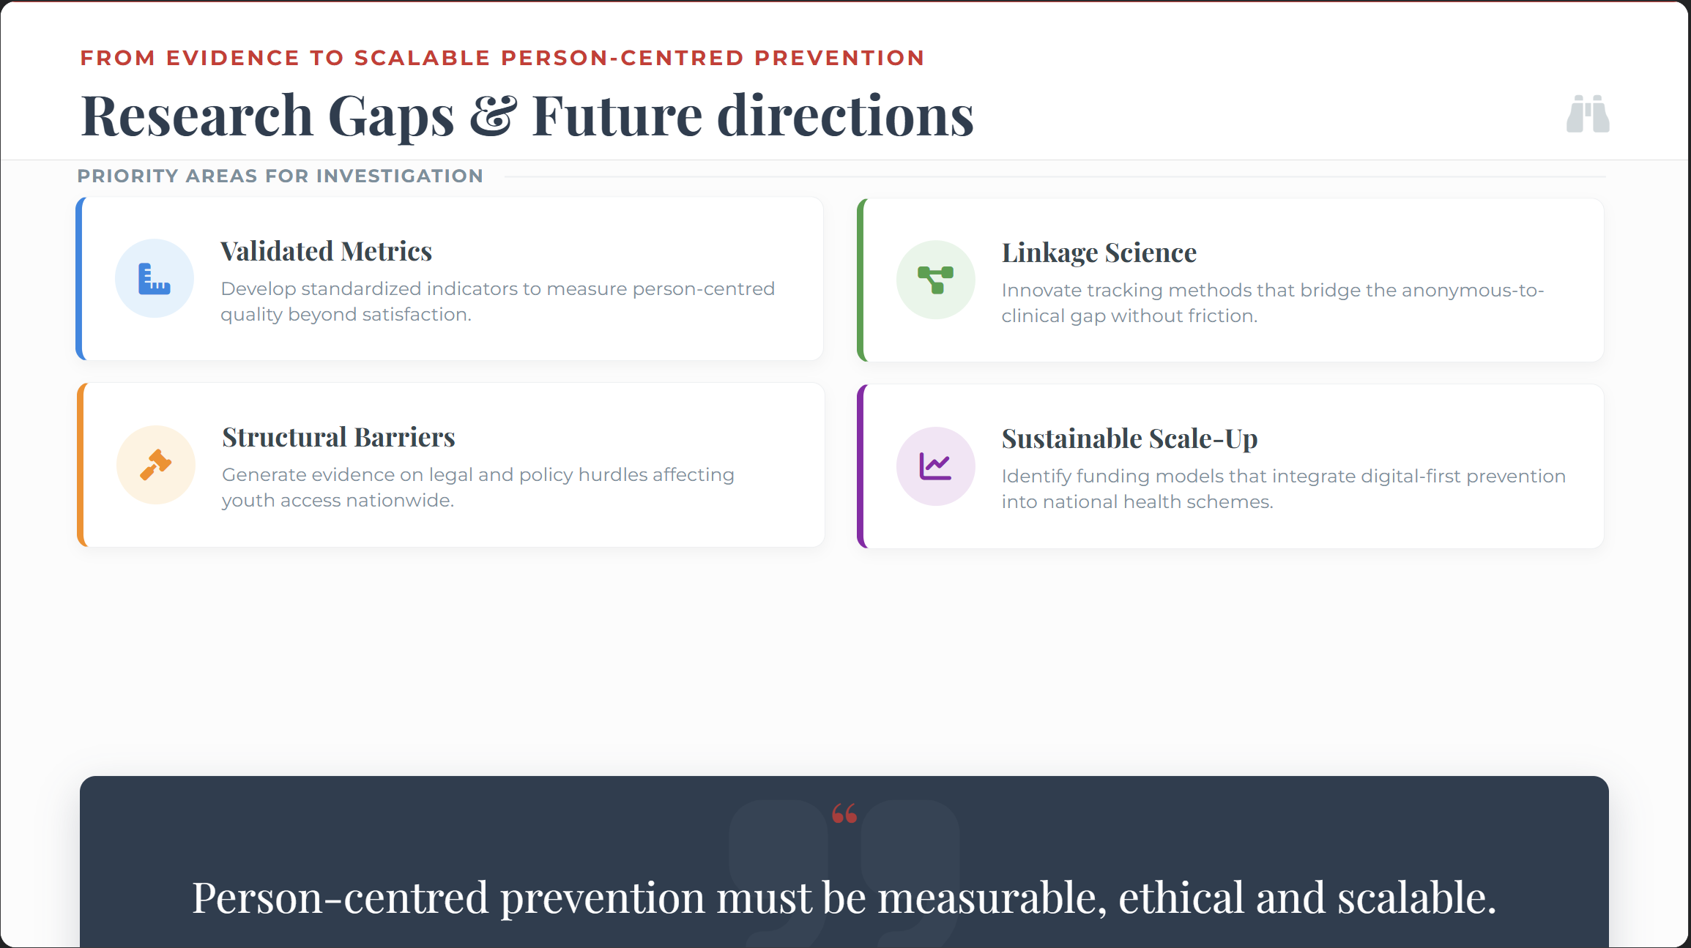
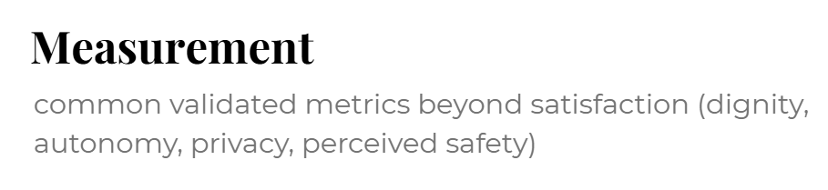
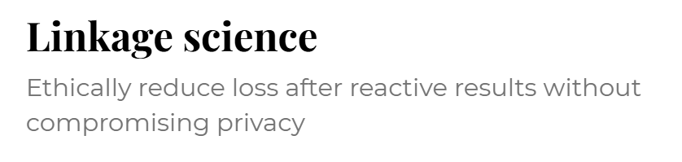


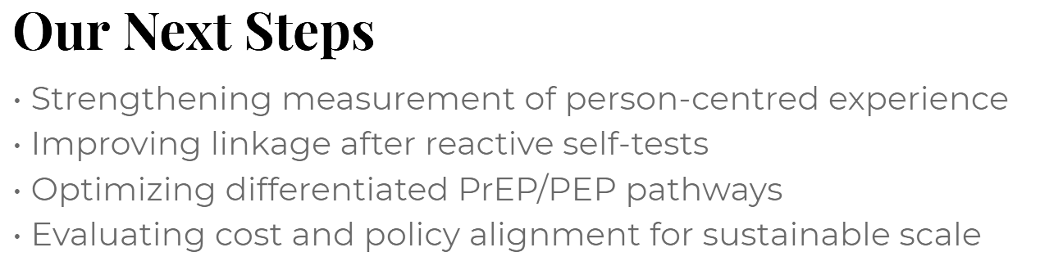

Notes:
What this study shows is that person-centred design is implementable — and measurable.
But scaling it responsibly requires solving 4 core challenges:
how to validate metrics for person-centred experience,
how to strengthen linkage without undermining privacy,
how to reduce structural friction at scale,
and how to scale up sustainability
Our next phase focuses on improving measurement, refining linkage strategies, optimizing differentiated prevention pathways, and aligning with national financing systems.
Because ultimately, person-centred prevention is not a soft concept.
It is the architecture of effective HIV prevention delivery.

Slide 38
Laser Hair Removal to Antiretrovirals: Findings From a Person-centred Care Model for Transgender People in India
RESEARCH ARTICLE
Simran Shaikh, Parthasarathy Mugundu Ramien, Jade Bell, Kanchan Pawar, Allison M. McFall, Saya Okram, Ajay Enugu, Lakshmi Ganapathi, Maria Salvat Ballester, Viswanathan Arumugam, Rose Pollard Kaptchuk, Aditya Singh, Shantanu Kumar Purohit, Alex Keuroghlian, Kevin Ard, Shruti H. Mehta, Sukhvinder Kaur, Kenneth H. Mayer and Sunil Suhas Solomon
Corresponding author: Sunil Suhas Solomon, Johns Hopkins University School of Medicine, 1830 E Monument Street, Rm 445, Baltimore, MD 21287, USA (sss@jhmi.edu)

Slide 39






Introduction
Globally, transgender people face deep inequalities in access to health services. These gaps are not accidental; they are shaped by interconnected structural and psychosocial barriers.
Stigma Negative attitudes and social exclusion discourage transgender people from seeking care.
Discrimination Denial of services, misgendering, and unequal treatment in healthcare settings
Violence & Harassment Fear of abuse, inside and outside healthcare settings limits access and continuity of care
Legal & Policy Barriers Restrictive laws, lack of legal gender recognition, and documentation issues block services
Psychosocial Stressors Mental health burden caused by marginalisation and chronic stress
Transgender women (TGW) in India continue to bear disproportionate HIV burden and face persistent social, legal and structural barriers to receive gender-affirming care.

Slide 40




Mitr Clinics - Bridging the Implementation Gap
To address persistent inequities in healthcare access for transgender communities, three comprehensive, person-centred clinics were launched in 2021.
Foundational Principles of Mitr Clinics
01
02
03
Gender-Affirming, Person-Centred Care
Healthcare that recognises dignity, identity, and care as a fundamental right.
Integrated, Comprehensive Services Seamless access to medical, psychosocial, and legal support reducing systemic barriers.
Community Ownership & Leadership Clinics are led and shaped by members of the transgender community in each city.
Maharashtra
Pune
Thane
Telangana
Hyderabad
Mitr Clinics were built on three core principles

Slide 41
Clinic Client Flow

Slide 42






Mitr Clinics - Services
Guided by stakeholder consultations and community leadership, Mitr Clinics were designed as a comprehensive, community-owned model that integrates care, dignity, and empowerment under one roof.
Integrated Healthcare Services
HIV prevention, testing, and treatment
Gender-affirming healthcare services
Linkages to broader medical care
Legal & Social Protection Linkages
Support to access legal identity documentation
Assistance with social protection schemes
Navigation of government entitlements
Expanded Counselling Support
Mental health and psychosocial counselling
Support beyond HIV-related care
Safe spaces for identity-affirming conversations
Peer Navigation & Community Outreach
Strengthened peer-led support systems
Community outreach to improve service access
Community-Led Staffing Model
Each clinic team includes
Medical Doctor
Clinic Manager
Nurse
Peer Counsellor
Two Community Outreach Workers

Slide 43

Mitr Clinics - Impact
5,223
26yrs
86%
35%
70%
unique clients registered between March 2021 and September 2024
Median age
Identified as transgender woman (TGW)
transactional sex
had not previously accessed public sector HIV services
75%
53%
34%
26%
accessed Mitr clinics for gender-affirming care
laser hair removal
gender-affirming hormone therapy (GAHT) consultations
Referral for Gender Affirming Surgeries
62%
6%
575
378
392
clients eligible for HIV testing underwent screening
newly diagnosed
Clients out of 585 were interested and eligible for PrEP
PrEP consistent in 3 months
Clients with HIV (newly diagnosed or previously known) out of 454 initiated on ART
As of
30 September 2024
233
98%
still receiving Mitr clinic services and retained in HIV care
Viral suppression among 156 clients with data

Slide 44

Critical Implementation Lessons
Fragmented confirmatory testing pathways
Disclosure concerns and stigma
Losses between community clinics and public ART services
Overall lesson : patient-centred care must extend beyond clinics to the entire health system

Slide 45

Conclusion
As a single-window, community-based, person-centred model, Mitr Clinics have significantly improved access to gender-affirming healthcare.
Gender identity-affirming services drive meaningful healthcare engagement within communities
Community-led service delivery builds trust, ownership, and sustained engagement
Integrated comprehensive care strengthens HIV prevention and treatment outcomes.
A model that makes healthcare more accessible, inclusive, and equitable

Slide 46

Thank You
https://drive.google.com/file/d/1rSw-ZbP_xaYo6OIg5ZdhNtspZnSJ_9Dv/view?usp=sharing
https://www.youtube.com/watch?v=_dCcGuRi7M0&t=30s

Slide 47
Programme (part 1) – yesterday
Topic | Speaker
Opening remarks, objectives of session and overview of supplement and editorial themes | Marie-Claude Lavoie, University of Maryland School of Medicine, United States
Harnessing digital health data for person-centred HIV prevention monitoring: a survey of national health information systems | Shona Dalal, World Health Organization, Switzerland
Oral pre-exposure prophylaxis initiation, continuation and adherence among pregnant and postpartum women receiving antenatal and postnatal care: a systematic review | Anke Rotsaert, Institute of Tropical Medicine, Belgium
Person-centred HIV care and prevention for youth in rural South Africa: preliminary implementation findings from Thetha Nami ngithethe nawe stepped-wedge trial of peer-navigator mobilization into mobile sexual health services | Maryam Shahmanesh, Africa Health Research Institute, South Africa
“From an HCV and HIV point of view, it’s been remarkable”: A qualitative study about using prescribed safer supply to support people who use drugs along the HIV and HCV prevention and treatment cascades in Ontario, Canada | Adrian Guta, University of Windsor, Canada
Panel discussion to propose and prioritize research gaps on themes | Moderator + speakers
Q&A and open discussion with participants | All participants
Closing remarks | Marie-Claude Lavoie, University of Maryland School of Medicine, United States

Slide 48
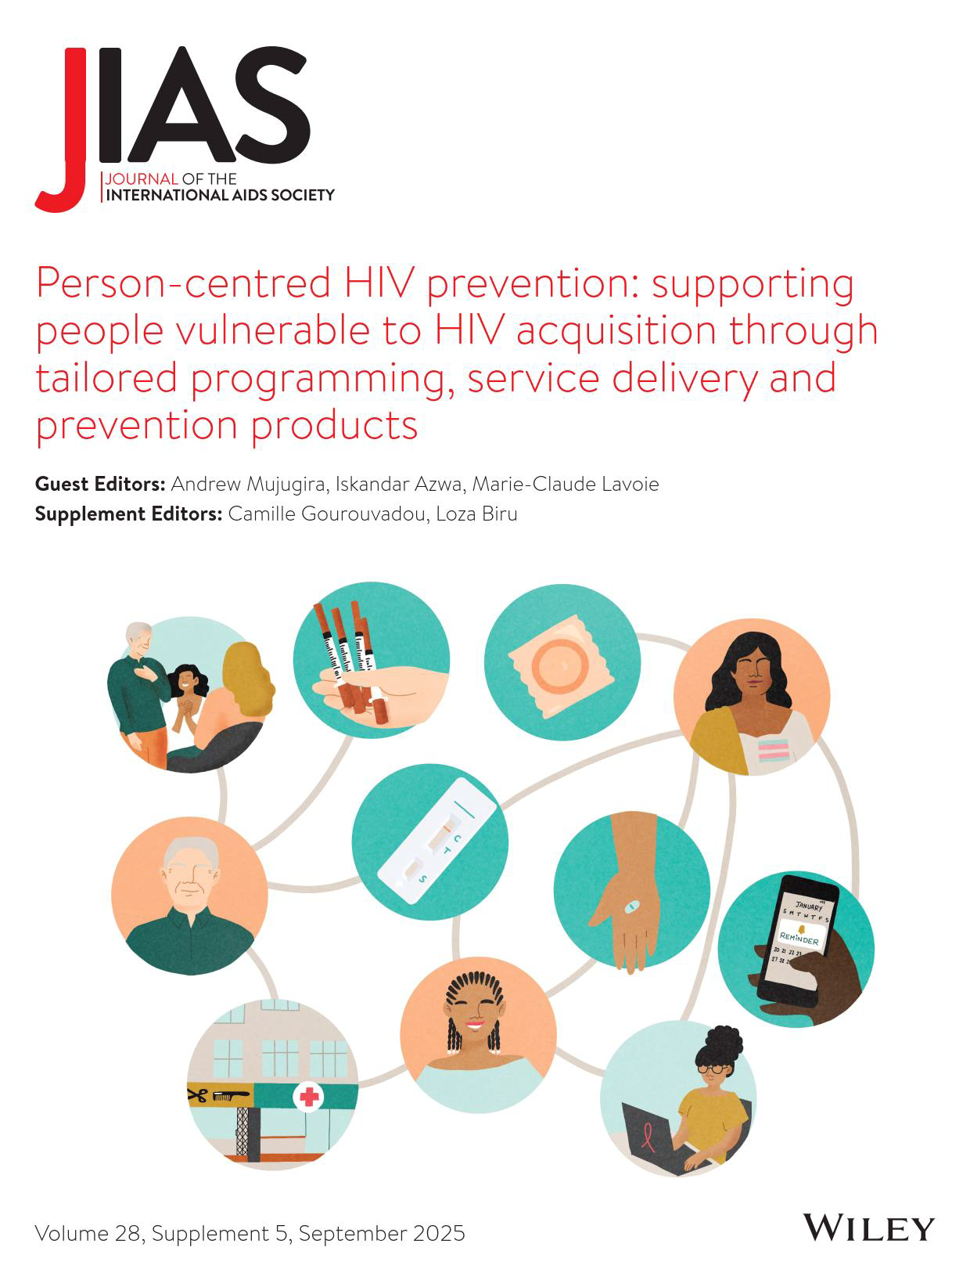
Person-Centred Care Research Collaborative
Scaling HIV prevention for the people who
need it most — through integrated,
community-driven, and evidence-based
approaches across biomedical, behavioural,
and social dimensions of care.
RESEARCH SUMMARY

Slide 49

Reaching the Last Mile: People-Centred Scale-Up
Bringing HIV prevention to scale demands a comprehensive strategy that weaves together biomedical, behavioural, and social
interventions within existing healthcare systems. Three delivery approaches are essential for reaching those farthest from services:
Peer Navigation
Trusted peers guide individuals
through prevention and care pathways,
reducing structural and social barriers
to engagement.
Dynamic Choice
Offering individuals a real choice of
prevention products and approaches,
aligned with their needs,
circumstances, and preferences.
Community Delivery
Bringing services to where people live
and gather — decentralising care
beyond clinic walls to maximise reach
and uptake.
Data gap: Only two countries globally could calculate linkage to prevention using digital health data — a critical bottleneck for
monitoring scale-up progress.

Slide 50
Data Availability: Strengths and Gaps
Systematic monitoring of HIV prevention is uneven. While data infrastructure exists for some core services, significant gaps remain
across key programme areas.
Better Availability
• HIV testing services
• Condom distribution
• PrEP (oral formulations)
• PEP (post-exposure prophylaxis)
• Vertical transmission (PMTCT)
Limited or Absent Data
• Needle–syringe programmes (NSP)
• Opioid agonist maintenance therapy (OAMT)
• STI testing and treatment data elements
• Behavioural indicator data
• Linkage-to-prevention metrics (nearly universal gap)
• Post-Exposure Prophylaxis (no monitoring systems)
Closing these gaps is foundational to evidence-based
programme planning and accountability.

Slide 51
Research Priorities: Long-Acting PrEP & Maternal Health
Integration of long-acting PrEP — including lenacapavir (LEN) — into antenatal and postnatal care (ANC/PNC) represents one of the
most urgent and complex research frontiers in HIV prevention. Key gaps requiring investigation include:
1
Safe ANC/PNC Integration
Understanding how long-acting PrEP can be feasibly and
acceptably incorporated into routine ANC/PNC, including
monitoring, counselling, and pharmacovigilance requirements.
2
Postpartum Continuation
Identifying differentiated service delivery models that prevent
the sharp decline in PrEP continuation observed during
postpartum and breastfeeding periods.
3
Digital & AI-Enabled Support
Evaluating how AI-supported tools can enhance risk
assessment, informed product choice, provider training, and
adherence support as prevention options expand.
4
Equity & Scalability
Generating cost-effectiveness evidence to ensure long-acting
PrEP delivery is scalable and accessible to women within and
beyond formal ANC platforms in resource-constrained
settings.

Slide 52
Integrating HIV Prevention with SRH and Social Care
Efficiency gains in HIV prevention are achievable by layering complementary services and leveraging community capacity. A multi-
dimensional integration model includes:
Layered Service Delivery
Combining HIV prevention with sexual and reproductive health
(SRH) and social care to address intersecting needs in a single
contact with services.
Task-Shifting to Peers
Scaling reach to priority populations at highest HIV acquisition risk
through peers with lived experience — building trust, relevance,
and sustained engagement.
Choice of Venue & Product
Empowering individuals through meaningful choice — both of
service location and prevention product — to maximise
acceptability, uptake, and adherence.
STI Integration
Embedding STI testing and treatment within HIV prevention
platforms to address co-occurring infections and strengthen
overall sexual health outcomes.

Slide 53

People Who Use Drugs: Cascade-Aligned Research
Priorities
For people who use drugs, the research agenda must be closely aligned to the prevention and treatment cascade, with a focus on
comparative effectiveness and the consequences of service disruption.
Comparative Effectiveness Studies
Cascade-aligned intervention studies should examine:
• Safer supply modalities: oral vs. smokable opioids
• Opioid vs. stimulant-focused models
• Differential impact on HIV and HCV outcomes across
modalities
Assessing the Cascade of Disruption
Given widespread programme defunding and harm reduction
scale-back, urgent epidemiological analysis is needed to track:
• Treatment interruption and loss of viral suppression
• Reduced HIV and HCV testing uptake
• Increased transmission risk from diminished safer supply
access
• Changes in HIV/HCV incidence linked to reduced needle–
syringe exchange
Parallel epidemiologic analyses are urgently needed to quantify the public health impact of harm reduction rollbacks and
inform advocacy for service restoration.

Slide 54
Key Takeaways & Next Steps
The discussion surfaces a clear, action-oriented agenda for the Person-Centred Care Research Collaborative. Progress requires
simultaneous investment in implementation science, data systems, and community partnerships.
01
Strengthen Digital Data Infrastructure
Prioritise linkage-to-prevention metrics and close data gaps for
NSP, OAMT, STIs, and behavioural indicators across country
health information systems.
02
Advance Long-Acting PrEP Research in Maternal
Settings
Conduct implementation studies on LEN and long-acting PrEP in
ANC/PNC, addressing pharmacovigilance, postpartum
continuation, and AI-enabled adherence tools.
03
Integrate HIV, SRH, and Social Care
Scale up layered, peer-delivered models that combine HIV
prevention with sexual health and social support — especially for
priority populations.
04
Protect and Evaluate Harm Reduction Services
Urgently assess the cascade effects of harm reduction
programme cuts on PWUD, and use epidemiological evidence to
advocate for service restoration and safer supply expansion.

Slide 55


Acknowledgements
The Person-Centred Care programme of IAS – the International AIDS Society – is implemented with financial support from, and in collaboration with, Gilead Sciences.
Gilead Sciences has nominated Megan Dunbar, Executive Director, Gilead Sciences to participate in the PCC research collaborative.
The IAS has full control over all the activities and decisions relating to, and forming part of, the Person-Centred Care programme.

