Slide 1








Welcome! This webinar will start soon.
Institutionalizing community engagement in HIV prevention
Join the online conversation around this webinar by using #Rethink. Rebuild. Rise
@iasociety
/iasociety
@iasociety
@iasociety.bsky.social

Slide 2
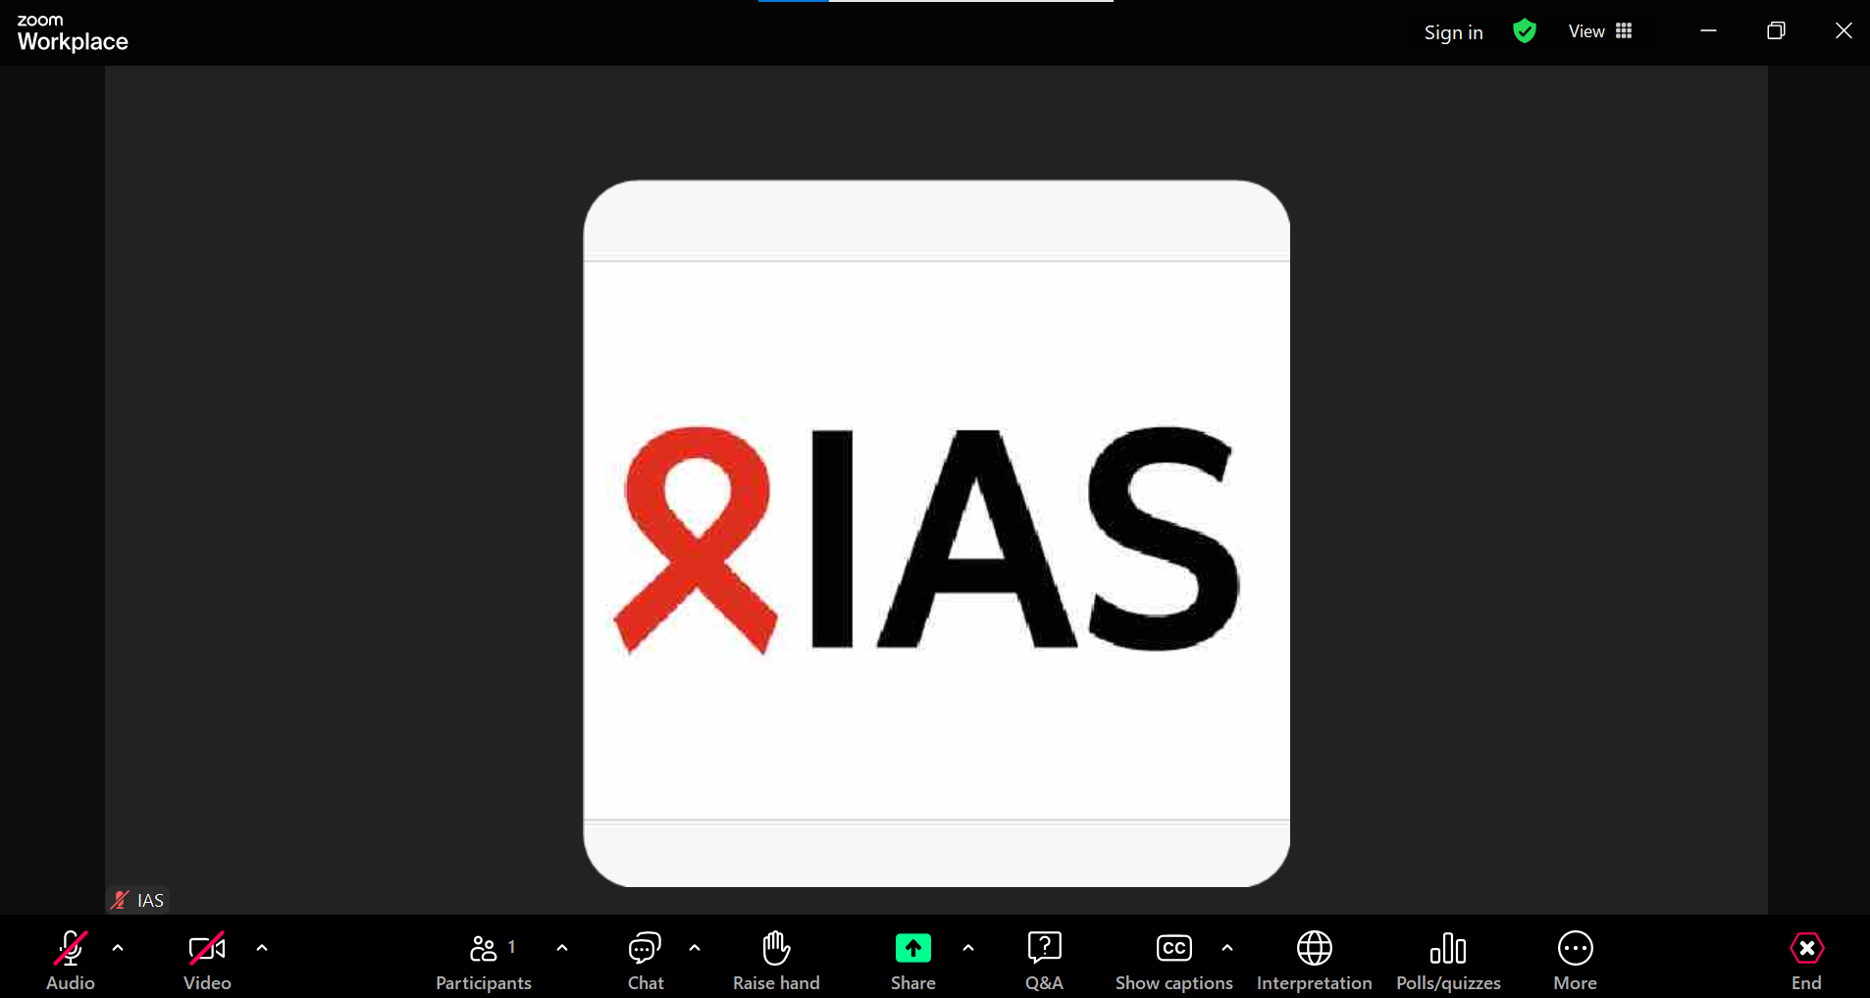
Housekeeping
To introduce yourself and for Zoom-related questions or comments, please use the “Chat” function
For questions to the speakers, please use the “Q&A” function
Enable captions in any language (AI generated)
Choose your preferred language (English, French, or Portuguese) in the Interpretation function
The recording will be available on the IAS+ platform and shared with all registrants

Slide 3


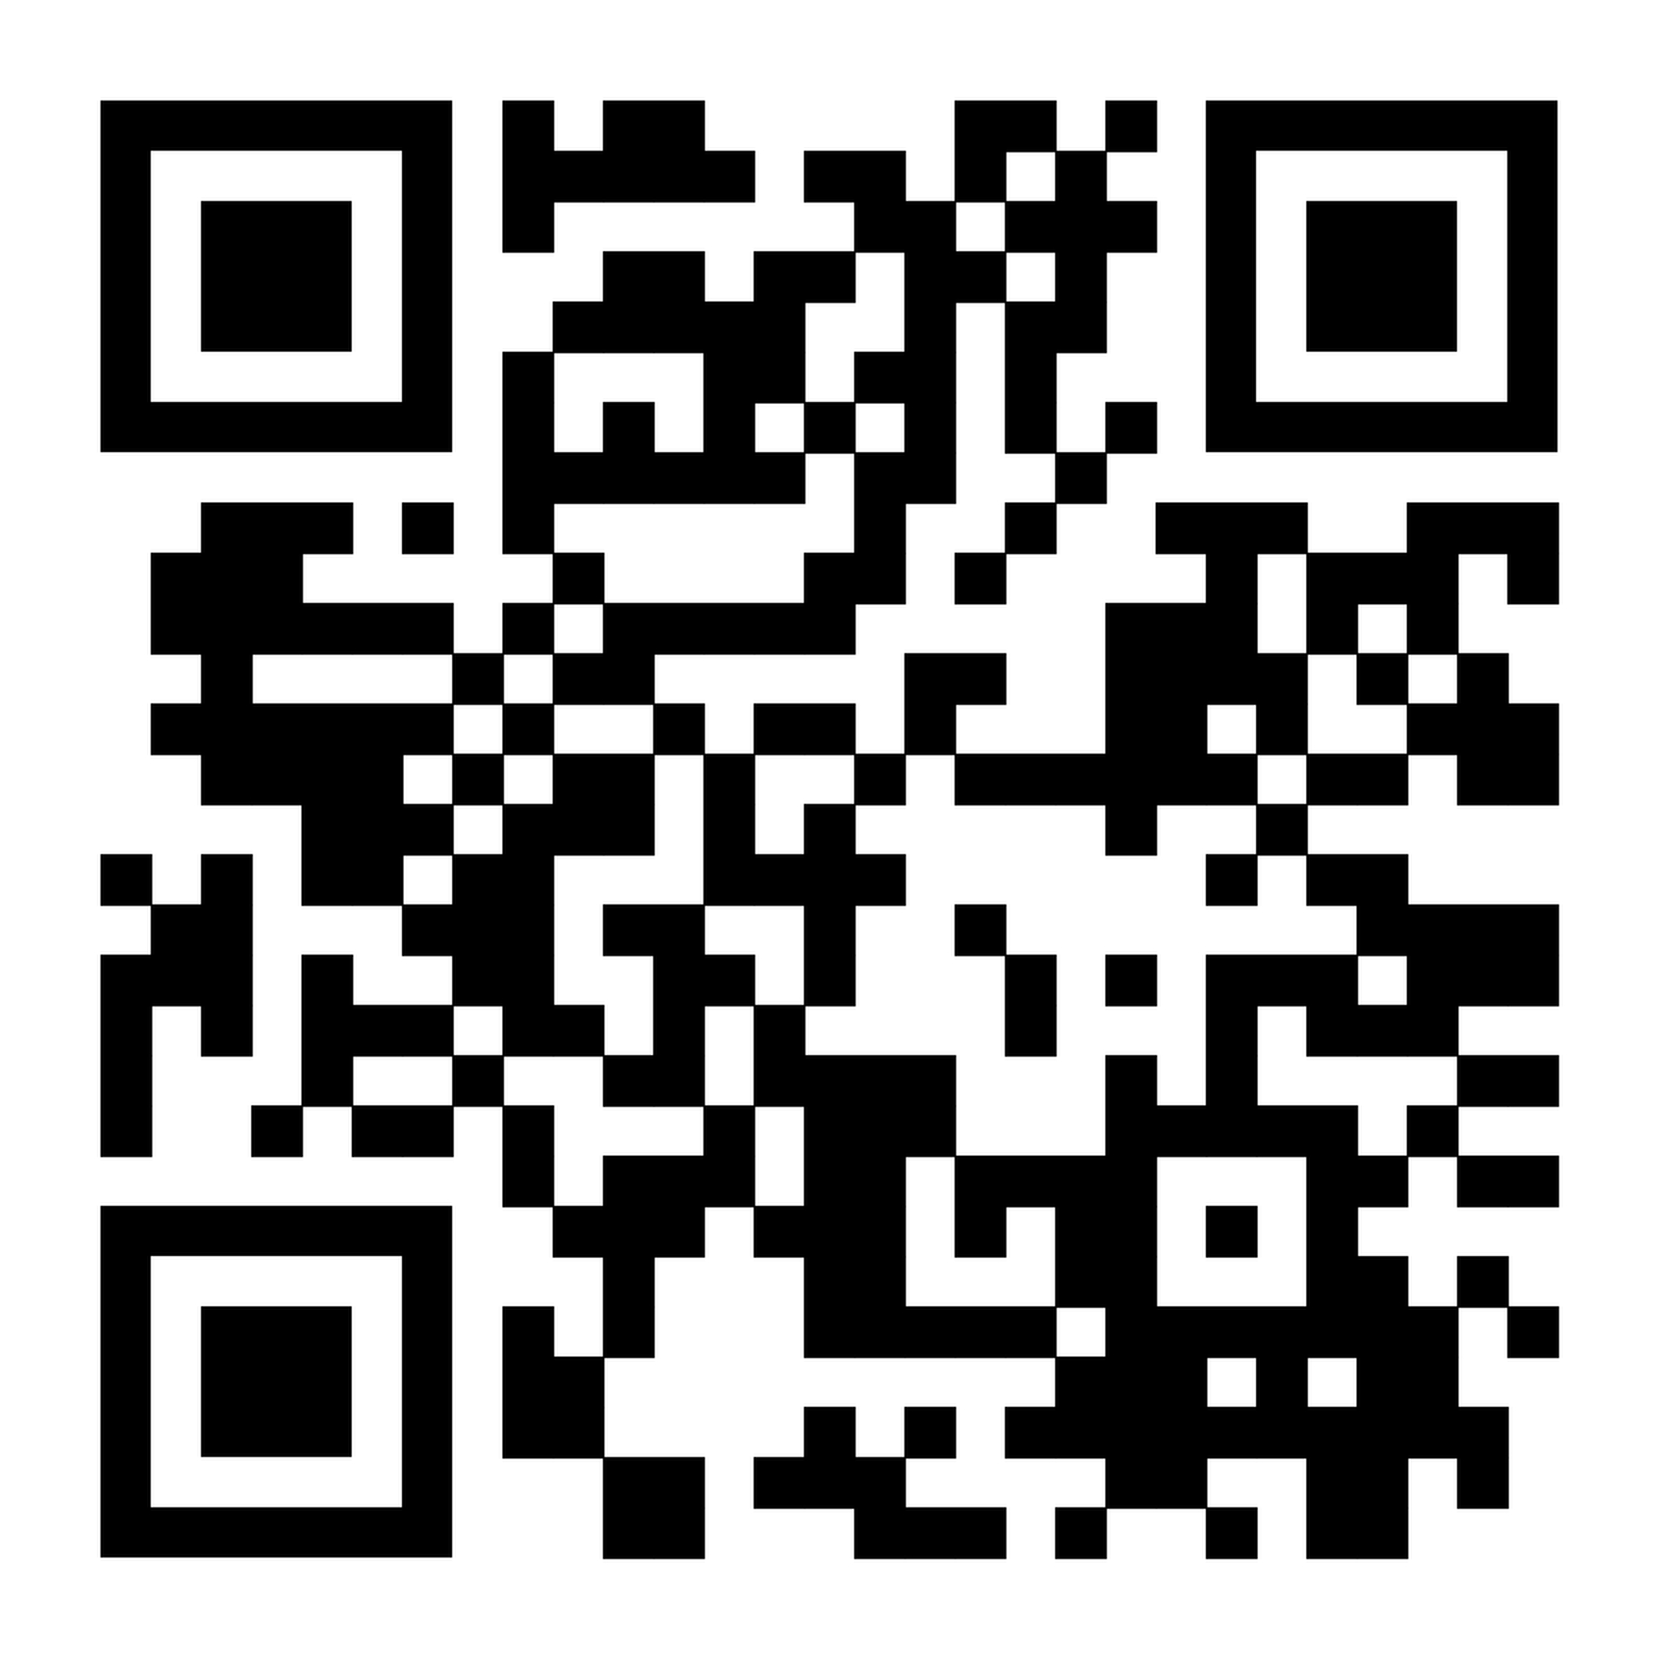
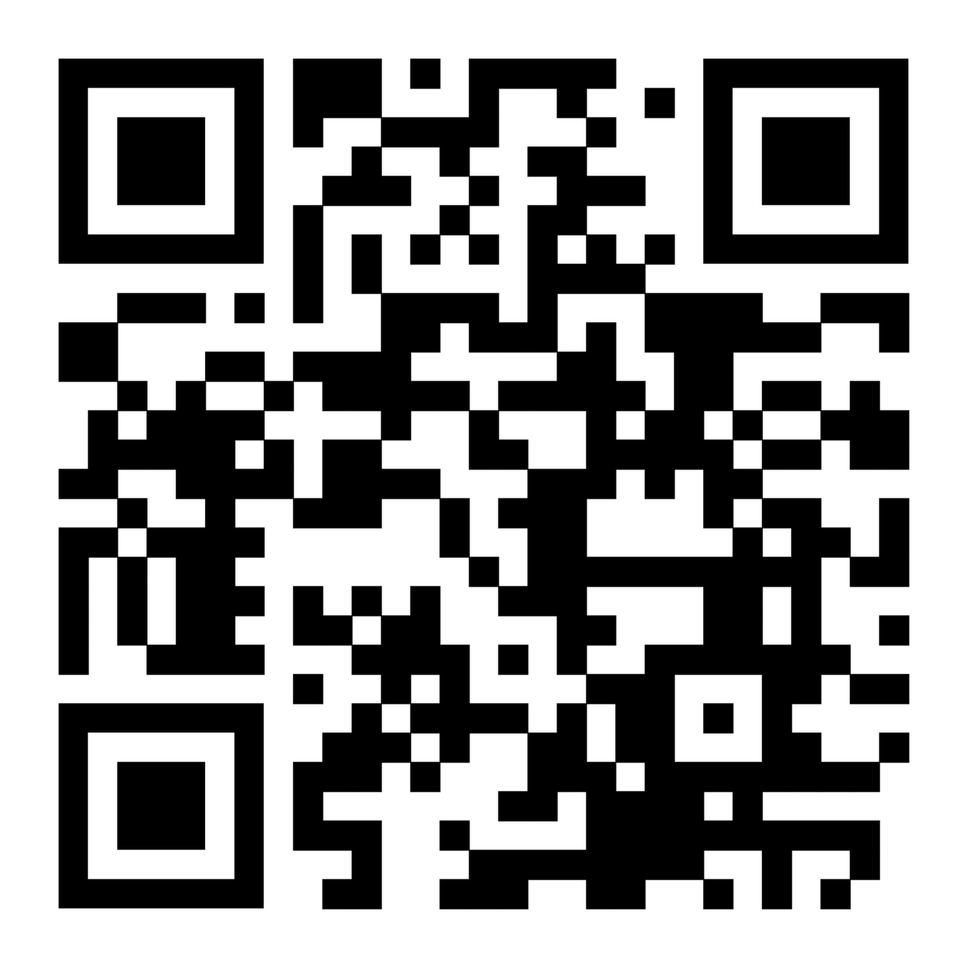
Sustainable HIV Prevention in Africa Lancet HIV and Lancet Global Health Joint Series
Paper 1: Global HIV prevention is not on track: how a health systems approach can promote sustainable progress in African countries
Paper 2: Advancing functional and systemic integration of HIV prevention into public health systems
Paper 3: The role of digital health and artificial intelligence in improving the reach and effectiveness of HIV prevention in Africa
Paper 4: Enhancing HIV prevention through systematic community engagement, learning, and response
Paper 5: Strengthening nationally led approaches to new product introduction for HIV prevention
Paper 6: Future directions: ending HIV in Africa—a call to action for sustainable and nationally led prevention
→
To learn more about The Lancet Global Health and The Lancet HIV Joint Series on Sustainable HIV Prevention in Africa
To learn more about the Sustainable HIV Prevention Initiative

Slide 4




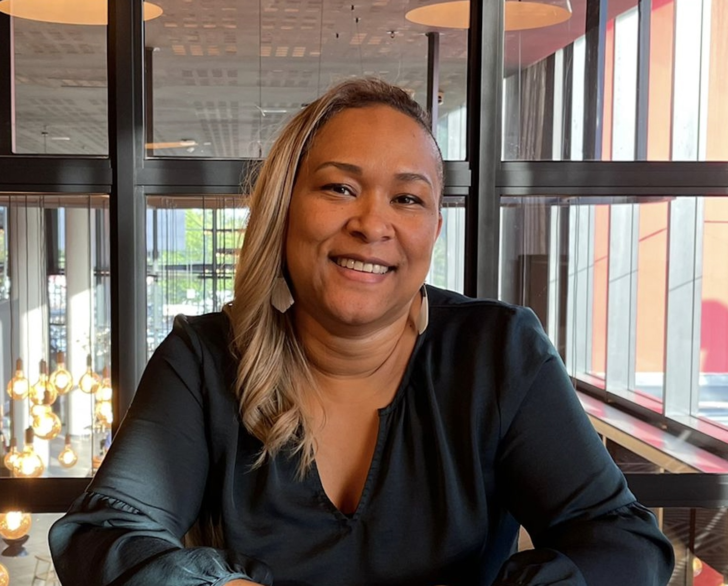


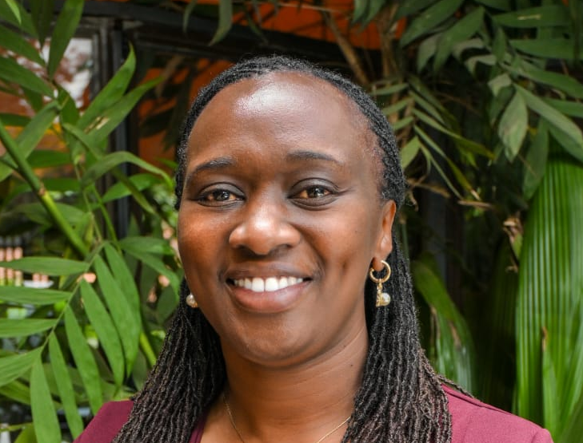
Institutionalizing community engagement for HIV prevention
Florence Anam
Co-Executive Director, Global Network of People Living with HIV, Kenya
Stephen Ayisi Addo
Ghana Health Service
Chrissy Banda
Blantyre District Health Promotion Office, Malawi
Ima John Dada
National AIDS, Viral Hepatitis and STIs Control Programme, Federal Ministry of Health, Nigeria
Solange Baptiste
ITPC, South Africa
Cheewanan
Lertpiriyasuwat
Department of Disease Control,
Ministry of Public Health, Thailand
Stephen Ndolo Kiio
National Syndemic Diseases Control Council, Kenya
Lilian Otiso
Executive Director, LVCT Health, Kenya

Slide 5
Institutionalizing community engagement in HIV prevention: Blantyre Prevention Strategy, Malawi
Chrissy Chabwera Banda​
Blantyre District Health Promotion Office
Malawi

Slide 6
Institutionalizing community engagement in HIV prevention-A Case of Blantyre Prevention Strategy, Malawi
Chrissy Banda-Blantyre, Malawi
7 July 2026
Notes:
Today I am greatly honored to share a case study on how we have institutionalized community engagement in HIV Prevention through Blantyre Prevention Strategy in Blantyre, Malawi. Let me thank the organizers The IAS, Georgetown University Centre for Innovation in Global Health for giving me such an opportunity.

Slide 7
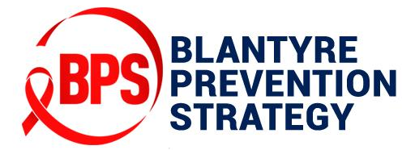
Presentation Outline
Community engagement Models in Blantyre
1
Background
4
2
Why community engagement matters?
5
Key gains from the institutionalization
3
6
Conclusion
The Blantyre Prevention Strategy (BPS)
Notes:
My presentation will follow this outline. I will share how Blantyre has managed to institutionalized community engagement working with community members in HIV response. Models we have used through the Blantyre Prevention Strategy and the key benefits we have achieved through institutionalizing community engagement

Slide 8
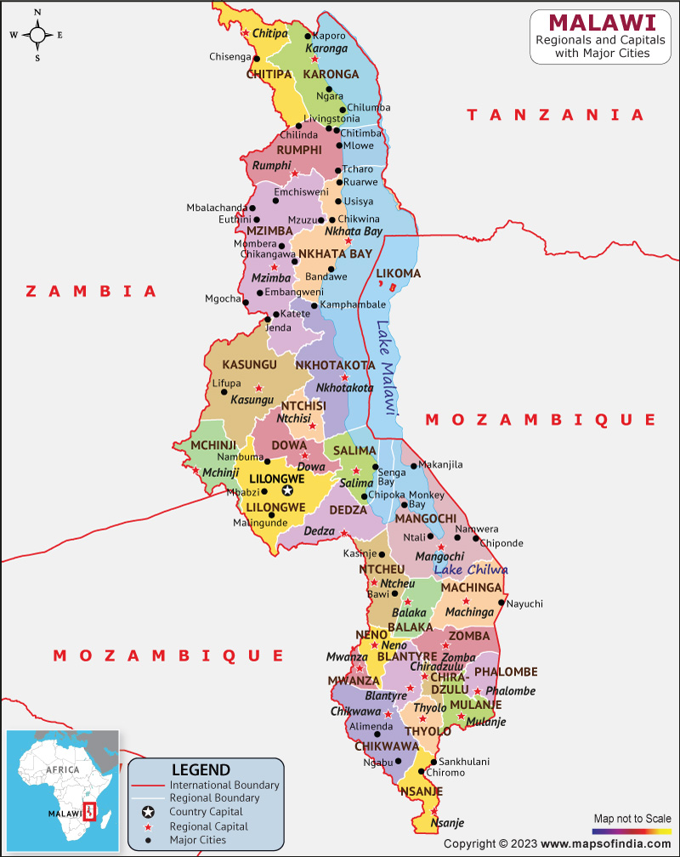
Background
Malawi is a Southern African country that borders Tanzania, Zambia, and Mozambique.
Estimated number of 1,006,000 PLHIV among the total population estimate of 21 million
Among countries with the highest HIV burden in the world.
Malawi Population-based HIV Impact Assessment (MPHIA) done in 2025-15 revealed a national HIV prevalence of 10.6%
Blantyre, the commercial hub of Malawi with approximately 1.3 million registered a higher prevalence rate of 17.7% (MPHIA 2025-15)
However, huge progress made in achieving the 959595 targets in 2024
The high prevalence and infection rates in Blantyre influenced development of the Blantyre Prevention Strategy (BPS)
8
Notes:
Malawi is a Southern African country that borders Tanzania, Zambia, and Mozambique.
According to the 2023 Malawi Spectrum model estimates, the country has an estimated number of 1,006,000 PLHIV among the total population estimate of 21 million
Among countries with the highest HIV burden in the world.
Ranking among the 10 countries with the highest HIV burden in the world.
Malawi Population-based HIV Impact Assessment (MPHIA) done in 2025-15 revealed a national HIV prevalence of 10.6%
Blantyre, the commercial hub of Malawi with approximately 1.3 million registered a higher prevalence rate of 17.7% (MPHIA 2025-15)
However, huge progress made in achieving the 959595 targets in 2024 (2025 HIV Epidemiological Estimates for Malawi)
95% of people living with HIV (PLHIV) are aware of their HIV-positive status,
95% of those aware of their HIV-positive status receive treatment, and
95% of individuals on HIV treatment achieve viral load suppression
The high prevalence and infection rates in Blantyre influenced development of the Blantyre Prevention Strategy (BPS)

Slide 9
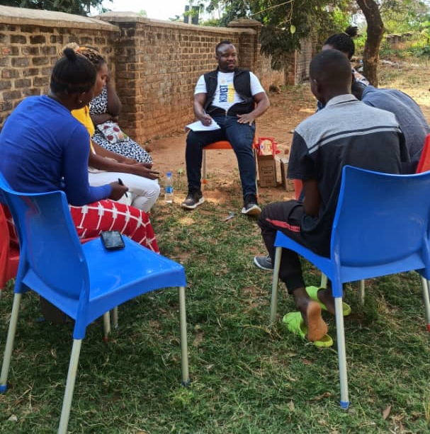
Why community engagement matters?
Several HIV response interventions have been implemented.
Still lack of is sustained demand for prevention services and products has been a challenge.
Traditional public health approaches used lacked a deeper understanding of client preferences, values and perceptions.
Underrepresented communities have faced challenges
Communities hold the keys to unlocking demand for HIV prevention
The BPS recognized that sustainable prevention outcomes cannot be achieved through health facilities alone.
Notes:
For many years in our HIV response, several HIV response intervention interventions have been implemented but still faced a key challenge of lack of sustained demand for HIV prevention.
Little did we know that the keys to unlocking demand for HIV prevention programs are found right in the communities.
Our traditional public health approaches have lacked a deep understanding of client preferences, values, needs and perceptions.
Underrepresented communities have faced challenges in accessing preferred HIV services
Issues of stigma, discrimination and social norms have posed a threat in response efforts
So the coming in of the BPS helped us to shift our thinking from making our HIV response business as usual by incorporating the voice of the community.
The BPS recognized that sustainable prevention outcomes cannot be achieved through health facilities alone.
The BPS established a need for meaningful community engagement

Slide 10
The Blantyre Prevention Strategy (BPS)
A 5-year, health systems strengthening-focused project funded by the Bill & Melinda Gates Foundation
Implemented under the leadership of the Government of Malawi and the Center for Innovation in Global Health at Georgetown University
  An expert Consortium of partners supports implementation and capacity building in Blantyre
  BPS Vision: A district-level system capable of rapidly deploying novel and existing HIV prevention products and interventions to the right populations, in the right places, at the right times, which can serve as a model for replication throughout the region.
  The project began on 1st May 2020
Notes:
Locally led project at District and City level in Blantyre, Malawi
BPS vision was to have a district-level system capable of rapidly deploying novel and existing HIV prevention products and interventions to the right populations, in the right places, at the right times, which can serve as a model for replication throughout the region.
The project began on 1st May 2020

Slide 11
Work Streams along the BPS HIV Prevention Cascade
TARGETING
Data Pipeline and Prevention Adaptive Learning and Management System (PALMS)
Integrated Disease Surveillance and Response Pilot for HIV (IDSR-HIV Pilot)
DELIVERY
Quality Improvement Collaboratives
Strengthening and/or Expanding HIV Prevention Service Delivery Channels (public, private, and community sectors)
DEMAND
Human Centered Design Community Laboratory & Continuous Feedback Loop
Health Communications
SUSTAINED USE
Structural Risk Reduction Working Groups in Blantyre City
All work streams are playing a role directly or indirectly to strengthen the targeting, demand generation, and quality of HIV service delivery and access, as well as support continuation of HIV services and products
Notes:
The BPS was implemented through four workstreams; targeting, demand creation, service delivery, and structural risk reduction with support from the Blantyre District and City Councils to unlock key capabilities to enhance the HIV response.
All work streams are playing a role directly or indirectly to strengthen the targeting, demand generation, and quality of HIV service delivery and access, as well as support continuation by users.
Working through six individual but mutually supportive program elements, we have developed a system capable of detecting and targeting disease risks, generating demand for HIV prevention services based on risks, and effectively delivering prevention products and interventions, and supporting sustained use of prevention products during periods of risk.
With the understanding that sustainable prevention outcomes cannot be achieved through health facilities alone, the goal for demand creation workstream was to develop a data driven grassroots model that will ensure that community engagement has indeed been institutionalized in HIV prevention response by:
Developing a data-driven, community-informed, responsive, and adaptive prevention programs that are attractive to at-risk populations
And generate demand for these programs through routine and sustainably financed public health messaging campaigns and a strengthened and engaged CSO and CBO network.

Slide 12
How the community has been institutionalized in Blantyre
Community engagement institutionalization in BPS with District and City Health Team Governance and Technical Leadership
Data Access and Use
Surveillance
Quality Improvements initiatives
Client insights
Health promotion
Linked networks
Multisectoral partnerships
Use of Human Centered Design driven Community Laboratory Model ( HCD CLs)
The network model to bring grassroot community structures together
Use of community structures, volunteers, leaders and other community members as key informants
Structural risk reduction to enable effective and sustained use of prevention services
Notes:
After being capacitated through the BPS project, now we engage communities in Blantyre through;
The use of Human Centered Design driven Community Laboratory Model
The network model to bring grassroot community structures together in planning, implementation of HIV response interventions
Use of community structures, volunteers, leaders and other community members as key informants in reporting signals that could be potential HIV risks
Community leaders such as Ward Councilors have been trained in structural risk reduction and they support in health promotion intervention at community level. Ward Councilors have access to data through our Preventive Adaptive learning and management Data Visualizer the PALMS which is user friendly even to a lay person. They are able to track HIV and Sexually Transmitted Infections (STI) data trends in their various wards.
All these are embedded as part of continuous quality improvement initiatives in HIV service delivery

Slide 13
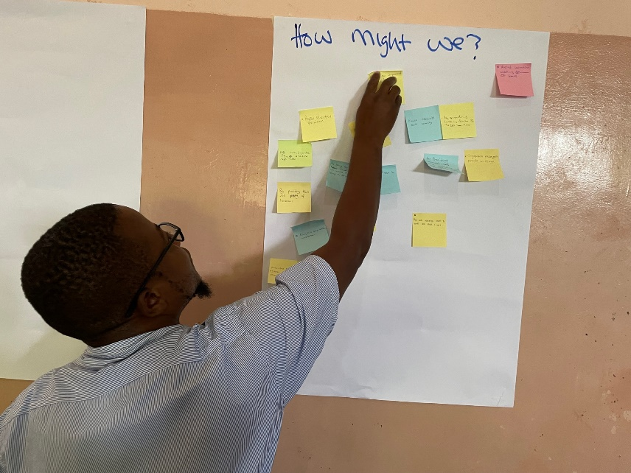
Use of HCD driven Community Laboratory Model
HCD driven CLs were used to help develop solutions to both demand and service delivery challenges
This model fosters a deeper understanding of client needs and preferences”.
A CL is a platform that enables diverse stakeholders to build deeper and more empathetic understanding with the community members around a common problem.
Trained over 200 Health Care workers and community members in the model
The insights elicited are fed back into service delivery through implementation of;
    Quality improvement initiatives
    Community interventions such as Love Blantyre! Love Life! HIV campaign.
    This campaign has been key in mobilizing the youths from institutions of higher learning as well as peri urban settings on HIV prevention.
    Shared with policy makers to influence policy change
Notes:
To ensure that interventions are tailored to local contexts, community insights were collected and utilized to inform programming
Developed a model—Community Laboratory (CL) to uncover client insights, to help develop solutions to both demand and service delivery challenges
A model to support the institutionalization of the systematic use of participatory HCD concepts, adapted to the Malawian context, for continual use by programmers and policymakers
It builds on HCD methodology in
Identifying evidence-based and data-driven key challenges
Co-creating solutions
Testing these solutions to refine them for implementation
Depending on the insights, solutions are co-created and fed back to quality improvement, for improved quality of service delivery or passed on for Community interventions such as Love Blantyre! Love Life! HIV campaign.
This campaign has been key in mobilizing the youths from institutions of higher learning as well as peri urban settings on HIV prevention.
Grassroots Community Laboratories use HCD methods to solicit user preferences and community feedback, which informs better programming, improvements in client-centered care, and creation of feedback loops between communities,
Through the BPS, we have trained over 200 Health Care workers and community members in Community Laboratory model
The insights elicited are fed back into service delivery through implementation of;
Quality improvement initiatives
Community interventions such as Love Blantyre! Love Life! HIV campaign. This campaign has been key in mobilizing the youths from institutions of higher learning as well as peri urban settings on HIV prevention.
Shared with policy makers to influence policy change

Slide 14
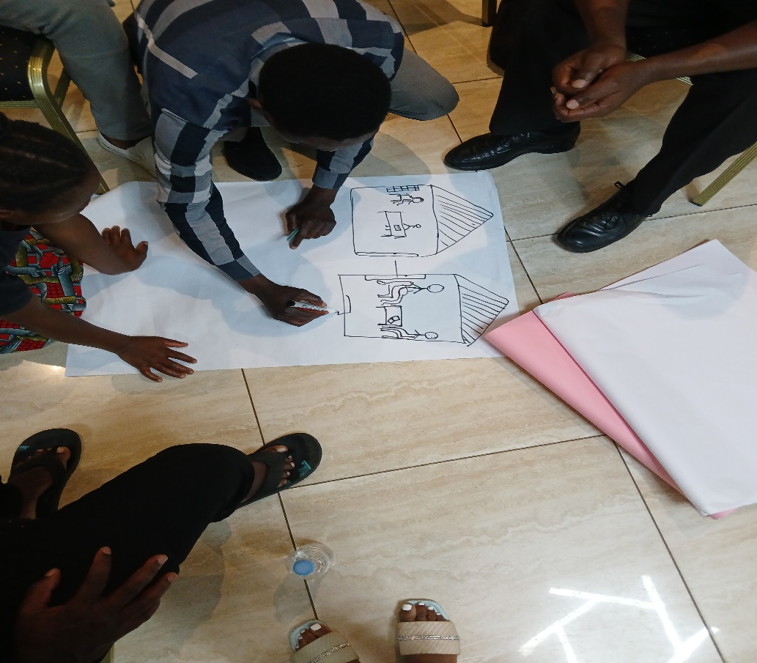
Use of HCD driven Community Laboratory Model
Issue of low PrEP initiations against eligible clients was noticed in the year 2021 in Blantyre
Community Laboratories were implemented
Interesting insights and findings were collected such as;
    Clients reported to be comfortable getting PrEP closer to them not at the clinic let alone ART clinic
    Clients preferred if PrEP was injectable due to pill burden
    Young people preferred to get PrEP information from their Peers
    Young people from institutions of higher learning s were sharing a bottle of PrEP
    The need to bridge knowledge gap on the difference between PrEP, PEP and ARV therapy for HIV treatment
Notes:
We implemented an HCD driven Community Laboratory. So in the 2020 in Blantyre was at the beginning of PrEP as a new prevention intervention so naturally the knowledge gap was big.
Community Laboratory's were implemented
Interesting insights were collected such as;
Clients reported to be comfortable getting PrEP closer to them not at the clinic let alone ART clinic
Clients preferred if PrEP was injectable due to pill burden
Young people preferred to get PrEP information from their Peers
We found out that Students from institutions of higher learning were sharing a bottle of PrEP, afraid of visiting the health facility due to stigma and HIV testing
People failing to difference between PrEP , PEP and ARVs for HIV treatment
This gave us also an insight on the need to bridge knowledge gap PrEP

Slide 15
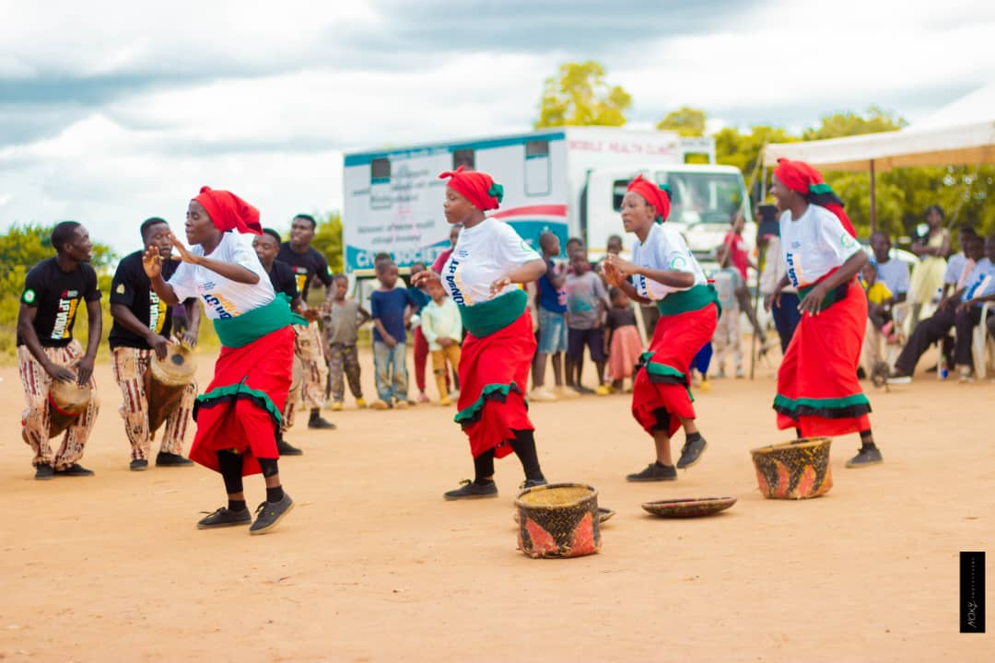
Interventions following co-creation sessions with community members
  Integration of PrEP service delivery with other services to reduce stigma and increase accessibility
  Use of PrEP champions to reach out to young people and key populations
  Expanding entry points for oral and injectable PrEP to the community
  Conducted “Love BT Love Life”, a unique HIV campaign An increase in PrEP uptake was observed
  The coming in of CAB-LA was an excitement because of we knew it will now take care of issue of pill burden
Notes:
Through the co-creation sessions, we created innovative solutions that were preferred by the community members such as :
Integration of PrEP service delivery with other services to reduce stigma and increase accessibility
Use of PrEP champions to reach out to young people and key populations
Issue of pill burden was taken care with the introduction of injectable PrEP in Blantyre Health facilities
Entry points for oral and injectable PrEP were expanded to community outreach
Conducted “Love BT Love Life” unique HIV campaign to bring services closer to people and bridge the knowledge gap on PrEP
At policy level, PrEP guidelines were revised to became more accommodative by incorporating community PrEP provision .

Slide 16
Key gains from institutionalized community engagement in HIV in Blantyre
  Community ownership in HIV prevention efforts at community level
  Increased acceptance of HIV services and products such as PrEP
  Strengthened linkages between health facilities and the communities
  Integration of services in broader health promotion
  Identification of HIV challenges and opportunities at grassroot level for better for collective action
  Enhanced strong collaboration among various stakeholders working in HIV prevention
  Intervention are designed to respond to the real needs and realities faced by young people and other priority populations
Notes:
By embedding community engagement as a core pillar in the district HIV system, we have seen:
Increased acceptance of HIV services and products such as PrEP
Community ownership in HIV prevention efforts at community level
Strengthened linkages between health facilities and the communities
Integration of services in broader health promotion
Grassroot identification of HIV challenges and opportunities for better for collective action
Enhanced strong collaboration among various stakeholders working in HIV prevention
Intervention are designed to respond to the real needs and realities faced by young people and other priority populations
Increased uptake of HIV services such as PrEP initiations was observed

Slide 17
PrEP initiation trends in Blantyre
Data Source: Malawi’s Department of HIV and AIDS Management Information System (DHAMIS) database
Notes:
PrEP uptake in Blantyre has increased rapidly since 2021, BPS is part of the contributing factors

Slide 18
Conclusion
  Community members hold keys to the health challenges which they usually face
  Communities must be active partners in designing, implementing, monitoring, and improving prevention programmes.
  HCD driven Community Laboratory's can be the best tool useful to reframe public health challenges into more people centric terms allowing for interventions that put user needs and preferences at the heart of service delivery.
  The model demonstrates a promise in demand creation and service delivery for HIV prevention
  Its replication locally, nationally and across the region could enhance HIV prevention effort in supporting progress towards achieving the global targets
Notes:
Community members hold keys to the health challenges which they usually face
Meaningful community engagement must consider community members as partners in designing, implementing, monitoring, and improving prevention programmes.
Community Laboratories can be the tool that unlocks creative community input into response plans
Community engagement is not only a tool to increase uptake of health services, but also a means of restoring legitimacy to health systems among historically excluded populations.
HCD can be useful to reframe public health challenges into more people centric terms allowing for interventions that put user needs and preferences at the heart of service delivery.
The HCD-driven CL model demonstrates a promise in demand creation and service delivery for HIV prevention
Its replication locally, nationally and across the region could enhance HIV prevention effort in supporting progress towards achieving the global targets

Slide 19
References
John-Dada I, Otiso L, Ayisi Addo S et al.
Enhancing HIV prevention through systematic community engagement, learning, and response
The Lancet HIV, 2025; 13, e50-e60
The role of community engagement in restoring trust and resilience in the aftermath of the COVID-19 pandemic and beyond. 2023
https://cdn.who.int/media/docs/default-source/universal-health-coverage/who-uhl-technical-brief-community-engagement.pdf?sfvrsn=20d6dbdc_3
Date accessed: June 12, 2026
https://www.blantyrepreventionstrategy.com/national-leadership-for-sustainable-hiv-programs
Date accessed: June 12, 2026
Kawalazira G, Kamgwira Y, Allinder SM, Mablekisi C, et al.
A health systems approach to more effective decentralised HIV prevention: development of Malawi's Blantyre Prevention Strategy.
BMJ Glob Health. 2025 Feb 25;10(2):e016880. doi: 10.1136/bmjgh-2024-016880. PMID: 40010778; PMCID: PMC11865780.
Malawi’s Department of HIV and AIDS Management Information System (DHAMIS) database
Notes:
These are the references used

Slide 20






















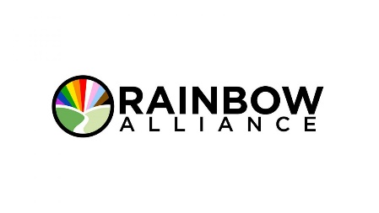





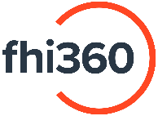


Thank you
Notes:
Gratitude to George town University Centre for Global Health and Innovation, Gates Foundation, and Consortium Partners for support and investment in the Blantyre HIV Prevention System. Thank you for listening, and back to you moderator
20

Slide 21
Government of Thailand's Perspectives on Engaging Community-Based Organizations (CBOs) in the National HIV Response
Cheewanan Lertpiriyasuwat
Department of Disease Control
Ministry of Public Health, Thailand

Slide 22
Government of Thailand's Perspectives on Engaging Community-Based Organizations (CBOs) in the National HIV Response.
Tuesday 7 July, 2026
Dr. Cheewanan Lertpiriyasuwat
Medical physician, Advisory level at the Department of Disease Control, Ministry of Public Health, Thailand

Slide 23
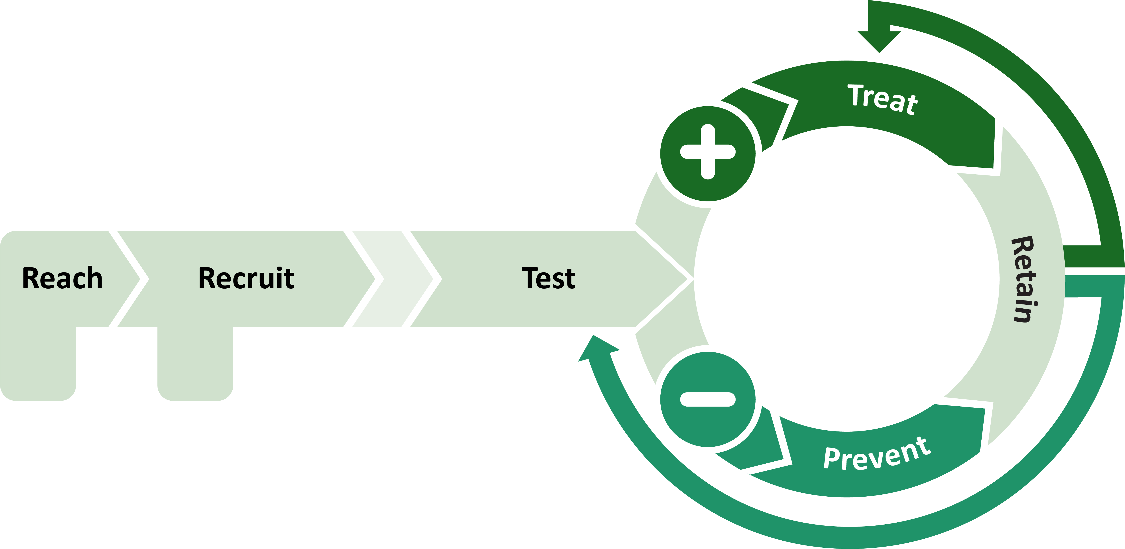
Service packages of EpiC* community-led health services (CLHS) (11 sites)
Provide HIV prevention tools such as condoms
Give HIV information and service information
HIV testing 4 times/year
POC/rapid CT/NG & syphilis 4 times/year
Rapid Anti-HCV 1-2 times/year
Pre-ART screening for 1st test reactive
HIV VL testing
Community-Based Same-Day ART
Same-Day STI treatment
U=U and Condoms/lubricant
Telehealth to support ART/PrEP adherence
Xpress service
Counseling
Online registration
Offline registration
HIV Self-Testing
HIV testing
STI/HCV
Substance use/chemsex
TB screening
Mental health screening
Same-Day PrEP with mixed daily & event-driven PrEP
Condoms/lubricant
* EpiC (Meeting Targets and Maintaining Epidemic Control) is a project supported by PEPFAR funding.

Slide 24
EpiC CLHS: PrEP Service
CLHSs have contributed approximately 66% of all PrEP initiation nationwide.
The key model is the partnership between CLHS-operated medical technology clinics and hospitals to jointly deliver services.
Current PrEP
7.8 K | 14.9 K | 20.5 K | 26.5 K | 33.0 K
Data sources: 1. https://hivhub.ddc.moph.go.th/officer/dashboard/service_area.php (update 13 June 2026), and 2. EpiC Thailand Program

Slide 25
EpiC CLHS: Community-based Same-Day ART (CB-SDART) Model (7 sites)
Through partnerships with local hospitals, clients can initiated ART at CLHS facilities and are subsequently referred to hospitals within their healthcare scheme for ongoing treatment.
(n = 462)
Among clients diagnosed with HIV at CLHSs, 69% initiated ART on the same day, compared with only 6% of those referred directly to hospitals.
(n = 721)
Data source: EpiC Thailand Program

Slide 26
Pathway for CBO Integration into Domestic Financing
Role of Division of AIDS and STIs (DAS), MOPH
Developed standardized training curricula and service delivery standards for CHW, and trained CHW.
Assessed and accredited organizations against established standards.
Developed quality assurance, monitoring, and reaccreditation guidelines for CBOs.
2016
2020-21
2022
2024
2025
launched an annual project-based reimbursement mechanism for CBO-delivered Reach & Recruit services.
Registered MOPH-accredited CBOs as Section 3 service units, making them eligible for reimbursement through the UHC fee-schedule payment mechanism. A total of 17 sites were registered.
The number of CBOs registered as Section 3 service units increased to 47 sites.
Role of National Health Security Office (NHSO)

Slide 27
Reach & recruit (RR) services funded by the National Budget
The percentage of R&R clients with HIV-positive has increased every year.
Proportion of CD4 count ≥200 cells/mm³ at diagnosis in FY25:
  EpiC CLHS – 84%
  Nationwide – 55%
R&R services have contributed to the increase in HIV testing nationwide.
Funding for R&R services has increased alongside program growth and achievements.
Data sources: 1. https://hivhub.ddc.moph.go.th/officer/dashboard/service_area.php (update 13 June 2026), 2. National Health Security Office (NHSO),
and 3. EpiC Thailand Program

Slide 28
Key Challenges and Strategic Considerations for Expanding CLHS in Thailand
1
2
3
4
Ensuring Quality and Accountability of CLHS
Strengthening Linkage to HIV Treatment and Continuity of Care
Scaling Up Community-Led HIV Services Through Capacity Strengthening
Strengthening Multisectoral Collaboration and Sustainability

Slide 29






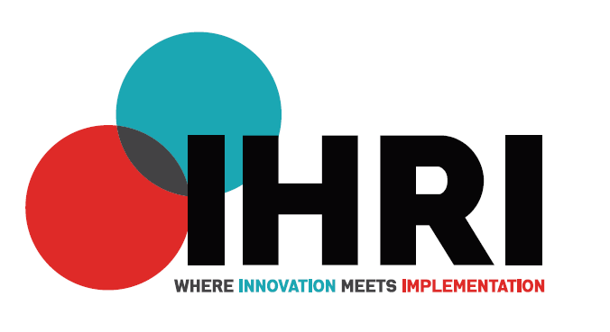

Thank you very much to:

Slide 30
Panel discussion
Florence Anam
Co-Executive Director, Global Network of People Living with HIV, Kenya
Stephen Ayisi Addo
Ghana Health Service
Chrissy Banda
Blantyre District Health Promotion Office, Malawi
Ima John Dada
National AIDS, Viral Hepatitis and STIs Control Programme, Federal Ministry of Health, Nigeria
Solange Baptiste
ITPC, South Africa
Cheewanan
Lertpiriyasuwat
Department of Disease Control,
Ministry of Public Health, Thailand
Stephen Ndolo Kiio
National Syndemic Diseases Control Council, Kenya
Lilian Otiso
Executive Director, LVCT Health, Kenya

Slide 31
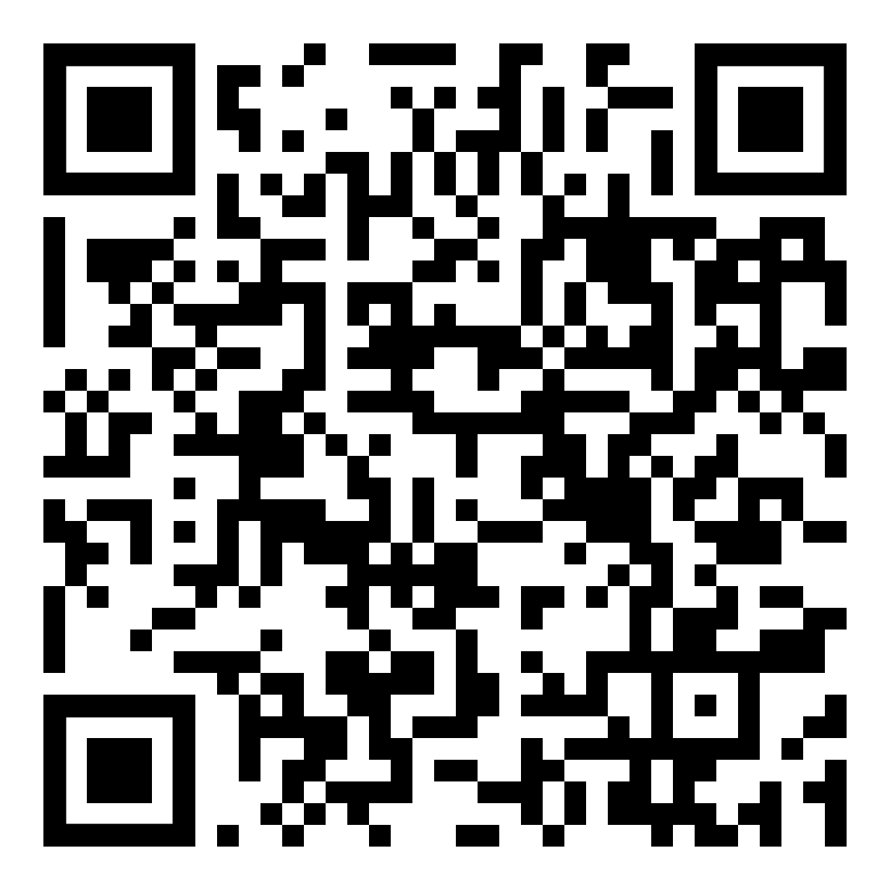
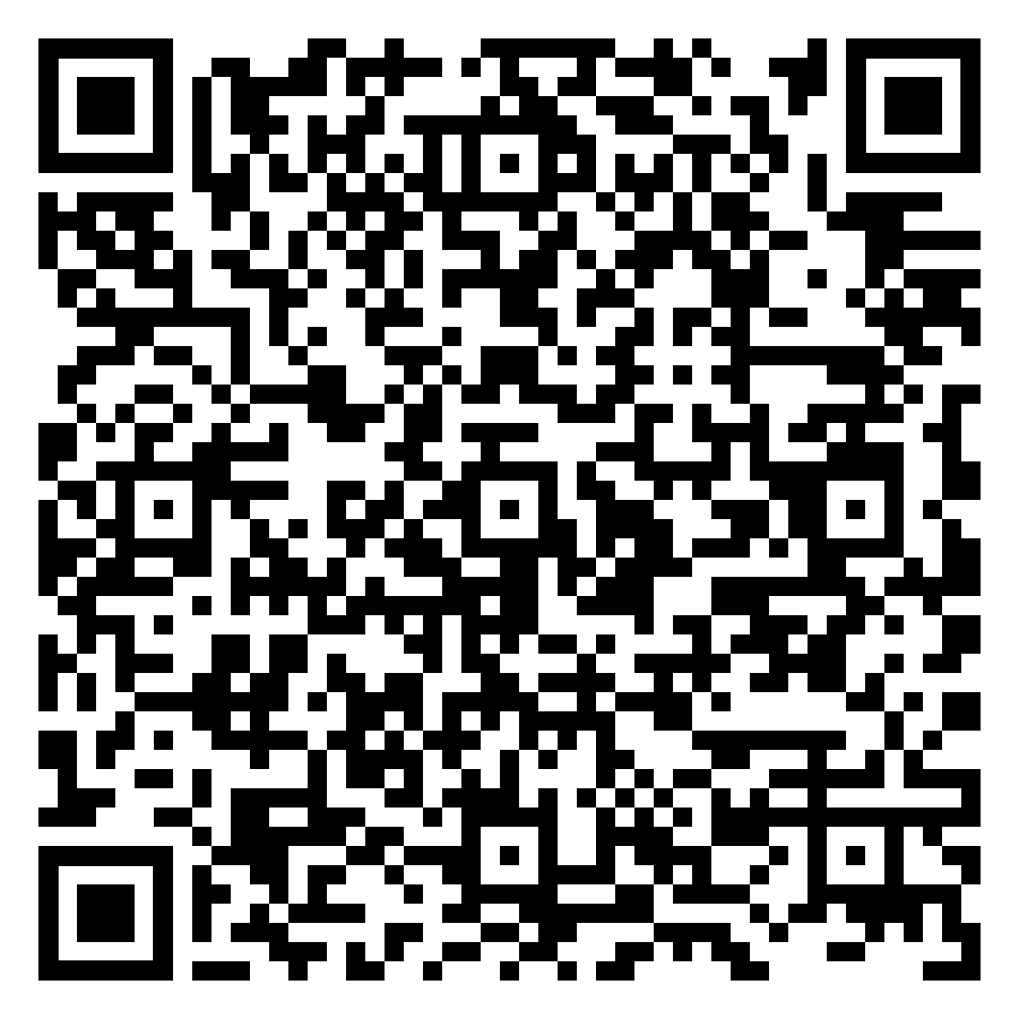
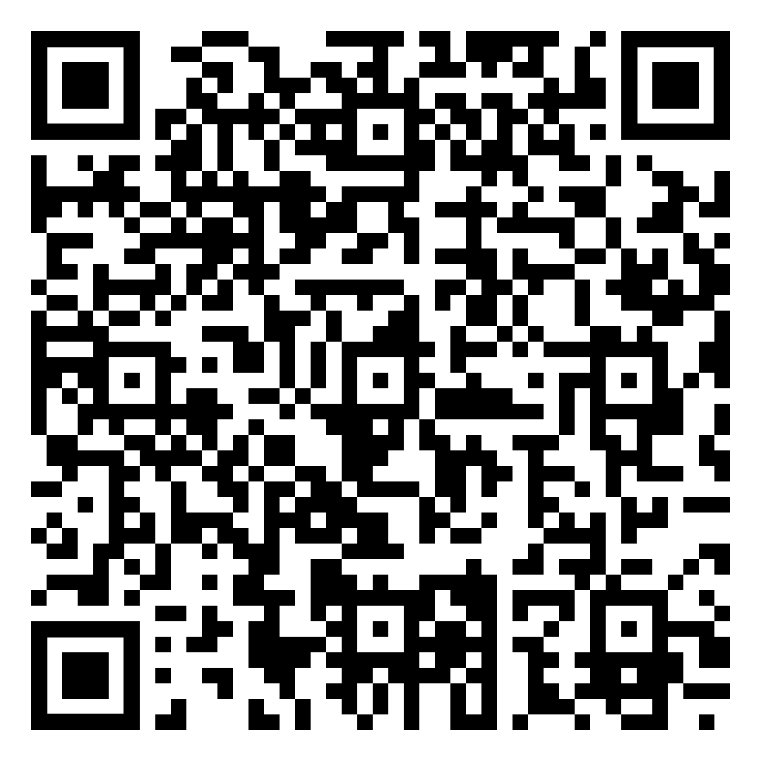
Other webinars in this series
Sustaining HIV prevention in a period of transition
7 April
Digital tools to launch and scale prevention products
6 May
Integrating HIV prevention into public health system while protecting equitable access
4 June

