Slide 1
A summary of the person-centred care (PCC) science at AIDS 2026
Prepared by the PCC team at IAS – the International AIDS Society

Slide 2
Titles link to abstracts on the online programme that can be viewed by all users. All abstracts can also be accessed via the AIDS 2026 Abstract Book.
The content – session recordings, slides and posters – are available to the public on IAS+.

Slide 3
Table of contents
PCC & HIV testing
PCC & HIV prevention
PCC & HIV treatment
Integration of other health conditions
Population-specific PCC approaches
Global guidance
Miscellaneous
What’s more to explore

Slide 4
1. PCC & HIV testing
Return to Table of Contents

Slide 5
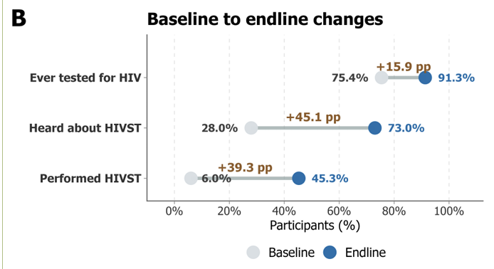
Implementation outcomes and preliminary effectiveness of a community-led HIV self-testing intervention for adolescent girls and young women in rural Northern Uganda: a quasi-experimental study
Results: Of 613 AGYW who received and performed HIVST kits, twelve tests were reactive. All were referred for confirmatory testing, and two initiated antiretroviral therapy.
Background: In 2024, about 210,000 adolescent girls and young women (AGYW) acquired HIV, with 81% in sub-Saharan Africa. This study evaluated the feasibility, acceptability, appropriateness, and preliminary effectiveness of a community-led HIV self-testing (HIVST) intervention among AGYW in Northern Uganda.
Methods: Quasi-experimental study among AGYW in five rural sub-counties in Omoro District from April to June 2025, including training community health workers (CHWs) and AGYW peer leaders to distribute HIVST kits and facilitate linkage to confirmatory testing and care. Study outcomes were assessed pre- and post-intervention with 415 randomly selected AGYW.
There was a significant increase (p<0.001) in HIVST awareness (28% to 71%), HIVST uptake (6% to 45%), and overall HIV testing (75% to 91%). AGYW were more likely to have performed HIVST (adjusted odds ratio [aOR] 13.1, 95%CI 8.4–21.1) and ever tested for HIV (aOR 4.65, 95%CI 2.7–8.2) post-intervention compared to pre-intervention. Overall, 80.7% and 88.9% agreed that the intervention was acceptable and appropriate, respectively.
Conclusion: Community-led HIVST was feasible, acceptable, and appropriate, and was associated with substantial increases in HIVST uptake and overall HIV testing among AGYW. This may offer a scalable option for expanding access to HIV testing in resource-constrained settings.
Poster available here.

Slide 6
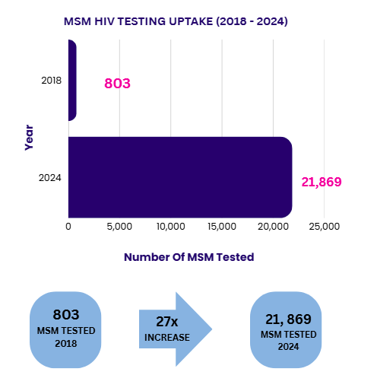
Decentralising HIV testing through peer-led rapid and assisted self-testing in Sri Lanka
Background: In Sri Lanka, HIV testing for key populations was historically facility-based; a model that limited access due to stigma, time constraints, and clinic availability. In 2018, Sri Lanka piloted key population–led HIV testing using rapid tests and assisted self-testing in community and virtual settings.
Methods: Peer outreach workers were trained to conduct HIV rapid testing and support assisted self-testing for men who have sex with men (MSM) in field and virtual settings. Peer outreach workers provided step-by-step guidance, pre- and post-test counselling, and emotional support until results were available, including real-time phone support for remote self-testing. Reactive results triggered immediate counselling, referral, and accompaniment to STD clinics for confirmatory testing and linkage to treatment.
Results: Testing expanded from 803 MSM tested across four districts in 2018 to 21,869 in 2024. Decentralised, peer-led testing reduced structural barriers, enabled testing outside clinic hours, and improved trust and disclosure. Continuous peer presence mitigated anxiety, reduced loss to follow-up after reactive results, and strengthened linkage to confirmatory testing and treatment. Virtual testing further extended reach to individuals unwilling or unable to attend physical sites.
Conclusion: : Decentralising HIV testing through peer-led rapid and assisted self-testing led to a sustained increase in HIV testing uptake among MSM in Sri Lanka. This model demonstrates how community-led task shifting can expand access and continuity of care in restrictive settings.
Poster available here.

Slide 7
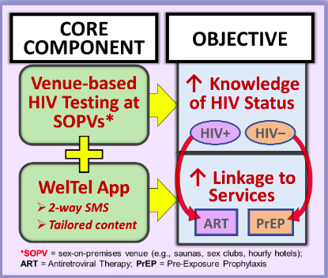
Pilot randomized trial of a venue-based HIV testing plus digital linkage-to-services intervention to support engagement in the status-neutral HIV continuum among men who have sex with men in Peru
Background: HIV incidence has increased over the last decade in Latin America, underscoring the need to improve uptake of HIV testing and prevention services in the region. An integrated HIV testing and linkage-to-services intervention was designed (“Mercury”) for men who have sex with men (MSM) in Peru, consisting of two core components: 1) HIV testing offered at sex-on-premises venues (SOPVs), 2) a digital application supporting status-neutral linkage.
Methods: Pilot trial of the Mercury intervention comparing four testing approaches offered at SOPVs: rapid HIV testing, HIV self-testing, coupon for facility-based testing or a choice between these 3 options. All participants received the digital application for three months, which included tailored educational content and bidirectional SMS messaging.
Results: Among 1,305 individuals approached, 160 (12.3%) accepted HIV testing. Uptake was similar across the four HIV testing arms, however, HIV test completion was significantly lower in those who received a self-test (70%) or referral coupon (39%) versus those who received a rapid HIV test (100%). Of 114 participants who completed testing, 22 (19%) tested positive for HIV.
Conclusion: A strategy combining SOPV-based HIV testing with digital health support was feasible and identified a high number of previously undiagnosed individuals living with HIV.
Poster available here.

Slide 8
Oral abstract session – Practice and pathways: Integrated testing and screening as entry points to HIV care
Integrating HIV testing, ART initiation and cervical cancer screening in primary care: programmatic results from Mozambique – Sheila Vanda Da Conceicao Uamba Tualufo, MoH, Mozambique (full abstract here)
Cervical cancer screening services offer a unique, woman-centered platform to identify previously undiagnosed HIV and facilitate ART initiation within routine primary care. This study includes a descriptive analysis of routine programmatic data from primary health care cervical cancer screening services in 2025.
In 2025, 1,441,901 women attended cervical cancer screening consultations. Of these, 503,394 (34.9%) had unknown HIV status at entry. Among women with unknown status, 471,780 (93.8%) were tested for HIV during the consultation, identifying 8,568 (1.8%) newly diagnosed HIV-positive cases.
From two community hubs to every Thai province: scaling a sex worker-led HIV self-testing distribution model across Thailand – Arnon Thepbinkarn, Service Workers in Group Foundation, Thailand (full abstract here)
A sex-worker led organization – system that allows anyone in Thailand to order an HIVST kit and receive it by post - Recipients were invited to submit results through a confidential return channel and offered linkage to confirmatory testing and care, delivered by peer navigators.
Across 168 days, two community sites processed 4,412 HIVST requests. Mailing addresses spanned all 77 of Thailand's provinces and 386 districts. Among 122 results returned, 8 were reactive (6.6%), well above Thailand's general adult HIV prevalence, indicating that the model is reaching the most vulnerable populations.
AND MORE …
Implementing community-based hepatitis C screening for key populations in the absence of established service infrastructure: a demonstration study from Singapore – Rayner Kay Jin Tan, National University of Singapore, Singapore
A festival-based, CHW-led testing and navigation model in rural Appalachia: reach, screening gaps, and linkage outcomes at Healing Appalachia 2025 – A. Toni Young, Community Education Group, United States
Integrating STI self-testing as a scalable entry point to HIV prevention among adolescent girls and young women in Dar es Salaam: evidence from a community-led advocacy initiative – Elizabeth Zahabu, WeCare Initiative, The United Republic of Tanzania
effects.
Session recording and slides available here.

Slide 9
Co-creating HIV testing services with communities; A participatory action to strengthen community-led HTS in pregnant women implementation in Katsina State, Nigeria
Results:
A total of 8,742 pregnant women were reached with community-led demand creation. Among these, 6294 (72%) pregnant women consented to HIV testing, including 2,146 young pregnant women aged 15 to 24.
Community selected testing points (markets, motor parks, women gathering spaces, Quranic schools) increased testing uptake by 34% compared to 4,697 baseline facility only approaches.
HIV positivity yield increased from 1.2% to 2.1% following co-created strategies.
Mentor Mothers linked all (100%) clients to care, improving linkage from 72% at baseline to 93% post intervention.
The findings highlighted strengthened trust, reduced stigma, and increased community ownership of HTS processes.
Conclusion: These findings highlight the importance of community-led models in scaling maternal HTS and advancing progress toward eliminating mother-to-child transmission in resource-limited settings.
Background: KNCV Nigeria implemented a community co-creation model under GC7, engaging community members as equal partners to design, implement, and refine HIV Testing Services (HTS). This study evaluated the effectiveness of participatory action approach in improving HTS access, uptake, and community leadership in implementation.
Methods: Participatory implementation conducted from January to December 2025. Co-creation sessions were held with community gate keepers, traditional birth attendants (TBAs), mentor mothers, and community volunteers to jointly identify barriers, map unconventional HTS sites, develop HTS and demand-creation strategies. The study population included pregnant women aged 15–49 years not accessing antenatal care.
No poster available.

Slide 10
Community peer navigators in barber shops to increase HIV self-testing uptake among young men in Biakoye District, Ghana
Background: Young men in Biakoye District have low HIV testing uptake and limited engagement with facility-based prevention services. Barber shops are heavily patronized by young men and offer a familiar and acceptable community space for health communication. This project aimed to assess the feasibility and acceptability of placing trained peer navigators in barber shops to promote HIV self-testing among young men in Biakoye District.
Methods: Implementation over a six-month period from June to December 2025 in 12 barber shops across Biakoye District. Each shop selected one trusted young male peer who was trained in HIV self-testing counseling, safe kit distribution, result interpretation support, referral pathways and confidentiality. Monthly follow-up visits assessed kit distribution, referrals, client feedback and operational challenges.
Results: A total of 482 young men visited the participating barber shops during the project period. Among them, 318 accepted HIV self-test kits and 274 completed testing either in the shop or at home. Challenges included concerns about privacy during busy periods and fear of receiving a reactive result. Despite these concerns, 61 clients who reported reactive results sought confirmatory testing, and 11 were linked to prevention or other follow-up services.
Conclusion: Embedding peer navigators within barber shops in Biakoye District increased HIV self-testing uptake among young men and created a practical community entry point for prevention messaging. The approach shows strong potential for scale up in similar rural communities.
No poster available.

Slide 11
Gamifying HIV prevention: TestD-Health, a community-led digital platform to build behaviour change and expand HIV and STI testing among key populations in Thailand
Background: Access to HIV and STI testing remains uneven for key populations in Thailand. In parallel, while digital health tools are expanding, many operate in silos and do not reflect community realities or support sustained behaviour change. TestD-Health was developed to address these gaps by applying gamification and community-led design to strengthen engagement with existing HIV prevention services.
Methods: Rather than creating new services, the platform aggregates and connects existing community-led testing, referral, and support services into one mobile-friendly interface. Gamified user journeys such as self-checks, progress tracking, and positive reinforcement encourage HIV and STI testing and service uptake while respecting user autonomy and privacy. The platform uses gender-affirming language and allows anonymous access. Activities include community co-design, digital outreach, peer-supported onboarding, and system integration with trusted service providers.
Results: Early implementation indicates that community-designed gamification increased engagement in HIV/STI testing, while integrated services and community leadership improved trust, accessibility, and uptake despite challenges related to digital literacy.
Conclusion: This scalable model offers a practical approach to digital HIV prevention grounded in community systems and real-world implementation.
No poster available.

Slide 12
Digital frontiers: leveraging social media for high-yield HIV case among previously unreached female sex workers in Ghana
Results: Digital outreach engaged 2,100 FSWs. HIV positivity among digitally recruited FSWs was 17.6% (n=370), nearly three times higher than physical outreach (6.0%; n=298). Digital recruits were more likely to be first-time testers (57% vs. 33%) and report inconsistent condom use with non-paying partners (61% vs. 46%). Young FSWs aged 18–24 comprised 65% of digital recruits compared to 20% in physical outreach. Peer-mediated digital navigation facilitated linkage, with 94% of newly diagnosed FSWs successfully accessing antiretroviral therapy.
Background: In Ghana, female sex workers (FSWs) are increasingly moving from physical hotspots to online platforms to solicit clients, creating critical gaps in traditional HIV outreach.
Methods: Implementation of a digital outreach model between January and December 2025 with:
A “Virtual Mapping” strategy to identify high-traffic digital hotspots used by FSWs on Facebook, Snapchat, TikTok, and Tinder
Trained Peer Digital Influencers conducting confidential, targeted outreach, delivering tailored HIV prevention, testing, and PrEP messaging
Interested participants being linked linked to a secure, anonymized booking platform and referred to physical Drop-In Centers (DICs) for HIV testing and care.
Conclusion: Social media platforms represent high-yield HIV “hotspots” for identifying previously unreached FSWs. Integrating virtual mapping, peer-led digital engagement, and secure virtual-to-physical linkage substantially enhances case finding and linkage to care.
No poster available.

Slide 13
Turning play into pathways: fun family days as a catalyst for family-centred HIV testing and care in South Africa
Background: HIV-related stigma remains a significant barrier to HIV testing, diagnosis, and linkage to care for infants, children, and adolescents in high-prevalence communities in South Africa. In response, Zoë-Life piloted an innovative, family-centred case-finding approach aimed at increasing HIV testing for children and adolescents aged 0 to 14 years.
Methods: The intervention was implemented in the uMlazi and Inanda townships, using “Fun Family Day” events as an alternative entry point for HIV testing services. Rather than branding activities as HIV testing outreaches, events were positioned as community family fun days, featuring recreational activities such as games and integrated child-friendly health education, alongside HIV testing.
Results: A total of 243 children were tested, of whom 7 tested HIV-positive and were successfully linked to care.
Conclusion: This model highlights the value of community-led, stigma-responsive strategies in strengthening paediatric and adolescent HIV case-finding. Embedding HIV services within broader family and wellness activities can improve early diagnosis, linkage, and retention in care.
No poster available.

Slide 14
Scaling online HIV self-testing (HIVST) via geolocation-based platforms: lessons from a pilot implementation among key populations in Lagos State, Nigeria
Background: Key populations in Nigeria often face barriers accessing facility-based HIV testing due to pervasive stigma and privacy concerns. This pilot evaluated discreet home-delivered HIV self-testing kits by leveraging Grindr.
Methods: From December 2025 to February 2026, and across 11 Local Government Areas in Lagos State, Grindr users were engaged via in-app pop-ups and then directed to an online request form. Successfully processed requests triggered the dispatch of a comprehensive prevention package, including an HIVST kit, condoms, lubricants, and instructional materials.
Results: 394 kits were requested with 86% of them asking for home delivery over facility pick-up. 316 kits were successfully delivered. 170 users reported back their results. Among them, 7 cases were reactive and all were successfully linked to treatment.
Conclusion: This pilot demonstrates that geolocation-based social platforms can effectively reach and link key populations to HIV services. Future scaling should prioritize optimized digital messaging, strengthened delivery systems ensuring courier safety, and real-time data monitoring.
No poster available.

Slide 15
2. PCC & HIV prevention
Return to Table of Contents

Slide 16
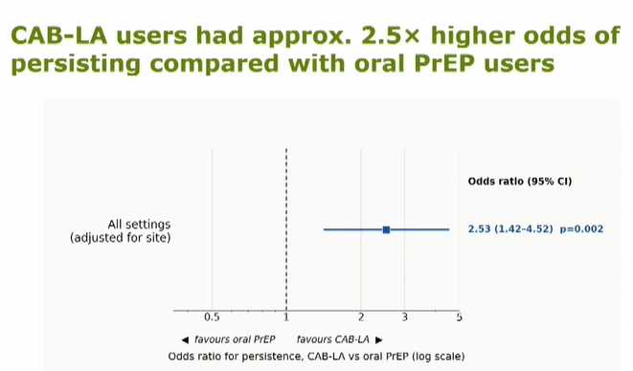
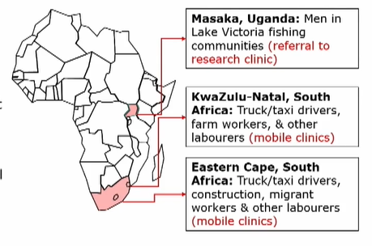
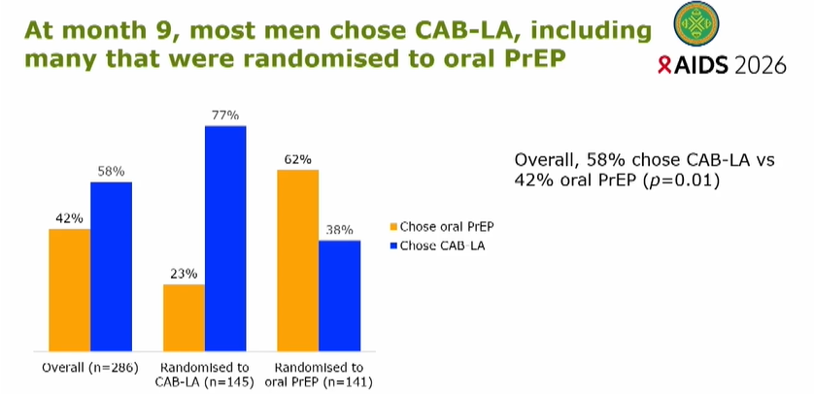
Co-Chairs’ choice – Uptake, persistence and preference for long-acting injectable versus oral PrEP among Mobile Men in Uganda and South Africa: primary user effectiveness and implementation outcomes in the Mobile Men trial
Background: Men who travel for work face elevated HIV vulnerability and limited access to prevention services.
Methods: Mobile Men is a phase 3b, open-label, trial comparing cabotegravir (CAB-LA) with oral tenofovir/emtricitabine (TDF/FTC; daily/event-driven) among men who travel for work. The study comprises a 9-month randomised phase followed by a 9-month choice phase.
Results: Of 400 men randomised to CAB-LA (n=202) or oral PrEP (n=198), overall persistence was low (22%) but higher with CAB-LA than oral PrEP (28% vs 16%). At 9 month, overall, 58% of the participants chose CAB-LA versus 43% oral PrEP, with preference varying by prior exposure.
Conclusion: Although persistence was low, it was higher with injectable PrEP, which was also the preferred modality, particularly among prior users. Long-acting PrEP can be a promising HIV prevention option for mobile populations.
Slides available here.

Slide 17
Satellite - Person-centred HIV prevention for key and vulnerable populations in Latin America and the Caribbean (1/3)
Setting the scene: Why person-centred HIV prevention matters in the Caribbean – Alexus D’Marco, United Caribbean Trans Network (UCTrans), The Bahamas
The Caribbean region has the second-highest HIV prevalence globally, with key populations experiencing the greatest burden.
Person-centred prevention recognizes that everyone has different identities and circumstances, and faces different vulnerabilities. Instead of asking people to fit services, we design services that fit people.
Community organizations like UCTRANS build trust and help improve access to prevention services, including through peer-led support, as well as advocate for human-rights based care.
Yyryvôvô: the Guaraní bridge for regenerative community care - Simón Cazal, SomosGay, Paraguay
Reflection on the epistemicide in Abya Yala (Latin America).
  “Mainstream health interventions operate within a Western, biomedical framework that separates body from territory, separates individual from community, separates health from ecology, and treats Indigenous knowledge as folklore rather than science.The health crisis cannot be solved within the epistemology that produced it.”
Concept of cuerpo-territorio and paradigm of radical interdependence operationalizing Guaraní principles
4 weaving circles: SOMOSGAY organization, Kunu’u clinic, Red Gay Latino regional networking and ñande rekorã cooperative & takuapu mirí village.
  → “Over 22,000 clients served in the Kunu’u clinic.”
Session recording and slides here.

Slide 18

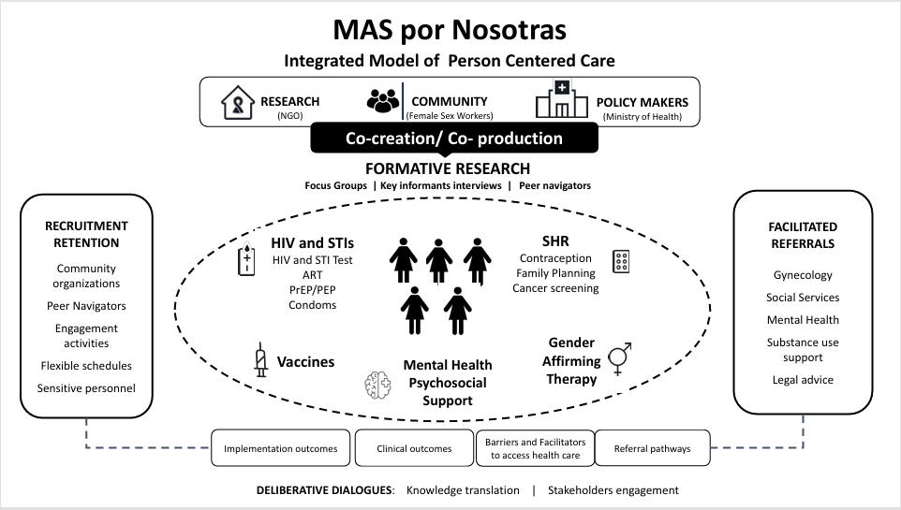

Satellite - Person-centred HIV prevention for key and vulnerable populations in Latin America and the Caribbean (2/3)
PrEP delivery in underserved rural communities, experiences from Centra America – Obed Quiroz, Organización Llaves, Honduras
MAS por Nosotras : comprehensive sexual and reproductive health for female sex workers – Valeria Fink, Fundación Huésped, Argentina
Assess the feasibility of a comprehensive prevention and care package (HIV, HPV, STIs, mental health, gender affirming therapy …) for female sex workers and inform public policies in Argentina through the development of a policy brief
Nearly 1/3 of the population of Central America lives in rural areas. What do barriers to healthcare access look like in practice?
PASMO PrEP decentralized delivery model includes community-based outreach and hybrid follow-up model.
Long-term PrEP success depends on decentralized follow-up services, not only on PrEP initiation.
Nearly 6 of every 10 PrEP initiations occurred outside the traditional clinic pathway, demonstrating the value of decentralized prevention services.
Cohort of 200 female sex workers (101 cisgender and 99 transgender women).
Participatory qualitative research with stakeholder mapping, interviews and focus groups. Important role of peer navigator support.
Session recording and slides here.

Slide 19
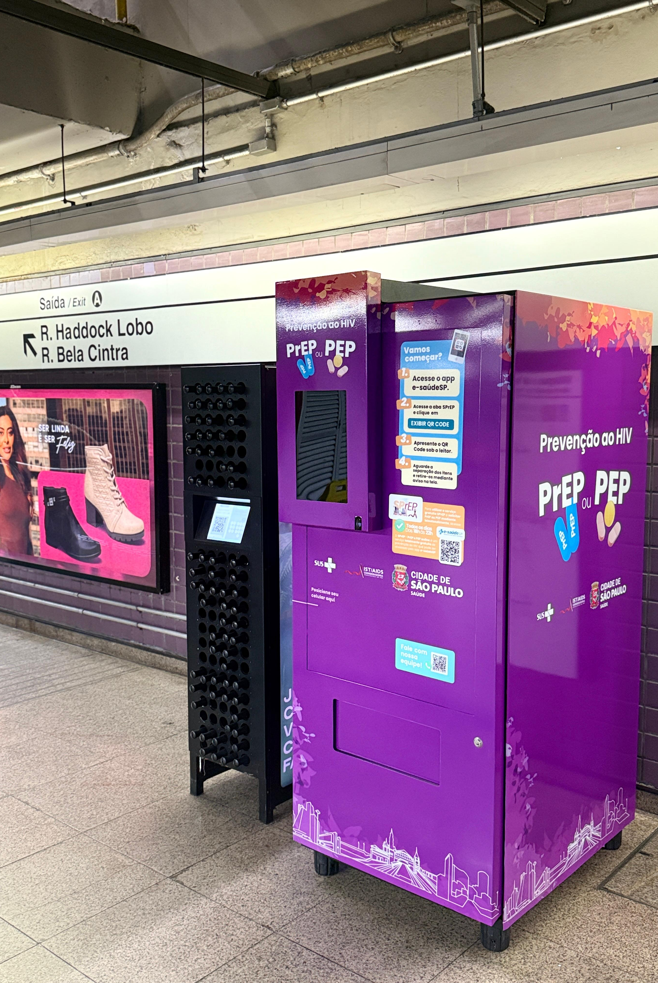

Satellite - Person-centred HIV prevention for key and vulnerable populations in Latin America and the Caribbean (3/3)
Investing in the integration of HIV prevention into daily life in São Paulo, Brazil – Adriano Queiroz da Silva, São Paulo City Health Department, Brazil
Long-acting PrEP implementation: lessons learnt from Brazil – Brenda Hoagland, Instituto Nacional de Infectologia Evandro Chagas (INI), FIOCRUZ, Brazil
Implementation studies of long-acting injectable PrEP -> to improve uptake and persistence among populations disproportionately affected by HIV
ImPrEP oral study (2018-2021)
ImPrEP CAB Brasil(since 2023)
ImPrEP LEN Brasil (since 2026)
Testing and counseling centres, including 1 mobile
PrEP, PEP and ART dispensing machines
Prevention supplies dispenser at subway stations and bus terminals
24h-hour pharmacies for medication pickup
Community outreach (parties, sex worker venues, sex cinemas …)
And more …
Learn more about the city’s person-centred strategy:
Focus on the mHealth intervention: 5 short videos with 17 min of content total covering oral and injectable PrEP and other HIV and STI prevention strategies.
People (including physicians) featured in the videos were individuals from sexual and gender minorities
55% reduction in new HIV acquisitions between 2016 and 2025.
Session recording and slides here.

Slide 20
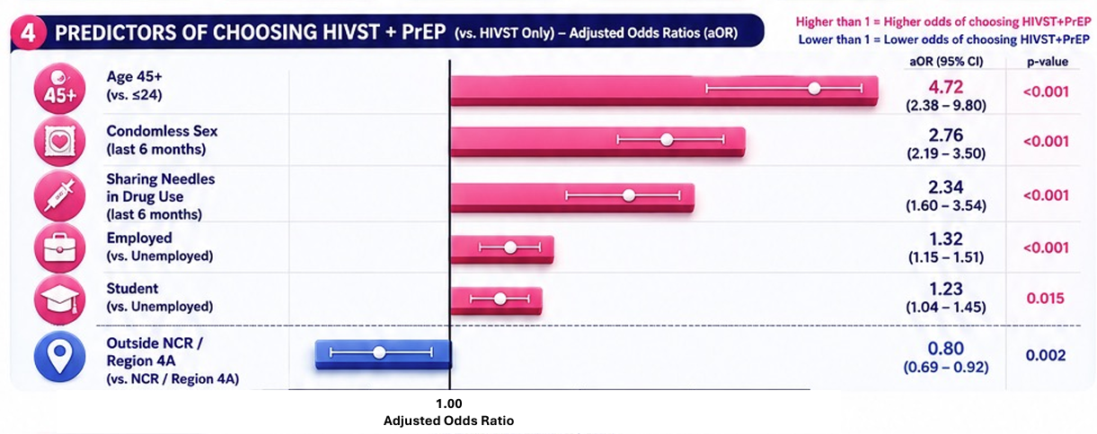
Predictors of choice between HIV self-testing with or without PrEP: a program evaluation of person-centered HIV prevention services of the save and improve lives(SAIL)-teleprep program in the Philippines
Background: Telehealth-based HIV self-testing (HIVST) has expanded access to prevention services, yet clients vary in their selection of HIVST alone versus HIVST combined with pre-exposure prophylaxis (PrEP). This study compared the characteristics of clients who selected HIVST only versus those who selected HIVST with PrEP to understand how social and structural determinants shape these choices in optimizing digital HIV prevention pathways in the Philippines.
Methods: Retrospective analysis among clients accessing HIV prevention services via SAIL-teleprep programme between January and September 2025. Hierarchical multivariable logistic regression models were fitted to identify factors associated with choosing HIVST+PrEP, sequentially adjusting for demographics, behavioral indicators, and geographic access. Statistical significance was set at p<0.05 and the analysis was done using R.
Results: A total of 4,955 clients accessed SAIL-teleprep services. Among them, 1,651 (33.3%) accessed HIVST only, while 3,304 (66.6%) accessed HIVST+PrEP.
Conclusion: HIV.
Conclusion: HIVST functioned as a critical entry point into the digital HIV prevention pathway, expanding reach to clients who may not initially seek biomedical prevention.
Poster available here.

Slide 21
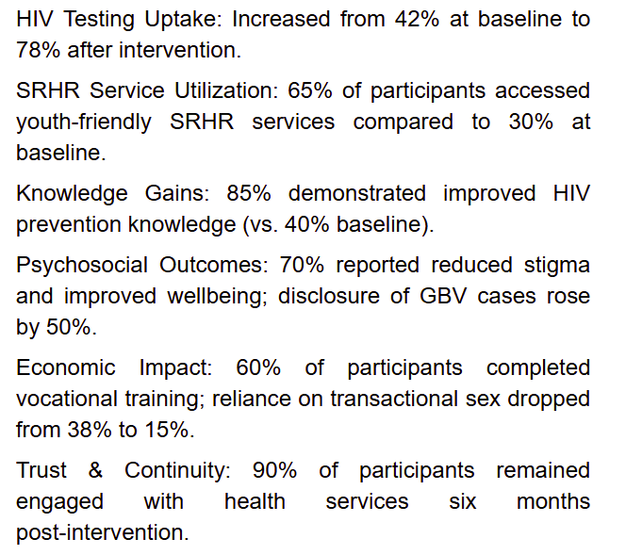
Adressing HIV vulnerability among young women aged 15-24 through trauma-informed GBV interventions in urban informal settlements of Kampala, Uganda
Background: Young women living in urban informal settlements in Kampala, Uganda face multiple vulnerabilities, including gender-based violence (GBV), poverty, unstable livelihoods, and limited access to youth-friendly sexual and reproductive health services. These intersecting challenges increase their vulnerability of acquiring HIV. GBV and HIV interventions are often implemented separately, limiting their effectiveness and impact.
Methods: Trauma-informed community-based intervention delivered by trained social workers and peer educators integrating:
  Survivor-centered psychosocial counseling
  GBV response and referral
  HIV prevention education
  Economic empowerment through vocational skills training
Results
Conclusion: Integrating trauma-informed GBV care with HIV prevention and livelihood support is a feasible and effective strategy to reduce HIV vulnerability among young women in informal urban settings. Future efforts should scale such integrated approaches to reach more marginalized young women and strengthen community-based HIV responses.
Poster available here.

Slide 22
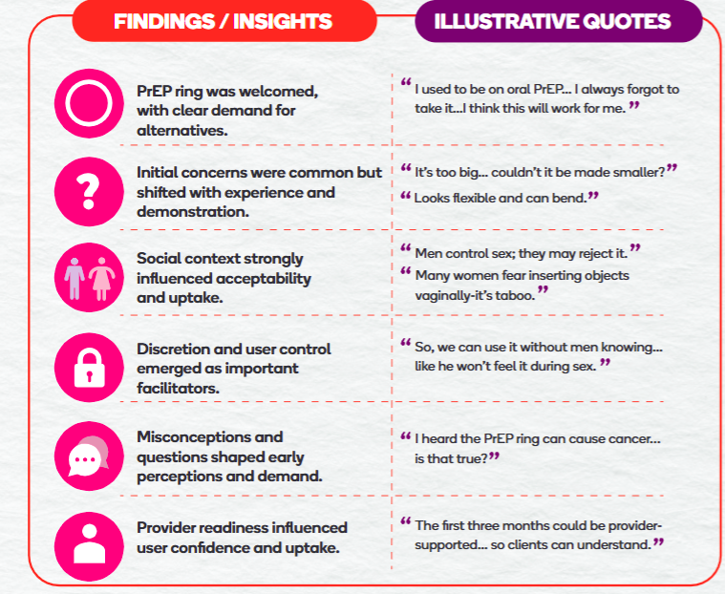
Empowering choice in HIV prevention: early engagement lessons from the PrEP ring in Botswana
Background: The one-month user-controlled dapivirine vaginal ring for HIV pre-exposure prophylaxis (PrEP Ring) presents a prevention option that could expand choice and agency for women and girls in sub-Saharan Africa. The PrEP Ring Transition to Scale project aimed to generate insights to inform product positioning, service delivery design, and demand generation strategies ahead of national introduction in Botswana.
Methods: Between January and June 2025, stakeholder and community engagement sessions, KIIs. A total of 179 stakeholders and 1,043 community members reached.
Results: See a snapshot included on the right and read more in the abstract and poster linked.
Conclusion: The findings stressed the importance of health literacy and communication messages tailored to clients and providers, proactive myth-mitigation, and client-centered service delivery models to support successful scaling up innovation.
Poster available here.

Slide 23


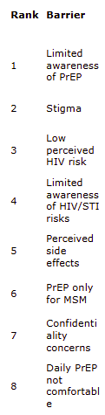
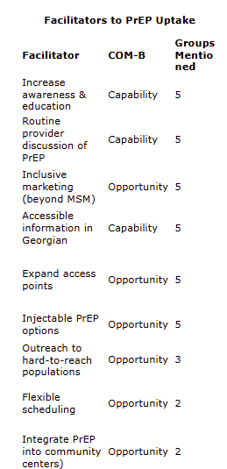

Barriers and facilitators to HIV pre-exposure prophylaxis (PrEP) uptake among key populations in Georgia: a mixed-methods study
Background: Oral HIV PrEP has been available in Georgia since 2017 and eligibility expanded in 2022, but uptake remains low among women, including women who use drugs (WUD), female sex workers (FSW), and female partners of people who inject drugs (PWID). This study identified barriers and facilitators to PrEP uptake for MSM and for women vulnerable to HIV acquisition to inform more inclusive, accessible delivery models.
Methods: Using the Capability, Opportunity, Motivation-Behavior (COM-B) model, 5 nominal group technique sessions took place where participants generated barriers and independently gave three votes to prioritize them.
Results: Results appear on the figures on the right. Only 17/50 women had heard of PrEP, and most believed it was “for gay men,” reflecting siloed messaging and access pathways.
Conclusion: PrEP delivery in Georgia inadvertently reinforces low awareness and constrain equitable access for women vulnerable to HIV acquisition. Shifting PrEP to neutral, flexible delivery platforms could reduce structural and social barriers and strengthen equitable HIV prevention for key populations.
Poster available here.

Slide 24
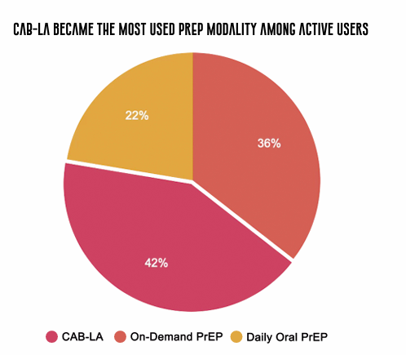


Nursing at the frontline: nurse-led implementation of long-acting injectables PrEP (CAB-LA) in a community-based adolescent service in Brazil
Background: In Brazil, recent regulations authorizing nurses to prescribe PrEP and PEP enable innovative nurse-led implementation models. This experience report describes the first nurse-led CAB-LA implementation in Brazil, delivered through a community-based adolescent service integrated into the public health system.
Methods: The protocol evaluates three PrEP modalities (daily oral, on-demand and CAB-LA) among 221 adolescents aged 15-19 vulnerable to HIV acquisition, including cisgender men who have sex with men, non-binary adolescents assigned male at birth, transgender women, and transgender men. Nursing activities included clinical assessment; HIV/STI testing with NAAT; syndromic management; CAB-LA prescribing and administration; follow-up; epidemiological surveillance (SINAN); and multidisciplinary coordination.
Results:
Conclusion: Nurse-led CAB-LA provision in community-based services is feasible, safe, and effective, improving adolescent retention and integrating HIV prevention with surveillance systems. Nursing functions as a bridge between marginalized adolescents and care, translating evidence into practice. Expanding the nursing scope represents a scientific, ethical, and social advance toward equitable HIV prevention.
Poster available here.

Slide 25
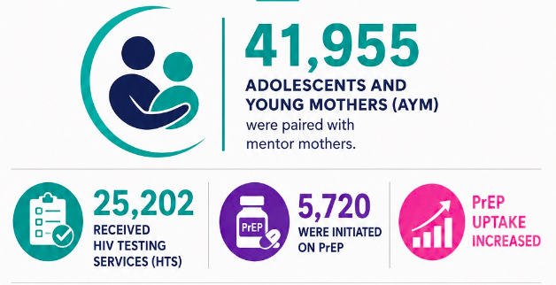
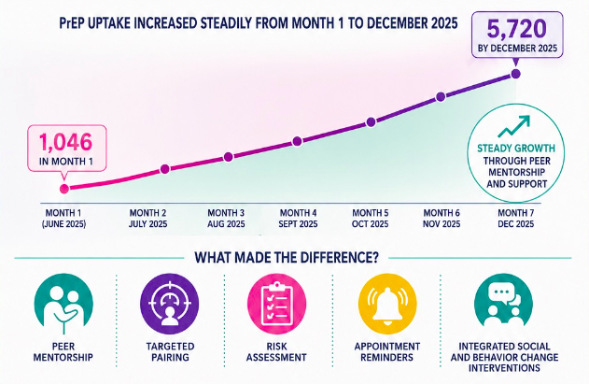
Improving uptake of HIV prevention services, including PrEP, among pregnant and breastfeeding adolescents and young mothers in seven high HIV-burden districts in Zambia using the Mentor Mother peer model
Background: Intersecting factors such as early childbearing, limited access to contraception and gaps in HIV prevention knowledge place pregnant and breastfeeding adolescents and young mothers (AYM) at increased vulnerability of HIV acquisition. In response, Coalition Health Zambia (CHZ) initiated the AYM HIV Prevention Project in February 2025 in seven high HIV-burden districts.
Methods: The Mentor Mother peer-led model pairs young mothers with lived experience with AYM vulnerable to HIV acquisition between June and December 2025. Through mentorship, they address myths and misconceptions, support engagement of sexual partners, and assist AYM in navigating health services. This is complemented by integrated social and behavior change interventions.
Results are depicted on the left.
Conclusion: The Mentor Mother peer led model increased uptake of HIV prevention services, including PrEP and HIV testing, among pregnant and breastfeeding adolescents and young mothers. Mentorship, targeted pairing, vulnerability assessment, and appointment reminders were key drivers of engagement and service continuity.
Poster available here.

Slide 26
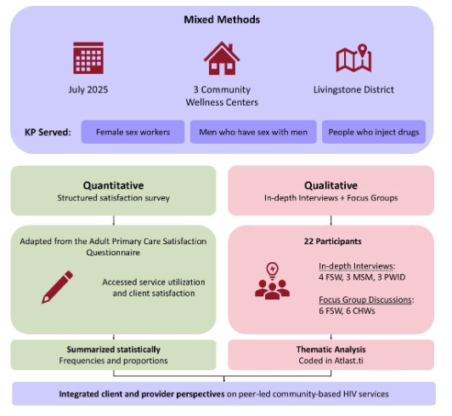
Recipients of care and community health worker perspectives on community-based HIV services for key populations in Livingstone district, Zambia
Background: Person-centred care emphasizes respect for individual preferences, needs, and values is critical for improving HIV outcomes among key populations. Despite Zambia’s progress towards epidemic control, key populations remain underserved. This study assessed the accessibility, acceptability, confidentiality, cultural relevance, and quality of peer-led community-based HIV services in Livingstone district.
Methods: See figure on the right.
Results: Overall satisfaction with peer-led, community-based HIV services was high (92%), with HIV testing (83%), condoms/lubricants (70%), and PrEP (59%) as the most accessed services. Clients valued accessibility, respectful treatment, confidentiality and timely home- or community-based service delivery. Key gaps included intermittent commodity stockouts, referral limitations, and provider transport constraints.
Conclusion: Peer-led HIV service delivery builds trust, improves engagement among key populations by fostering confidentiality, respect and cultural sensitivity. This approach reduces barriers in stigmatising facility-based settings, as clients feel more comfortable with peers who share similar experiences.
Poster available here.

Slide 27
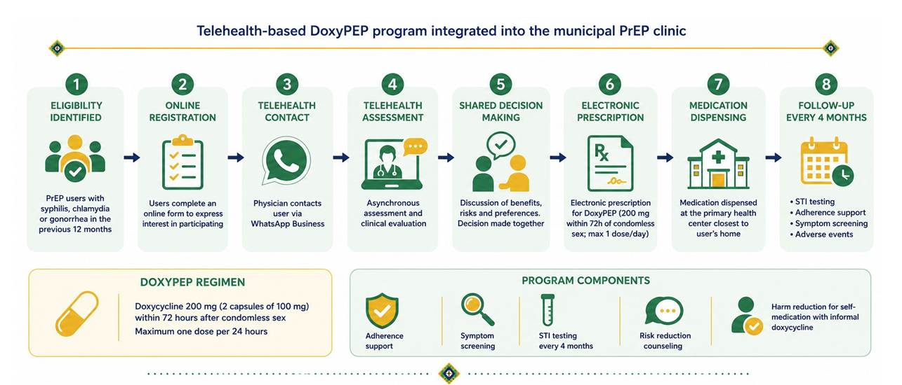
Integrating DoxyPEP into PrEP services through telehealth: a municipal implementation model in southern Brazil
Background: Bacterial sexually transmitted infections (STIs) are increasing globally. While Doxycycline post-exposure prophylaxis (DoxyPEP) is emerging as an effective prevention strategy, its structured use within public health systems remains limited. This municipal program aimed to implement a telehealth-based service to prescribe and monitor DoxyPEP among PrEP users.
Methods: The target population included PrEP users diagnosed with syphilis, chlamydia, or gonorrhea in the previous 12 months. Users were screened via an online form and contacted by a physician via WhatsApp Business for asynchronous telehealth assessment and shared decision-making. Electronic prescriptions for DoxyPEP were issued, and medications were dispensed at primary health centers close to users' homes. The protocol included adherence support, symptom screening, and four-monthly STI testing.
Results: 60 users enrolled. The telehealth model was feasible and acceptable, reducing access barriers and facilitating rapid initiation.
Conclusion: This municipal service demonstrated feasibility, acceptability and operational integration of DoxyPEP within a public PrEP clinic.
Poster available here.

Slide 28
Acceptability of peer-delivered systems navigation for HIV pre-exposure prophylaxis among heterosexual men and other key-informants in Malawi – results from HPTN 112
Background: Objective to describe acceptability of a peer-delivered system navigation (SN) strategy to improve PrEP use for heterosexual men in sub-Saharan Africa.
Methods: Type I effectiveness-implementation hybrid randomized trial among men >=15 years initiating PrEP in Lilongwe, Malawi. Men were randomized to SN or Standard of Care (SOC). SN was integrated into STI clinic-based PrEP services and included counseling informed by motivational interview techniques, community tracing for missed PrEP visits, and “restart kits” (PrEP pill-pack and HIV self-test) for persons who stopped PrEP. 31 in-depth interviews conducted as well.
Results: SN was deemed acceptable among men (median AIM 16 [IQR:16,20]) and key informants (median AIM 18 [IQR:15,19]).
Nearly all men felt respected by navigators and reported rapport facilitating honest conversations about HIV vulnerability and PrEP decision-making.
Key informants supported male-focused PrEP interventions and peer navigators, while highlighting concerns about the feasibility of community tracing at scale and the potential misuse of restart kits or misinterpretation of HIV test results.
Conclusion: Male participants and key informants embraced peer navigators integrated into STI-clinic based PrEP services, with concerns raised by the latter on implementation at scale and re-start kits misuse.
Poster available here.

Slide 29
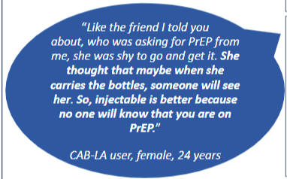
High demand and moderate retention of long-acting injectable Cabotegravir (CAB-LA) offered as an alternative HIV pre-exposure prophylaxis (PrEP) option via mobile clinics in female sex work hotspots, Malawi
Background: Evidence on the real-world uptake and use of long-acting injectable Cabotegravir (CAB-LA) for HIV PrEP amongst vulnerabilized populations is limited. Since January 2025, Médecins Sans Frontières, Malawi Ministry of Health and female sex workers (FSW)-led community-based-organizations (CBO), are offering CAB-LA as an alternative PrEP option alongside oral PrEP through mobile clinics in sex work hotspots.
Methods: An 18-month prospective observational mixed-methods study; (a) reporting PrEP uptake and use during the first 11 months based on routine clinic data (b) qualitative findings collected through in-depth interviews and group discussions.
Results: In 2025, PrEP was proposed to 81.9% (1094/1335) HIV-negative clinic clients, 42.1% (461/1094) declined PrEP and 54.1% (592/1094) were prescribed PrEP. While 70.6% (418/592) preferred CAB-LA, 56.2% (333/592) initially received CAB-LA and 43.8% (259/592) daily oral PrEP. Visit adherence was moderate for CAB-LA and low for oral PrEP, with early lost-to-follow-up. Clinic clients perceived CAB-LA as more convenient and discreet than oral PrEP given their mobility and experiences of violence from partners related to oral PrEP use. Factors hindering uptake and persistent use included fear of injections and injection-site reactions (ISR), and PrEP services not tailored to FSW mobility. Informants identified non-judgmental attitudes of the clinic staff, ISR management, and CBO-led health promotion as enablers.
Conclusion: PrEP delivered via mobile clinics in sex work hotspots showed good acceptability and uptake with high preference for CAB-LA. Gaps in PrEP uptake, challenges to visit attendance and early lost-to-follow-up call for strengthening of community sensitization, health promotion and person-centered services. Ensuring CAB-LA access for sex workers and others highly vulnerable to HIV acquisition should remain a priority.
Poster available here.

Slide 30
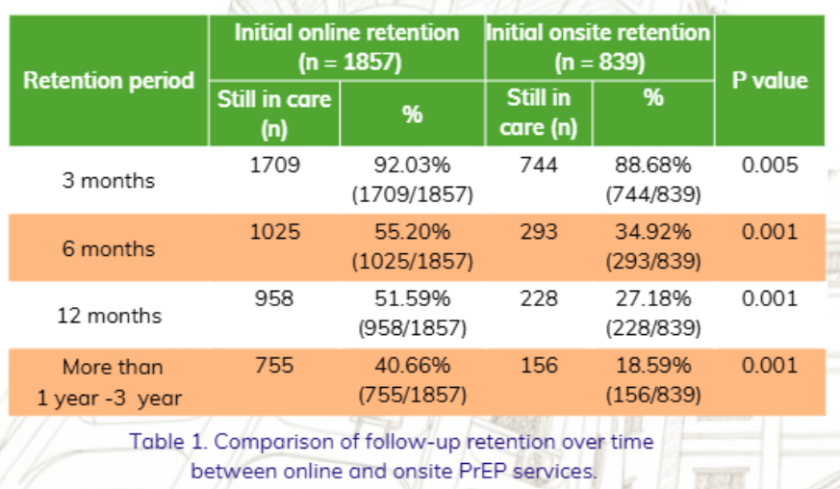
The impact of online self-administered daily PrEP screening on PrEP retention among Thai clients at the Thai Red Cross AIDS and Infectious Diseases Research Centre (Anonymous Clinic), 2022–2025
Background: This study evaluated PrEP retention among daily PrEP users receiving online-supported services—combining chat-based support with a self-administered online PrEP screening tool—compared with those accessing conventional face-to-face, clinic-based services at the Anonymous Clinic.
Methods: Prospective cohort study was conducted between 2022 and 2025 among PrEP-naïve individuals initiating daily PrEP. The primary outcome was PrEP retention, defined as continued engagement in PrEP care, assessed at 3, 6, and 12 months, and beyond 12 months up to 3 years following PrEP initiation.
Results: A total of 4,511 PrEP users were included: 2,498 men who have sex with men (55.4%), 171 transgender women (3.8%), 969 heterosexual men (21.5%), and 873 heterosexual women (19.3%). Overall, 2,382 participants (52.8%) initiated PrEP through online-supported services, while 2,129 (47.2%) accessed PrEP through onsite clinic-based services. Overall PrEP retention was substantially higher in the online-supported group compared with the onsite group (68.9% vs. 31.1%; p < 0.001). This advantage was consistently observed across all follow-up time points.
Conclusion: Digital service models may enhance convenience and sustained engagement in PrEP programs, representing a promising strategy to strengthen HIV prevention efforts and support progress toward ending the HIV epidemic.
Poster available here.

Slide 31
The Pharmacy-based HIV prevention and Sexual Health Engagement Services (PHASES) project: implementation strategies and mechanisms for pharmacist-delivered HIV/STI prevention care in Philadelphia, USA
Background: Pharmacy-based services can improve equitable access to HIV prevention and sexual health care, particularly for communities facing barriers to traditional healthcare. However, restrictive pharmacy scope-of-practice laws in many U.S. states limit pharmacists’ ability to initiate PrEP, PEP, and doxyPEP.This study aimed to develop implementation strategies for pharmacist-led sexual health services in Philadelphia, where HIV/STI rates are high and pharmacy laws are restrictive.
Methods: The researchers used a structured Implementation Mapping approach to develop and implement PHASES from October 2024 to April 2025, a pharmacy-based model designed to provide HIV testing and initiate PrEP, PEP, and doxyPEP. Guided by the Consolidated Framework for Implementation Research, they conducted interviews and focus group discussions with community partners and program implementers to identify and address key implementation barriers.
Results: Detailed explanation of PHASES is available in the graphs at this link. Within PHASES, pharmacists can provide HIV testing and initiate HIV PrEP, PEP, and doxyPEP, with referrals to primary care, sexual health providers, and telehealth providers for continuation of care, while operating within legislative restrictions.
Conclusions: Researchers identified implementation strategies and change mechanisms to pilot the PHASES intervention in community pharmacies in Philadelphia. Further research is needed to evaluate the program’s implementation success.
No poster available.

Slide 32
Structural determinants of HIV vulnerability: a multi-country analysis of labour rights and health exclusion among South Asian migrant workers
Background: This study looks at the intersection of labour rights and public health, focusing on documented and undocumented returnee migrant workers and their spouses and their access to the HIV prevention, testing and treatment continuum across 5 South Asia nations.
Methods: Situational analysis between 2024 and 2025 synthetizing quantitative data and policy frameworks, with a focus on the evaluation of the impact of bilateral labour agreements and workplace health entitlements, such as sick leave and insurance, on HIV service utilization and ART adherence.
Results:
  Returnee migrants account for a disproportionate share of new HIV diagnoses, frequently exceeding 60% in Bangladesh and 41% in Nepal.
  HIV testing uptake is not primarily hindered by lack of knowledge, but by undocumented status and the pervasive fear of deportation. Fewer than 30% of migrants reported access to employer-provided health insurance while abroad.
  Qualitative evidence suggests that condom use rates remain below 50% in sectors characterized by high workplace isolation and restricted freedom of movement, indicating that labor exploitation directly compromises sexual health autonomy and increases behavioural vulnerability patterns.
Conclusion: HIV prevention in South Asia cannot succeed through clinical interventions alone. Addressing the epidemic requires a "health in all policies" approach that integrates labour rights—such as wage protection and non-discriminatory health access—into national HIV strategies. Next steps include advocating for cross-border referral mechanisms that ensure a continuous and equitable continuum of care for mobile populations.
No poster available.

Slide 33
Community-led injectable HIV prevention for AGYW in Nakivale refugee settlement, Southwestern Uganda: decentralized, peer-supported CAB-LA delivery restores coverage amid funding instability
Background: Adolescent girls and young women (AGYW) in refugee settlements face heightened vulnerability to HIV acquisition due to mobility, economic dependence, partner influence, and disrupted health services including PrEP stockouts and decline in continuation linked to the recent reductions in foreign aid.
→ This study evaluated whether community-led, decentralized delivery of long-acting injectable cabotegravir (CAB-LA) could restore HIV-prevention coverage, engagement and adherence under humanitarian, resource-constrained conditions.
Methods: From July 2024 – June 2025, enrolment of 600 HIV-negative AGYW residing in Nakivale refugee settlement through 3 community-led delivery platforms: (1) Mobile PrEP hubs (2) Youth-friendly clinics with peer support and integrated SRH services (3) School / vocational points. Outcomes included initiation, 6- and 12-month continuation, re-engagement after missed visits and CAB-LA acceptability.
Results: PrEP initiation increased from 58% to 79% post-intervention. Twelve-month continuation rose from 18% to 34%, with youth-friendly clinics achieving 50%, mobile hubs 45%, and school points 20%. Re-engagement after missed visits improved from 32% to 61%. CAB-LA acceptability reached 86%, with 70% preferring 8-weekly injections over daily oral PrEP.
Participants highlighted enhanced privacy, reduced partner monitoring, predictable follow-up and trust in peer navigators as key enablers.
Operationally, mobile hubs reduced structural barriers; youth-friendly clinics mitigated stigma, reinforced adherence; school/vocational points maintained routine access.
Conclusion: Community-led, peer-supported, decentralized CAB-LA delivery restored HIV-prevention coverage during funding instability. This approach is feasible, scalable and adaptable to diverse humanitarian contexts to sustain HIV prevention among vulnerable adolescents.
No poster available.

Slide 34
Transgender-led, disability-inclusive policing to improve HIV prevention knowledge and service uptake in marginalized communities in Pakistan
Background: Persons with disabilities in Pakistan experience overlapping vulnerabilities related to poverty, exclusion, low health literacy, and limited access to inclusive health services, increasing their vulnerability to HIV acquisition and reducing timely linkage to prevention and care. From 2023 to 2025, a community-based study was conducted across 3 urban districts through a transgender police officer–led, disability-inclusive HIV awareness and referral programme including advocates and peer educators.
  Materials were adapted using sign language, pictorial guides, and simplified language.
  Sessions covered HIV acquisition, prevention options, safety measures, and service rights, alongside confidential referrals to testing and treatment sites.
Methods: A total of 348 persons with physical, hearing, or visual disabilities participated (56% women, 29% men, 15% transgender people; ages 18–50). Pre- and post-session surveys measured HIV knowledge, stigma attitudes, and intention to test. Clinic referral logs assessed service uptake. Quantitative data were analyzed using paired comparisons, and qualitative feedback was thematically reviewed.
Results:
Mean HIV knowledge scores increased from 44% at baseline to 83% post-intervention.
Willingness to seek voluntary testing rose from 39% to 71%.
Referral records showed a 46% increase in testing within three months.
Reported stigma attitudes declined by 34%, with greater improvements among women and transgender participants.
Participants described increased confidence, accessibility, and trust when sessions were delivered by inclusive policing and peer-led teams.
Conclusion: Integrating accessible education within community–law enforcement partnerships offers a scalable strategy to reach underserved populations and reduce structural barriers to care.
No poster available.

Slide 35
3. PCC & HIV treatment
Return to Table of Contents

Slide 36
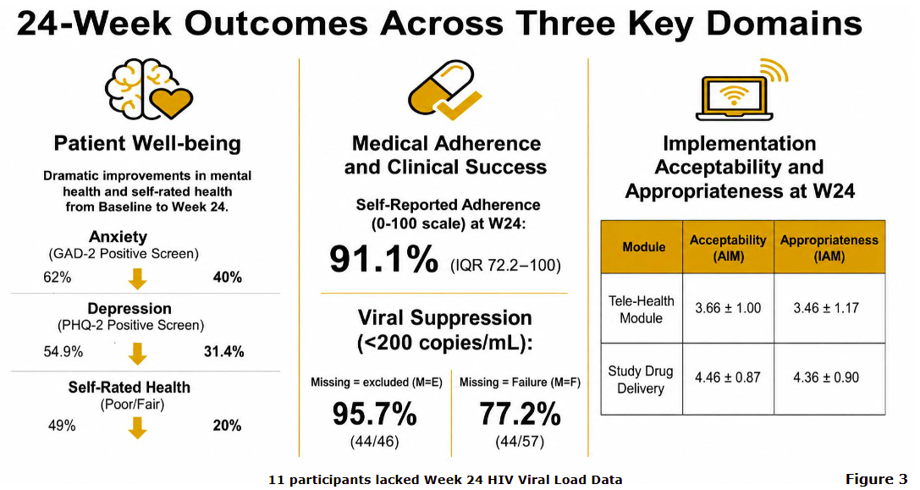
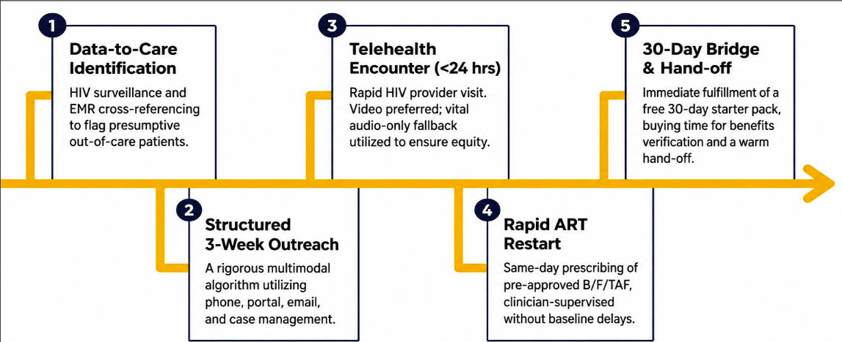
Rapid telehealth-enabled antiretroviral re-initiation for re-linkage to HIV care: interim findings from the multisite ACCELERATE study
Results:
Background: People with HIV (PWH) who are out of care (OOC) experience multiple barriers to staying engaged in care. Although rapid antiretroviral therapy (ART) initiation is well established, evidence on rapid ART re-initiation is limited.
Methods: The study enrolled 57 adults OOC PWH across Missouri (no HIV care visit for = 6 months and not on ART for = 1 month) and involved:
Conclusion: The ACCELERATE model demonstrates feasibility of re-engaging PWH OOC despite substantial barriers to care with improvement in patient-reported and HIV treatment outcomes.
Poster available here.

Slide 37
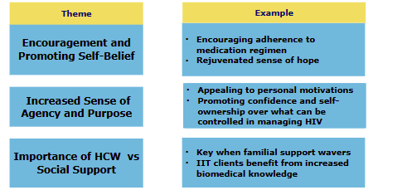
Client-provider interactions, cyclical interruptions in treatment, and the role of positive relationship building in treatment adherence and retention among men living with HIV in Malawi: a qualitative study
Background: Negative experiences with antiretroviral therapy (ART) providers are a major contributor to interruption in HIV treatment (IIT) of 28 days or more, and delayed re-engagement in care. In Malawi, men living with HIV often cite these negative experiences as the primary reason for IIT.
Methods: Secondary analysis of qualitative data embedded within two parent trials in Malawi (ENGAGE and IDEaL) focusing on evaluating the impact of person-centred counseling through 61 in-depth interviews with men living with HIV.
Results: Before intervention, respondents reported receiving punitive action from providers due to IIT, like being skipped over in lines for medications, and targeted disrespect, including being told their relatives “Should be ready with coffins”. These experiences created fear and anxiety around upcoming appointments minimizing personal ownership over disease management and progression. On the contrary, respondents stated positive provider interactions increased feelings of belonging to and agency in disease management promoting ART re-initiation and retention in care.
Conclusion: Health systems should prioritize encouraging non-judgmental and compassionate client-provider interactions to promote ART adherence and retention among men living with HIV.
Poster available here.

Slide 38
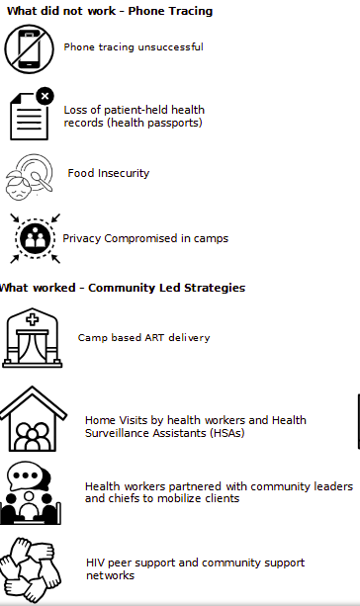
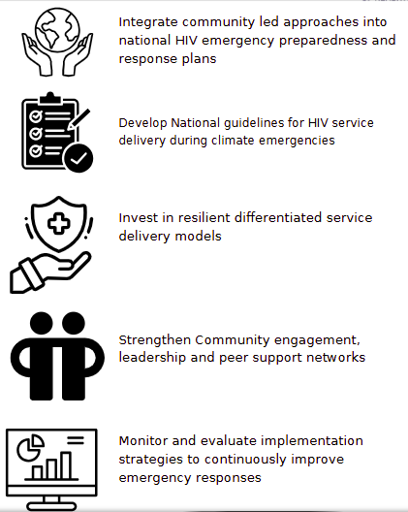
Evaluating the effectiveness of health workers’ strategies used in re-engaging women living with HIV with missed appointments post tropical cyclone Freddy in Mulanje, Malawi: a retrospective analysis
Background: Climate-related disasters disrupt HIV care continuity. This study evaluates the effectiveness of strategies in re-engaging women living with HIV (WLHIV) who missed ART appointments after Cyclone Freddy at Kabenke and Muloza health centres in Mulanje, Malawi.
Methods: Mixed-methods design between September 2024 and June 2025 using ART records analysis and 46 semi-structured interviews (11 with health workers, 26 with WLHIV).
Results: Of 100 WLHIV who missed ART appointments, 91% were successfully re-engaged. Successful strategies were community-driven, including camp-based delivery, home visits and collaboration with local leaders.
Conclusion: The research showed that continuity of HIV treatment during climate related disasters is possible when care models are flexible and community centred.
Poster available here.

Slide 39
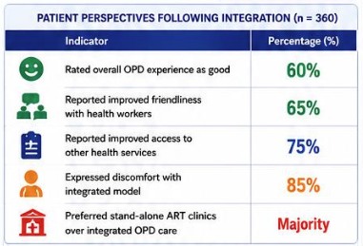
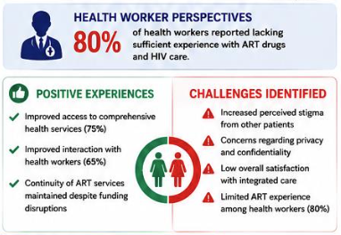
Perspectives of people living with HIV on the integration of antiretroviral therapy (ART) services into outpatient department (OPD) care at Inomo Health Centre III, Kwania District, Northern Uganda
Background: HIV/TB services in Uganda have traditionally been provided through stand-alone ART clinics largely supported by foreign funding. Following the U.S. government stop-work order and suspension of several USAID-funded programs, these clinics faced staffing and operational challenges. To maintain continuity of HIV care, the Uganda Ministry of Health integrated ART services into general Outpatient Department (OPD) services. This study aimed to explore the perspectives of people living with HIV (PLHIV) regarding this integration of ART services into OPD care.
Methods: Between May and November 2025, 360 PLHIV attending integrated OPD services answered a structured questionnaire capturing their service experiences before and after integration. 20 healthcare workers working at the OPD were also interviewed.
Results: See details on the right. 85% of interviewed PLHIV expressed discomfort with the integrated model. 80% of health workers reported lacking sufficient experience with ART drugs.
Conclusion: While ART integration preserved access to treatment during funding disruptions, patient-centered improvements addressing stigma, privacy, confidentiality, and health worker capacity are essential to ensure successful long-term implementation.
Poster available here.

Slide 40
Closing the gap in early and same-day ART initiation among young adults in Bangkok via telemedicine-supported community-based organization HIV services
Background: Initiation of antiretroviral therapy (ART) among young adults remains suboptimal. Community-based organization (CBO) HIV services have emerged as entry points for populations facing barriers to healthcare facilities. Integrating CBO outreach with primary care, supported by telemedicine, enables early diagnosis and same-day ART (SD-ART) initiation while maintaining care continuity in the public health system.
Methods: A public-private partnership model was implemented between Public Health Center 28 (PHC28) and a CBO, Service Workers in Group Foundation (SWING), to promote early HIV diagnosis and SD-ART initiation in Bangkok. The CBO conducted outreach and HIV testing in community settings. Individuals with reactive results underwent baseline laboratory assessment and telemedicine consultation with a physician at PHC28 to determine eligibility for ART initiation. Eligible clients were offered SD-ART initiation, and medications were dispensed through the CBO pathway, with referral to PHC28 or a healthcare facility of the client’s choice for ongoing care.
Results: From 2023-2025, 1,328 clients initiated ART at PHC28, of whom 496 (37.3%) initiated treatment through the CBO pathway. Clients accessing initial ART through the CBO pathway were younger than those receiving facility-based care (median age 23 vs. 32 years) and had a higher proportion of individuals aged 15-24 years (58.6% vs. 15.0%). CBO pathway clients initiated ART earlier, with a higher median CD4 cell count (443 vs. 376 cells/mm³). Linkage from the CBO pathway to PHC28 for clinical review/ART initiation was 100%, and the median time from diagnosis to ART initiation among eligible clients was 0 days. Among clients with available viral load (VL) results, 75.0% were suppressed, 20.4% had VL =200 copies/mL, and 1.5% had VL >200 copies/mL, similar to the facility-based cohort.
Conclusion: Integrating CBO HIV services with primary care can improve early ART initiation among young adults while maintaining continuity of care and comparable outcomes within the public health system.
Poster available here.

Slide 41
Effect heterogenicity for person-centred care intervention on retention in HIV care in Zambia: using CATE to understand who benefits most
Results: Among 85,003 clients, (n=41,998 SOC, n=43,005 intervention), PCCi led to an overall +3.1% (95% CI 2.9-3.4%) improvement in retention, but effects varied by baseline risk for poor retention. In quintile with highest CATE, PCCi led to a +13.2% (95% CI 12.6-13.9%) improvement in retention, and this group also had the lowest estimated retention under SOC (63.6% [95% CI 63.0-64.2%]). In contrast, the two quintiles that benefitted least (CATE -4.4% [95% CI -5.0 – -3.9%] and -0.1% [95% CI -0.6-0.3%]) already had the highest predicted baseline retention (85.5% [95% CI 85.1-85.9%] and 89.6% [95% CI 89.2-89.9%], respectively). Compared to the quintile with least benefit, the quintile with greatest benefit were more likely new ART initiates (29.5% vs. 7.3%), female (71.1% vs. 63.7%), younger (median age 32.7 vs. 41.4), and attended clinics with worse historical retention (mean pre-study loss 21.6% vs. 15.3%) (all p<0.001).
Conclusion: PCC benefits were concentrated among clients most likely to do worse, with minimal effects in those already expected to have high retention and fostered more equitable outcomes. Characterizing effect heterogeneity can enable targeted approaches to strengthening PCC for those needing it most.
Background: A previous study demonstrated that a multicomponent PCC intervention (PCCi) targeting healthcare worker (HCW) behaviour in 24 clinics in Zambia (Aug 2019-Nov 2021) improved client experience and retention, but some individuals may have benefitted more than others. Using conditional average treatment effects (CATE), this study characterizes effect heterogeneity of PCCi to understand which populations benefitted most.
Methods: The researchers evaluated 15-month retention (defined as having =1 visit between 11 to 19 months after first visit during study) in 16 clinics in a parallel, cluster-randomized trial subcomponent. They estimated CATEs for intervention vs. standard-of-care (SOC) using causal forests trained on augmented inverse probability weighted pseudo-outcomes, and characterized quintiles of CATEs that benefitted the most and least by sociodemographic, clinical characteristics, and retention under SOC.
No poster available.

Slide 42
Teen club participation doubles odds of viral suppression among children and adolescents living with HIV in Eswatini: recent program data from 2025-2026
Background: Eswatini has the highest HIV rates in the world with a prevalence rate of 27%. Despite progress toward epidemic control, viral load suppression (VLS) among children and adolescents living with HIV (CALHIV) remains a critical barrier. Adolescent focused differentiated service delivery models, including teen clubs are widely implemented, yet programmatic evidence of their impact is limited.
Methods: Retrospective analysis of Young Heroes organization’s routine program data amongst 2,689 CALHIV aged 10-19 years from October 2025 to March 2026. VLS was compared between 1,994 CALHIV enrolled in teen clubs and 1,695 not participating in the clubs.
Results: VLS among teen club participants was consistently high, ranging from 93% to 97%, compared to 91% to 95% among none teen club participants. Across all months, adolescents participating in teen clubs were twice as likely to achieve viral suppression VLS (OR 2.0; p<0.001). Age analysis showed higher VLS rates amongst younger adolescents aged 10-14 years (96%) , compared to 15-19 years (94%). Male adolescent also showed higher VLS (97%) than female adolescent (93%).
Conclusion: Teen club participation is independently associated with improved viral load suppression among CALHIV, with up to 5 percent points gains and higher VLS observed amongst younger adolescents and males. These results provide robust real-world evidence supporting adolescent focused differentiated care models. To improve HIV/AIDS treatment outcomes countries need to integrate large scale evidence based adolescent focused differentiated care models, like teen clubs.
No poster available

Slide 43
“We are all one”: engagement and experiences with a multilevel intervention to promote viral suppression and wellbeing among transgender women in the Dominican Republic
Background: Transgender (trans) women experience sub-optimal HIV care and treatment outcomes due to factors at multiple levels. As a result, multilevel interventions are needed to promote viral suppression and overall wellbeing.
Methods: GAP, an intervention with and for trans women living with HIV in the Dominical Republic, is a gender-affirming adaptation of the Abriendo Puertas (Opening Doors) intervention and included 3 components implemented with trans women: individual counseling sessions; continuous peer navigation; and community support sessions. Trans women with HIV who were at least 18 years old (n=117) were randomized to intervention (n=58) or control (n=59) groups.
Results: Experiences with intervention components were overwhelmingly positive.
  Participants highlighted processes of improved self-esteem, management of emotions, and reduced internalized stigma, which they attributed to trusting relationships with counselors and mindfulness practices.
  They linked receiving information about HIV information to reinvigorating their commitment to adherence and self-care.
  With navigation, participants felt they were not alone and had someone they could count on related to all aspects of life with HIV.
  With community support sessions, participants expanded their social networks and enhanced trust with other trans women.
Conclusion: This assessment of engagement in the GAP intervention suggests that individual, interpersonal, and group-based intervention components can promote optimal HIV outcomes and overall wellbeing for trans women living with HIV.
No poster available.

Slide 44
4. Integration of other health conditions
Return to Table of Contents

Slide 45
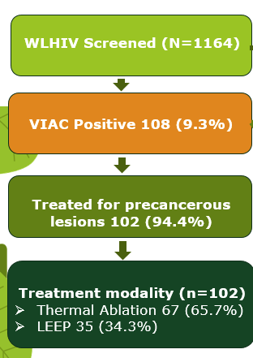
Beyond barriers: delivering comprehensive cervical cancer screening and treatment for WLHIV via a remote static–outreach model in Mashonaland Central, Zimbabwe (Oct 2023–Sep 2024)
Background: Cervical cancer remains a leading cause of mortality among women living with HIV (WLHIV) in Zimbabwe. Since 2018, Zim-TTECH has supported cervical cancer screening and treatment for WLHIV across the country in 71 static clinics and 325 outreach sites. One static site and nine outreach points were selected to evaluate programme delivery.
Methods: From October 2023 through September 2024 WLHIV aged 25–49 years were offered cervical cancer screening, same-day thermal ablation for eligible women, and referral for loop electrosurgical excision procedure (LEEP). Cervical cancer services were integrated with ART refills and viral load monitoring.
Results: See on the right.
Conclusion: A remote, nurse-led static and outreach model can be effective in delivering comprehensive cervical cancer care and can achieve high coverage and timely treatment among WLHIV. Efficient same-day thermal ablation and coordinated LEEP referral demonstrate feasible, scalable strategies for strengthening cervical cancer prevention and care in hard-to-reach, resource-limited settings.
Slides available here

Slide 46
Integrated screening, treatment, and care for cardiometabolic non-communicable diseases to address multimorbidity among PLHIV in Lusaka, Zambia: results from the TASKPEN pragmatic, stepped-wedge, cluster-randomized controlled trial
Background: Cardiometabolic non-communicable diseases (NCDs) are increasingly common among people living with HIV. This study evaluates the effects of TASKPEN, an intervention for TASK-shifted delivery of the WHO package of essential NCD (PEN) interventions, in HIV program settings in Lusaka, Zambia.
Methods: 12 HIV clinics transitioned from standard care to TASKPEN. TASKPEN consisted of creating a one-stop shop for integrated HIV-NCD management in the HIV clinic, supported by PEN treatment algorithms, health worker coaching, and point-of-care diagnostics. A nested cohort of PLHIV with cardiometabolic NCDsin 4 trial sites was followed longitudinally to assess individual-level effects.
Results: Between May 2023 and September 2025, 64,220 eligible PLHIV visited a study clinic, of whom 5,500 (8.6%) were randomly sampled and enrolled into the trial.
  Dual HIV-NCD control* increased from 59% under standard care to 66% with TASKPEN, while blood pressure control improved from 69% to 76%.
  In the nested cohort, dual control more than doubled (18% to 38%).
Conclusion: A WHO-aligned, multicomponent intervention targeting multimorbidity among PLHIV improved control of HIV and cardiometabolic NCDs in Zambia.
*“Dual control”—was defined as viral load<1,000 copies/mL plus BP<140/90 mmHg, normoglycemia, and no current tobacco use.
Poster available here.

Slide 47
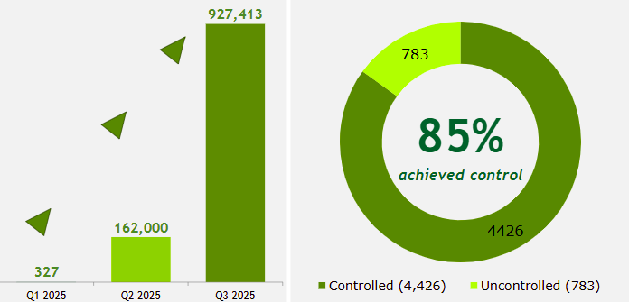
Integrating HIV and non-communicable disease services in primary healthcare: impact on diabetes mellitus screening, care, and reporting among people living with HIV in Uganda
Background: Following major HIV funding cuts in 2025, the Ministry of Health of Uganda prioritized integration of HIV and non-communicable diseases (NCDs) services, including diabetes mellitus (DM), to preserve treatment gains, optimize limited resources, and sustain care for the 1.4 million PLHIV on ART in the country.
Methods: Implementation from January to September 2025 across 1,751 ART facilities, focusing on all PLHIV active on ART with particular attention to adults aged 35+ years. Key interventions included: (a) development and adoption of national HIV Service Integration guidelines; (b) development of integrated service delivery curricula; (c) training 36,000+ healthcare workers on integrated service delivery; (d) institutionalizing routine blood glucose screening during ART visits; (e) adapting health information systems to capture more comprehensive NCD indicators.
was followed longitudinally to assess individual-level effects.
Results: DM screening increased from 327 (Quarter 1) to 927,413 (Quarter 3). Newly diagnosed DM cases rose from 19 to 8,172, with 14,298 PLHIV receiving concurrent ART and DM treatment by Quarter 3. Among known DM cases, 85% (4,426/5,209) achieved glycaemic control, while HIV viral suppression remained high across age groups.
Conclusion: Integration dramatically improved NCD case detection without compromising HIV outcomes, critical for fiscally constrained health systems. Next steps include expanding to hypertension and other NCDs, strengthening community-based screening, and conducting cost-effectiveness analysis to inform regional scale-up.
Poster available here.

Slide 48
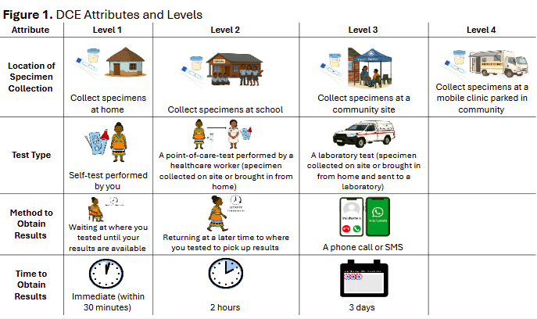
Preferences for community-based sexually transmitted infection screening in a high HIV incidence setting in South Africa: a discrete choice experiment
Background: Curable sexually transmitted infections (STIs) can cause long-term complications and increase HIV transmission. Although STI prevalence is high among adolescents and young adults (AYA) in rural South Africa, young people’s preferences for STI screening programs remain unexplored.
effects.
Methods: A discrete choice experiment was conducted between October – December 2025 among adolescents and young adults aged 16-30 years in rural KwaZulu-Natal, comparing preferences for collection location, testing approach, result notification, and result turnaround time.
Results: 574 participants participated in the experiment. Results show a preference for home-based collection, point-of-care testing (with the exception of male respondents preferring self-testing), phone-based result notification, and thirty-minute result turnaround time.
Conclusion: Decentralized, community-based approaches to STI screening will be vital to addressing high STI burdens among AYA affected by and vulnerable to HIV acquisition in South Africa.
Poster available here.

Slide 49
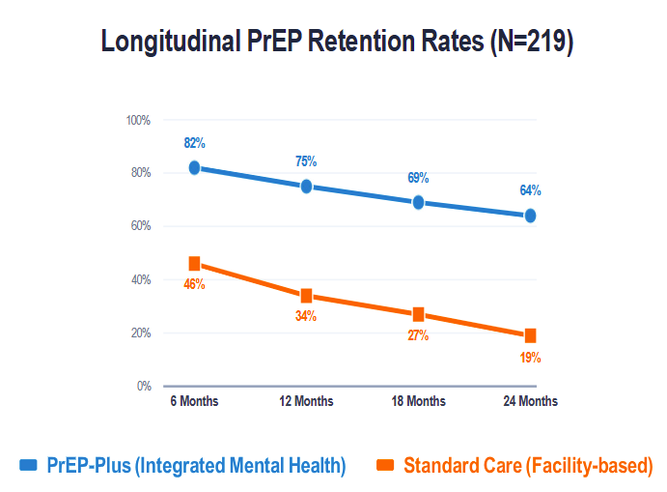
Integrating mental health in a hostile climate: a longitudinal analysis of PrEP retention among LGBTQ+ individuals in rural Kayunga, Uganda (2024-2025)
Background: In rural Uganda, LGBTQ+ individuals navigate a double burden of high HIV vulnerability and extreme social surveillance. Following the enactment of the Anti-Homosexuality Act (AHA) 2023, fear of state and community-led persecution has significantly deterred this population from seeking services at traditional health facilities. The primary objective of this project was to reduce new HIV acquisitions and increase well-being within the LGBTQ+ community.
Methods: Between January 2024 and December 2025, the intervention group (n=114) accessed the PrEP-Plus model coupling PrEP refills with peer-led mental health screenings and psychological first aid while the control group (n=105) received standard PrEP services. Retention was tracked through confirmed pharmacy refills at 6, 12, 18, and 24 months.
Results: PrEP-Plus participants were 3.4 times more likely to remain on PrEP after 24 months than those on standard care.
Conclusion: HIV prevention in hostile climates must treat mental health as a core clinical component rather than an elective service. Decentralized, community-led, and models that prioritize psychological safety may improve PrEP retention rates where legal and social barriers undermine HIV prevention.
effects.
Poster available here.

Slide 50
Integrating mental health into HIV care for high risk* communities in Uganda: lessons from the safe healthy empowered and protected (SHEP) project
Background: Key populations (KPs) in Uganda face significant mental health challenges due to widespread stigma, discrimination, violence, and legal marginalization - all factors further exacerbated by the passage of the Anti Homosexuality Act (AHA). Mental health concerns, including depression and anxiety, directly impact adherence to HIV prevention and treatment services. However, access to appropriate mental health care and psychosocial support remains limited.
Methods: From 2023 to 2024, the SHEP Project aimed to improve access to mental health care, trauma counselling, and psychosocial support for KPs in Uganda. The project focused on those affected by gender based and intimate partner violence and people living with HIV with unsuppressed viral loads. Targeting 12,000 individuals across 25 districts, SHEP trained peer educators and health workers in mental health assessment using the Patient Health Questionnaire 4,9, and Generalized Anxiety Disorder 7 tools.
Results: As a result, 21,584 people received mental health information and 5,156 received psychoeducation. Tailored psychosocial interventions for people living with HIV led to improved treatment adherence and viral suppression. An endline evaluation showed that 95% of previously unsuppressed support group participants achieved viral suppression.
effects.
Conclusion: The integration of mental health into HIV care significantly improved health outcomes and engagement. Psychosocial support groups were particularly effective in promoting viral load suppression and treatment continuity.
* This is the title of the abstract as submitted by the authors. Please note that the IAS encourages the use of “vulnerability” terminology rather than “risk” terminology. More on language here.
Poster available here.

Slide 51
Conversations at the point of care: a qualitative study of provider–healthcare client interactions and tobacco cessation in HIV clinics Kisumu County, Western Kenya
Background: Tobacco use remains a major contributor to morbidity and mortality among people living with HIV. Integrating tobacco cessation into routine HIV care has been recommended as a practical strategy in major resource-limited settings. However, little evidence exists on how provider – client conversations can help advance this objective.
Methods: Qualitative study conducted in public HIV clinics in Kusumu County, Kenya, with 36 in-depth interviews, 8 focus group discussions and 16 key informant interviews.
Results: Routinely, providers did not initiate conversations about tobacco use during HIV clinic visits, primarily due to high workload and competing clinical priorities. When they did, the study shows that repeated and respectful interactions increased trust, disclosure, and engagement over time. Where available, structured support, including cessation medication and elements of the 5As (Assess, Advise, Agree, Assist, and Arrange) enhanced counseling confidence and reduced cravings. Overall, integration was supported by providers but constrained by staffing shortages, limited training, and tobacco-related stigma affecting disclosure and engagement.
Conclusion: Provider - client conversations during routine HIV care represent critical but underutilized opportunities for tobacco cessation. While integration of tobacco cessation within HIV care is acceptable and valued, strengthening provider capacity, normalizing routine tobacco screening, and addressing workload constraints are essential to support sustainable cessation integration and improve long-term HIV care outcomes in many resource-constrained settings.
effects.
Poster available here.

Slide 52
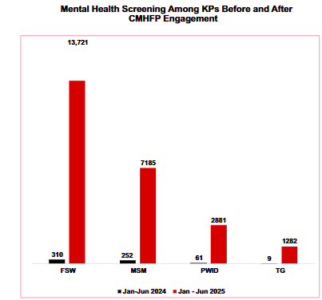
Strengthening mental health and psychosocial support (MHPSS) to the key populations (KPs) through community mental health (MH) service delivery: lessons from Anambra state
Background: This study looks at community mental health and psychosocial support services for key populations (KPs) through the engagement of Community Mental Health Focal Persons (CMHFPs) in Anambra State, Nigeria.
Methods: Comparison of mental health screening and case identification the six months before CMHFPs engagement (January to June 2024) and after engagement (January to June 2025).
Results: Before, a total of 632 KPs were screened and assessed for mental health conditions. Of the 632 screened, 165 (26.1%) KPs were clinically diagnosed with a mental health condition requiring therapy and were provided the required services. After, a total of 25,069 KPs were screened and assessed for mental health conditions, with 2,098 (8.4%) KPs clinically diagnosed with a mental health condition. This represents a 39.6-fold increase in screening and a 12.7-fold increase in case identification.
Conclusion: Scaling up the use of CMHFPs can help to bridge gaps in access to mental health services among key populations.
effects.
Poster available here.

Slide 53
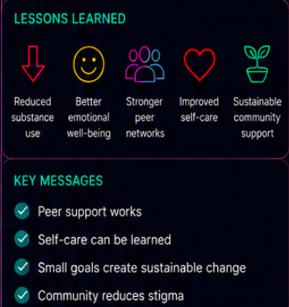
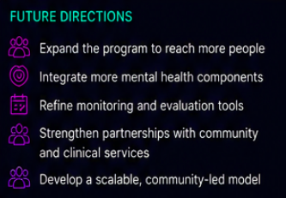
Self‑care challenges in the sexualized use of psychoactive substances among people living with HIV: a peer‑led harm reduction model
Background: People living with HIV who engage in the sexualized use of psychoactive substances face increased vulnerability to adverse physical and mental health outcomes. Despite the urgency, few community based initiatives address the intersection of HIV, chemsex, and mental health in a holistic and accessible way.
Methods: Transparente A.C developed the TRP challenge in Mexico; a peer-based program designed to strengthen self-care through a holistic approach using exercise routines, self monitoring notes, structured check ins and goal setting.
Results: The TRP Challenge shows that when individuals feel supported, motivated, and connected to peers, they can significantly reduce substance use—sometimes entirely during the program period—while improving physical and mental health. The initiative also strengthens social bonds and builds sustainable support networks that extend beyond the challenge itself.
Conclusion: Peer led, participatory models can meaningfully enhance harm reduction practices among people living with HIV who engage in chemsex.
effects.
Poster available here.

Slide 54
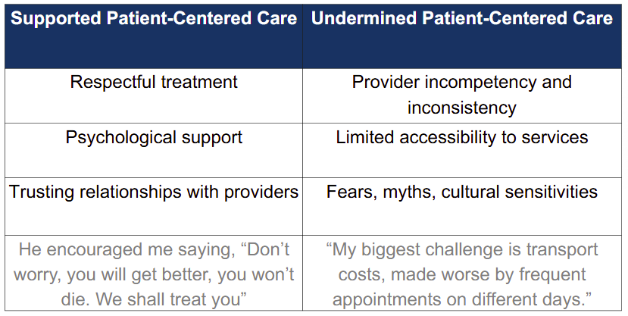
Enhancing person-centered care for Kaposi sarcoma: a qualitative exploration of experiences and perceptions of care among patients in Kenya and Uganda
Background: Kaposi sarcoma (KS) is an important cause of mortality among people living with HIV (PLHIV) in East Africa. KS lesions may also be associated with stigma, which delays diagnostic and treatment. Applying person-centred care (PCC) principles may improve engagement and outcomes for PLHIV with KS.
Methods: Five focus group discussions with 21 clients in Kenya and Uganda explored care experiences and were then analyzed through thematic analysis.
Results: The following themes emerged:
effects.
Conclusion: This study highlights the importance of PCC in improving experiences and outcomes for clients with KS. Compassionate, consistent, and well-informed interactions built trust and satisfaction, while communication gaps, provider turnover, and access barriers limited engagement. Optimizing PCC within oncology and HIV programs can enhance care for PLHIV with KS.
Poster available here.

Slide 55
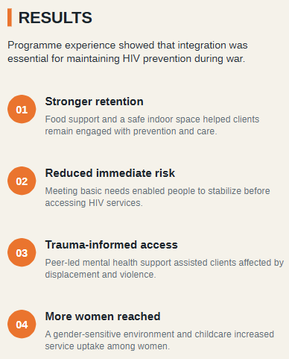
Community-led continuity of HIV prevention during the polycrisis in Ukraine
Background: Ukraine’s ongoing polycrisis: full-scale war, mass displacement, economic instability, energy disruptions and increased exposure to violence has created barriers to HIV prevention services, particularly for people who use psychoactive substances.
Club Eney, a women-led and community-led organisation, developed an integrated approach to sustain continuity of HIV prevention during 2024–2025.
Methods: The Safety Club integrated (a) harm reduction services (b) HIV self-test navigation and peer-to-peer support (c) trauma-informed counselling (d) medical and legal consultations (d) humanitarian assistance (access to a safe space during air raid, food support, hygiene …) (e) a child-friendly room with childcare.
effects.
Conclusion: The Safety Club model demonstrates that HIV prevention in conflict settings must include humanitarian support, mental health care and safe spaces as core components. Safe spaces are not separate from HIV prevention. In wartime, it is the infrastructure that makes prevention possible.
Poster available here.

Slide 56
Integrating key population HIV Services into public health facilities for sustainable access to health services: lessons from early programmatic effects in Migori, Western Kenya
Background: Integration of key population (KP) HIV services into public health facilities from targeted efforts (e.g., Drop-in centers) is increasingly adopted to enhance sustainability amid shifting donor priorities. However, evidence on early programmatic effects remains limited.
→ We evaluated the early impact of integration on HIV services among men who have sex with men (MSM) and female sex workers (FSW) in Migori County, western Kenya.
Methods: Six-month before-and-after evaluation using routine facility data from four public health facilities where drop-in centre services for MSM and FSW were integrated between June and July 2025. Indicators including HIV testing, linkage to antiretroviral therapy (ART), retention in care and viral load monitoring, pre-exposure prophylaxis (PrEP) initiation and continuation, and access to HIV prevention commodities were evaluated.
Results:
Core HIV treatment services were largely preserved following integration. ART linkage within 30 days remained stable at ~100% with consistent cohort retention before and after integration.
In contrast, HIV prevention services declined substantially. HIV testing decreased progressively from >1,600 tests per month before integration to <300 tests per month after integration, accompanied by reduced identification of new HIV acquisitions. PrEP initiation fell sharply after integration, with several months recording minimal or zero new enrolments. Access to prevention commodities became inconsistent, with interruptions in the distribution of male condoms, lubricants, and female condoms.
Concurrently, the number of HIV-positive clients with viral load tests declined during the post-integration period, suggesting reduced treatment monitoring following the transition
Conclusion: Integration of KP HIV services into public health facilities preserved treatment performance but coincided with significant gaps in prevention reach. Integrated models must embed stigma training, prioritize community-led outreaches, and ensure reliable access to prevention interventions to prevent erosion of HIV gains.
effects.
No poster available.

Slide 57
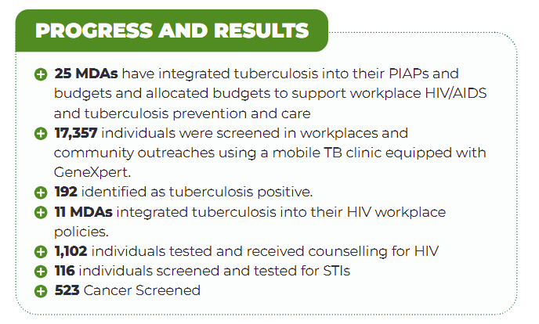
Bridging Policy and Practice: Implementing the MAF-TB Framework for Integrated HIV and TB Services in Workplaces and High- Communities
Background: In 2020, Uganda introduced the Multisectoral Accountability Framework for TB (MAF-TB), which mandates Ministries, Departments and Agencies (MDAs) to incorporate HIV and TB interventions into institutional plans, budgets, and reporting systems. However, implementation has been inconsistent, hindered by weak coordination, limited protected funding, and difficulties reaching key populations. Additional evidence is needed to inform effective implementation of these directives.
Methods: Between 2021 and 2025, State House Medical Department operationalized MAF-TB notably through: (a) 01.% budget allocation to HIV and TB mainstreaming (b) implementation of community outreach in key settings (c) integrated workplace and community health outreach package (HIV, TB, family planning, STI, …).
Results:
effects.
Conclusion: Governance-driven frameworks like MAF-TB can translate policy into measurable health outcomes when supported by political leadership, budget allocation at the institutional level, integrated service delivery models and community-based outreach approaches. The approach provides a replicable pathway for advancing equitable, rights-based HIV and TB responses in high-burden settings.
No poster available.

Slide 58
Rising above misinformation: safety-first, quality-assured AI for HIV and sexual and reproductive health self-care
Background: Limited safety evidence and accountability have slowed AI adoption in HIV and SRH care. Robust safeguards are essential for trust and scale-up.
  → Evaluation of the safety performance of AI-enabled HIV/SRH self-care platforms deployed across multiple programs in South Africa in 2025.
Methods: The study assessed a hybrid safety architecture integrating automated AI functions for harm detection, human-in-the-loop review, and clinician escalation protocols across AI-mediated conversations in self-care programs in Southern Africa, including Aimee, Coach mPilo, and VimbAI. Comparative analyses examined AI-based moderation against human labeling by clinicians to assess clinical accuracy, harm flag validity, and operational efficiency.
Results: Across over 300,000 AI-mediated user interactions, no instances of harmful misinformation were identified. No false negatives were identified in self-harm risk detection, and all high-risk interactions were appropriately escalated according to protocol. Automated triage substantially reduced clinician review burden while preserving clinical oversight and accountability. Implementation analyses identified context-specific limitations in broadly available moderation tools, prompting targeted system augmentations that improved performance in local linguistic, cultural, and epidemiological contexts.
Conclusion: AI-enabled HIV/SRH self-care platforms can achieve high safety performance when designed with layered safeguards, continuous monitoring, and human clinical oversight.
effects.
No poster available.

Slide 59
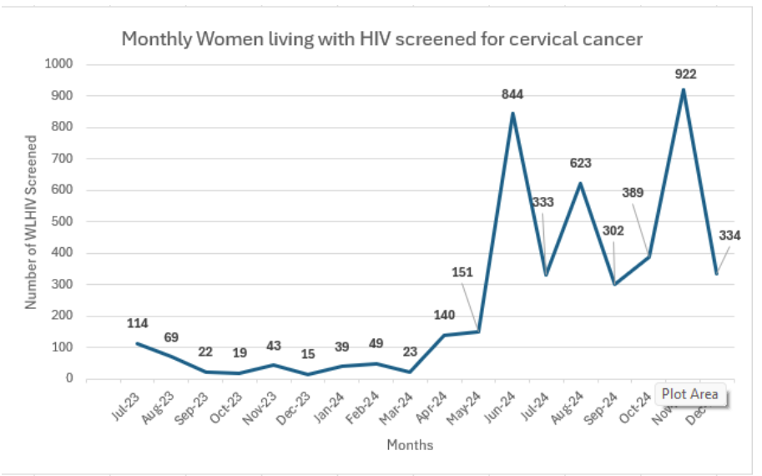
A decentralized, community-integrated model achieves a tenfold increase in cervical cancer screening among women living with HIV in Bayelsa State, Nigeria
Background: Women living with HIV (WLHIV) being 6 times more likely to develop cervical cancer (WHO), yet screening coverage remains critically low in resource-limited settings due to access barriers. This program aimed to increase access to cervical cancer screening services for WLHIV on the ACE 6 project in Bayelsa State, Nigeria.
Methods: This nine-month scale-up activity (April–December 2024) targeted WLHIV aged 25–49 who were receiving antiretroviral therapy (ART). The core intervention involved training existing health workers at non-ART sites in hard-to-reach areas to integrate Visual Inspection with Acetic Acid (VIA) screening into routine activities and to refer screen-positive clients for expert care. Activities also included community sensitization campaigns among PLHIV support groups.
Results: The intervention screened 4,038 WLHIV over nine months—an average of 449 women per month. This represents a 920% increase from the pre-intervention monthly average of 44. All screen-positive clients were successfully linked to treatment. Key findings include: (a) delivering integrated screening at nearby health posts directly addressed the key barriers of transportation cost and distance, which were cited by >85% of the WLHIV as the main reason for prior non-screening (b) community-driven mobilization through PLHIV support group is highly effective: Utilizing local support groups for demand creation significantly increased the uptake rate among contacted, eligible WLHIV.
Conclusion: This program demonstrates that a community-based, integrated service delivery model can significantly improve the uptake of essential but underutilized secondary prevention services for WLHIV.
No poster available.

Slide 60
Mental health and psychosocial support as a key component of sexual and reproductive health programs for women who use and inject drugs in southern Nigeria
Background: Women who use and inject drugs (WWUIDs) in southern Nigeria face high vulnerability to HIV acquisition, poor mental health, stigma and gendered exclusion. Despite a clear need, mental health and psychosocial support (MHPSS) is seldom integrated into sexual and reproductive health (SRH) programming for this key population. This study assesses the outcomes of a community-led intervention that embeds MHPSS within comprehensive SRH services for WWUIDs.
Methods: From April 2024 to July 2025, a peer-led intervention was implemented across bunk settlements and drop-in centers in four Southern Nigerian states (Lagos, Rivers, Cross River, and Akwa Ibom) with: (1) training 278 service providers and 1,560 peer educators on integrated MHPSS-SRH delivery and referral pathways; (2) embedding individual and group counseling within SRH services; (3) piloting a gender-sensitive MHPSS screening tool; and (4) establishing linkages to specialized care for severe cases.
Results: A total of 3,260 WWUIDs were reached with integrated SRH–MHPSS services. Of these, 719 (22.1%) reported depression or psychological distress and were referred for specialized care. Non-injecting women constituted 93.3% (n=671) of MHPSS referrals, while injectors accounted for 6.7% (n=48). MHPSS integration was associated with sustained increases in SRH service uptake. HIV testing coverage reached 56.0% (n=1,826), with 2.0% positivity (n=37). All 37 HIV-positive women were enrolled on antiretroviral therapy, with 29.7% (n=11) being injectors and 70.3% (n=26) non-injectors. PrEP uptake reached 20.2% (n=660).
Conclusion: Integrating MHPSS into SRH programming for WWUIDs is feasible, acceptable, and highly effective. This peer-led, community-based model enhanced psychosocial well-being, reduced stigma, and demonstrably improved HIV prevention, testing, and treatment outcomes.
effects.
No poster available.

Slide 61
5. Population-specific PCC approaches
Return to Table of Contents

Slide 62
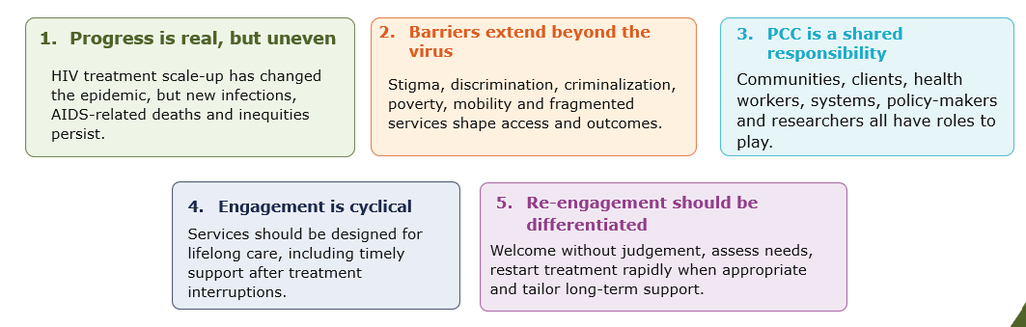
Satellite – Barriers and facilitators of person-centred care for key and vulnerable populations (1/3)
Setting the scene– Clarice Pinto, World Health Organization, Switzerland
Person-centred care recognizes that health outcomes are shaped by people’s lived realities – not only by clinical needs.
WHO definition of people-centred health serviced, good practice statements and implementation considerations are in the new 2026 guidelines here
Key messages:
Systemic factors driving health-related quality of life for justice-involved communities – Pankaj Sethi, Positive East, United Kingdom
Prevalence of HIV, hepatitis B, C and tuberculosis in prison is substantially higher than in the general population.
90% of people in prison will eventually return to the community, therefore prison health is public health.
Multiple barriers faced in prison settings when it comes to healthcare: (a) overcrowding (b) insufficient respect of autonomy, dignity, and confidentiality ; (c) stigma ; (d) disrupted continuity of care before, during and after incarceration.
Peer support and continuity pathways can support person-centred care. Person-centred care must extend beyond community clinics and into every prison system.
Session recording and slides here.

Slide 63
Satellite – Barriers and facilitators of person-centred care for key and vulnerable populations (2/3)
Protecting HIV treatment gains for female sex workers during funding disruptions through person-centred transition support – Daisy Kwala, Bar Hostess Empowerment and Support Programme (BHESP), Kenya
Stop work order:
  14,511 female sex workers no longer accessing services, including 2,364 clients living with HIV.
  31 members of staff and 165 peer educators left without paid employment.
With the PCC grant, partial re-opening of two service points 8 months later and 78% of clients living with HIV successfully accessing transition support.
Person-centred care means ensuring that no one falls through the cracks during times of crisis or transitions. When systems fail to protect continuity of care, they fail the very people they were designed to serve.
Protecting and advancing HIV prevention access for young, Black, queer communities – Princess Jauan Durbin, Southern Legal Center for Youth, United States
52.1% of new U.S. HIV diagnoses occur in the South and 47.5% of them are among Black individuals, despite a smaller population share.
  Meeting communities where they are; in the ballroom and kiki scene in Atlanta, Charlotte and Miami with peer navigators involved
  Sexual health education and empowerment, peer-led and culturally rooted
  On-site self-test distributions
  Handoff to gender-affirming legal care and community referrals
  Practical support: transportation to appointments, emergency financial assistance, …
265-330 young people reached, 90 HIV & syphilis self-tests distributed, 8 Ambassadors certified, 15 young people linked to a PrEP provider, 4 direct referrals to Gender-Affirming Legal Care, & more …
Session recording and slides here.

Slide 64
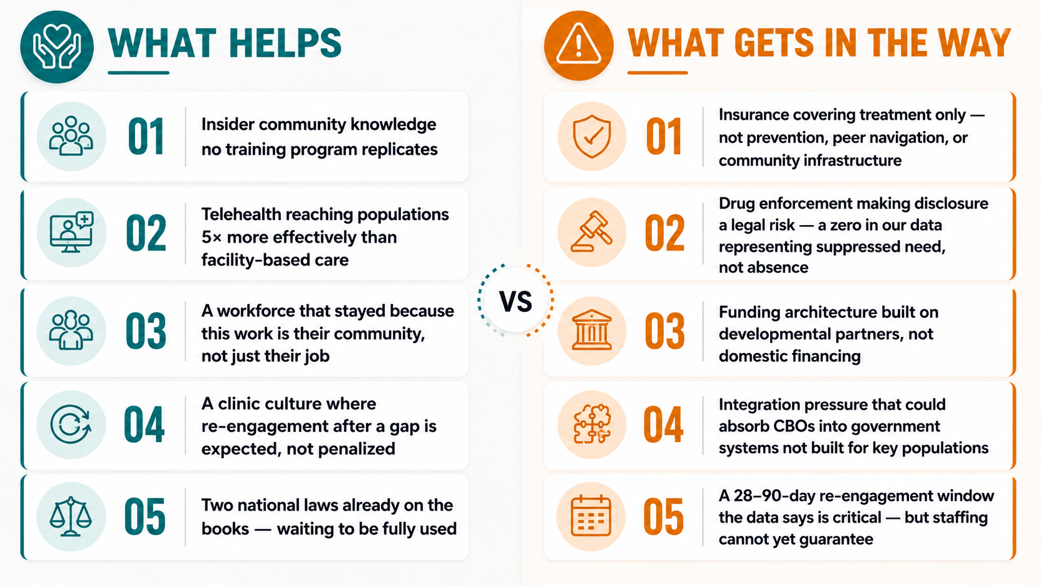
Satellite – Barriers and facilitators of person-centred care for key and vulnerable populations (3/3)
Systemic factors driving care quality for trans, travesti and non-binary populations – Maria Felipe Medeiros, Casa de Pesquisa CRT / DST Aids São Paulo, Brazil
Trans and gender-diverse people experience significant barriers to healthcare (lack of providers with expertise, discrimination, financial barriers, lack of family support, etc), leading to a diminished ability to access appropriate care. Both individual and social level factors impede access to HIV prevention and care.
Healthcare providers and healthcare systems can play a crucial role by providing non-pathologizing care models, continuing education for healthcare professionals, including peer navigation and favoring community-based research.
When the roadmap meets reality: Operationalizing person-centred care in community-based clinics in the Philippines – Rodenie Arnaiz Olete, Sustained Health Initiatives of the Philippines (SHIP), The Philippines
Based on the roadmap to scale up person-centred care in the HIV response published in 2025.
And following the work of the PrEP Uptake SAIL telePrEP pilot (2023) and its expansion, as well as the SAIL START Program.
Session recording and slides here.

Slide 65
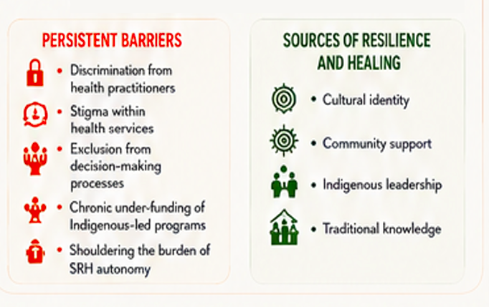
Centring Indigenous women living with HIV: Community-led sexual and reproductive health and rights advocacy across seven countries
Background: Indigenous women living with HIV face layered barriers to Sexual and Reproductive Health and Rights (SRHR). These barriers are rooted in colonialism, gender inequity, stigma, and systemic discrimination. Health systems often exclude Indigenous voices and ignore community knowledge, intensifying these challenges.
Methods: Multi-country, community-led initiative bringing together Indigenous women, researches and community organizations across seven countries: Canada, Guatemala, India, Nepal, Nigeria, Peru, and Aotearoa New Zealand. The project applies participatory and Indigenous methodologies, such as sharing circles, storytelling, community dialogues, and collective analysis.
Objective to center Indigenous women living with HIV as leaders, knowledge holders, and advocates.
Objective to foster safe spaces for women to share SRHR priorities, document lived experiences, and shape policy and practice.
guide
Results: Identified by the participants below:
Conclusion: This project demonstrates how community-driven SRHR initiatives can advance equity, leadership, and health system accountability while generating knowledge directly relevant to policy and practice.
Poster available here.

Slide 66
Community-led, layered health services drive high ART initiation, PrEP uptake and TB treatment success among sex workers in rural South Africa
Background: Sex workers (SWs) are identified as a key population in South Africa’s National Strategic Plan on HIV, STIs and TB and carry the highest HIV burden of all key populations nationally. Vulnerability to HIV acquisition among SWs is compounded by criminalisation, stigma, violence, untreated STIs, mental health challenges and limited access to integrated, rights-based health services, particularly in rural districts.
Methods: Programme implemented in Sekhukhune and Zululand Districts of Limpopo and KwaZulu-Natal provinces from April 2022-September 2025 by local NGO HPPSA. The programme reached SWs through peer-led community and hotspot outreach, and mobile services. Core interventions included HIV testing services, linkage to ART, PrEP, integrated TB and STI screening with treatment support, sexual and reproductive health services, mental health and psychosocial support, screening for non-communicable diseases, and human rights and gender-based violence response. A differentiated, community-based approach was used, tailored for structurally vulnerable sub-groups to reduce barriers to care and strengthen continuity across prevention and treatment.
Results: A total of 5,523 SWs were reached (97.9% females, 2.1% men or transgender), mostly aged 18–35 years (73%). HIV testing reached 2,692 SWs; 161 tested HIV positive, with 98% ART initiation. Of the 2,692 SWs who tested HIV-negative, 94% (2,155) of 2,293 were successfully initiated on PrEP. Further, all SWs were screened for TB, with 40 SWs returning positive TB results, all of whom were initiated on treatment with 100% treatment success and no loss to follow-up. Peer leadership and integration of non-HIV services emerged as critical to maintaining SW engagement.
Conclusion: The programme demonstrated comprehensive, peer-led and rights-based approaches can achieve strong HIV prevention outcomes alongside TB treatment success among SWs in a rural setting.
Poster available here.

Slide 67
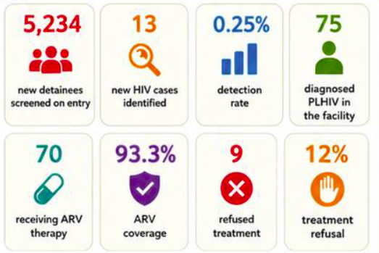
Empowering inmates: the SOS RUCI peer-led model for rights-based HIV care at Cipinang Detention Center, Indonesia
Background: Cipinang Detention Center in Jakarta, Indonesia, implemented an innovative, community-based program based on trained inmate health cadres, known as SOS RUCI (Safe Our Soul Rutan Cipinang). This model aims to provide a comprehensive, rights-based approach to HIV prevention and care, addressing the unique needs of people living in prisons while aligning with human rights standards for marginalized settings.
Methods: The study uses programmatic data from 2024 – 2025, when cadre responsibilities included assisting in systematic HIV screening for all new inmates, providing peer education regarding prevention, monitoring antiretroviral (ARV) treatment adherence, supporting TB Preventive Therapy (TPT) administration for people living with HIV (PLHIV), and fostering peer support networks to combat stigma and discrimination.
Results: See figure on the right.
Conclusion: The SOS RUCI peer-cadre model represents an effective, scalable, and sustainable strategy for delivering HIV services in challenging prison settings. By empowering the inmate community through a peer-to-peer approach, the program successfully improves screening access, supports high adherence, and addresses the critical HIV-TB intersection. This initiative upholds the health rights of incarcerated persons and demonstrates that community-led interventions can overcome structural barriers, offering valuable lessons for implementing human rights-centered approaches globally.
effects.
Poster available here.

Slide 68
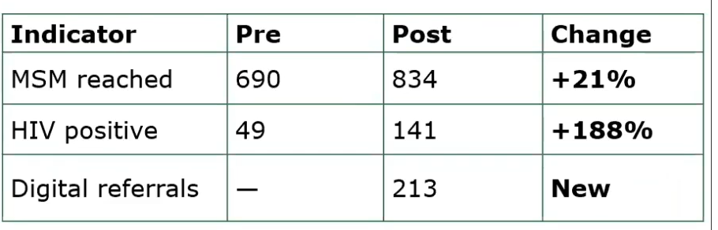
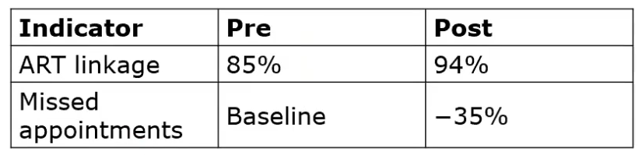
Oral abstract session – Practice and partnerships: Community roles in driving HIV service delivery (1/4)
Adaptive, safety-centered HIV service delivery for men who have sex with men in Ghana amid escalating anti-LGBTQ+ pressures: a pre-post evaluation of case-finding and linkage outcomes - Samuel Elliot Owusu, Maritime Life Precious Foundation, Ghana (full abstract here)
Men who have sex with men (MSM) face Ghana’s intensifying legal and political hostility that impede their access to HIV services.
Implementation of a community-led safety-centered HIV model including: (a) discrete one-on-one peer outreach (b) confidential digital engagement (c) WhatsApp consultations (d) rotating mobile clinics (e) multi-month ART dispensing (f) doorstep ART delivery (g) psychosocial support.
Comparison pre-intervention (Jan-Jun 2025) and post-intervention (Jul-Dec 2025) with results displayed in the figures on the right.
Qualitative feedback confirmed that MSM reported greater safety, greater trust, and reduced testing hesitancy.
effects.
Session recording and slides available here.

Slide 69
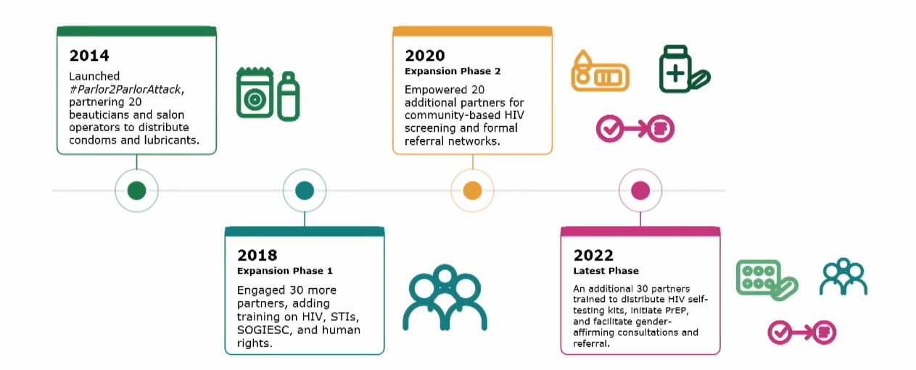
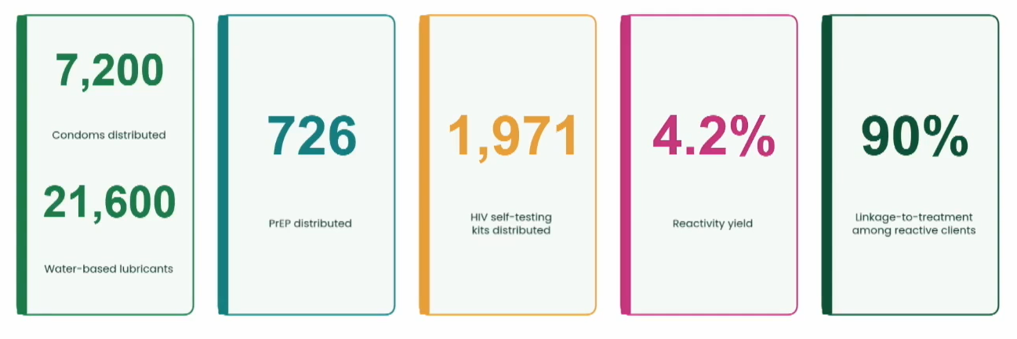
Oral abstract session – Practice and partnerships: Community roles in driving HIV service delivery (2/4)
A beautiful choice: transgender-led differentiated HIV testing and prevention through beauty salon owners and beauticians in the Philippines – Jonathan Laguing, DIOSSA, the Philippines (full abstract here)
Transgender women in the Philippines are disproportionately affected by HIV. Only an estimated one in three have ever accessed HIV prevention services, amid persistent stigma and discrimination.
Can non-clinical community spaces (such as beauty salons) become an effective front door for HIV testing and prevention among transgender women?
Launched in 2014, this initiative shows a transgender –led network of now more than 100 beauty-sector partners offering various testing modalities and prevention options.
Results for the year 2025 alone are displayed in the figure on the right.
effects.
Session recording and slides available here.

Slide 70
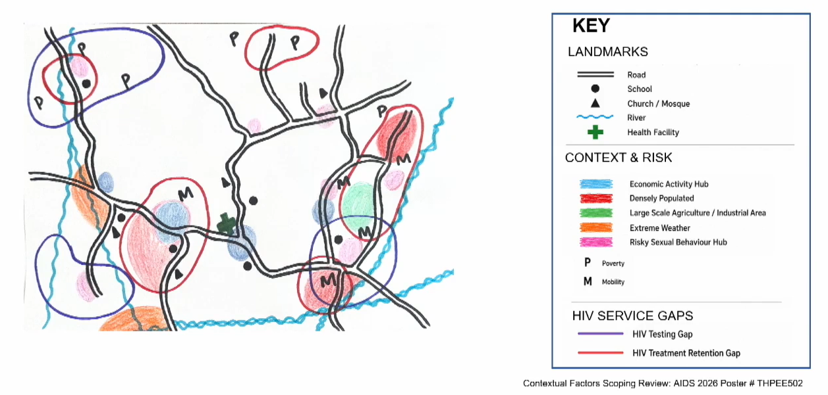
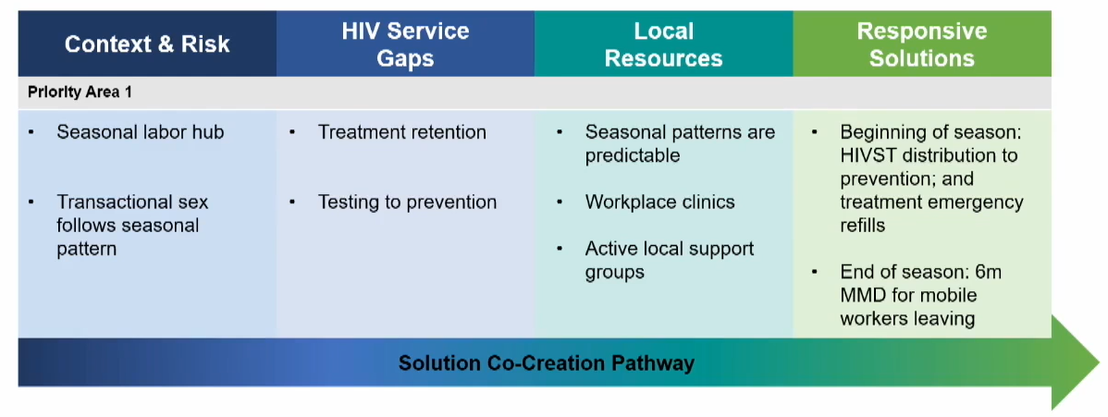
Oral abstract session – Practice and partnerships: Community roles in driving HIV service delivery (3/4)
Engaging communities through participatory mapping to strengthen responsive HIV programming in Malawi: lessons from the RESPOND project – Isabella Robson, University of California, USA & Malawi (full abstract here)
Can participatory mapping workshops help co-create responsive HIV interventions for high-need communities?
Between Aug 2024 and Aug 2025, 245 participants joined 15 one-day workshops including community members and healthcare workers to participate in a mapping exercise followed by the completion of solution co-creation pathways.
Participatory mapping was able to a) identify contextual drivers of HIV vulnerability absent in routine data b) identify geographic priority areas and co-create responsive solutions c) create a shared platform for HCWs and community members.
Participatory mapping operationalizes community engagement and gives national HIV programs a replicable, low-cost way to design and target responsive interventions with community engagement.
effects.
Session recording and slides available here.

Slide 71
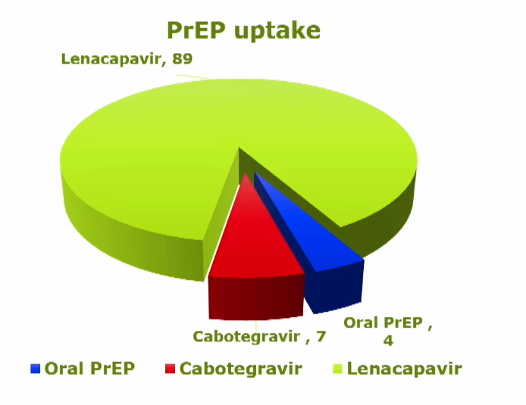
Oral abstract session – Practice and partnerships: Community roles in driving HIV service delivery (4/4)
Transforming prevention landscapes: community-led implementation of lenacapavir (LEN) in Nairobi – Jackson Kamau, Nairobi City County Government / HOYMAS Kenya, Kenya (full abstract here)
Can a community-led clinic successfully roll out the twice-yearly injectable Lenacapavir to populations facing high adherence barriers?
Intervention with (a) clinic adaptation and modified one-stop-shop services to accommodate LEN injections (b) treatment literacy through peer-led sessions (c) choice-based counseling: oral PrEP, CAB-LA and LEN choice offered to clients
232 clients enrolled in the study, 211 from key populations (90 already on PrEP, 70 restarting PrEP and 72 never had been on PrEP)
Results: Overall, 89% of enrolled participants selected LEN. 60% of clients who were already on PrEP transitioned from oral PrEP to LEN.
effects.
AND MORE …
Impact of community-based interventions on viral load among adolescents and young adults living with HIV – Elektra Carras-Terzian, Caris Foundation, the Dominican Republic (full abstract here)
Session recording and slides available here.

Slide 72
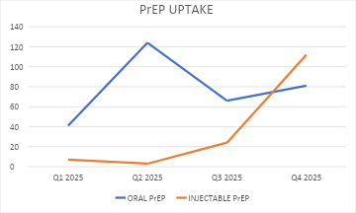
Oral abstract session – Status-neutral practice: Interventions for young people
Leveraging youth champions to enhance PrEP uptake among clients substantially vulnerable to HIV at South Lunzu health center, Blantyre, Malawi: a quality improvement initiative – Gilbertha Chisamba, Blantyre district health office, Malawi (full abstract here)
Despite availability, PrEP uptake remained low in the South Lunzu health center. Long waiting times and PrEP knowledge gaps among young people were identified as key barriers to PrEP initiations and continuation.
The project equiped 4 youth champions with PrEP knowledge and counselling skills and deployed them in PrEP entry points. They were both providing tailored health education and counselling to clients, and orienting them within the facility.
Integrating U=U into HIV care for adolescents and young adults in Cape Town, South Africa: a randomized trial – Tembeka Sineke, Health Economics and Epidemiology Research Office, South Africa (full abstract here)
Between May and August 2025, 150 adolescents and young adults living with HIV were enrolled in a randomized controlled trial.
Evaluation of the Undetectable & You App intervention integrating U=U messaging.
High acceptability with over 95% reporting the App as easy to use and useful. U=U knowledge improved from 34.2% to 78% among participants. Greater comfort with intimacy and improved sexual well-being were reported.
Results displayed on the right
Integration of youth champions into PrEP service delivery can substantially increase uptake among adolescents and young people vulnerable to HIV acquisition.
AND MORE …
First evidence of adherence, safety, and effectiveness of long-acting injectable cabotegravir for PrEP among sexually and gender-diverse adolescents in Brazil – Ines Dourado, Universidade Federal da Bahia, Brazil
Empowering gen Z: peer-led digital campaign for HIV prevention and mental health among Thai youth – Natthaporn Manojai, MPLUS Foundation, Thailand
effects.
Session recording and slides available here.

Slide 73

Oral abstract session – Chemsex everywhere: Interventions across contexts
Meeting transgender-specific needs: Service acceptance and identified needs among Thai trans women engaging in substance use or chemsex (iT-REX study) - Akarin Hiransuthikul, Chulalongkorn University, Thailand (full abstract here)
→ iT-REX study ongoing cohort started in September 2025, including 63 trans women who use substances or engage in chemsex who are not living with HIV. The aim is to evaluate the acceptability of a multicomponent model integrating substance use literacy, sexual health services, mental health counseling and socio-legal support
→ Trans women using substances (including in the context of chemsex) showed high acceptance of multi-component harm reduction assessments. Care uptake was then highest for mental health, STI treatment and PrEP, while uptake of Hepatitis B vaccination, substance literacy and rights literacy requires further improvement.
Improving HIV retention among men who have sex with men who engage in chemsex in South African townships: evidence from the EJAF Chemsex Program community model – Daniel Nel, OUT, South Africa (full abstract here)
Project implemented with a cohort of 127 men accessing chemsex houses in Soweto township. The project included both individual interventions (harm reduction services, mental health support, unemployment assistance) and community interventions (skill development, family interventions, police training).
At the start of the programme, high HIV prevalence (more than 50%) but low ART retention. ART retention increased from 42% at baseline to 83% by March 2025, but declined then to 68% (linked to USAID funding cut).
AND MORE …
Addressing inter-institutional partnerships on combination HIV prevention for chemsex in São Paulo, Brazil – Eduardo Almeida, UNAIDS Brazil, Brazil
Breaking the silence: introducing chemsex harm reduction in criminalized Asian settings – Mihitha Basnayake Mudiyanselage, The Family Planning Association of Sri Lanka, Sri Lanka
effects.
Session recording and slides available here.

Slide 74
Beyond the hotspot: achieving a 22% HIV positivity yield through peer-led, differentiated outreach segmentation among hidden MSM in Ghana
Background: In Ghana, growing stigma and criminalization concerns have reduced the effectiveness of hotspot-based HIV outreach among men who have sex with men (MSM), requiring a more targeted testing strategy.
Methods: Between January and November 2025, three districts implemented a community-led, differentiated outreach model. MSM were segmented into four distinct sub-populations based on network characteristics: (1) virtual-only MSM reached via social media platforms; (2) discreet, higher-socioeconomic-status MSM reached through appointment-based, private-sector testing; (3) MSM sex workers and people who inject drugs (MSM-PWID) reached through integrated harm-reduction services; and (4) sexual partners of MSM identified via index testing. Outreach shifted from large evening gatherings to individualized, peer-led sessions conducted in safe spaces or via encrypted digital channels.
Results: Under conventional outreach (January–June 2025), 463 MSM were tested, yielding 31 HIV-positive diagnoses (6.7% positivity). Following the transition to the differentiated model (July–November 2025), 313 MSM were tested, identifying 68 HIV-positive individuals (21.7% positivity; p<0.001), representing a 3.2-fold increase in case-finding efficiency. Notably, 45% of new diagnoses were identified via social media, reaching a cohort that had never accessed physical hotspots. Appointment-driven testing for discreet MSM reduced missed confirmatory visits from 28% to 7%, while peer-led harm-reduction sessions improved case-finding among MSM sex workers by 15%.
Conclusion: Precision-based, peer-led outreach segmentation substantially improves HIV case-finding efficiency among hidden MSM in restrictive environments.
effects.
No poster available.

Slide 75
“Communities are the experts”: Co-designing a community-led e-health intervention for general health of hijra (transgender women) in Dhaka, Bangladesh
Background: Hijra in Bangladesh face substantial healthcare barriers beyond HIV and STI services due to stigma, discrimination, and limited access to inclusive services. This study co-developed an e-health intervention to address general health needs.
Methods: Using a three-phase participatory design framework (exploration, discovery, prototyping), we conducted interviews, focus groups, and co-design workshops with hijra and key stakeholders to develop and refine an e-health intervention.
Results: Participants prioritized confidential, Bengali-language, peer-supported and 24/7 services' options, referral support, medication adherence reminders, and audiovisual counselling, including psychosocial support. These preferences informed the intervention design and app refinement.
Conclusion: Co-designed e-health interventions may improve access to culturally safe healthcare for hijra communities and provide a scalable model for marginalized populations.
effects.
No poster available.

Slide 76
Assessing the effectiveness of Sierra Leone’s radical inclusion policy in expanding equitable HIV prevention, treatment, and retention services for female sex workers and men who have sex with men
Background: Stigma and systemic exclusion have over the years hindered HIV service delivery in Sierra Leone for key populations (KPs). “The Radical Inclusion” policy was originally developed as an educational mandate by the government of Sierra Leone. However, the policy was adapted to the health sector to address barriers for the most marginalised. This study assesses the policy’s effectiveness in expanding equitable HIV prevention, treatment and retention services for KPs.
Methods: During the implementation between 2023 and 2025 across high prevalence urban centers (Freetown, Kenema, and Makeni), key interventions included the establishment of “Safe Space” drop-in centers, the integration of peer-led outreach, and mandatory sensitivity training for healthcare providers. The program targeted over 5,000 KP members, utilizing mobile testing units and multi-month dispensing (MMD) of Antiretroviral Therapy (ART) to ensure service continuity in "hard-to-reach" social networks.
Conclusion:
Results:
35% increase in HIV testing uptake among MSM
28% improvement in ART retention among FSWs
Peer-led navigation was the most significant factor in overcoming medical mistrust; 85% of participants reported increased comfort accessing public facilities after peer intervention.
Community-led monitoring (CLM) revealed that "Radical Inclusion" succeeded because it addressed the psychosocial barriers of shame and fear, not just the physical availability of medication.
However, policy tension remains between health-based inclusion and existing legal frameworks that criminalize KP behaviors, occasionally impeding the safety of outreach workers.
effects.
Conclusion: The results prove that policy-driven equity can bridge the gap in the HIV care continuum for criminalized populations. To sustain these gains, next steps include legislative advocacy to align national laws with health policy and the nationwide expansion of the "Safe Space" clinic model to rural districts.
No poster available.

Slide 77
Community-led HIV testing with high-yield outcomes: lessons learned from a federal service delivery model in Argentina
Background: Persistent gaps in HIV service delivery affect LGBT+ communities in Argentina due to structural stigma, territorial inequities and limited access to community-based testing. To address these challenges, the Federación Argentina LGBT+ implemented a community-led HIV testing programme to improve early diagnosis, linkage to care and service delivery efficiency through a federal, rights-based approach.
Methods: Operating since 2017, the programme is implemented by the HIV and STI Secretariat in partnership with local LGBT+ organizations across all 24 jurisdictions of Argentina. HIV testing is delivered in non-clinical community settings, including organization headquarters, community centres and outreach activities, through trained community promoters coordinated at national level. Individuals with reactive results are referred through formalized pathways for confirmatory testing and timely linkage to HIV care. HIV-negative individuals vulnerable to acquisition receive counselling and referral for prevention services, including PrEP where available.
Results: Between January 2023 and June 2024, 5,214 HIV tests were conducted through community outreach. The overall HIV positivity rate was 4.8%, reaching 6.2% in specific territorial settings. Among people with reactive results, 89% were linked to confirmatory testing and HIV care within 30 days, supported by promoter-led navigation.
Conclusion: Community-led HIV testing achieves high-yield outcomes and strengthens early diagnosis and linkage to care among populations with higher undiagnosed HIV prevalence. Key best practices identified include targeted outreach guided by community knowledge, task-shifting to community promoters, delivery of services in trusted non-clinical settings, and structured linkage pathways that reduce losses along the care cascade.
effects.
No poster available.

Slide 78
Peer-driven delivery of long-acting injectable cabotegravir for key populations: preliminary findings from a PrEP choice implementation study in Beira, Mozambique
Background: In Mozambique, key populations (KPs), including female sex workers (FSWs), men who have sex with men (MSM), and transgender people (TGP), face disproportionate vulnerability to HIV acquisition and significant adherence barriers to daily oral PrEP. This implementation study evaluates the integration of long-acting injectable cabotegravir (CAB-LA) into a peer-driven outreach model in Beira to assess its uptake and real-world continuation.
Methods: Convergent parallel mixed-methods design; (a) prospective cohort study enrolling HIV-negative members of KPs with participants choosing between oral PrEP and CAB-LA via two community drop-in centers and two clinics (b) in-depth interviews and focus groups to explore acceptability and enablers of persistence.
Results: Between July-November 2025, 239 participants were enrolled. The KP distribution included 111/239 (46.4%) FSW, 102/239 (42.7%) MSM, 2/239 (0.8%) TGP, and 25/239 (10.5%) undisclosed. At baseline, 188/239 (78.7%) participants chose CAB-LA, 31/239 (13.0%) oral PrEP, and 20/239 (8.4%) received PEP or delayed choice. No HIV seroconversions have occurred during follow-up. Forty-two (20.6%) CAB-LA users reported 70 adverse events, mainly mild injection site reactions no grade 4 events occurred. In-depth interviews (n=16) revealed CAB-LA is preferred due to its discretion, mitigating the stigma associated with oral PrEP bottles.
Conclusion: Preliminary findings indicate CAB-LA is a highly acceptable, safe HIV prevention option for KPs. Persistence appears to vary by delivery modality and population group. Participants valued decentralized, KP-centred services. Community platforms can accelerate equitable scale-up of LA-PrEP, while highlighting the need for differentiated delivery to optimize continuation across groups.
No poster available.

Slide 79
Where is intimacy? Relational well-being in HIV research among Black same-gender-loving men in the United States
Background: Black same-gender loving (SGL) men remain disproportionately affected by HIV in the United States. While HIV research emphasizes behavioral, biomedical, and structural factors, there has been limited attention to relational and emotional dimensions of sexual health with constructs such as intimacy, affection, touch, emotional connection, and relational well-being.
Methods: A scoping review analyzed 54 US studies (2014-2026) involving Black SGL men and HIV outcomes. Thematic analysis assessed representation of intimacy, emotional connection, affection, touch, and relational well-being.
Results: HIV research focused on behavioral, biomedical, and structural factors, including condom use, substance use, PrEP uptake, stigma, and socioeconomic conditions. Explicit attention to relational constructs was absent.
Intimacy was referenced in only two studies, and both situated intimacy within sexual risk or biomedical prevention rather than as a primary interest.
No studies examined affection or touch.
When relationships were included, they were framed as risk contexts, mechanisms for disclosure or communication, or sources of psychosocial support. Relational experiences were often conceptualized as barriers, deficits, or vulnerabilities, rather than as dimensions of well-being.
Conclusion: HIV research involving Black SGL men in the United States is limited in relational well-being constructs, reflecting a dominant focus on risk reduction over holistic sexual health. Integrating intimacy, emotional connection, and relational experiences into HIV frameworks may enhance cultural relevance and intervention effectiveness.
No poster available.

Slide 80
6. Global guidance
Return to Table of Contents

Slide 81


Satellite - WHO clinical, service delivery and surveillance updates: new recommendations for HIV and sexually transmitted infections
Click on the left to access new 2026 Consolidated HIV guidelines.
In addition, presentation of the new WHO guideline on doxycycline PEP > here.
In addition, presentation of the new WHO consolidated guidance for strengthening national routine surveillance systems > here.
Link to the 2026 mid-term progress report of Global health sector strategies on HIV, viral hepatitis and sexually transmitted infections, 2022–2030.
Coming soon
Recording and slides available here.

Slide 82
7. Miscellaneous
Return to Table of Contents

Slide 83



Delivering HIV services in a time of transition (Lloyd Mulenga, Zambia)
How to sustain HIV services through this period of transition from donor funding to domestic funding? This intervention covers:
The context of the HIV financing shift
The transition spectrum & how to manage the transition
Transition enablers
A practical transition roadmap
Learning from the Zambia Minimum Package
Watch the full presentation and access slides here.

Slide 84

Scaling community-led digital HIV service delivery through Love2Test: implementation lessons from a national online booking platform in Thailand
Background: Thailand continues to face challenges in reaching key populations with HIV testing and prevention services. Love2Test was created to improve access, strengthen community-clinic linkages, and expand HIV testing and PrEP uptake through client-centered digital service delivery.
Methods: L2T platform has partnered with 30+ public and community-based clinics across Thailand, providing online booking for HIV testing, STI screening, PrEP, PEP and ARV.
Results: Between January to December 2025, the platform recorded over 34,700 bookings. HIV testing represented the largest category (35.3%), followed by STI screening (30.7%) and PrEP services (27.3%). Service uptake was highest among users aged 25–34 years, with substantial engagement also observed among 18–24 year olds.
1) Digital platforms can serve as effective entry points to HIV prevention services, with HIV testing acting as the primary gateway to additional care such as PrEP initiation and STI screening.
2) Demand for PrEP remains high, with more than 2,000 users expressing interest but not yet initiating prevention, highlighting the need for improved follow-up and navigation support.
3) Behavioral data revealed important prevention gaps: 75.5% of users reported never having tested for HIV previously, and 50.3% had never discussed HIV status with sexual partners.
→ These findings emphasize the value of integrated digital education, behavioral nudges, and targeted communication within service platforms.
Conclusion: Love2Test demonstrates digital service integration can substantially expand HIV testing and prevention access national scale. The programme highlights importance of combining online booking, behavioral insights, and clinic partnerships to strengthen HIV service uptake.
Poster available here.

Slide 85

Oral abstract session – From insecurity to inequity: Examining structural drivers of HIV outcomes
Rethinking HIV prevention prioritization during funding crisis: evidence from rapid service declines among key populations in Nigeria – Ramatu Aliyu Magaji, National Agency for the Control of AIDS (NACA), Kenya (full abstract here)
Objective to assess changes in HIV prevention service utilization among key populations during the 2025 funding disruption and stop-work order.
Within one quarter, prevention reach declined by 50.5%, HIV testing by 70.2% and PrEP initiation by 83.0%.
The largest losses were observed among sex workers, men who have sex with men, and people who inject drugs.
Early impact of funding withdrawal on HIV care and treatment programs in East Africa - Hong-Ha M.Truong, University of California, San Francisco, United States (full abstract here)
Evaluate the early impact of the PEPFAR funding pause on HIV services and patient outcomes in Kenya, Uganda and Tanzania (EA-IeDEA regional cohort) with data from 102,990 clients.
New enrollments declined by 59% in 2025 compared to the same period in 2024. The decline was greater among men and among those aged <25.
33% decline in the number of viral load tests conducted.
Viral suppression declined by 3.4% overall.
AND MORE …
Intimate partner violence, food insecurity, and HIV incidence among women aged 15–49 years in Wakiso and Hoima, Uganda: a population-based longitudinal cohort study (2018-2023) – Amanda P. Miller, San Diego State University, United States
Water insecurity as a structural determinant of HIV treatment outcomes among people with HIV in Kisumu County, western Kenya – Jacquelyne Odak, Maseno University, Kenya
Molecular HIV surveillance during Fiji’s HIV epidemic – Dashika Balak, Fiji Ministry of Health and Medical Services, Fiji
effects.
Session recording and slides available here.

Slide 86

Oral abstract session – When stigmas intersect: Advancing HIV research and practice
Evaluating an intervention to reduce stigma towards key populations among healthcare workers in Mombasa, Kenya - Ahmed Adam, Department of Health Mombasa County, Kenya (full abstract here)
2h-workshops delivered to healthcare workers conducted in 3 health facilities, enrolling a total of 597 individual participants (n=261 in the intervention arm and n=336 in the control arm).
The intervention was associated with decreased stigma towards sexual and gender minorities but this was not observed for the other key populations (people who use drugs, sex workers) as the difference was not statistically significant.
It is important to note that only workshops for sexual & gender minorities were led by representatives of those communities themselves. Further investigation is needed on longer, more intensive or directly engaging communities’ workshops to study the impact on stigma towards other key populations.
AND MORE …
Psychosocial mechanisms linking intersecting stigmas and condomless anal sex among trans women in India: mediation or interactions or both? – Venkatesan Chakrapani, Centre for Sexuality and Health Research and Policy (C-SHaRP), India
Institutionalized intersectional stigma among medical students in the Southern United States: the impact of HIV knowledge, heterosexism and racism on HIV stigma – Krishen Samuel, University of Arkansas, United States
Stigma and resilience trajectories in the Manas por Manas peer-navigation HIV prevention trial among trans women and travestis in São Paulo, Brazil – Sabrina Cluesman, Columbia University, United States
Persistent internalised HIV stigma among persons living with HIV in Jamaica and implications for engagement in care in the context of shifting funding priorities – Sharlene Jarrett, University of California, San Francisco, United States and Jamaica
effects.
Session recording and slides available here.

Slide 87


Oral abstract session – HIV service delivery in conflict, humanitarian and development settings
Sustaining HIV care and support in Ukraine: a model of integrated, state-coordinated community-based services - Liudmyla Legkostup, State Institution “Center for Public Health of the Ministry of Health of Ukraine”, Ukraine (full abstract here)
In 2019, Ukraine institutionalized community-based HIV care by integrating previously donor-funded services into the national programme. Although the full-scale invasion in 2022 created broad humanitarian disruptions, the earlier shift to domestic financing enabled the country to maintain availability, integration, and continuity of HIV services during the crisis.
Resilience is built before crises through institutionalization, national coordination, community partnerships and integrated information systems.
Improving the HIV care cascade among Venezuelan migrants in Colombia through a rights-based model, community-based testing and assisted partner notification - Jose Guillen, Profamilia, Colombia (full abstract here)
Intervention with (a) community-based HIV testing and assister partner notification (b) peer navigation (c) psychosocial, legal and social support.
Focus on Venezuela migrants newly diagnosed with HIV or re-engaging in care.
AND MORE …
Adapting HIV service delivery in Myanmar: lessons learned from community-led interventions during public health emergencies – Aung Than Oo, Rotary International, RPC of Makerere University, Uganda and Myanmar
Retention breaks HIV prevention: sustaining survivor peer educators for trans women living with HIV in Nigeria’s safe houses and IDP camps – Kingsley Kalu, Supporting Trans, Intersex and Gender Nonconforming People (STAG) Initiative, Nigeria
effects.
Session recording and slides available here.

Slide 88
Healthcare workers' perspectives on person-centred care: baseline findings from KwaZulu-Natal, South Africa
Background: The objective was to understand challenges to implementing person-centred care (PCC) before the rollout of Ngiyakuzwa, a model focusing on nurse mentors delivering on-the-job training and mentoring to enhance HCWs knowledge, attitudes, and practices pertaining to PCC, as well as perceptions of teamwork, peer support and capacity to implement PCC in resource-constrained settings.
Methods: Baseline surveys conducted with HCWs from 13 facilities in Kwazulu-Natal.
Results: A total of 119 HCWs, with 73% of them being women, completed baseline surveys between August-September 2025. 42/119, 35% believed PCC was not possible, 54/119 (45%) believed clients would take advantage of their niceness, and only 82/119 (69%) can talk with colleagues or supervisors about challenges experienced.
Conclusion: Significant barriers to PCC exist for HCWs, demonstrating the need to scale up PCC interventions such as Ngiyakuzwa that support HCWs and mindset shifts toward the importance and feasibility of implementing PCC strategies.
No poster available.

Slide 89
From evidence to action: using stigma research and local-language SRHR tools to influence rights-based HIV policy and practice in Zimbabwe
Background: Rural communities in Zimbabwe continue to experience deep structural and social barriers that undermine equitable access to HIV prevention, treatment, and SRHR services. Persistent stigma toward LGBTQ+ persons, sex workers, adolescent girls and young women (AGYW), and individuals living with HIV affects their willingness to seek care and their treatment outcomes. Compounding this challenge is the language barrier.
→ To address these gaps, a community-led stigma and discrimination study was conducted and an SRHR–Shona Glossary (120-term) was developed as a language justice tool to enhance comprehension of HIV/SRHR terminology.
Methods: The programme was implemented between 2023–2024 and engaged 150+ participants in Zvishavane District, a rural mining community in Zimbabwe with high HIV prevalence and intersecting vulnerabilities affecting AGYW, LGBTQ+ persons, and sex workers.
Results: Findings showed that 72% of key populations experienced discrimination in clinics, leading to reduced HIV testing and PrEP uptake, 64% of AGYW reported judgmental attitudes from providers, while 58% of participants lacked clear Shona terminology for core HIV/SRHR concepts, reinforcing myths and silence, After introducing the SRHR-Shona Glossary, comprehension scores during community dialogues increased by 43%, and health-worker attitude-shift sessions reported notable improvements in communication confidence and rights-based service delivery.
Best practices identified include: (a) grounding HIV education in locally validated language; (b) pairing evidence with practical communication tools; (c) engaging key populations as knowledge-holders, not subjects; (d) fostering health-worker reflection spaces to shift attitudes.
Conclusion: The integration of research and local-language tools demonstrated significant potential to strengthen trust in health facilities, increase demand for HIV prevention services, and support more inclusive SRHR education.
No poster available.

Slide 90
8. What’s more to explore
Return to Table of Contents

Slide 91
HIV testing
Abstract - HIV self-testing: analysis of acceptability and feasibility of assisted and unassisted models among key populations (Poster available here)
Abstract - Scaling up HIV testing through community leadership: evidence from a One Stop Centre model for transgender populations in India (No poster available)
Abstract - "I missed my appointment, but I have peace of mind": HIV self-testing in the context of community-based delivery of long-acting HIV pre-exposure prophylaxis in rural South Africa (No poster available)
Abstract - HIV self-testing works - but context matters: social support and user experience shape future uptake in the Dominican Republic (No poster available)
Abstract - Segmentation for impact: peer-driven, digitally supported HIV self-testing to reach hidden MSM subgroups in Ghana (No poster available)
Abstract - Barriers and facilitators of HIV testing in men who have sex with men in countries where same-sex sexual acts are illegal: a mixed methods systematic review (Poster available here)

Slide 92
HIV prevention (1/2)
Preconference – Advancing HIV prevention science and access, organized by IAS – the International AIDS Society with session 2 ”Expanding the biomedical HIV prevention toolbox” (here) and session 5 “Delivering prevention: From innovation to real-world choice” (here).
Satellite – From evidence to access: Implementation science to inform Lenacapavir scale-up, organized by The Gates Foundation, Unitaid and the World Health Organization. Recording and slides available here.
Satellite - Reimagining PrEP delivery for youth through peer leadership and community insights, organized by Federal University of Bahia, State University of Bahia, Fiocruz-Bahia, University of São Paulo, University of Alabama at Birmingham. Recording and slides available here.
Oral abstract session – Reimagining HIV prevention for youth: Integrating creativity and community action. Recording and slides available here.
Abstract - Bridging the intention-behaviour gap in HIV prevention: a peer-led cognitive dissonance intervention increasing condom use and LAI-PrEP readiness among young men who have sex with men (MSM) in Taraba North (Poster available here)
Abstract - Automated dispensing machines for HIV prevention tools: early implementation experience with PrEP, PEP and self-testing in São Paulo, Brazil (No poster available)

Slide 93
HIV prevention (2/2)
Satellite – Bridging the implementation gap: Practical insights to strengthen HIV prevention access for key populations, organized by IAS – the International AIDS Society. Recording and slides available here.
Satellite – Sharing cross-country implementation learning and introducing a structured demand generation playbook supporting effective introduction and uptake of LEN within a broader PrEP Choice framework, organized by Wits RHI, CHAI, PSI. Recording and slides available here.
Abstract - Knowledge, attitudes and use of pre-exposure prophylaxis (PrEP) among sex workers. (No poster available)
Abstract - Scaling up HIV prevention: community-led, decentralized, and differentiated interventions for PWID in India. (No poster available)
Abstract - Collaborative approaches to improving access to HIV prevention and healthcare for people in detention settings. (No poster available)
Abstract - Protecting choice under criminalisation: early lessons from Uganda national trans forum on introducing lenacapavir for trans and gender diverse communities (Poster available here)
Abstract - “They advise you, they don't force you": peer-navigated pathways to prevention - implementation challenges and opportunities for expanding PrEP options (Poster available here)

Slide 94
HIV treatment (1/2)
Satellite - Bridging Communities and Health Systems - Recognise, Integrate, Sustain: Unlocking the Power of Community Health Workers, organized by Paediatric Adolescent Treatment Africa (PATA) → “Community Health Workers (CHWs) at the Heart of the PBP model” (Recording available here).
Abstract - Leveraging mobile health to improve ART adherence and retention: evaluation of the iCare platform in Vietnam (Poster available here)
Abstract - Being heard makes all the difference: women’s lived experience as evidence for improving HIV care (No poster available)
Abstract - The effect of psychosocial supports on HIV care retention among people living with HIV (PLHIV) in Edo State, Nigeria (No poster available)
Abstract - Double stigma: HIV and substance use - results of a person-centered approach (PCA) (Poster available here)
Abstract - From informal care to protected profession: leassons learned from formalizing HIV community health workers in Indonesia (Poster available here)
Abstract - Perspectives of people living with HIV in Europe on their clinical consultations: an equity analysis (Poster available here)

Slide 95
HIV treatment (2/2)
Abstract - Is the community involved in HIV implementation science?: a systematic literature review of social support interventions supporting adherence in the U.S. (Poster available here)
Abstract - Over 13,000 PLHIV voices: community-led monitoring drives HIV care and treatment improvement in Thailand, 2024 - 2025 (Poster available here)
Abstract - The effect of facility-led continuous quality improvement (CQI) projects on HIV services in Cameroon’s Far North region, 2024–2025 (Poster available here)
Abstract - Re-engagement strategies for people living with HIV: analysis of the early implementation phase of a service delivery protocol in Buenos Aires, Argentina (Poster available here)

Slide 96
Integration (1/3)
Satellite - No more silos: Integration as the pathway to resilient triple elimination and people-centered care, organized by PATH, Unitaid, International Community of Women living with HIV Eastern Africa, World Hepatitis Alliance and World Health Organization. → “Building towards people-centered triple elimination” (Recording and slides available here.)
Oral abstract session - Syndemics in practice: Supporting people living with HIV and other conditions. Recording and slides available here.
Abstract - Feasibility and outcomes of an integrated high-risk human papillomavirus self-sampling and screen-and-treat model for cervical cancer prevention among fisherfolk women in Migori County, Kenya (Slides available here).
Abstract - Comorbid symptoms of common mental disorders and unhealthy substance use among adolescents living with HIV reporting suicidal ideation and behaviors in Lilongwe, Malawi (No poster available)
Abstract - The impact of the youth readiness intervention and youth readiness plus economic empowerment intervention on mental health outcomes of refugee youth living with HIV in Uganda (No poster available)
Abstract - AI-driven digital triage for mental health, violence, and HIV risk among female sex workers in Calabar, Nigeria: a cross-sectional acceptability and feasibility study (Poster available here)
Abstract - Integrating harm reduction services into public hospitals: lessons from Bangladesh’s strategic shift in HIV prevention for PWID (No poster available)
Abstract - Hard time: barriers to harm reduction and HIV care in Canadian prisons. (Poster available here)

Slide 97
Integration (2/3)
Abstract - Beyond depression: delivering integrated community-based care within microfinance groups significantly reduces anxiety among persons living with HIV compared to economic support alone (No poster available)
Abstract - Rebuilding person-centered HIV/STI care for historically marginalized populations: reflection on optimized sexual health service models for indigenous populations in Eastern Taiwan (No poster available)
Abstract - Perceived implementation factors of SALUD MÓVIL: an integrated bilingual telehealth and mobile phlebotomy model for Latino MSM in the U.S. South (No poster available)
Abstract - Integrating HIV prevention and sexual and reproductive health for women and girls: a scoping review of current models and their implementation (Poster available here)
Abstract - Co-producing a psychosocial harm-reduction intervention in prison settings: development and piloting of the HOPE programme in Kyrgyzstan (Poster available here)
Abstract - A community-led social enterprise clinic to improve affordable HIV and STI services and long-term sustainability in Thailand (No poster available)
Abstract - Defining the non-negotiables: PLHIV-led minimum standards for rights-based, person-centered integration to safeguard HIV treatment access, strengthen PLHIV leadership, and ensure sustainable health systems (No poster available)
Abstract - Healthcare discrimination, service environment, and uptake of STI and viral hepatitis screening in Nigeria: evidence from National Community-Led Monitoring (No poster available)

Slide 98
Integration (3/3)
Abstract - Community first: how peer-led outreach keeps LGBTQI people connected to HIV care, mental health support, and prevention in Blantyre and Mzuzu, Malawi (Poster available here)
Abstract - Institutionalizing community-led HIV and STI services: a national health system reform to scale access in Thailand (Poster available here)
Abstract - From exclusion to inclusion: developing evidence-based guidance to include people living with HIV in non-HIV clinical trials through a community-lead and multi-stakeholder process (Poster available here)
Abstract - Screened but siloed: insomnia and cardiovascular risk screened but rarely integrated clinical targets in HIV care (Poster available here)
Abstract - Embedding THRIVE in routine HIV care for youth in Wakiso District, Uganda: operational delivery adaptations and implementation lessons (No poster available)
Abstract - Integrating WHO ICOPE screening into HIV care: feasibility and implementation outcomes in a cohort of older people living with HIV in Zimbabwe (Poster available here)
Abstract - Co-design of an integrated HIV-sexual and reproductive health service model in Zimbabwe (Poster available here)
Abstract - High-coverage telehealth education for HIV-related NCD comorbidities in Siha District clinic setting (No poster available)
Abstract - Preferences for HIV and STI prevention services in the doxycycline post-exposure prophylaxis era among transgender population in Taiwan: a discrete choice experiment (Poster available here)
Abstract - Project COMRED: implementation outcomes and lessons from a community-led harm reduction model for chemsex in Malaysia (Poster available here)

Slide 99
Population-specific approaches
Abstract - “Should We Continue to Hide?” Quantifying the impact of anti-LGBTQ+ legislation on HIV service uptake among MSM in Northern Ghana (No poster available)
Abstract – “Community-led approaches to reducing human rights–related barriers in HIV services in Indonesia” (Slides available here)
Abstract - Participatory assessment of sexualized psychoactive substance use and HIV‑related needs among trans women in Mexico to inform the integrated care and harm reduction guidelines for chemsex in Latin America (Poster available here)
Abstract - Empowering young women: building safe environments and strengthening gender based violence prevention on the UNICEF- supported adolescent and young mothers project across seven districts of Zambia (Poster available here)
Abstract - Advancing HIV care for court-involved women through integrated reentry services (Poster available here)

Slide 100
Miscellaneous
Preconference – HIV Treatment at a Crossroads: Community Power in the Age of Austerity and Algorithms, organized by ITPC: “From Evidence to Power – Communities on the Frontline” (Recording available here).
Symposium – Community-led monitoring in conservative and restrictive environments: Strategies for influence and integration with recording and slides available here.
Oral abstract session – Law, power and access: Overcoming barriers to HIV services. Recording and slides available here.
Oral abstract session - People in crisis: Conflict, migration and sustaining HIV care. Recording and slides available here.
Abstract - Addressing criminalization and discrimination as barriers to equitable HIV prevention and care in Cameroon (No poster available)
Abstract - Better access to HIV and related services in EECA prisons based on to CLM data (No poster available)
Abstract - Understanding HIV service access preferences for people who use drugs in Dar es Salaam: findings from community-led monitoring (No poster available)
Abstract - A mixed-methods assessment of the quality of post-violence clinical care services in Mozambique, 2023 (Poster available here)
Abstract - Pilot study of implementation and preliminary effectiveness of integration of stigma and discrimination reduction content into student health worker curricula in Tanzania: the expanded total facility approach (No poster available)
Abstract - The CHAMPION model in community-led monitoring implementation: communities for the community (No poster available)
Abstract - Words matter: the impact of stigmatizing language in the healthcare setting among cisgender and transgender women and non-binary adults living with HIV in the US (Poster available here)

