Slide 1

PROGRESS MADE PERSONAL
Notes:
[General guidance here – full TPs in briefing documents]
Garry to prompt audience to scan QR to complete PMP

Slide 2
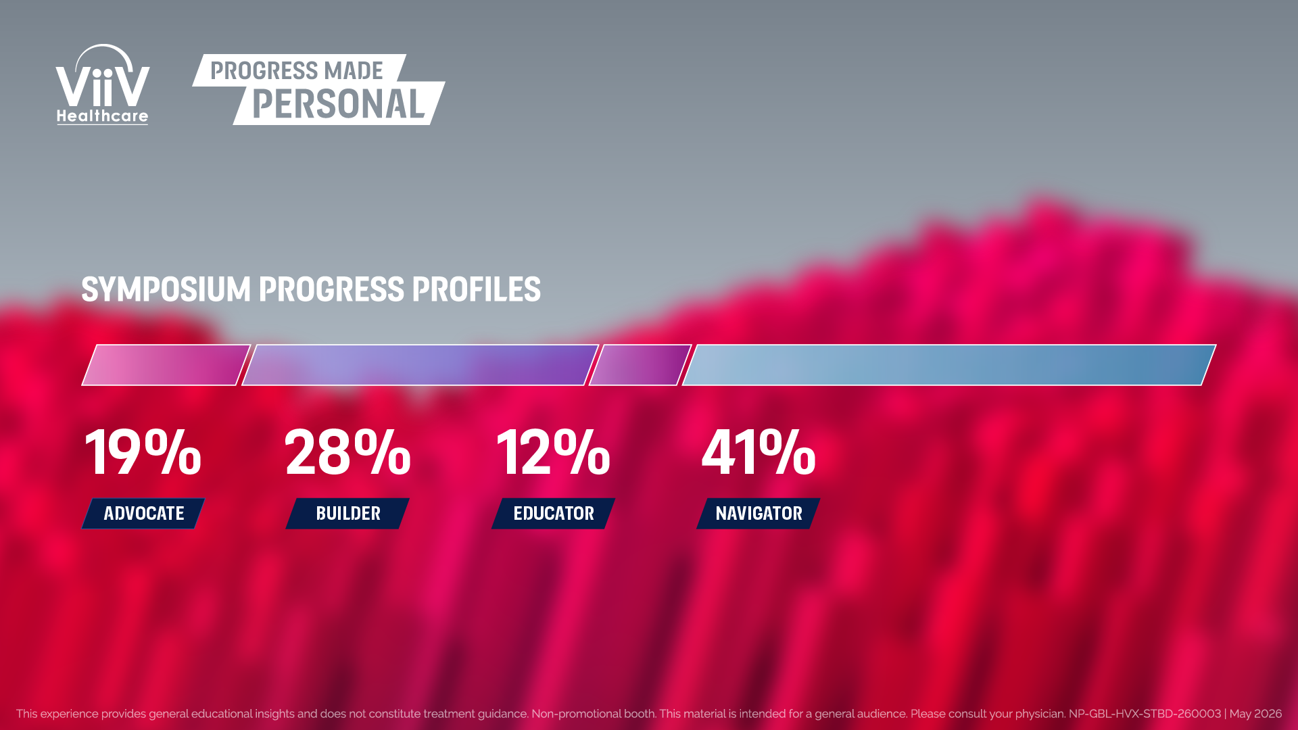
NOTE FOR REVIEWERS:
PLACEHOLDER FOR INTERACTIVE PMP RESULTS TO BE SHOWN ON SCREEN
LINKED OUT LIVE IN SYMPOSIUM TO LIVE RESULTS
Notes:
- Garry to introduce PMP and speak to results on screen

Slide 3
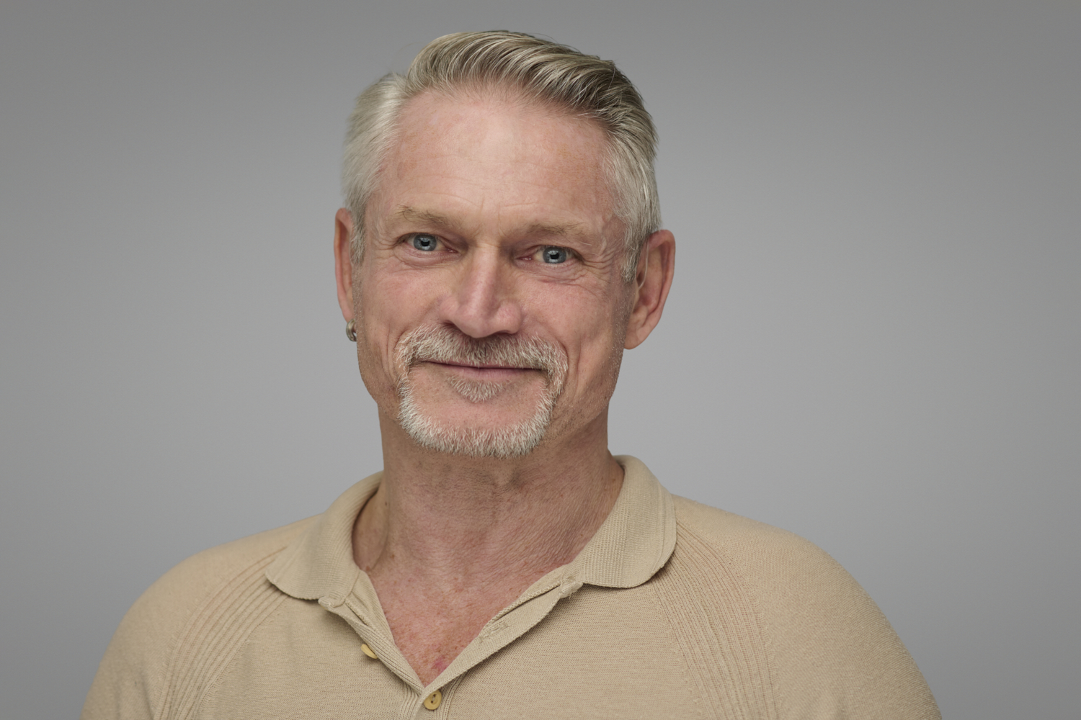
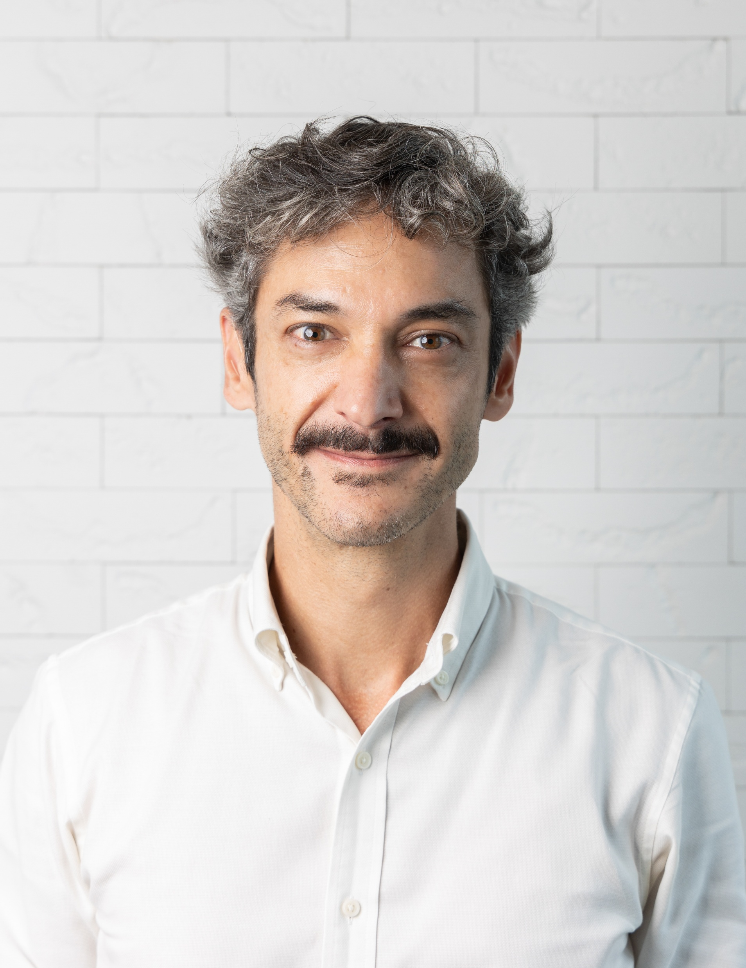


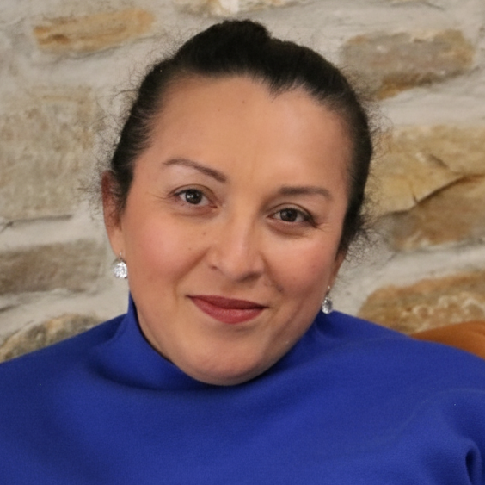
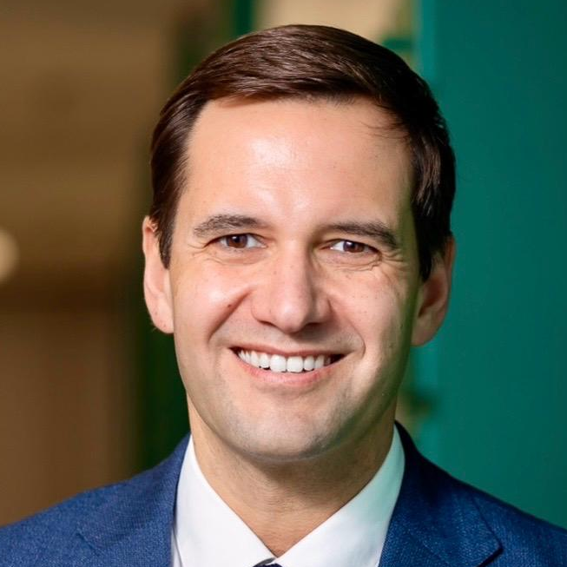
FUTURE CARE IS SHARED:
REDEFINING PEER SUPPORT
What role will peer support play
in the evolution of HIV care?
#WEWONTSTOP
This material is intended for a general audience. Please consult your physician.
NP-GBL-HVX-PPTX-260006 | MAY 2026
Notes:
Garry formally welcomes audience + highlights objectives/theme of symposium

Slide 4
MEET YOUR
PANEL
Moderator
Speakers
GARRY BROUGH
DR RICO VASCONCELOS*
MIRJAM SCHULPEN
DR DANIELLE M CAMPBELL
ERIKA CASTELLANOS
RICARDO BAPTISTA LEITE
Commissioner of HIV Support and Peer Navigator Services, UK
General Practitioner and Infectious Disease Specialist, Brazil
Peer Navigator, the Netherlands
Advocate, USA
Human Rights Advocate, the Netherlands
Global Health Policy and AI Expert, Switzerland
*CRM-SP 116.119 RQE 88317/88318
Notes:
- Garry to welcome and introduce speakers

Slide 5
AGENDA
Welcome
Meet the
panel & housekeeping
First paired discussion:
Building fit-for-purpose peer support networks
Second
paired discussion:
Bridging clinical & lived experiences
Panel Q&A with Ricardo Baptista Leite:
The digital future of peer support
Audience
Q&A
Summary of
key topics
Symposium
close
Notes:
- Garry to provide topline overview of agenda

Slide 6
DISCLOSURES
This symposium is organised and funded by ViiV Healthcare. All speakers participating in this symposium are being compensated by ViiV Healthcare.
GARRY BROUGH
I, Garry Brough, declare the following real or perceived conflicts of interest in the context of the subject of this presentation:
  Speaker and advisory board fees received from ViiV Healthcare and Gilead Sciences
DR RICO VASCONCELOS*
I, Dr Rico Vasconcelos, declare the following real or perceived conflicts of interest in the context of the subject of this presentation:
  Speaker fees, research support and board membership received from ViiV Healthcare, Gilead Sciences and MSD
MIRJAM SCHULPEN
I, Mirjam Schulpen, declare the following real or perceived conflicts of interest in the context of the subject of this presentation:
  Speaker fees received from ViiV Healthcare and Gilead Sciences
DR DANIELLE M CAMPBELL
I, Dr Danielle M Campbell, declare the following real or perceived conflicts of interest in the context of the subject of this presentation:
  Advisory fees received from ViiV Healthcare and Gilead Sciences and board membership at APHA
ERIKA CASTELLANOS
I, Erika Castellanos, declare the following real or perceived conflicts of interest in the context of the subject of this presentation:
  Speaker and advisory fees received from ViiV Healthcare
RICARDO BAPTISTA LEITE
I, Ricardo Baptista Leite, declare the following real or perceived conflicts of interest in the context of the subject of this presentation:
  Past speaking engagements with honoraria from Boehringer Ingelheim, Novartis, Sanofi, Viatris, ViiV Healthcare, Bial, Pfizer and GSK
*CRM-SP 116.119 RQE 88317/88318
Notes:
- Garry to briefly acknowledge disclosures

Slide 7
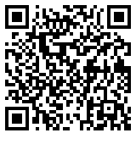
HOUSEKEEPING
NON-PROMOTIONAL SYMPOSIUM
This symposium is focused on how peer support can help shape the evolution of HIV care. No specific drug or brand names will be discussed.
Q&A
PHONES
FILMING
SCAN TO ACCESS THE VIRTUAL Q&A FUNCTION
Notes:
- Garry to briefly overview housekeeping

Slide 8
SIDE EFFECT
REPORTING
At ViiV Healthcare we take the safety of our patients and consumers very seriously. We know that side effects can happen but it is not always possible to predict who will get them. For this reason, it is vital for us to continuously monitor the safety of our products. By hearing about your experiences and others like you we are able to offer the best possible advice to those using ViiV/GSK's products.
To help us process your information quickly and effectively, please remember to report as much relevant information as possible. At a minimum you will need to provide the following:
/ The initials of the person who experienced the possible side effect and/or other identifiers, such as gender, date of birth
/ The contact information of the reporter, namely the person who is reporting the issue
/ A description of the possible side effect itself, such as the signs and symptoms experienced, date the possible side effect started and the result of the possible side effect.
/ The name of the ViiV/GSK product involved
How to report a possible side effect?
http://www.gsk.com/en-gb/contact-us/report-a-possible-side-effect
Notes:
- Garry to briefly cover side effects reporting

