Slide 1
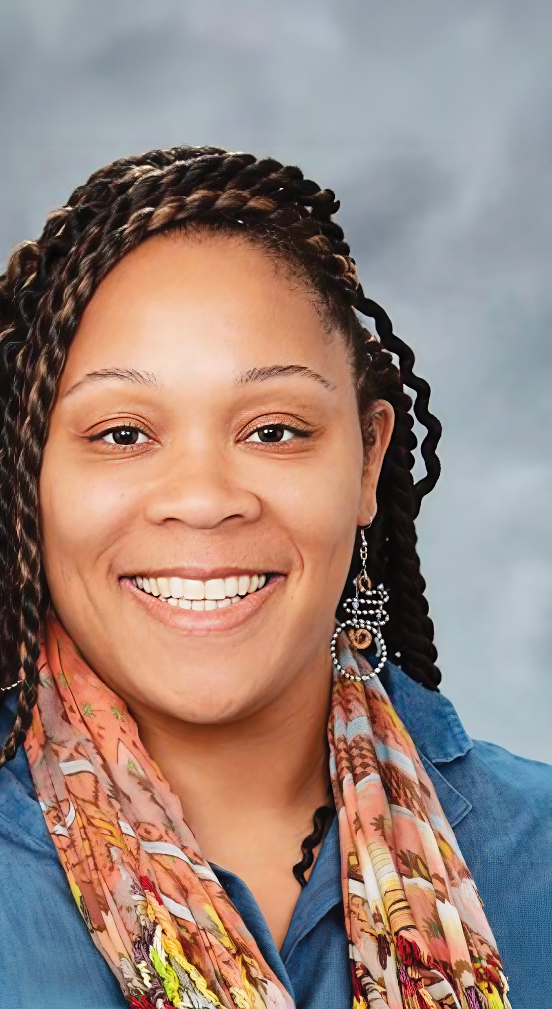
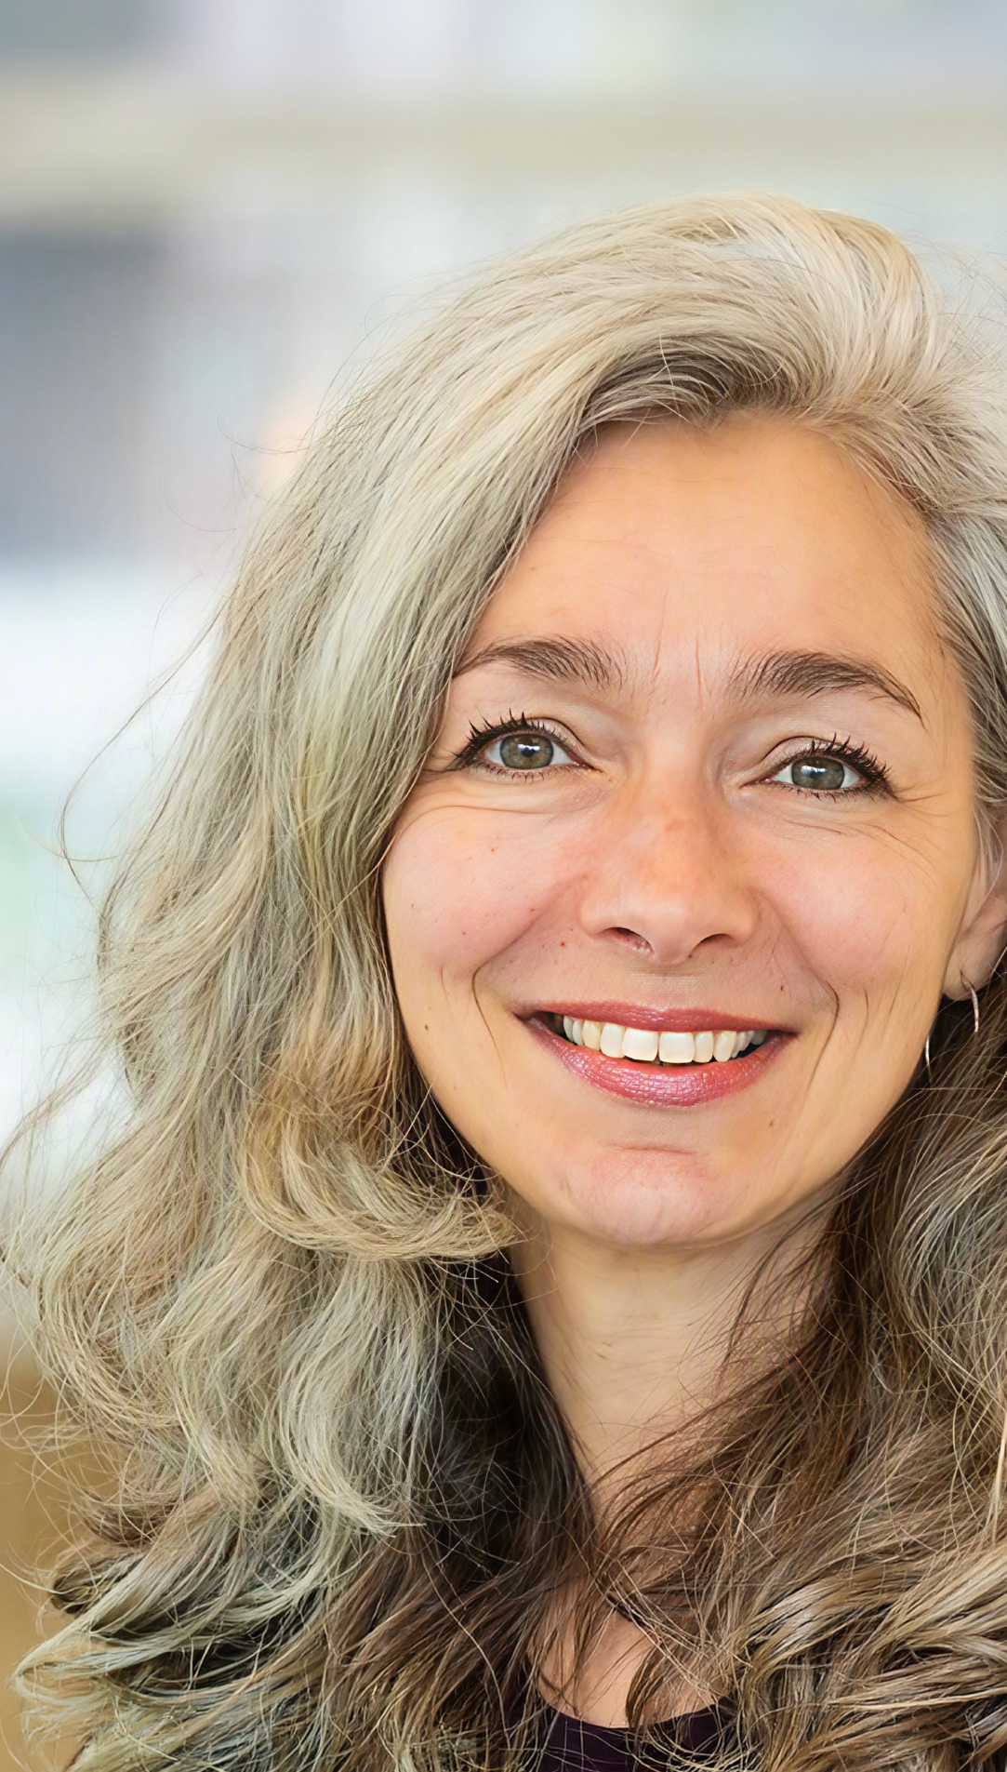

MIRJAM
SCHULPEN
Peer Navigator
BUILDING FIT-FOR-PURPOSE PEER SUPPORT NETWORKS
DR DANIELLE M CAMPBELL
Q&A
Advocate
Notes:
Garry to introduce first 1-1 conversation
Danielle to kick off the conversation by asking Mirjam the following question: Mirjam, in your experience, what does it mean to be a peer support navigator and what benefits does peer support bring to PLHIV?
Danielle to thank Mirjam for sharing her thoughts and share any quick sentiments on topics shared. Mirjam to ask Danielle the following question: How can we optimise peer support networks to truly benefit the HIV community, while ensuring integration with existing clinical care and programmes?
Mirjam to thank Danielle for sharing her thoughts and share any quick sentiments on topics shared. Danielle to ask Mirjam the following question: Can you share any insights on how to set up and run a peer support network, including what types of support might be available e.g. possible partnership opportunities with health and community organisations?
Danielle to thank Mirjam for sharing her thoughts and share any quick sentiments on topics shared. Mirjam to ask Danielle the following question: Can you share your thoughts on how you think peer support might evolve considering advances in digital health?

Slide 2
MIRJAM
SCHULPEN
Peer Navigator
Mirjam, in your experience, what does it mean to be a peer support navigator and what benefits does peer support bring to people living with HIV?
DR DANIELLE M CAMPBELL
Q&A
Advocate
Notes:
Garry to introduce first 1-1 conversation
Danielle to kick off the conversation by asking Mirjam the following question: Mirjam, in your experience, what does it mean to be a peer support navigator and what benefits does peer support bring to PLHIV?
Danielle to thank Mirjam for sharing her thoughts and share any quick sentiments on topics shared. Mirjam to ask Danielle the following question: How can we optimise peer support networks to truly benefit the HIV community, while ensuring integration with existing clinical care and programmes?
Mirjam to thank Danielle for sharing her thoughts and share any quick sentiments on topics shared. Danielle to ask Mirjam the following question: Can you share any insights on how to set up and run a peer support network, including what types of support might be available e.g. possible partnership opportunities with health and community organisations?
Danielle to thank Mirjam for sharing her thoughts and share any quick sentiments on topics shared. Mirjam to ask Danielle the following question: Can you share your thoughts on how you think peer support might evolve considering advances in digital health?

Slide 3
MIRJAM
SCHULPEN
Peer Navigator
Danielle, how can we optimise peer support networks to truly benefit the HIV community, while ensuring integration with existing clinical care and programmes?
DR DANIELLE M CAMPBELL
Q&A
Advocate
Notes:
Garry to introduce first 1-1 conversation
Danielle to kick off the conversation by asking Mirjam the following question: Mirjam, in your experience, what does it mean to be a peer support navigator and what benefits does peer support bring to PLHIV?
Danielle to thank Mirjam for sharing her thoughts and share any quick sentiments on topics shared. Mirjam to ask Danielle the following question: How can we optimise peer support networks to truly benefit the HIV community, while ensuring integration with existing clinical care and programmes?
Mirjam to thank Danielle for sharing her thoughts and share any quick sentiments on topics shared. Danielle to ask Mirjam the following question: Can you share any insights on how to set up and run a peer support network, including what types of support might be available e.g. possible partnership opportunities with health and community organisations?
Danielle to thank Mirjam for sharing her thoughts and share any quick sentiments on topics shared. Mirjam to ask Danielle the following question: Can you share your thoughts on how you think peer support might evolve considering advances in digital health?

Slide 4
MIRJAM
SCHULPEN
Peer Navigator
Mirjam, can you share any insights on how to set up and run a peer support network, including what types of support might be available?
DR DANIELLE M CAMPBELL
Q&A
Advocate
Notes:
Garry to introduce first 1-1 conversation
Danielle to kick off the conversation by asking Mirjam the following question: Mirjam, in your experience, what does it mean to be a peer support navigator and what benefits does peer support bring to PLHIV?
Danielle to thank Mirjam for sharing her thoughts and share any quick sentiments on topics shared. Mirjam to ask Danielle the following question: How can we optimise peer support networks to truly benefit the HIV community, while ensuring integration with existing clinical care and programmes?
Mirjam to thank Danielle for sharing her thoughts and share any quick sentiments on topics shared. Danielle to ask Mirjam the following question: Can you share any insights on how to set up and run a peer support network, including what types of support might be available e.g. possible partnership opportunities with health and community organisations?
Danielle to thank Mirjam for sharing her thoughts and share any quick sentiments on topics shared. Mirjam to ask Danielle the following question: Can you share your thoughts on how you think peer support might evolve considering advances in digital health?

Slide 5
MIRJAM
SCHULPEN
Peer Navigator
Danielle, can you share your thoughts on how you think peer support might evolve considering advances in digital health?
DR DANIELLE M CAMPBELL
Q&A
Advocate
Notes:
Garry to introduce first 1-1 conversation
Danielle to kick off the conversation by asking Mirjam the following question: Mirjam, in your experience, what does it mean to be a peer support navigator and what benefits does peer support bring to PLHIV?
Danielle to thank Mirjam for sharing her thoughts and share any quick sentiments on topics shared. Mirjam to ask Danielle the following question: How can we optimise peer support networks to truly benefit the HIV community, while ensuring integration with existing clinical care and programmes?
Mirjam to thank Danielle for sharing her thoughts and share any quick sentiments on topics shared. Danielle to ask Mirjam the following question: Can you share any insights on how to set up and run a peer support network, including what types of support might be available e.g. possible partnership opportunities with health and community organisations?
Danielle to thank Mirjam for sharing her thoughts and share any quick sentiments on topics shared. Mirjam to ask Danielle the following question: Can you share your thoughts on how you think peer support might evolve considering advances in digital health?

