Slide 1
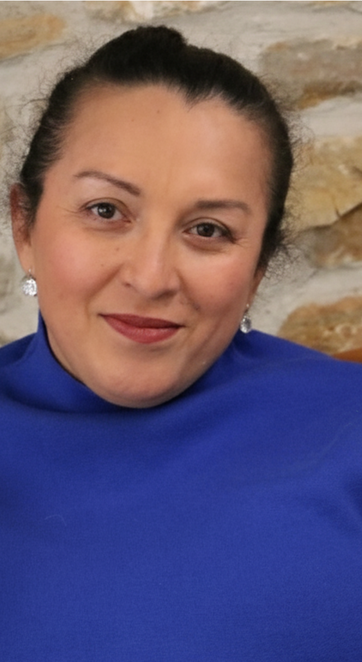
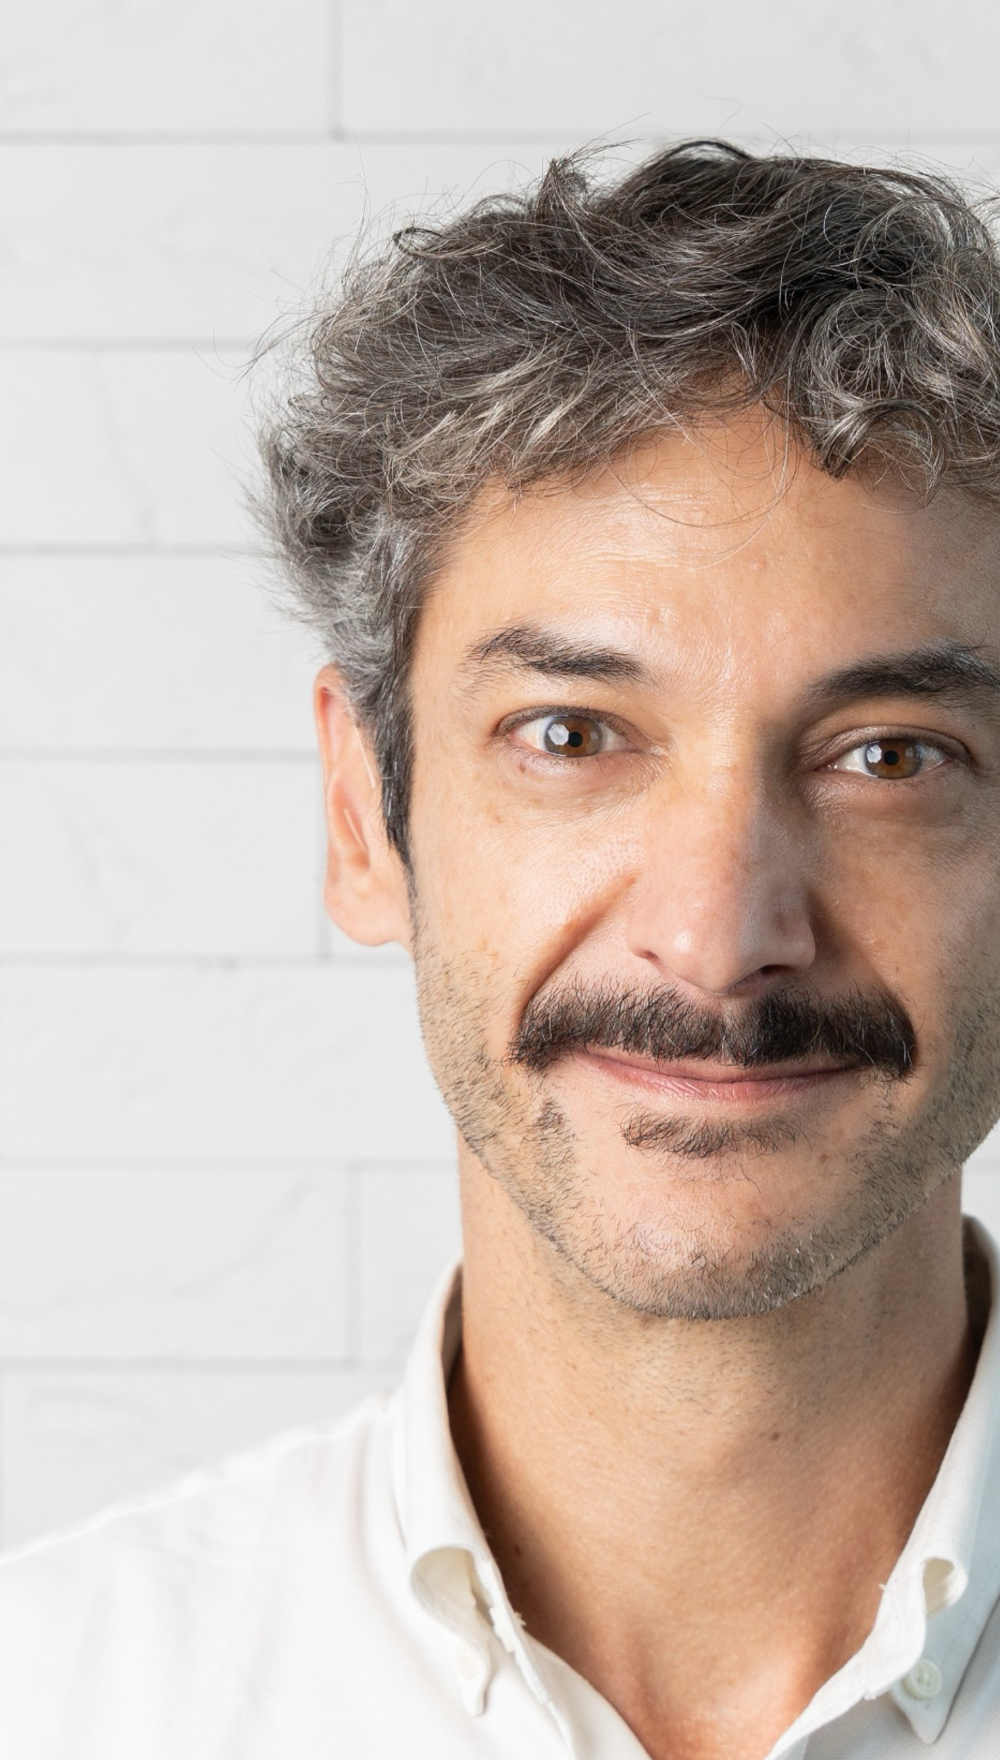
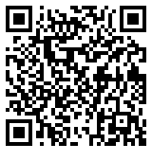
DR RICO
VASCONCELOS*
General Practitioner and
Infectious Disease Specialist
BRIDGING CLINICAL AND LIVED EXPERIENCES
ERIKA
CASTELLANOS
Q&A
Human Rights Advocate
*CRM-SP 116.119 RQE 88317/88318
Notes:
Garry to thank Danielle and Mirjam + share any quick sentiments on topics shared
Garry to introduce next 1-1 with Erika + Dr Rico
Dr Rico to open the conversation by asking Erika the following question: In your experience how do peer support networks most benefit PLHIV?
Dr Rico to thank Erika for sharing her thoughts and share any quick sentiments on topics shared. Erika to ask Dr Rico the following question: How does peer support improve the partnership dynamic between HCPs and PLHIV?
Erika to thank Dr Rico for sharing his thoughts and share any quick sentiments on topics shared. Dr Rico to ask Erika the following question: In what ways do you think people with first-hand lived experience can help inform HCPs and improve outcomes for PLHIV?
Dr Rico to thank Erika for sharing her thoughts and share any quick sentiments on topics shared. Erika to ask Dr Rico the following question: How has peer support improved PrEP engagement in Sao Paulo and Brazil more broadly? How do you help PLHIV understand options around prevention?

Slide 2
DR RICO
VASCONCELOS*
General Practitioner and
Infectious Disease Specialist
Erika, in your experience how do peer support networks most benefit people living with HIV?
ERIKA
CASTELLANOS
Q&A
Human Rights Advocate
*CRM-SP 116.119 RQE 88317/88318
Notes:
Garry to thank Danielle and Mirjam + share any quick sentiments on topics shared
Garry to introduce next 1-1 with Erika + Dr Rico
Dr Rico to open the conversation by asking Erika the following question: In your experience how do peer support networks most benefit PLHIV?
Dr Rico to thank Erika for sharing her thoughts and share any quick sentiments on topics shared. Erika to ask Dr Rico the following question: How does peer support improve the partnership dynamic between HCPs and PLHIV?
Erika to thank Dr Rico for sharing his thoughts and share any quick sentiments on topics shared. Dr Rico to ask Erika the following question: In what ways do you think people with first-hand lived experience can help inform HCPs and improve outcomes for PLHIV?
Dr Rico to thank Erika for sharing her thoughts and share any quick sentiments on topics shared. Erika to ask Dr Rico the following question: How has peer support improved PrEP engagement in Sao Paulo and Brazil more broadly? How do you help PLHIV understand options around prevention?

Slide 3
DR RICO
VASCONCELOS*
General Practitioner and
Infectious Disease Specialist
Rico, how does peer support improve the partnership dynamic between healthcare professionals and people living with HIV?
ERIKA
CASTELLANOS
Q&A
Human Rights Advocate
*CRM-SP 116.119 RQE 88317/88318
Notes:
Garry to thank Danielle and Mirjam + share any quick sentiments on topics shared
Garry to introduce next 1-1 with Erika + Dr Rico
Dr Rico to open the conversation by asking Erika the following question: In your experience how do peer support networks most benefit PLHIV?
Dr Rico to thank Erika for sharing her thoughts and share any quick sentiments on topics shared. Erika to ask Dr Rico the following question: How does peer support improve the partnership dynamic between HCPs and PLHIV?
Erika to thank Dr Rico for sharing his thoughts and share any quick sentiments on topics shared. Dr Rico to ask Erika the following question: In what ways do you think people with first-hand lived experience can help inform HCPs and improve outcomes for PLHIV?
Dr Rico to thank Erika for sharing her thoughts and share any quick sentiments on topics shared. Erika to ask Dr Rico the following question: How has peer support improved PrEP engagement in Sao Paulo and Brazil more broadly? How do you help PLHIV understand options around prevention?

Slide 4
DR RICO
VASCONCELOS*
General Practitioner and
Infectious Disease Specialist
Erika, in what ways do you think people with first-hand lived experience can help inform healthcare professionals and improve outcomes for people living with HIV?
ERIKA
CASTELLANOS
Q&A
Human Rights Advocate
*CRM-SP 116.119 RQE 88317/88318
Notes:
Garry to thank Danielle and Mirjam + share any quick sentiments on topics shared
Garry to introduce next 1-1 with Erika + Dr Rico
Dr Rico to open the conversation by asking Erika the following question: In your experience how do peer support networks most benefit PLHIV?
Dr Rico to thank Erika for sharing her thoughts and share any quick sentiments on topics shared. Erika to ask Dr Rico the following question: How does peer support improve the partnership dynamic between HCPs and PLHIV?
Erika to thank Dr Rico for sharing his thoughts and share any quick sentiments on topics shared. Dr Rico to ask Erika the following question: In what ways do you think people with first-hand lived experience can help inform HCPs and improve outcomes for PLHIV?
Dr Rico to thank Erika for sharing her thoughts and share any quick sentiments on topics shared. Erika to ask Dr Rico the following question: How has peer support improved PrEP engagement in Sao Paulo and Brazil more broadly? How do you help PLHIV understand options around prevention?

Slide 5
DR RICO
VASCONCELOS*
General Practitioner and
Infectious Disease Specialist
Rico, how has peer support improved PrEP engagement in São Paulo and Brazil more broadly? How do you help people living with HIV understand options around prevention?
ERIKA
CASTELLANOS
Q&A
Human Rights Advocate
*CRM-SP 116.119 RQE 88317/88318
Notes:
Garry to thank Danielle and Mirjam + share any quick sentiments on topics shared
Garry to introduce next 1-1 with Erika + Dr Rico
Dr Rico to open the conversation by asking Erika the following question: In your experience how do peer support networks most benefit PLHIV?
Dr Rico to thank Erika for sharing her thoughts and share any quick sentiments on topics shared. Erika to ask Dr Rico the following question: How does peer support improve the partnership dynamic between HCPs and PLHIV?
Erika to thank Dr Rico for sharing his thoughts and share any quick sentiments on topics shared. Dr Rico to ask Erika the following question: In what ways do you think people with first-hand lived experience can help inform HCPs and improve outcomes for PLHIV?
Dr Rico to thank Erika for sharing her thoughts and share any quick sentiments on topics shared. Erika to ask Dr Rico the following question: How has peer support improved PrEP engagement in Sao Paulo and Brazil more broadly? How do you help PLHIV understand options around prevention?

