Slide 1
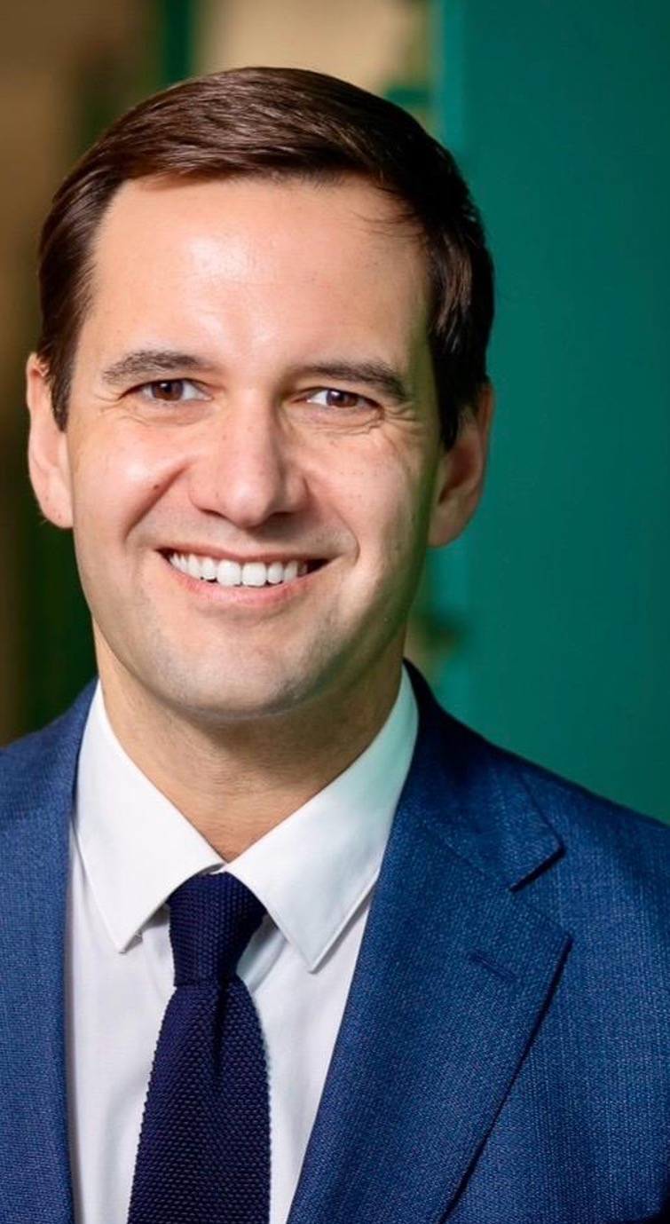

Q&A:
THE DIGITAL FUTURE OF PEER SUPPORT
With RICARDO BAPTISTA LEITE Global Health Policy and AI Expert
Notes:
Garry to thank Dr Rico and Erika
Garry to bridge to Q&A with Ricardo
Garry: I’d like to kick this off by asking: How do digital platforms allow for more accessible peer support for PLHIV, e.g. by overcoming geographical and scheduling barriers?
Garry hands over to Mirjam to ask her question: Mirjam: As digital tools can provide immediate access to information on HIV prevention, treatment, and nearby services via smartphone - how can this benefit peer support?
Mirjam: hands over to Dr Rico to ask his question: Dr Rico: In what ways can digital tools and AI better support HCPs? How can they support improved relationships between HCPs and PLHIV?
Dr Rico: hands over to Danielle to ask her question: Danielle: How can digital technology/AI enhance or improve existing peer support apps or tools?
Danielle: hands over to Erika to ask her question: Erika: What does the future of digital HIV care and peer support look like?
Garry thanks Ricardo for his expertise and insights and wraps up this Q&A

