Slide 1
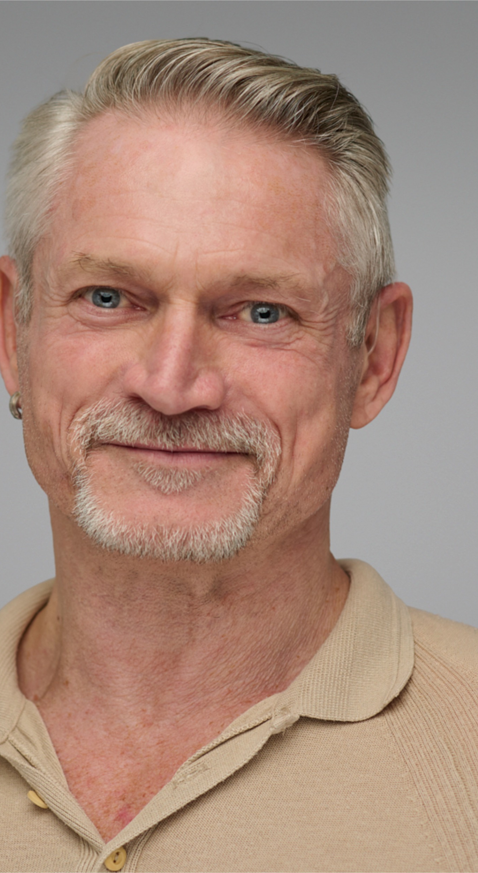
FUTURE CARE
IS SHARED:
REDEFINING PEER SUPPORT
A SUMMARY OF KEY TAKEAWAYS FROM TODAY’S SESSION
Led by Garry Brough
Commissioner of HIV Support and Peer Navigator Services
Notes:
Garry summarise key discussion points and weave in his lived/professional experience
Suggested TPs as back-up:
Peer support is an under-utilised tool that can greatly support PLHIV and PWBP with their health outcomes and improve their quality of life.
Peer networks can improve self-managed care by empowering PLHIV and HCPs to initiate discussions with each other about the power of shared decision-making in HIV care, having conversations around treatment optimisation and improving their relationship generally.
Underscoring the tangible/practical tips shared by the speakers on stage, encouraging the audience to consider such approaches in their work/regions.

Slide 2
Join us at our booth talks at the Positive Action booth in the Global Village and ViiV’s booth in the exhibition hall
Today (28 July) 14:30-14:50 | Tomorrow (29 July) 14:30-14:50 | Thursday (30 July) Starting at 15:00
How can peer support networks be better integrated into HIV care models? | How peer support networks can help optimise care for women living with, or affected by, HIV? | Rethinking and rebuilding peer-led support across regions via shared learning
ViiV’s main exhibition booth Featuring: Garry Brough and Dr Rico Vasconcelos | ViiV’s main exhibition booth Featuring: Erika Castellanos, Dr Danielle M Campbell and Mirjam Schulpen | Global Village workshop Featuring: Garry Brough and peers
Notes:
- Garry to promote upcoming talks on ViiV exhibition booth and in Global Village

Slide 3
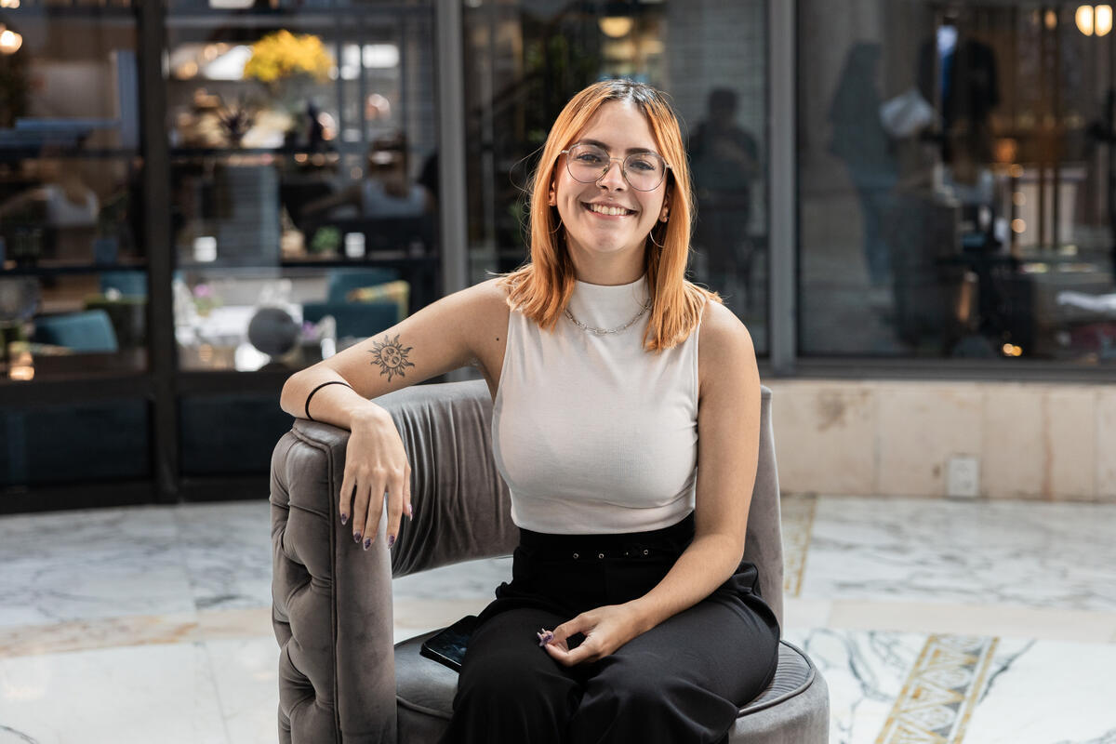

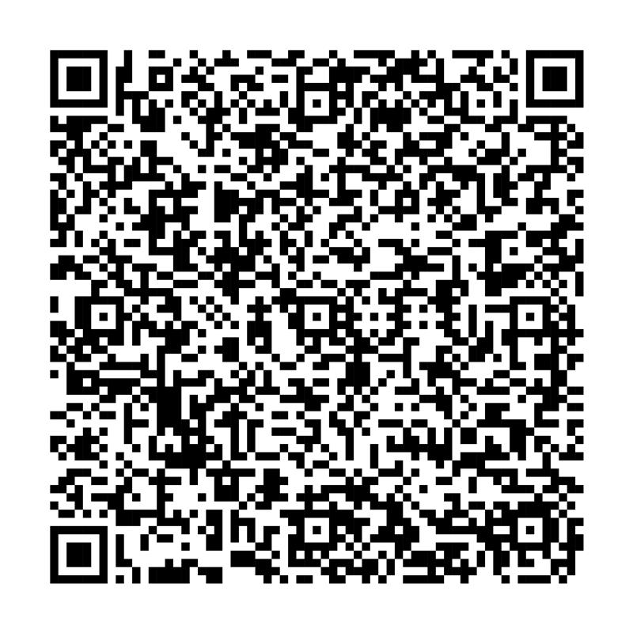
THANK YOU
Learn more about ViiV at AIDS 2026
This material is intended for a general audience. Please consult your physician.
NP-GBL-HVX-PPTX-260006 | MAY 2026
THANK YOU
Notes:
- Garry to thank speakers and audience + close symposium

