Slide 1



AIDS 2026 · RIO DE JANEIRO · SESSION: AI FOR ALL
Navigating ethics,
trust and bias
AI for all: Building trust, equity and smarter HIV solutions
Dr Primrose Matambanadzo
Implementation scientist · Independent health researcher, Zimbabwe
26th International AIDS Conference · 26–31 July · Rio de Janeiro · aids2026.org
Notes:
Framing line: Effective use of AI in HIV can accelerate progress only if we proactively earn trust, ensure ethical guardrails, and reduce or eliminate bias at every step. I'm the ethics-trust-bias voice in this session — the conditions that decide whether everything you've just heard actually reaches the people who need it.
1

Slide 2
Navigating ethics, trust and bias
  Background
  Defining the issues: Ethics, Trust, and Bias
  Where do ethics, trust and bias play out?
  What do we already know?
    How are we navigating Ethics? Guardrails and Gaps
    How are we building Trust? What supports confidence in AI Solutions
    How are we managing Bias? Mitigations and Challenges
  Unanswered Questions and Priorities for Future Research and Implementation
  Conclusion
Presentation
Outline
Navigating ethics, trust and bias · Dr Primrose Matambanadzo · AIDS 2026, Rio de Janeiro

Slide 3
Background
LLM-based health assistants for information dissemination
Computer vision improving diagnostics
Support management of clinical outcomes
ML models moderately predict loss-to-follow-up/ missed appointments
Documented AI use cases along the HIV continuum:
BUT
Documented shortcomings:
Current evidence gaps:
Chatbot self-testing support (& service uptake boost)
Linking to care
Support treatment monitoring and retention in care
privacy breaches and misuse fears
missing or misclassifying underserved groups
Not explained well
Equity outcomes, frameworks and metrics
Few studies have shown improved patient outcomes in practice
limited rigorous evidence on long-term impact, cost-effectiveness, or risks
Notes:
Mostly Retrospective, descriptive studies
We must ensure AI solutions work for everyone, especially marginalized groups, rather than deepen existing gaps. But there are pitfalls and gaps getting in the way of equitable and smarter AI for all
3

Slide 4
Defining the issues
BIAS
ETHICS
TRUST
“responsible use that respects moral and governance principles”
confidence stakeholders have in an AI system
‘systematic error or skew that leads to unfair outcomes’
  Do no harm (safety, promote human well being)
  Informed consent for data use.
  Who guards the data?
  Privacy/confidentiality
  Protect autonomy
  Protection from stigma/exclusion
  Responsibility and accountability
  Equitable access and benefit
  Guard against degradation of skills
  Historical and data bias: Poor/incomplete data = non-representative and flawed assumptions ; replicate structural bias/inequities already within the health system
  Algorithmic bias = design/optimisation favours overall accuracy at the expense of underserved groups
  Feedback loop bias = systematic distortion or unfairness from AI outcomes
  Deployment Bias
  Explainability
  Community engagement and oversight: user-centred design + co - design
  Earned through reliability, accuracy (checks for inaccuracy in place), cultural competence/relevance, and openness
  Clarity about what AI is doing
  Human support in the loop
  Who manages cyber security risks?
Navigating ethics, trust and bias · Dr Primrose Matambanadzo · AIDS 2026, Rio de Janeiro
Notes:
Responsibility and accountability, especially when AI errs (governance, safety, transparency)
Earned through reliability, accuracy (checks for inaccuracy in place), cultural competence, and openness
Lost if systems unsafe/opaque. ; Confidence of clients, providers, and communities in AI solutions: user-centred design; co – design; bias ‘Bakes’ inequalities into the tool
Identifying where available data overlooks those most at risk. Eg: AI trained mostly on data from urban clinics, will not work for rural populations
WHO AI In SRHR Technical Guidance: “human-in-the-loop” to ensure there is active detection of potential biases and inaccuracies
Human safety/data stewardship: Cover governance of AI systems, "do no harm," and who safeguards the data — especially given people may disclose more to an AI than in in-person programs due to a sense of anonymity/invisibility.
4

Slide 5
Where in the AI lifecycle
do ethics, trust and bias play out?
Design
Deployment
02
04
data bias, privacy, sampling bias, community engagement- stakeholders
safety, equity, consent, build user trust, human in the loop
Model development
Monitoring
01
safety, transparency, reliability, relevance, fairness metrics
03
safety, accountability, catching bias, human oversight
A series of decisions must be made at each stage to mitigate bias, build trust, navigate ethics
Navigating ethics, trust and bias · Dr Primrose Matambanadzo · AIDS 2026, Rio de Janeiro
Notes:
Ethics, trust and bias are not a single checkpoint: they run from data collection (privacy, sampling bias), to model design (transparency, fairness metrics), to deployment (consent, user trust), to monitoring (accountability, catching bias drift). We need checks and balances throughout. Why it matters: a biased, unethical, untrusted tool doesn't merely underperform — it actively increases inequity and worsens outcomes for the people already least served.
5

Slide 6
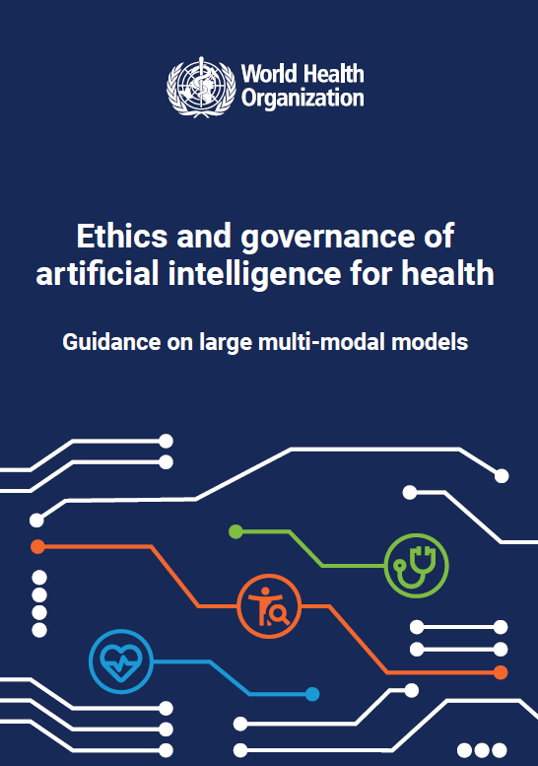
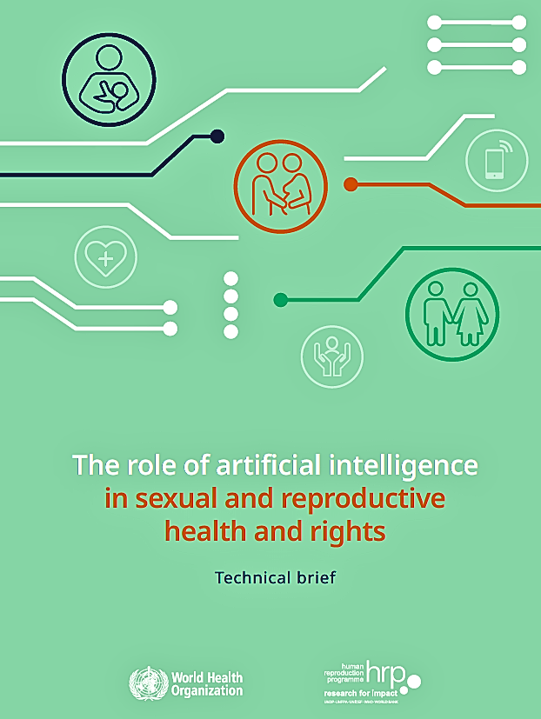
Why do ethics, trust and bias matter?
Biased, unethical and untrusted AI solutions
=
increased inequity in HIV prevention and treatment
and poorer outcomes
Notes:
the tool’s performance or outputs differ across groups in ways that worsen inequality
The Lancet Commission on AI and HIV
5

Slide 7
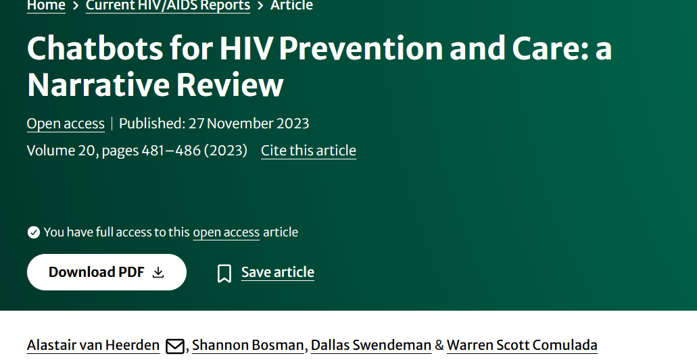
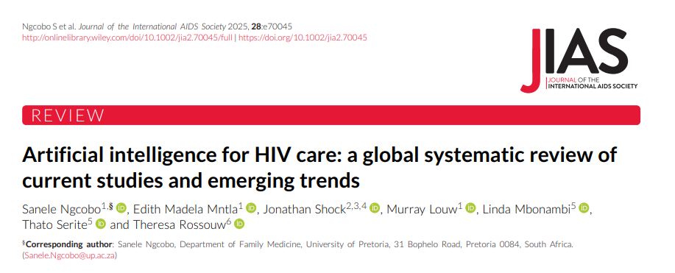
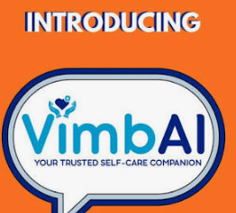
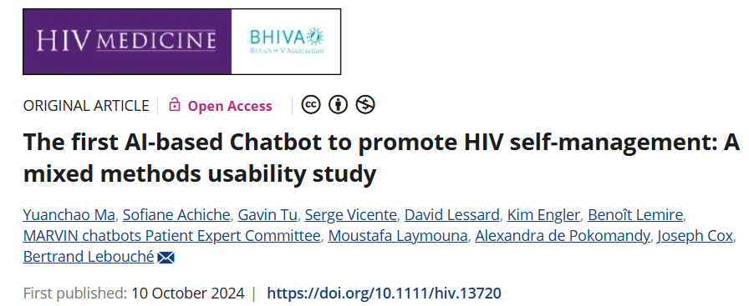
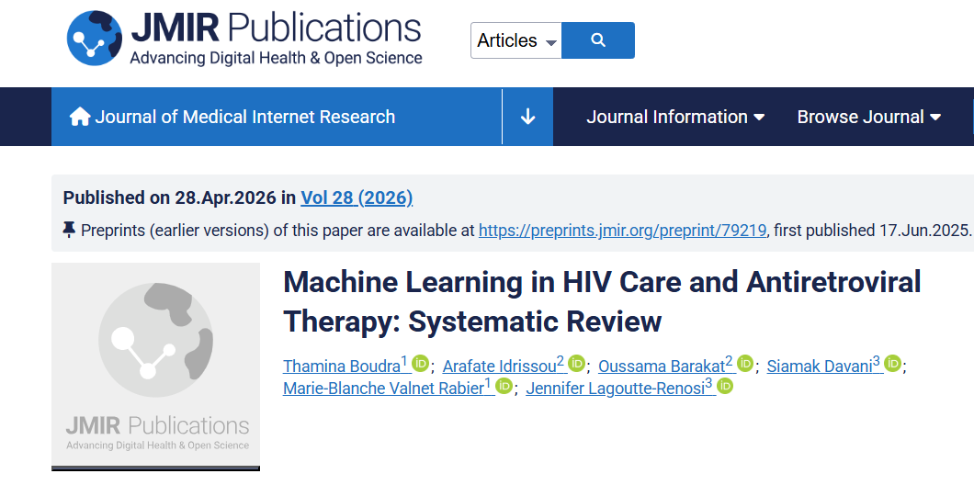

What do we already know about what works?
Navigating ethics, trust and bias · Dr Primrose Matambanadzo · AIDS 2026, Rio de Janeiro

Slide 8
Building Trust
Users
Providers
Health system
Perceived safety (data & self)
Relatability & Utility
Can I trust this enough to use it for decision support?
Net benefits? Reliability? Sustainable? Maintainable? Secure?
  involving community in design
  familiar and inclusive language
  being transparent about how it works, and what data is kept
  Relatable tone and content, feeling understood
  Evidence of accuracy
  Explainability
  Clear human-in-the-loop roles
  clear evaluation before scale up
  govt stewardship
  governance frameworks (data protection, ethical AI guidelines)
Gained by:
  any breach of privacy
  misinformation
  system failures
  unclear oversight framework/structures
Lost by:
  Wrong suggestions
  Unclear liability/responsibility: if something goes wrong
Notes:
- Practical Trust-Building Moves (for programs now):
- Participatory Design: Co-create AI tools with the target users (patients, community, providers) – not just for them[27]. This yields culturally appropriate solutions and a sense of ownership.
- Transparency & Communication: Be open about what the AI does and doesn’t do. Avoid techno-jargon; use community radio, flyers, peer educators to explain the tool in local languages. Clarify that “this app will keep your data private” or “this algorithm just helps our nurses, it doesn’t replace them.”
- Human Touchpoints: Hybrid approaches often work best – e.g. a chatbot that can seamlessly escalate to a human counselor on request. Knowing a human is behind the curtain when needed can greatly increase trust.
- Grievance & Redress Mechanisms: Provide a way for users to report problems or biases (e.g. a hotline if the AI gives an offensive response or a wrong answer). Showing that feedback leads to fixes will build trust over time.
- Oversight & Community Governance: Set up community advisory boards for your AI projects. For instance, involve PLHIV networks or key population leaders in reviewing the AI’s impact regularly. People trust something more if “someone like me” has a say in it.
9

Slide 9
Bias is not inevitable: inclusive data, fairness testing, transparency about limitations can significantly reduce bias.
  pooling data across countries or using federated learning (sending the algorithm to train on data in-country without extracting the data)
  audit for bias/ “counterfactual fairness” tests
    Not just “what’s the overall accuracy?”; ask “how does it work for young people? For sex workers? For transgender persons? For different clinics in different settings?”
  algorithmovigilance (Gurevich et al., 2022)
  address discrepancies with rebalancing training/adjusting the model to treat groups more equitably
  Bias can evolve: monitoring and periodic fairness checks are needed.
Tackling Bias

Slide 10


VimbAI in Zimbabwe | Gates Foundation | CeSHHAR Zimbabwe × Audere | PACE Project | Field Study Sept 2025 – April 2026
Female sex workers, women on the edge of sex work, and men at higher risk · Zimbabwe
“When you talk to AI you put in exactly what you’re feeling… when you talk to a human and you fear stigma, you filter”
VimbAI
— VimbAI user
Design
Deployment
Government, clinicians and sex workers co-designed it.
Adapted to local data, SOPs, policies, guidelines
community chose the personas — and the name: Vimbai means trust.
Plain-language consent, encrypted chats, nicknames. After-hours access carries about a third of conversations.
02
04
case study
01
03
Model development
Monitoring
Data labelling by clinicians for accuracy and by peers with lived experience for relatability, flag stigma. Slang dictionaries in three languages.
Usability study, further adaptations
Safety: Real-time harm detection on every conversation, sampled human review, clinician sign-off on AI risk scores.
Notes:
VimbAI — clean version. Narrate around the four stages; the detail is here, not on the slide.
DESIGN (01): MoHCC, NAC, CeSHHAR, Audere, FSWs and women on the edge of sex work co-designed VimbAI. The co-design workshop surfaced real tensions — government assumed automatic trust despite having no AI-in-healthcare guidelines at the time; a participant challenged STI policy directly in the room. Community ownership is what drove adoption and legitimacy. Community chose four personas: Approachable Friend, Healthcare Professional, Tete, Older Sister. The name itself: Vimbai means trust.
MODEL DEVELOPMENT (02): 12 trained data labellers plus QA checkers on stigma/tone, accuracy and translation. Labelling done by trained clinicians (accuracy) AND people with lived experience (relatability). Localised to Zimbabwe: national guidelines, clinician oversight, community-built slang dictionaries in English/chiShona/isiNdebele, local service directories. Language choice was the single biggest usability comfort driver.
DEPLOYMENT (03): T&Cs in simple language, accepted at sign-up. Conversation data encrypted, identifiers limited, nicknames allowed. In-app privacy education ("keep your chats private if you share your phone"). After-hours availability removes the clinic-hours barrier that matters most for FSWs, women on the edge of sex work and criminalised key populations — roughly a third of chats. Barriers remain: some lack smartphones, data or WhatsApp; QR-code usability gap. High social media reach (42k+ Facebook, 38k+ TikTok) but low conversion — awareness is not engagement. Peer-led onboarding outperforms digital-only in every context.
MONITORING (04): Real-time harm and risk detection running continuously on all user interactions. Hybrid model — automated AI evaluation framework plus sampled human-in-the-loop labelling. Clinician review of AI-generated risk scores; users know human backup exists. Watch-outs: clinical portal turnaround exceeded 24 hrs on busy days; Shona/Ndebele phrasing read as too formal for youth; slang and mixed-language input sometimes unrecognised; navigation and onboarding continuity gaps.
THE POINT: none of this was a single ethics checkpoint. Every stage carried a decision that either earned trust or cost it.
Field study Sept 2025 – April 2026. Gates Foundation | CeSHHAR Zimbabwe x Audere | PACE Project.

Slide 11
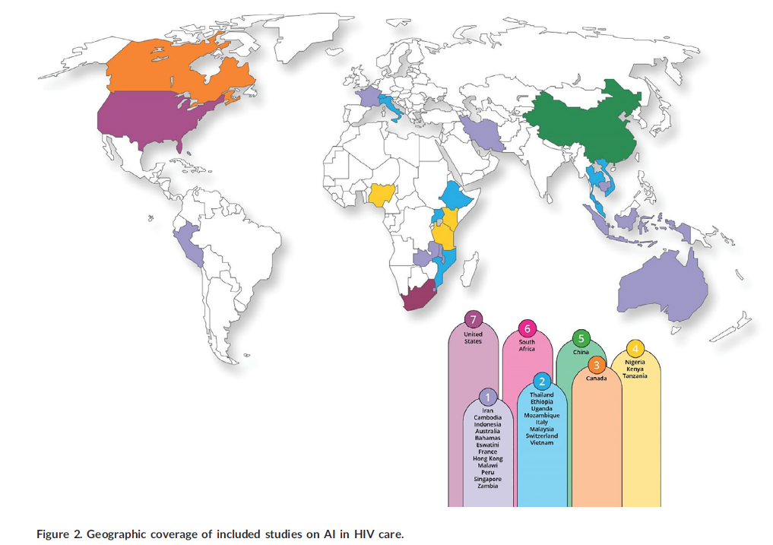
We need more data!
Unanswered Questions:
Especially in LMIC settings!!!
Ngcobo S, Mntla EM, Shock J, Louw M, Mbonambi L, Serite T, Rossouw T. Artificial intelligence for HIV care: a global systematic review of current studies and emerging trends. J Int AIDS Soc. 2025 Oct;28(10):e70045. doi: 10.1002/jia2.70045. PMID: 40990267; PMCID: PMC12458397.

Slide 12
Unanswered Questions and Priorities for Future Research and Implementation:
01
07
02
03
06
05
04
Effectiveness
Cost effectiveness
Equity Outcomes
Human-AI Strategy
Metrics and Frameworks
Harm Monitoring
Behavioural responses
Do AI interventions actually improve HIV outcomes?
AI vs standard of care – who does better, and by how much?
Narrowing gaps or widening them?
Are there more efficient and better outcomes per dollar or improved outcomes that justify added costs?
What is the optimal mix of AI and human effort in various interventions?
Research into different hybrid and integration models
What frameworks to evaluate
AI-for-health on ethics, trust, bias dimensions in a standardised way?
How do we systematically detect and measure psychological
harm, breached confidentiality, mis-triage ?
How do clients and providers change their behaviour in response to AI tools?
Who benefits first and fastest — and who is left further behind?

